Slide 1


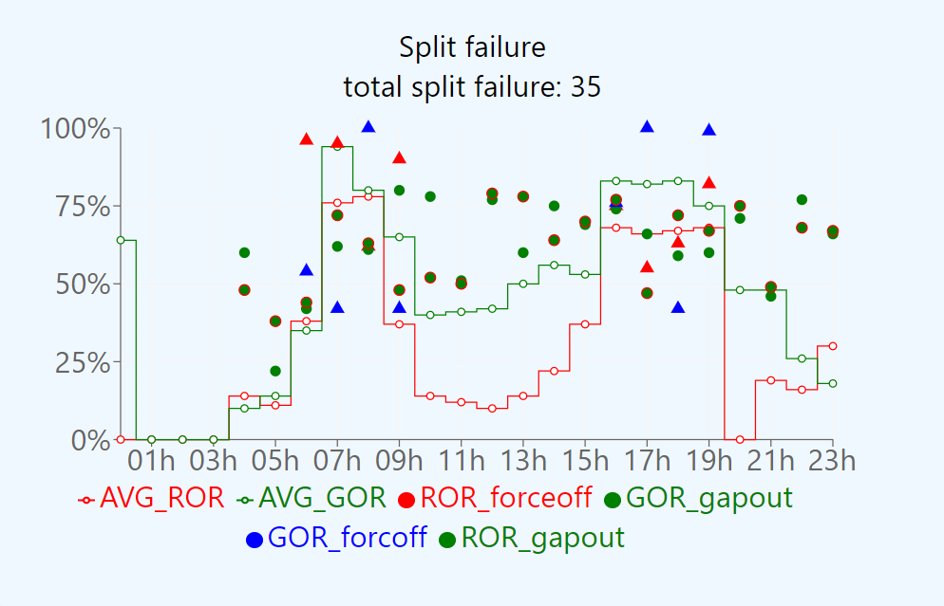
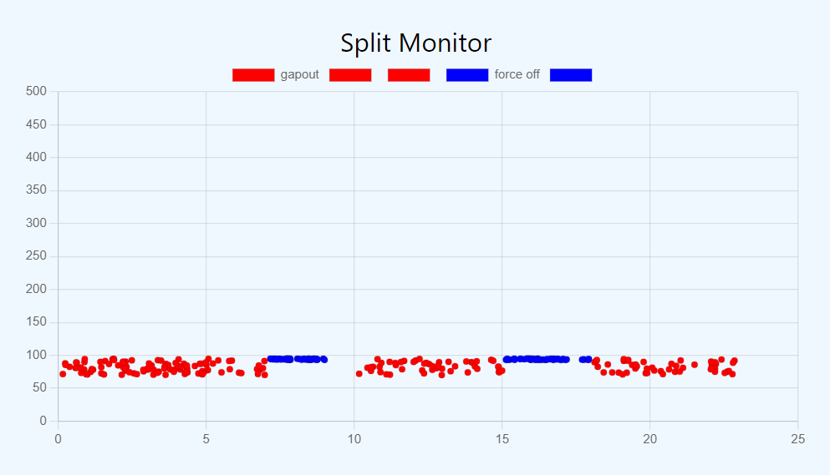
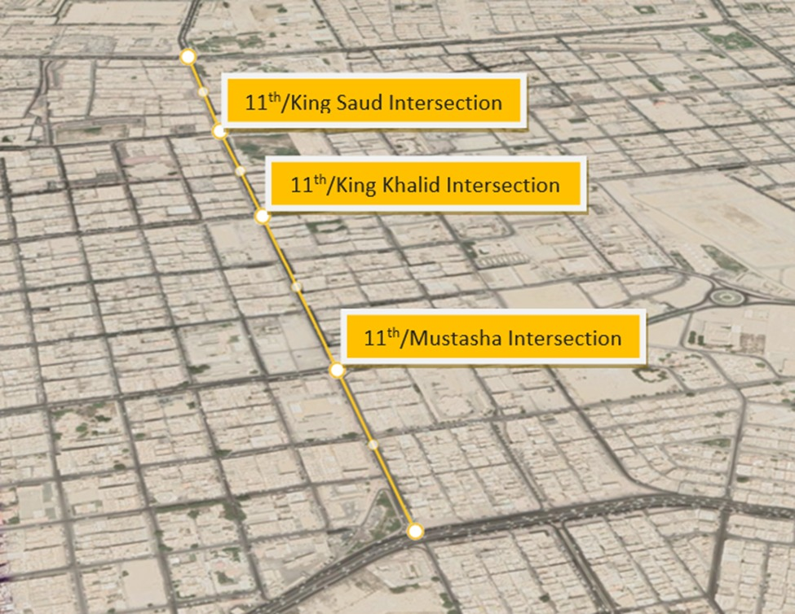






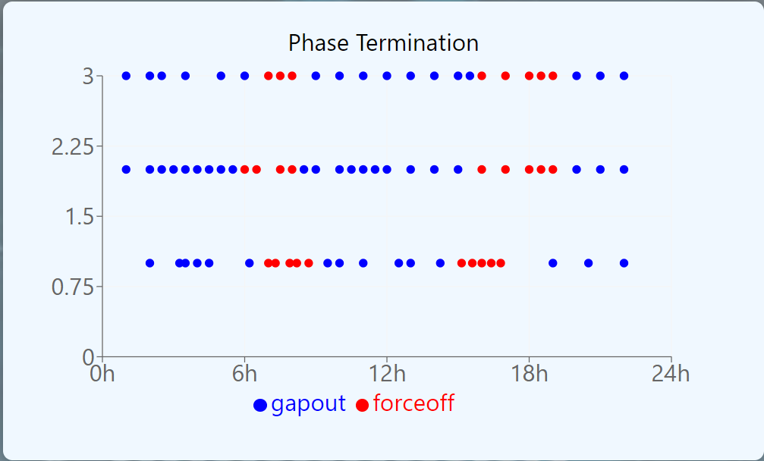

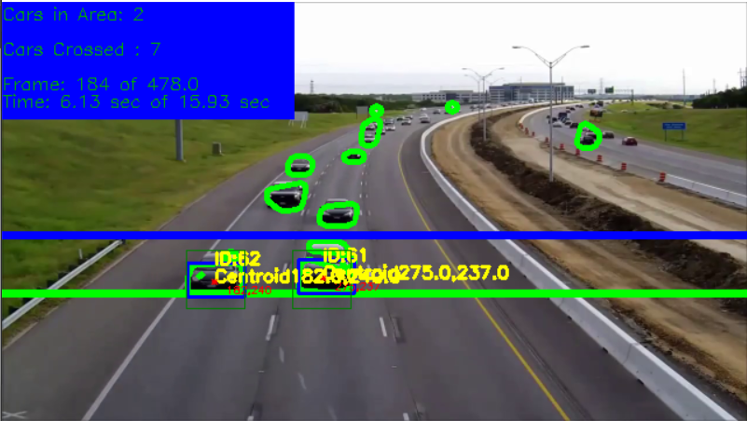
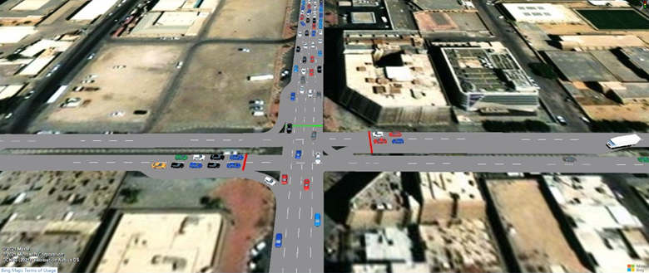
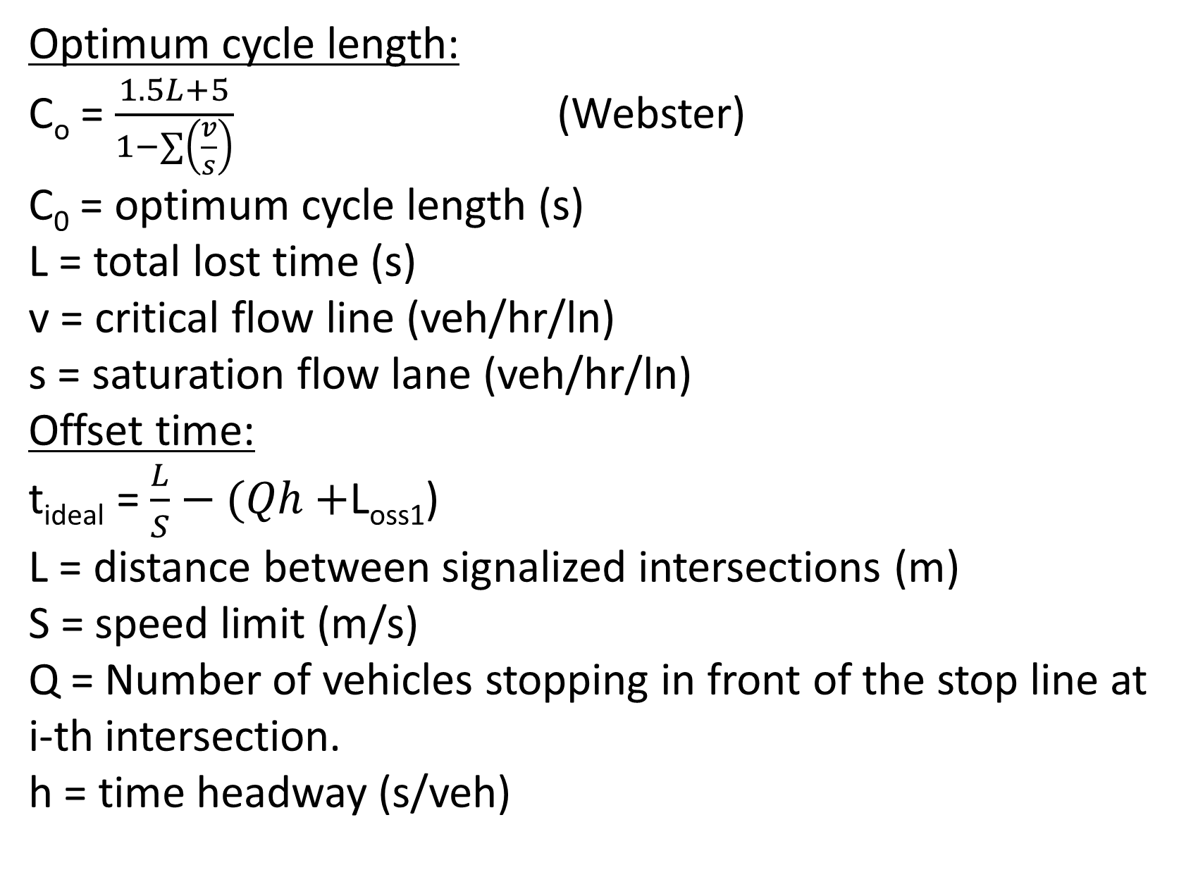
Intelligent Traffic Signals Control System and its Application on Dammam 11th Street
Advisor: Mohamed Elrabaa
Mohannad Al-Omayri, Qassim Al-Nakhli, Abdulaziz Al-Osaimi, Faisal Al-Shammasi, Majed Al-Ayouni.
Introduction/Background
Equations
Web Application for Automated traffic signal performance measures:
Testing/Validation
Problem Statement: A major problem in traffic management is congested and unoptimized traffic signals. Road users and municipality are both encountering difficulty in traffic signal operation and maintenance.
Project Scope: The main objective is to provide an intelligent traffic signals system to have optimum traffic flow and safety for both vehicles and pedestrians. Moreover, using a section of 11th street in Dammam as a representative corridor with multiple traffic signals to apply the system at that section.
Constraints:
No authority to implement the system in real traffic signal.
Multiple commercial traffic signal controller types have been utilized.
Extreme heat and high humidity conditions.
Driver behavior (e.g. Drivers are not complying with traffic regulations).
Specification:
Update traffic signal time every 15 min.
Reduction of the delays at traffic lights by 20%.
Automated Traffic Signals Performance Measures (ATSPM) optioned for the last hour.
Analyze and send data in less than 2 seconds.
Collection of traffic data without interruption (24/7).
Optimum cycle length:
C_{o} = $\frac{1.5L+5}{1−∑\left(\frac{v}{s}\right)}$ (Webster)
C₀ = optimum cycle length (s)
L = total lost time (s)
v = critical flow line (veh/hr/ln)
s = saturation flow lane (veh/hr/ln)
Offset time:
t_{ideal} = $\frac{L}{S}−(Qh+$L_{oss1})
L = distance between signalized intersections (m)
S = speed limit (m/s)
Q = Number of vehicles stopping in front of the stop line at i-th intersection.
h = time headway (s/veh)
Based on before and After analysis that showcase current not optimized and optimized condition.
Measurement | Before | After
Cycle length | 216 s | 201 s
Delay | 105 s | 62 s
Level of Service | F | E
v/c Ratio | 1.16 | 1.06
CO2 Emissions | 9421 g/hr | 5826 g/hr
Queue Length | 530 m | 440 m
Communication
Recommendations
What could we improve:
Build an Artificial Intelligent model that estimate the volumes based on the gathered traffic volume.
More research in the field of smart city improvement is needed in Saudi Arabia. Future research should be conducted to find out new technologies that can enhance traffic networks.​
Raspberry Pi
Gateway
Internet
Our Cloud system (AWS)
Conclusion
Signal controller
In this study, a multi-intersection coordination algorithm model was proposed. The proposed traffic model was composed of upstream and downstream intersections.
The communication between the system component .
Prototype Design
Traffic data acquisition: Traffic data will be acquired using a camera. OpenCV, computer vision library is used for detecting and counting the cars
Acknowledgements
We would like to express our greatest gratitude to KFUPM for providing such a great opportunity for its students by applying and expanding their knowledge.
We would also like to thank our advisors Dr. Mohammed Elrabaa, Dr. Zyad Lesman, Dr. Hammad Khalid, and Dr. Mohammed Emzir for their mentorship as they provided us with guidance and support.
Finally, we would like to express our deepest appreciation for Eng. Zyad Al-Oraini from Saudi Aramco and Eng. Ahmed Al-Arfaj from Al-Amana for their continues support and helpful advice
Vissim Simulation:

