Slide 1


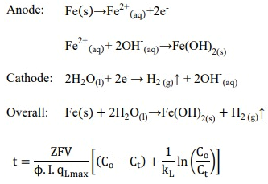
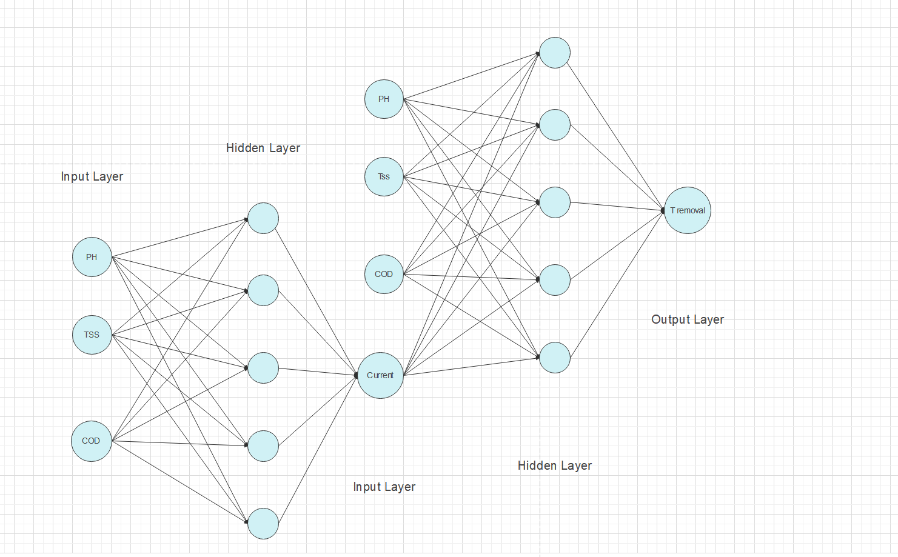
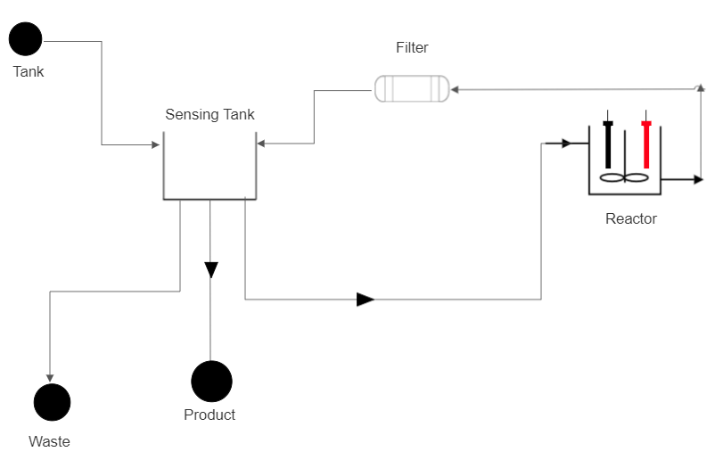
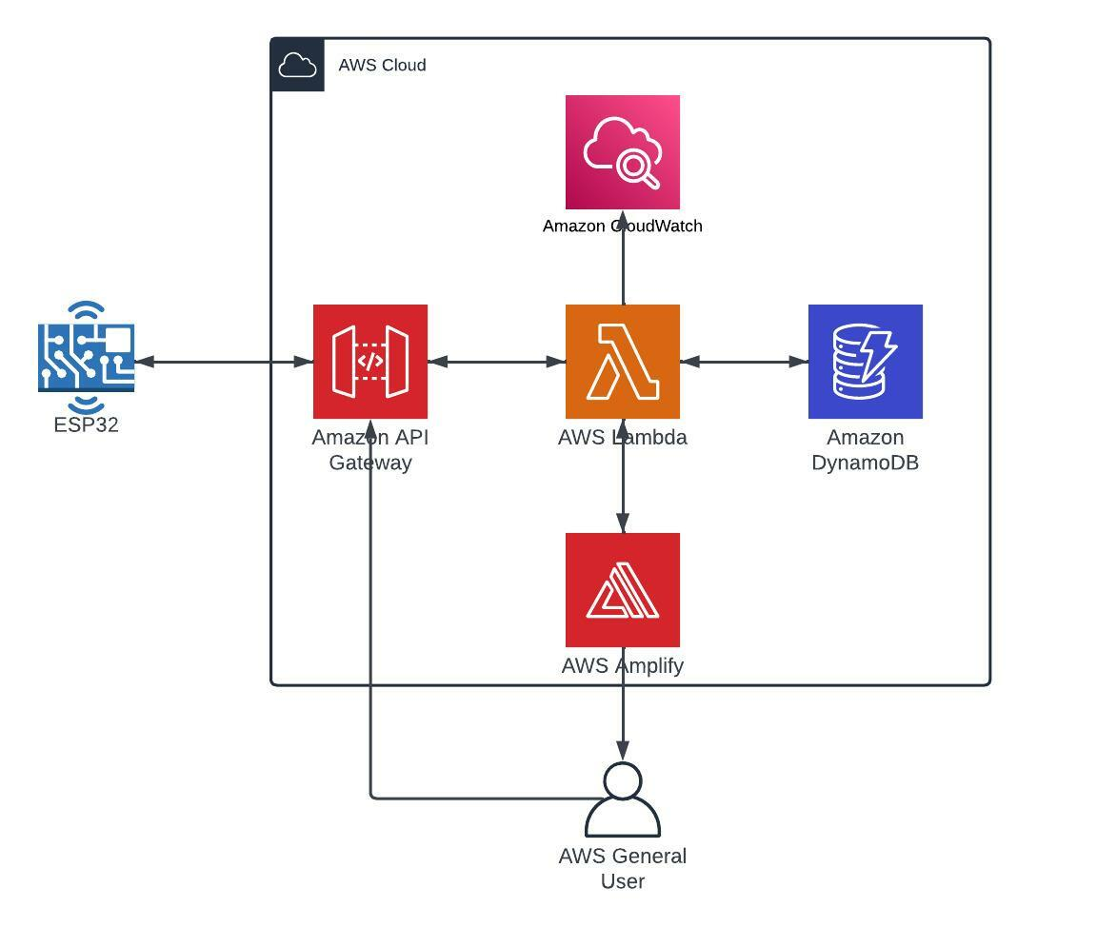
Intelligent Water Quality Monitoring and Treatment
Mohammed Braika. Abdulrahman Al-Jaber. Hussain Al-Saleh . Abdulaziz Naif Lebdah | Zayd C. Leseman​ | Chemical Engineering Department & Computer Engineering Department | KFUPM
Introduction/Background
Chemical Equation
Conclusion
Applying Electrocoagulation technique to treat greywater without human interference by implementing AI, cloud and Networking.
Achieving a 60% turbidity removal under 20 minutes
Predict the amount of electric current needed to perform the treatment process in 15 minutes, as well as the percentage of removal.
Problem Statement
Automation of the greywater treatment process, reducing the overall energy consumption and optimizing the process by applying artificial intelligence (AI), cloud services, and networking
Constraints
Budget.
Very specific regulations.
Applied only for few application.
Time
Target Specifications
Reduce energy consumption by 10%
Treat contaminated greywater in 15 min.
Results
What We Learned
Use project management techniques to improve performance in design development
Work with multidisciplinary team.
Better results emerge from teamwork and collaborative problem solving.
Applying standards and regulations on a projects
Prototype Design
Development Idea
Use TSS & COD sensors .
Develop the front end as cloud-native.
Develop the system in a microprocessor.
Back up the table every week and refresh the items.
Changing the prototype design from horizontal to vertical to reduce the power consumption.
Adding inert chemical to speed up the reaction.
Testing / Validation
the treatment time has been verified by achieving a 70% turbidity removal. 2- the reduction of energy consumption has been achieved by comparing between the currents under exact conditions 2.9 A ( traditional way) and 2.4 A (AI prediction). The energy consumption reduced by 18% .
Notes:
To change this poster, replace our sample content with your own. Or, if you'd rather start from a clean slate, press the New Slide button on the Home tab to insert a new page. Now enter your text and pictures in the empty placeholders. If you need more placeholders for titles, subtitles or body text, copy any of the existing placeholders, then drag the new one into place.

