Slide 1
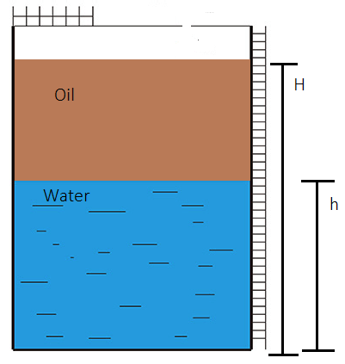
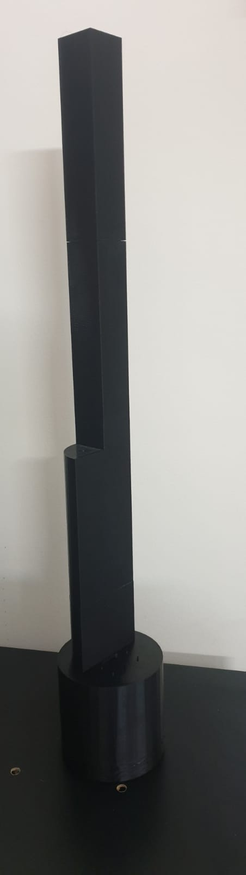
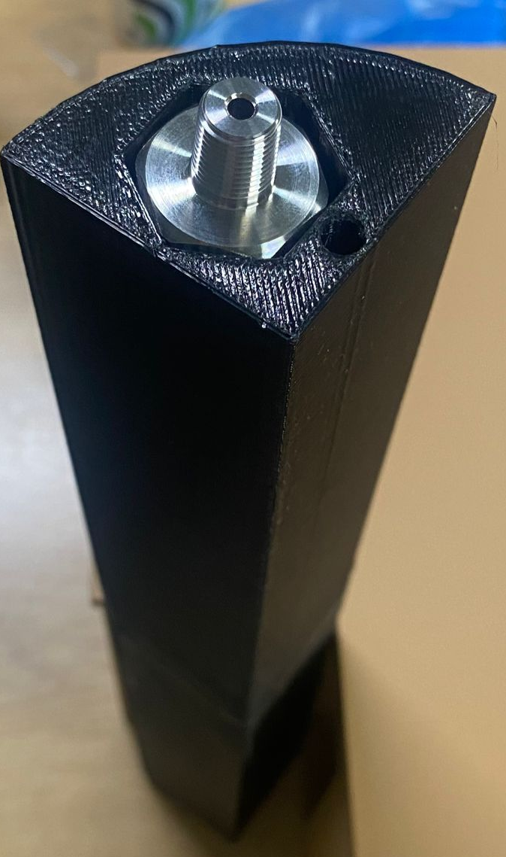
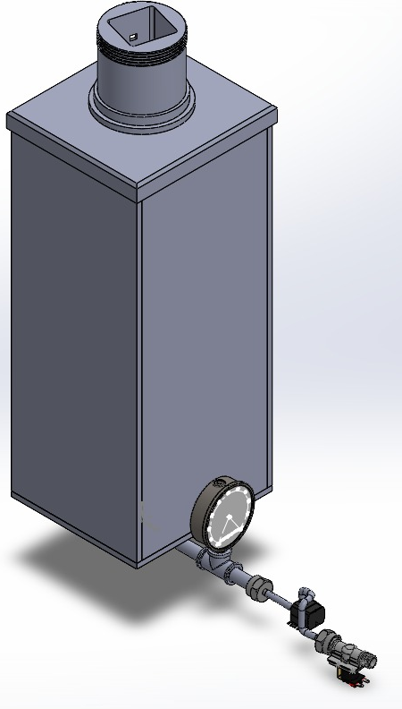
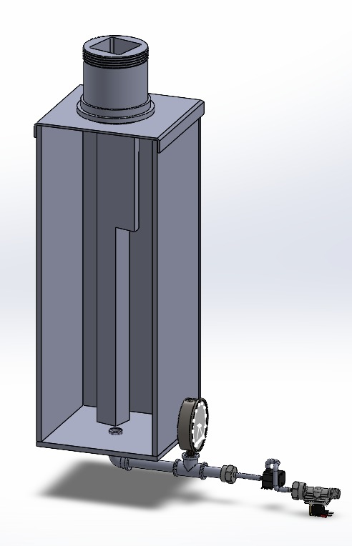
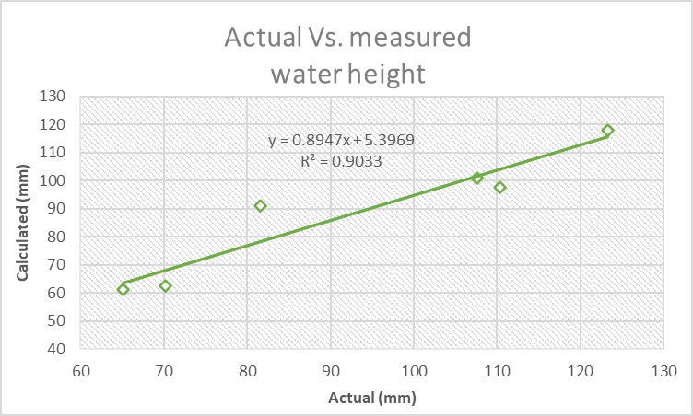
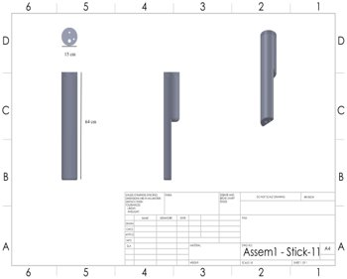
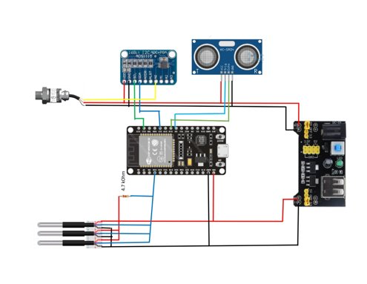
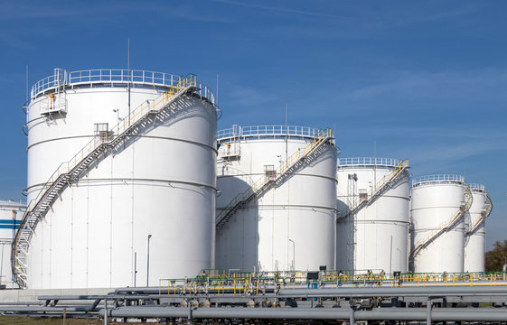
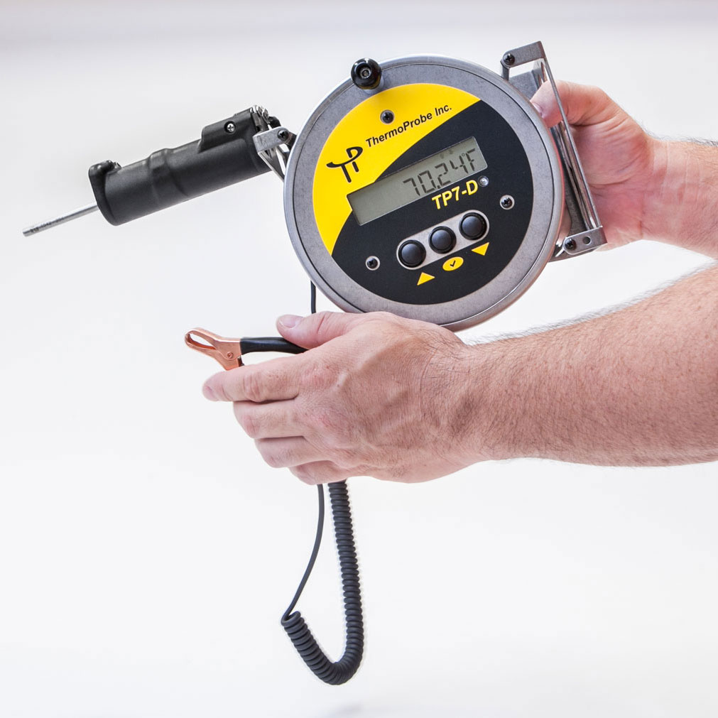
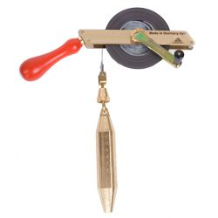
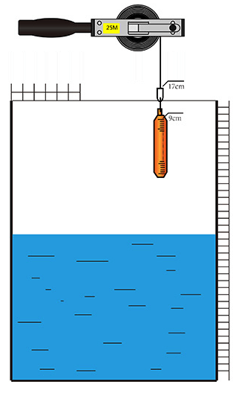
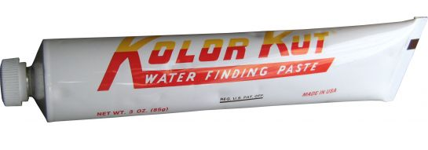
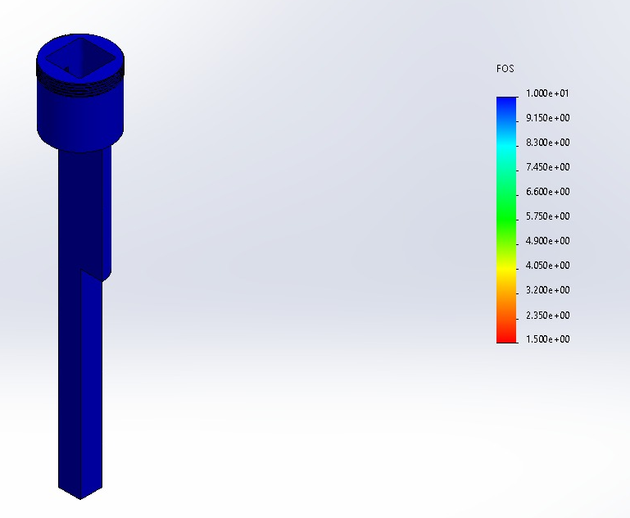

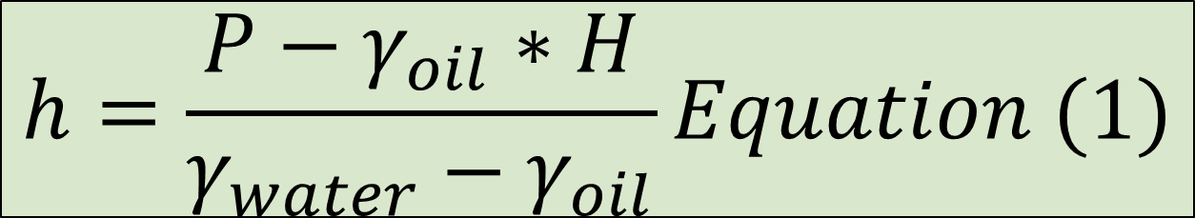
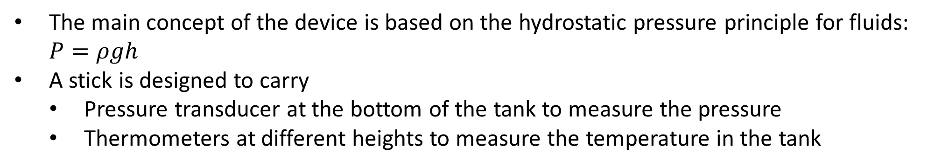

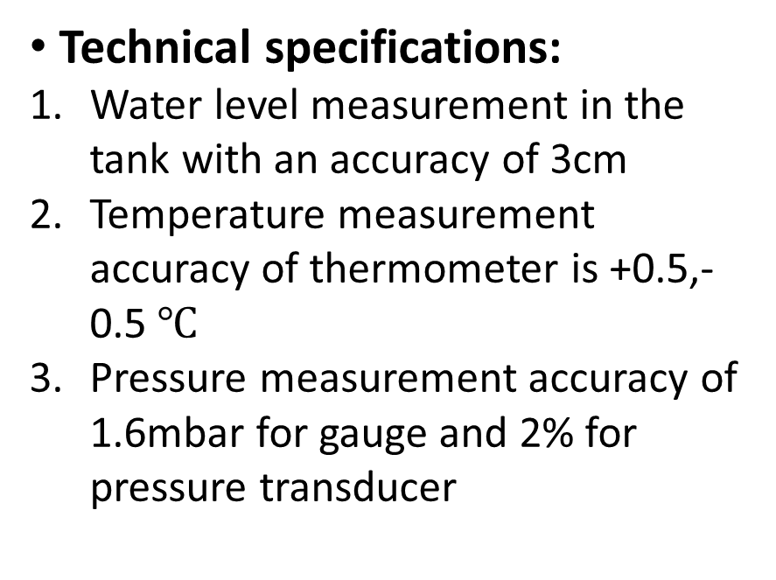

Automated Hydrostatic level measurement device for upstream oil storage tanks
Ahmed Alshehri – Abdulaziz Alruwaished – Mohmaad Al-Ghamdi –Nasser Alasmari
Introduction
Prototype
Validation and testing
Problem statement: This device aims at automating the oil level, and oil temperature measurement procedure, through designing a device placed inside the tank with sensors on it.
The main concept of the device is based on the hydrostatic pressure principle for fluids: $P=ρgh$
A stick is designed to carry
  Pressure transducer at the bottom of the tank to measure the pressure
  Thermometers at different heights to measure the temperature in the tank
8 experimental tests on the device were performed using an engine oil of grade 20w-40 and water. The densities of oil and water were measured and found to be:
Constraints
1.Overal tank design is not to be changed
2. Physical size
For prototype, 65 cm in height and 25 cm in diameter or width
3. Material
Prototype is made of PLA and PTEG
4. Design
The general design of storage tanks is not to be changed
5. Measurement response Time
Under 5 minutes
Technical specifications:
Water level measurement in the tank with an accuracy of 3cm
Temperature measurement accuracy of thermometer is +0.5,-0.5 $℃$
Pressure measurement accuracy of 1.6mbar for gauge and 2% for pressure transducer
$$ρ_{water}=986.7 Kg/m^{3}$$
$$ρ_{oil}=855 Kg/m^{3}$$
Actual height of water was evaluated using Vernier caliper
Using equation1, the device calculated the theoretical height of water
Data was plotted into a graph
The height of water is measured using equation 1
$$h=\frac{P−γ_{oil}∗H}{γ_{water}−γ_{oil}}Equation (1)$$
Water height
Actual (mm) | Calculated (mm) | Difference (mm) | Difference (cm)
123.26 | 118.116 | 5.144 | 0.5144
110.41 | 97.7 | 12.71 | 1.271
107.56 | 100.93 | 6.63 | 0.663
81.63 | 91.11 | 9.48 | 0.948
65.05 | 61.15 | 3.9 | 0.39
70.17 | 62.7 | 7.47 | 0.747
P
Current procedure
The stick
Pressure transducer in stick
General assembly of prototype
Current oil level measuring process
Operators get on top of oil storage tank with a level dipstick and a thermometer
Dip stick is filled with water finding paste and dipped into the bottom of the tank
Operator picks up the dipstick and reads the level of water in the tank by observing the change of dipstick color
Then the operator dips in the thermometer to evaluate temperature at different heights
This process is repeated multiple times for every tank
The problem with this process is:
It is time consuming
It is harmful to operators during normal and harsh conditions
Oil storage tanks
Dip thermometer
Level Dipstick
Stress analysis on the stick
Conclusion
Water finding paste
In conclusion, the device has accurately measured the level of water with an error that does not exceed 2cm, it has measured the temperature in the tank at different heights and it proves its
Future design development
Improving the pressure measurement by using a higher accuracy pressure sensor
Developing the device to be used for actual oil storage tanks
Adding an automatic drain system such that water drains automatically
Adding viscometer at drainage valve inlet to ensure that no

