Slide 1

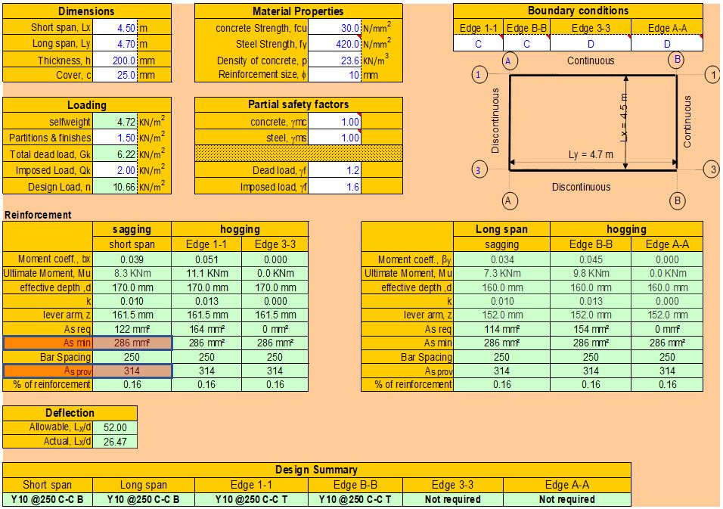
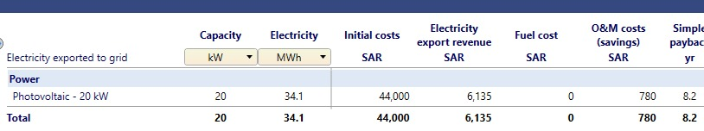
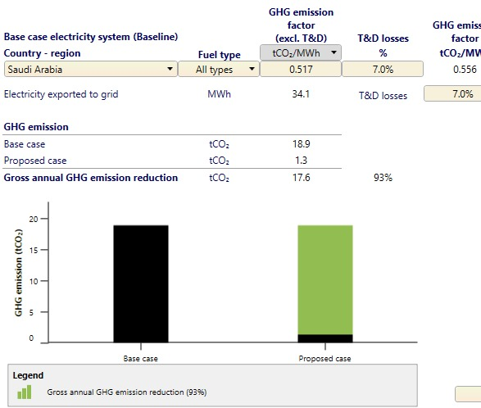
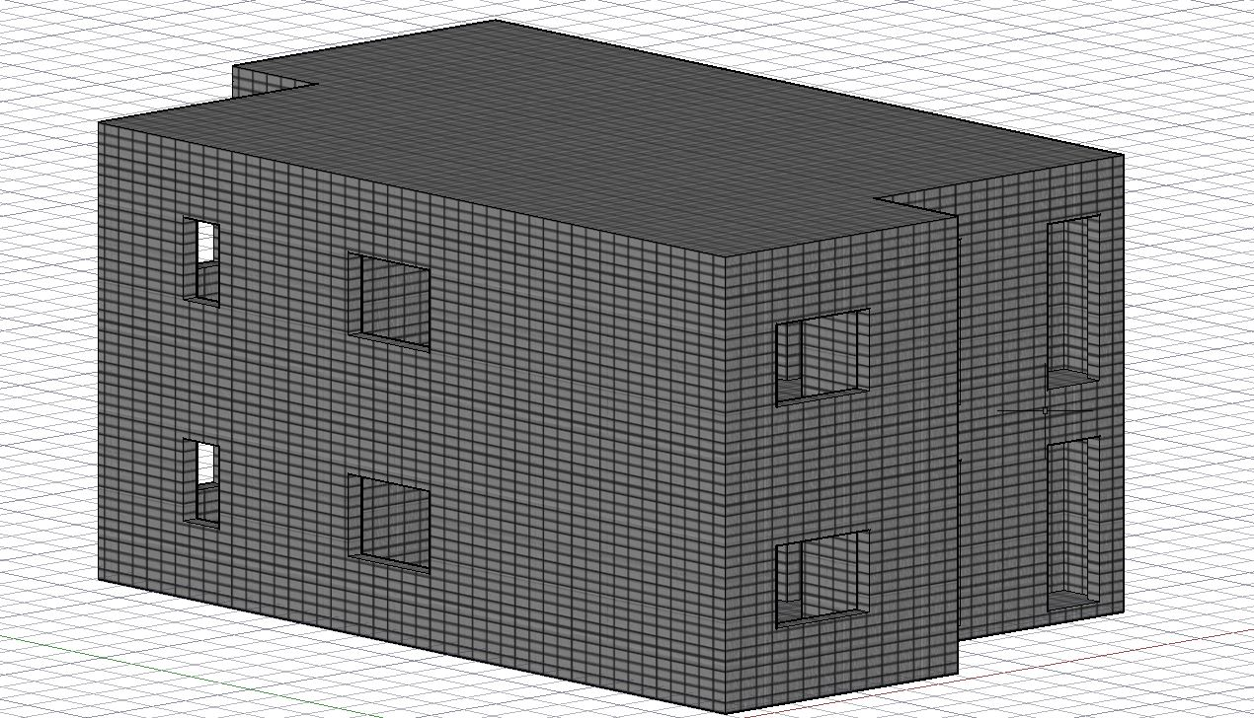
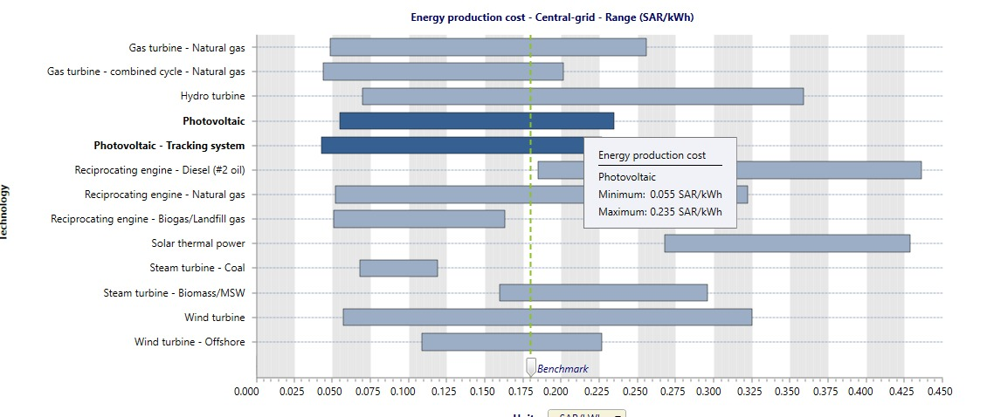
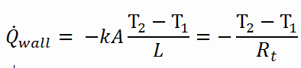

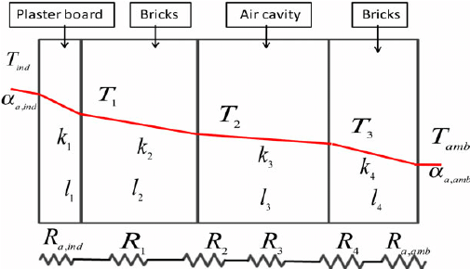
ZERO-Net Energy Building
Done by Fares Alqahtani, Abdulrahman Bukhari, Nasser Baarma, and Abdullah alhussain
Team 2 Instructor: Dr. Muhammad Emzir
Problem Statement
Analysis (Testing / Validation)
Design a sustainable & efficient residential building that supplies it energy need
Months | Efficiency | PV Area ( m2) | Irradiation (kWh/m/D) | Number of panels | Avg Daily supply (kW) | Avg Daily Loads (kW)
January | 0.209 | 3.1 | 3.57 | 32 | 74.016096 | 48.78
Feb | 0.209 | 3.1 | 4.42 | 32 | 91.638976 | 55.68
March | 0.209 | 3.1 | 5.13 | 32 | 106.359264 | 87.5
April | 0.209 | 3.1 | 6.03 | 32 | 125.018784 | 89.61
May | 0.209 | 3.1 | 7.03 | 32 | 145.751584 | 92.5
June | 0.209 | 3.1 | 7.73 | 32 | 160.264544 | 95.67
July | 0.209 | 3.1 | 7.26 | 32 | 150.520128 | 99.28
August | 0.209 | 3.1 | 6.97 | 32 | 144.507616 | 102.51
September | 0.209 | 3.1 | 6.45 | 32 | 133.72656 | 95.22
October | 0.209 | 3.1 | 5.33 | 32 | 110.505824 | 90.69
November | 0.209 | 3.1 | 4 | 32 | 82.9312 | 75.22
December | 0.209 | 3.1 | 3.28 | 32 | 68.003584 | 47.22
Constraints
• Land Area 201.5 m2
• built-up area of 256m2 (villa with two-level)
• Overall Cost must not exceed 500,000 SR (estimated to be less than 440,00SR)
• Energy produced by the solar panels (250w/m2 )
• Average efficiency of PV panels is 20%
• Saudi Building Code (SBC):
➢ SBC 301 (Structural – Loading and Forces)
➢ SBC 602 (Energy Conservation – Residential)
➢ SBC 304 (Structural – Concrete Structures)
Technical Specifications
Off-grid System Capacity of 20kWh
Efficient Reinforcement Concrete Design (As min/ A req = 0.90)
Heat Insolation (U-value < 0.611 w/m^2k),(R-value > 1.5) m^2C/W
Efficient HVAC (5.0kWh)
A microcontroller with Bluetooth, 15 General-purpose input/output (GPIO) pins, and 10 analog input pins for every room
A user interface that is accessible through the internet
Grey Water System 2000-3000 L ( Total Tank Storage)
Prove how to save money by using red-screen softwere
User Interface
GUI
Learned
Concepts Evaluation
Applied what we learn in courses before for example, the calculation of the U-value to get the suitable insolation material and the calculation of the power load for the equipment’s house.
​ | Concept​
Criteria​ | A​ | B​ | C​ | D​
Capital Cost​ | +​ | -​ | -​ | -​
Operation Cost​ | -​ | +​ | 0​ | -​
Reliability​ | -​ | +​ | +​ | -​
Sustainability​ | 0​ | 0​ | +​ | 0​
Production Carbon Footprint​ | +​ | -​ | -​ | -​
Operation Carbon Footprint​ | -​ | +​ | 0​ | +​
Client acceptance​ | +​ | 0​ | +​ | -​
Sum +’s​ | 3​ | 3​ | 3​ | 1​
Sum 0’s​ | 1​ | 2​ | 0​ | 1​
Sum -’s​ | 3​ | 2​ | 3​ | 5​
Net Score​ | 0​ | 1​ | 1​ | -4​
Rank​ | 3​ | 1​ | 2​ | 5​
Continue​ | no​ | yes​ | no​ | no​
Reducing the greenhouse gases by using redscreen
Conclusion
The cost of producing electricity from solar panels compared to the cost of producing it in other ways by using RED-SCREEN software.
The project contributes to solving global warming by reducing CO2 emissions from residential buildings at a reasonable cost. Additionally, it will be efficient for heat insolation and HVAC system which is proven by analysis.
Important Equation
Improvement
Solar On-grid system
Solar Off-grid system with batteries
Solar Hybrid system
Solar Off-grid system with wind turbine

