Slide 1

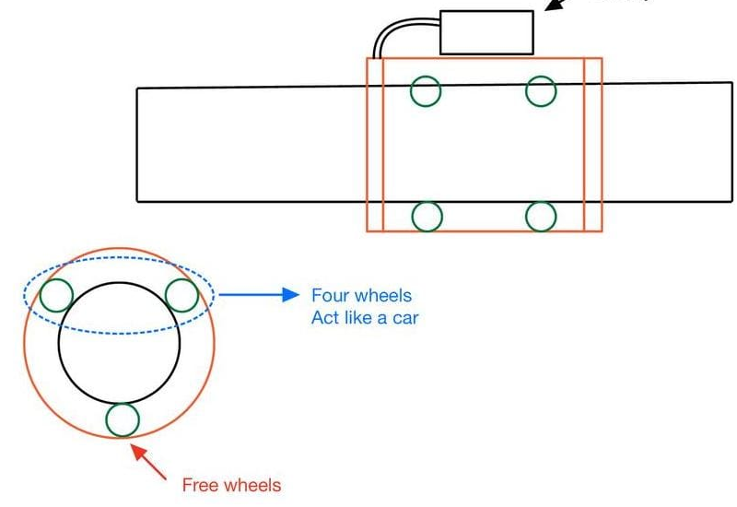
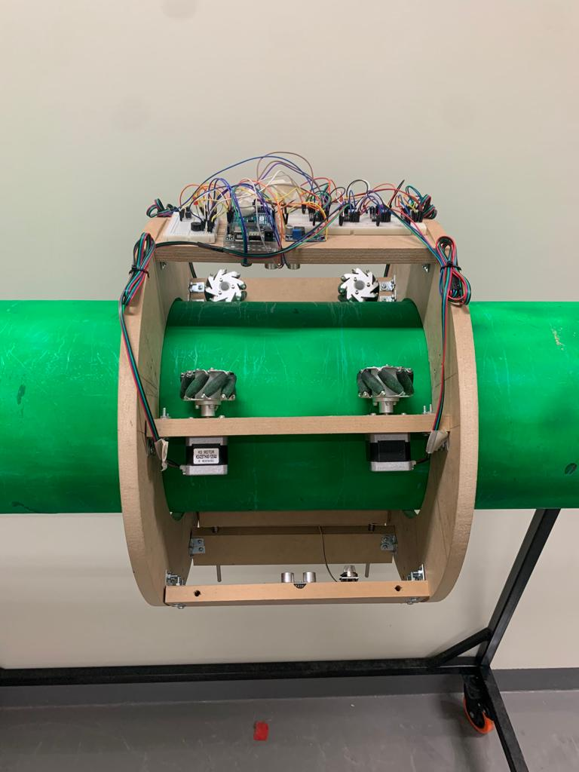
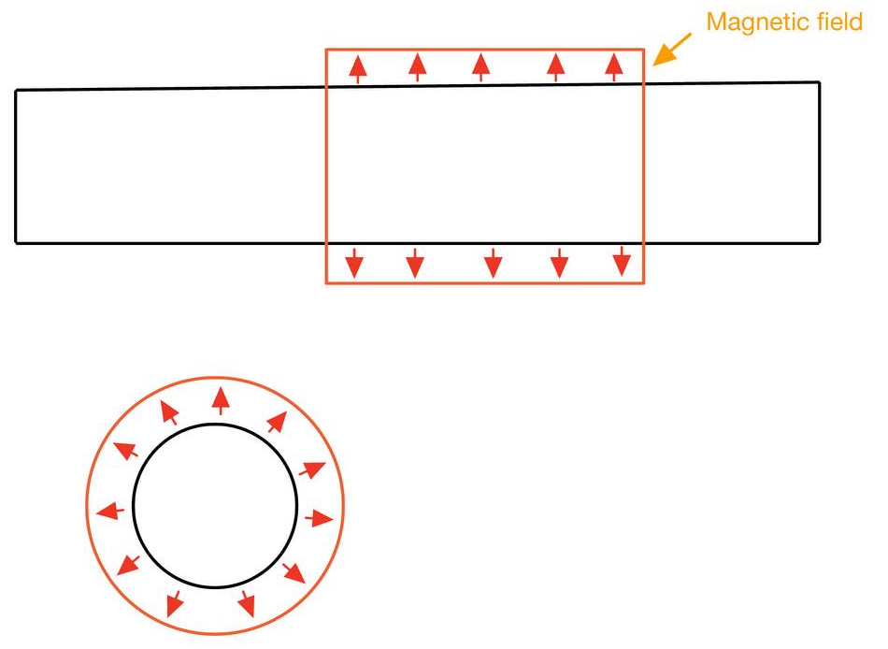
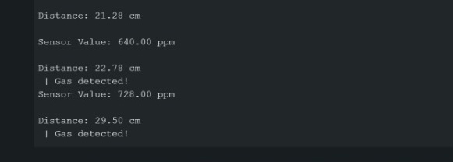
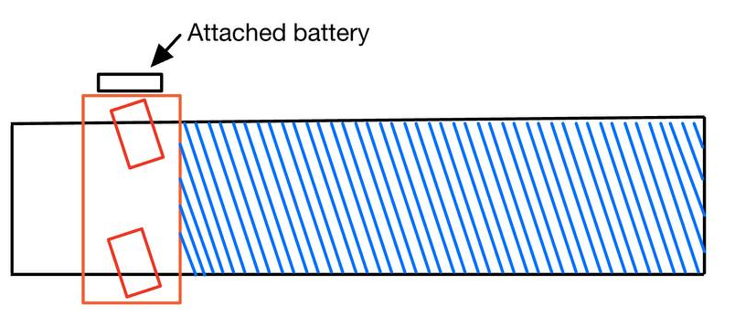
Robot For Pipe Inspect
Saleh Alabood – Abdulwhab Alsenayyn– Salman Alrobie– Majed Alarbash
Introduction
Three Design Concepts
Testing / Validation
Project Statement: Building a robot moving on the outside surface of a gas pipe that will be able to locate the cracks and leaks at any location on the pipe.
A
This project aimed to develop a robot that can move on the surface of the pipe and find cracks before getting more extensive or more costly to maintain it. The robot has an ultrasonic sensor (HC-SR04) and a gas sensor (MQ2) to detect cracks and leaks respectively. Moreover, the robot has four mecanum wheels and two omni wheels to move in every direction. Furthermore, the robot is powered by an electrical cable. Consequently, the robots that identify cracks are necessary for pipeline companies.
B
Specifications and Constraints
Target Specifications
The robot will measure the cracks with accuracy ±2mm depth.
The robot will detect the leakage from 400 to 10,000 ppm.
Minimum translation speed of 0.01 m/s .
The robot will take less than 10 minutes to cover 1 meter length of the pipe.
The wight of the robot is less than 15 kg.
C
Concept Evaluation & Selection
A: Robot with mecanum wheels
B: Floating robot
C: Rotating robot with fixed wheels
Criteria | A | B | C
Speed | 0 | + | +
Power | 0 | - | 0
Weight | + | - | -
Torque | + | + | 0
Stability | + | - | 0
Cost | 0 | - | +
Sum + | 3 | 2 | 2
Sum - | 0 | 4 | 1
Total | 3 | -2 | 1
Conclusion and improving
Constraints
Temperature of the pipe
Pipe supports
Flanges
Vertical pipes
We learned how to connect steeper motors and sensors together to a microcontroller, which is the Arduino, to be able to detect cracks and leaks of a gas pipe using a mechanum wheel. To improve the robot, we need higher torque motors to make the robot rotate and more advanced ultrasonic, to be more accurate.

