Slide 1



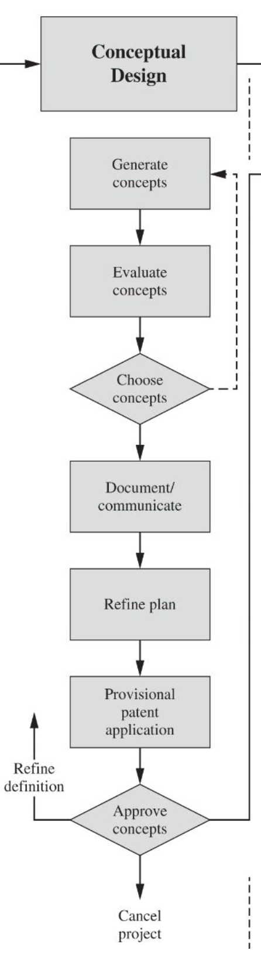
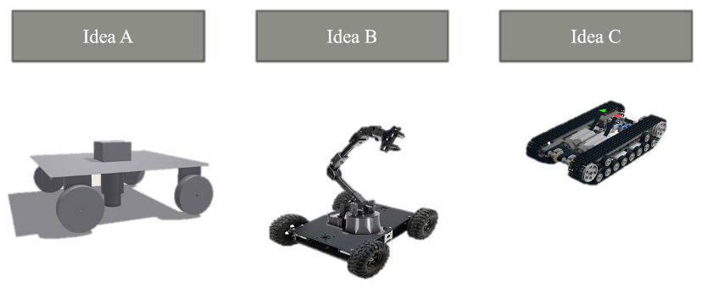
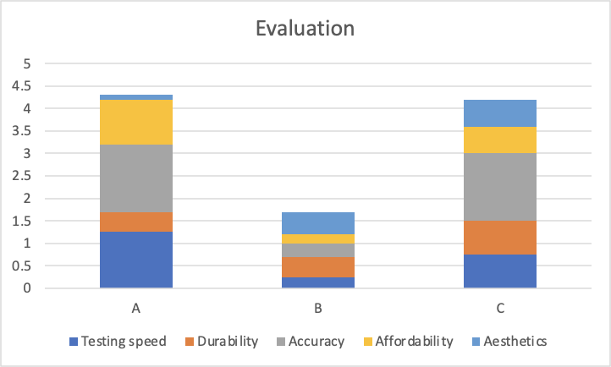
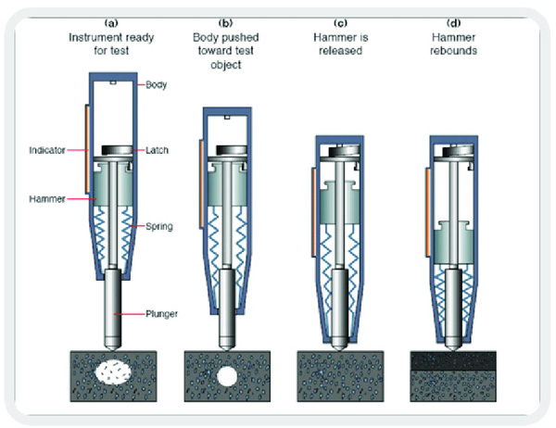
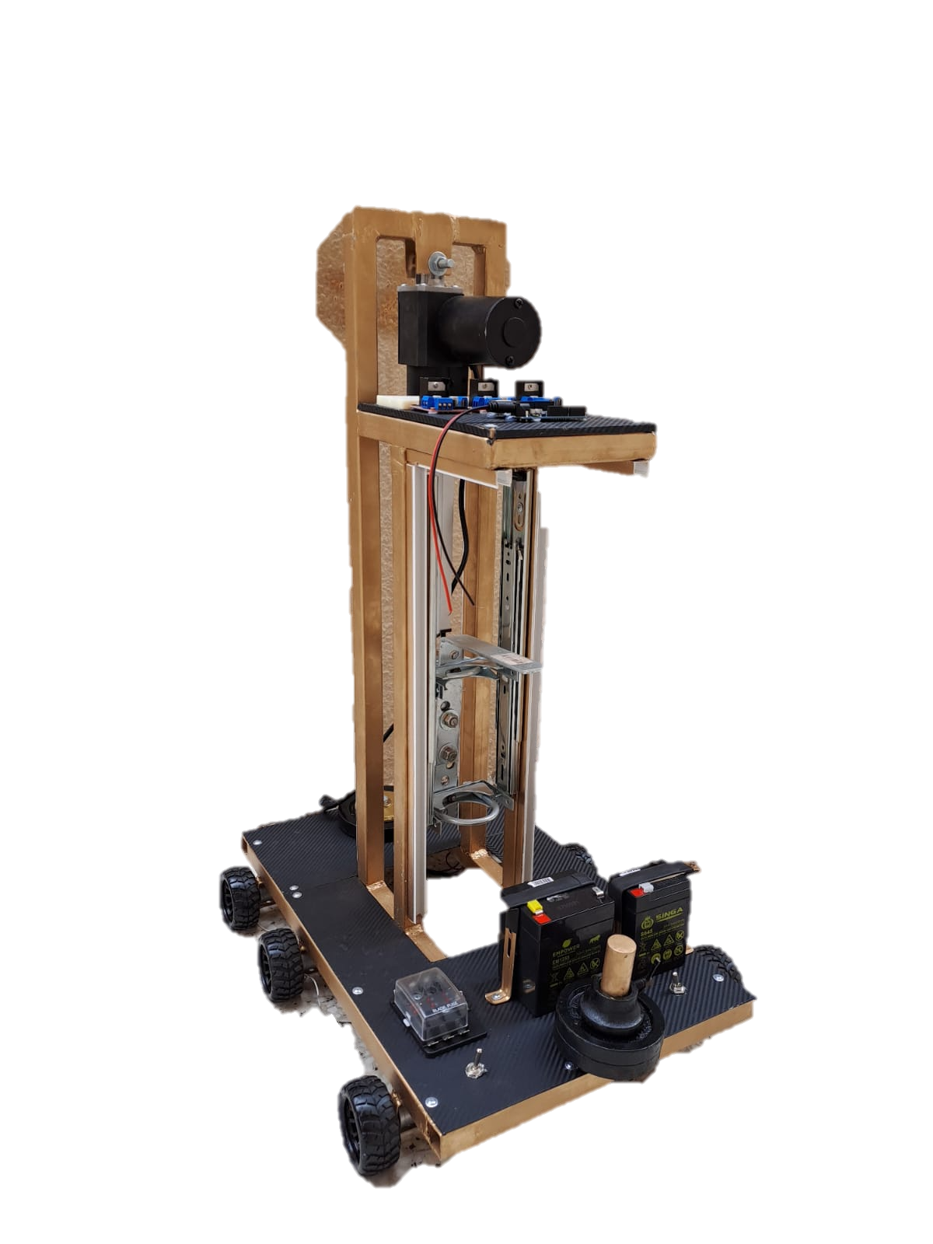
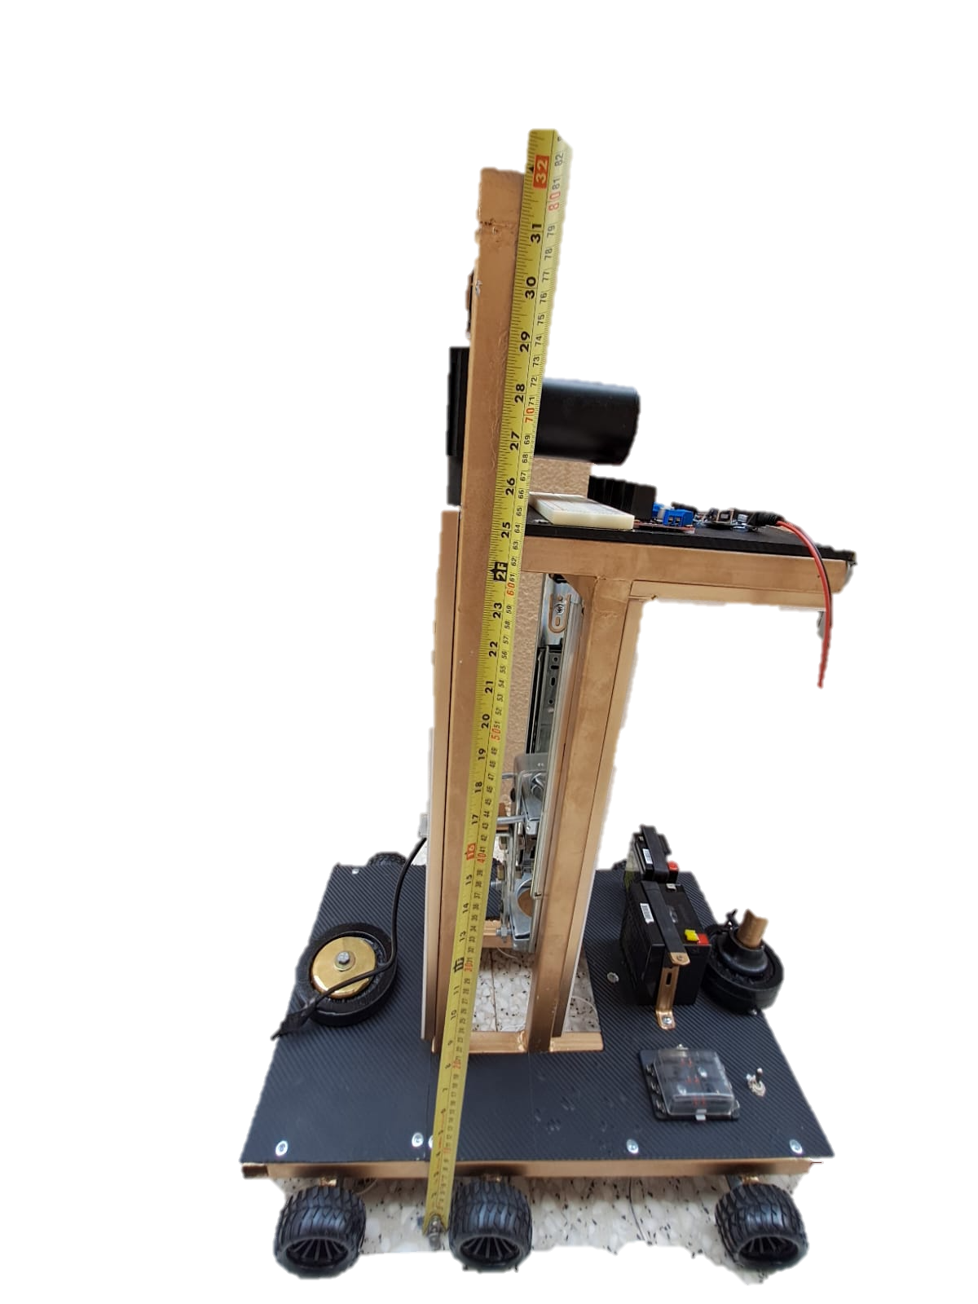
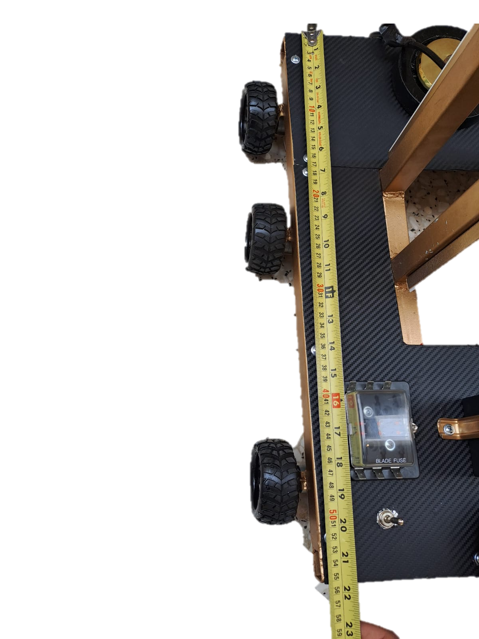
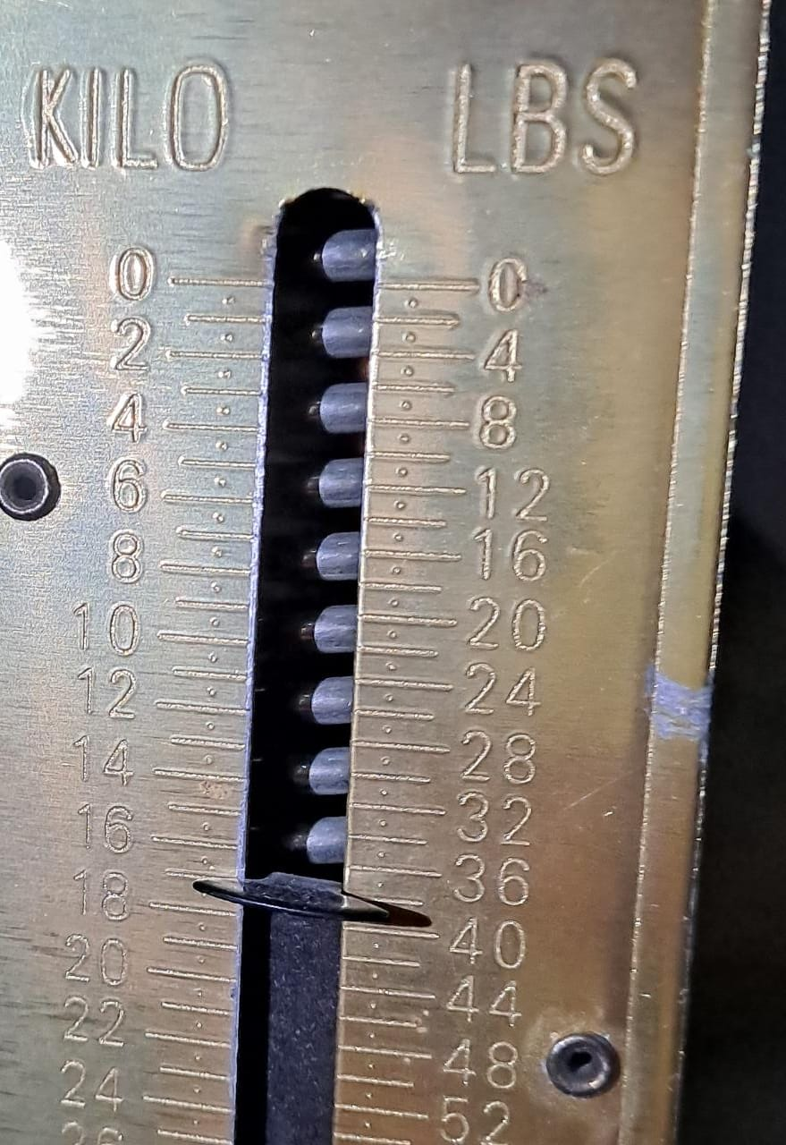
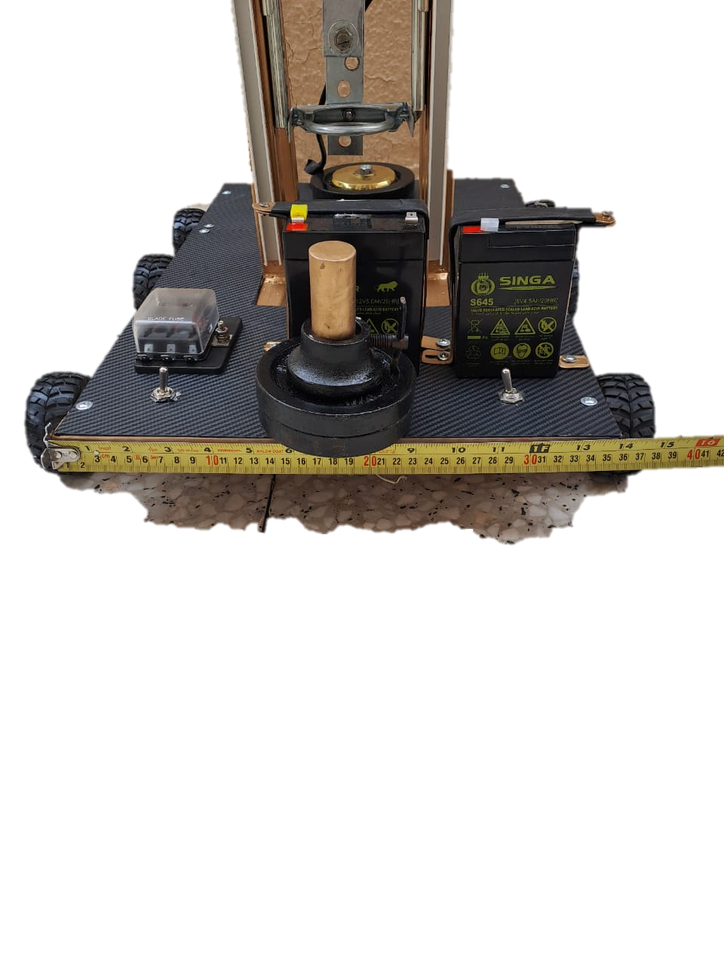
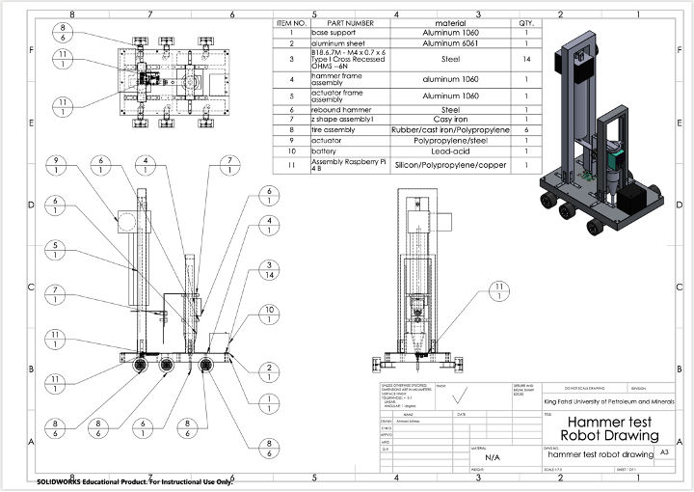
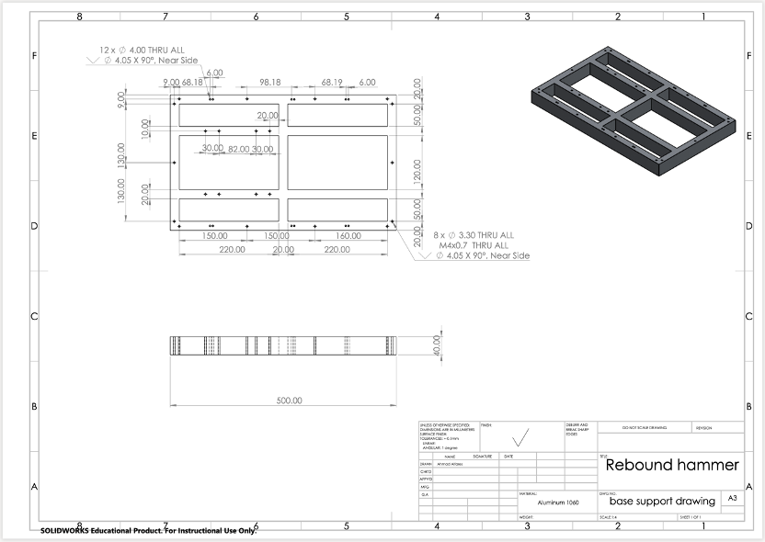
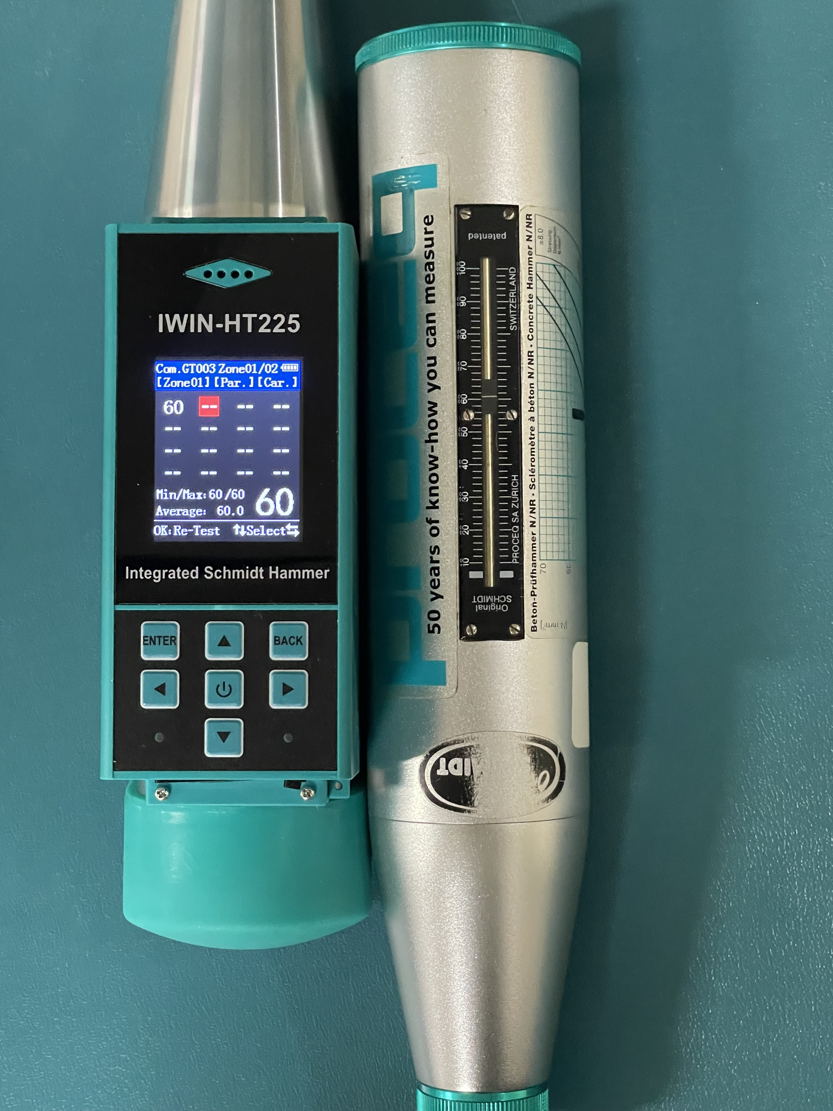
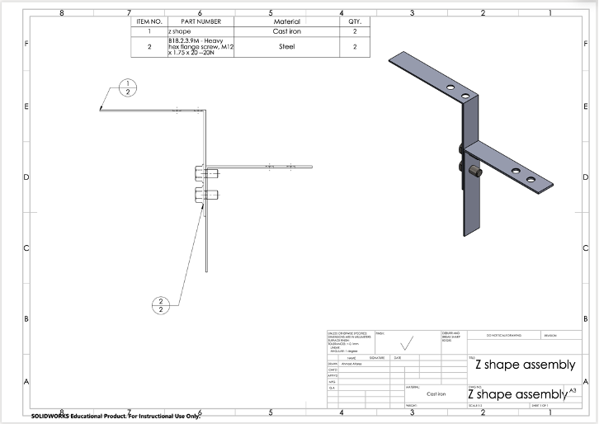
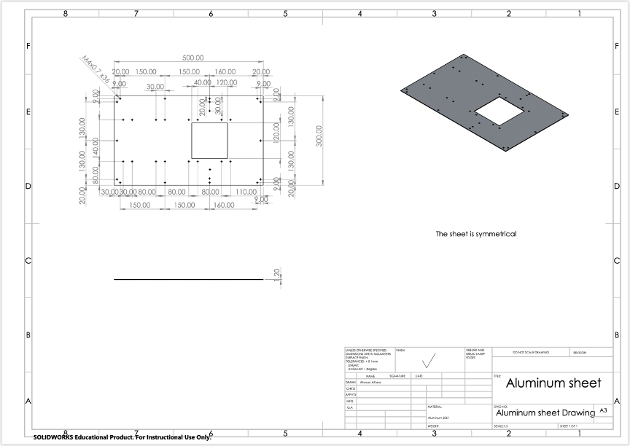



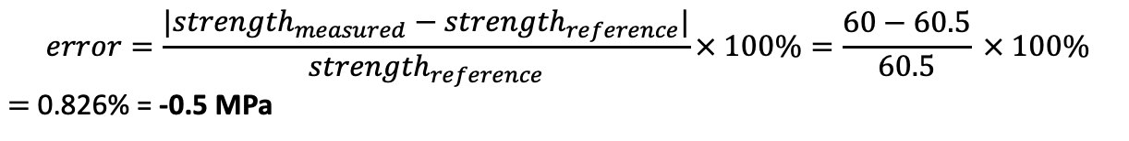
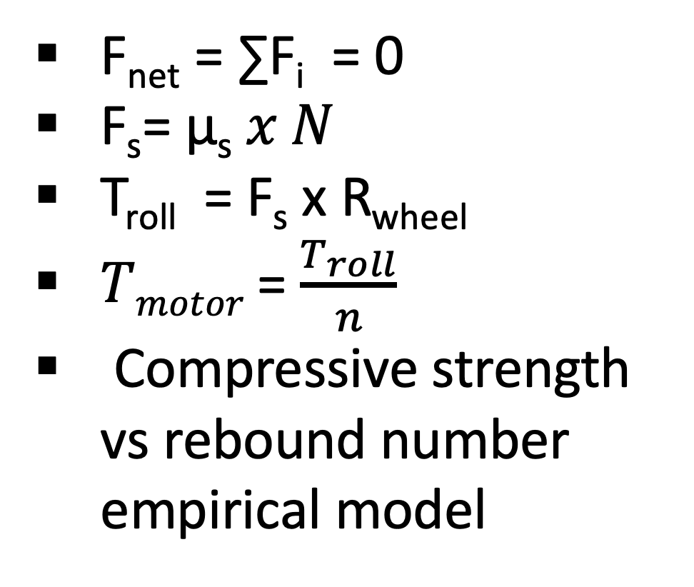
Concrete Test Robot
By: Ahmad Alfares
Ahmed Alkhuwaitem
Feras Alfaraj
Abdulmohsen Alfuhaid
Abdulhadi Fatani
King Fahd University of Petroleum and Minerals
Capstone 2.0
Term: 221
Conceptual Design
Background
As a result of the project, the product is able to test large areas autonomously. It integrates a vehicle with a crucial non-destructive testing method of concrete. Moreover, it was designed to decrease the testing speed and provide accurate results with a competitive cost without compromising its quality. Therefore, it will aid in improving the quality of concrete by providing an easier alternative to the conventional testing method.
Conclusion
Problem Statement:
The robot needs to test the quality of a large area of concrete by multiple points autonomously and rapidly using the rebound hammer test.
Constraints:
Non-destructive tests require an impact energy of:
Testing normal weight concrete 2.25 J
Testing light weight concrete 0.75 J
Testing mass concrete 30.00 J
The device should be portable for operators.
Testing requires a minimum distance of 25 mm between tests.
Technical Specifications:
Total testing time 3 min/ m²
Device size: size < 55 x 45 x 85 cm
Affordability Cost of parts used < 5000 SAR
Number of collected data. Collected > 3 samples/m²
Accuracy ± 10 MPa
Mass of the robot m < 20 kg
Important Calculations
Product development necesitates trial and error.
Manufacturing takes most of the project time.
Time availability effects cost significantly.
Team communication is essential.
Predicting future risk is important for cunstructing a project plan.
F_{net} = ∑F_{i} = 0
F_{s}= µ_{s} 𝑥 𝑁
T_{roll} = F_{s} x R_{wheel}
𝑇_{𝑚𝑜𝑡𝑜𝑟} = $\frac{T_{roll}}{n}$
Compressive strength vs rebound number empirical model
Lessons Learned
Size
Mass
Accuracy
Number of collected samples
Testing time
Testing and Validation
Final CAD
Prototype
Simplified manufacturing process
Direct data acquisition from hammer
Implementing Artificial Intelligence
Size reduction
Future Improvements
$$error=\frac{{|strength}_{measured}−{strength}_{reference}|}{{strength}_{reference}}× 100\%=\frac{60−60.5}{60.5} × 100\%$$
$=$ 0.826% = -0.5 MPa
Average testing time:
2.87 mins
Per
Area tested:
1 m²
Number of collected samples:
3 samples
Per

