Slide 1

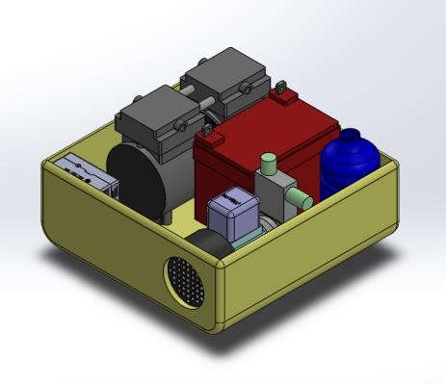
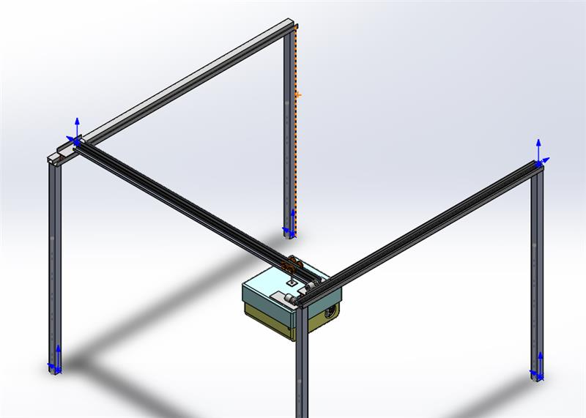
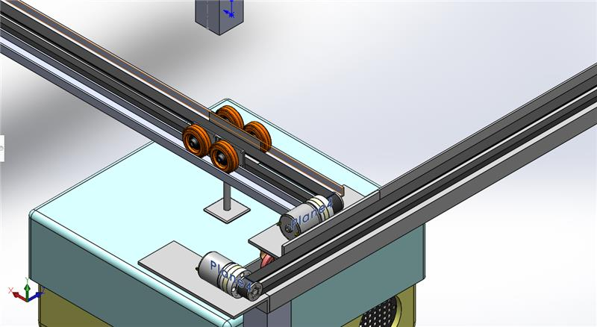
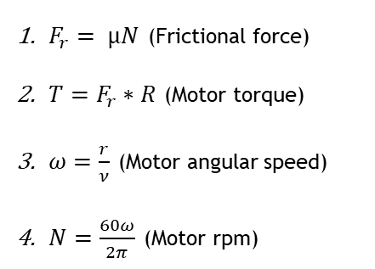
An automated solar panels cleaning system
King Fahd University of Petroleum & Minerals (KFUPM)
Department of Computer Engineering
Department of Mechanical Engineering
Capstone 2.0 - Senior Design Project (221)
Significant Findings
Supervisor: Prof. Mohamed Elrabaa
Team 13: EMAD ADDIN ALSHARAFI (COE), IBRAHIM ALYAHYA (ME), SULAIMAN ALDAMEGH (COE), FAISAL ALQAHTANI (ME), SALMAN MAHJOUB (COE)
Problem Statement
Prototype Design
Requirements & Specifications
Traditional manual cleaning methods suffer from low cleaning quality, low efficiency, and high-water consumption, making it difficult to achieve consistent cleaning.
Design overview
Robot box
Requirements | Specifications
The system should be able to clean various kinds of soiling | The system will have an air blower with 150 psi to clean average-size dust and a water pump with 150 psi to clean sticky soiling
The system should work for at least 3 hours without charging | Each of the air blower and water pump is connected to a battery of 6000 mAh to ensure 3 hours of automation
The system should not make any damage to the PV panel surface | The air and water pressure should not exceed 35 Bar (3.5 Mpa) pressure, just enough to clean the dust without harming the surface
Framework Proposed
This project proposes an automated dual-methods cleaning robot that moves above the solar stations using a suspension system and cleans the PV panels using air or water for dust removal in Saudi Arabia
Box mechanism
Elements & Specifications
Element | Specification
Dimension (length, width, height) | (300 mm * 300 mm * 300 mm)
Weight (including an air compressor and a water pump) | Approx. 8 kg
Max moving speed | 0.2 m/s
Control system | On-board processor (Raspberry Pi 8GB RAM)
Power supply (air compressor 150 psi) | lithium battery Built-in 6000 mAh for 3 hours autonomy
Power supply (water pump 150 psi) | lithium battery Built-in 6000 mAh for 3 hours autonomy
Power supply (On-board processor) | Single-cell battery, 2000mAh For about 4 hours autonomy
Prototype cost | ≤ SR 6000
What We Learned
Equations used
Prototype & Test Result
Learned how to do design process, project management, team dynamics and socio-economic context of design
Learned how to apply design principles, engineering analysis and experimental methods for a design project
$F_{r}= µN$ (Frictional force)
$T=F_{r}∗R$ (Motor torque)
$ω=\frac{r}{ν}$ (Motor angular speed)
$N=\frac{60ω}{2π}$ (Motor rpm)
Here we will attach figures of real prototype and a QR code for movement video to confirm that out prototype has met the specifications.
What We Could Improve
Detect the soiled spot on the PV panel using AI and then clean it up
Make the robot recharge itself once its battery is close to die

