Slide 1

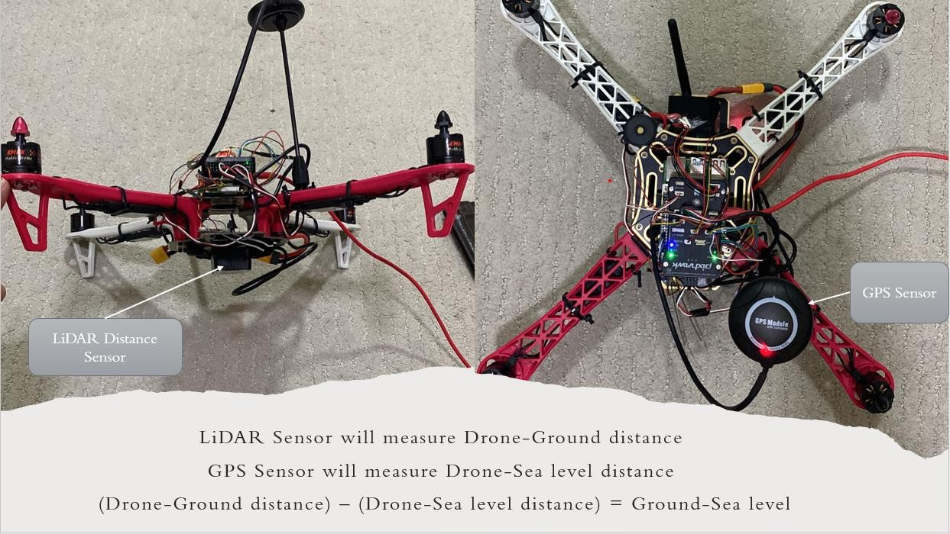
Autonomous Leveling Drone
Our original thrust goal was 2100g to achieve our goal of a weight double that of the drone. Now we know our drone is well above that goal at 2680g of thrust. For the drone to be lifted even slightly, the thrust needs to be equal to the weight of the drone. However, to have stable and higher height, the thrust needs to be double that of the drone. The thrust used is going to be enough thrust for the drone to fly over 10 m of height stably.
The flying time can be calculated using the following equations:
The flying time can be calculated using the following equations:
discharge
time = capacity ×
𝐴𝐷𝐷
discharge
time = capacity ×
𝐴𝐷𝐷
where capacity of our battery is 3000 mAh, discharge is 0.8 or 80%, and ADD can be calculated
as
𝐴𝐷𝐷 =
𝐴𝑈𝑊 ∙ 𝑃
where capacity of our battery is 3000 mAh, discharge is 0.8 or 80%, and ADD can be calculated
as
𝐴𝐷𝐷 =
𝐴𝑈𝑊 ∙ 𝑃
𝑉
1.05 ∙ 170
=
11.1
= 16.08
which is in the range of specified of 7-15 min.
𝑉
1.05 ∙ 170
=
11.1
= 16.08
which is in the range of specified of 7-15 min.
discharge
𝐴𝐷𝐷
discharge
𝐴𝐷𝐷
0.8
time = capacity ×
0.8
time = capacity ×
= 3.0 ∙ = 15ℎ = 9 𝑚𝑖𝑛
= 3.0 ∙ = 15ℎ = 9 𝑚𝑖𝑛
16
16
`
Khalid Alshehri – Jafar Alhabeeb – Abdulmohsen Alsubaie – Mohammed Almutawa
Introduction
Design Process
Final Prototype
Project Statement: this project aims to develop a drone that utilizes elevation sensors to make leveling measurement controlled by a computer software.
Equations needed to find the measurements from the drone:-
Deliverables:
1. Prototype of the autonomous leveling drone. 2. Software to interface with the drone. 3. Altitude measurements of specified locations in (m) [area in front of building #3].
Constraints:
Stability of the drone while flying.
Smooth horizontal movements.
Limited fly time.
Limited budget
Drone fly to the specified points (i.e., TP, TP2, and TBM1) and record readings of GPS & LiDAR sensor
GPS distance reading - LiDAR Distance Sensor = E(TP1)
GPS distance reading - LiDAR Distance Sensor = E(TP2)
GPS distance reading - LiDAR Distance Sensor = E(TBM1)
For example, To find the difference in elevation between any two points = E(TP2) - E(TP1)
Final Target Specifications:
Lifting Maximum Height: 10 m
Measurements Accuracy: 0.05 m
Flight Time: 7-13 min.
Target Area: 500 m^2
Proof that specifications are met:-
Function of Product
Our original thrust goal was 2100g to achieve our goal of a weight double that of the drone. Now we know our drone is well above that goal at 2680g of thrust. For the drone to be lifted even slightly, the thrust needs to be equal to the weight of the drone. However, to have stable and higher height, the thrust needs to be double that of the drone. The thrust used is going to be enough thrust for the drone to fly over 10 m of height stably.
Testing
In this project we will be investigating the method of measurement using LiDar Distance Sensor along with GPS sensor.
Enter required path and checkpoints in software
Drone flies following the path
Record measurement at each checkpoint
Prototype Details:-
Conclusion and Points of Improve
Using GPS, and LiDar Distance Sensor
Compare the findings
Analyze data on software
Send elevation data to software

