Slide 1

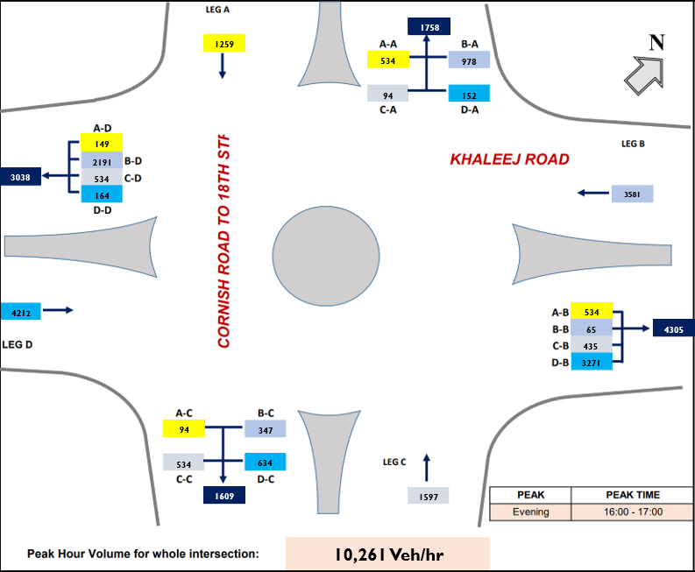
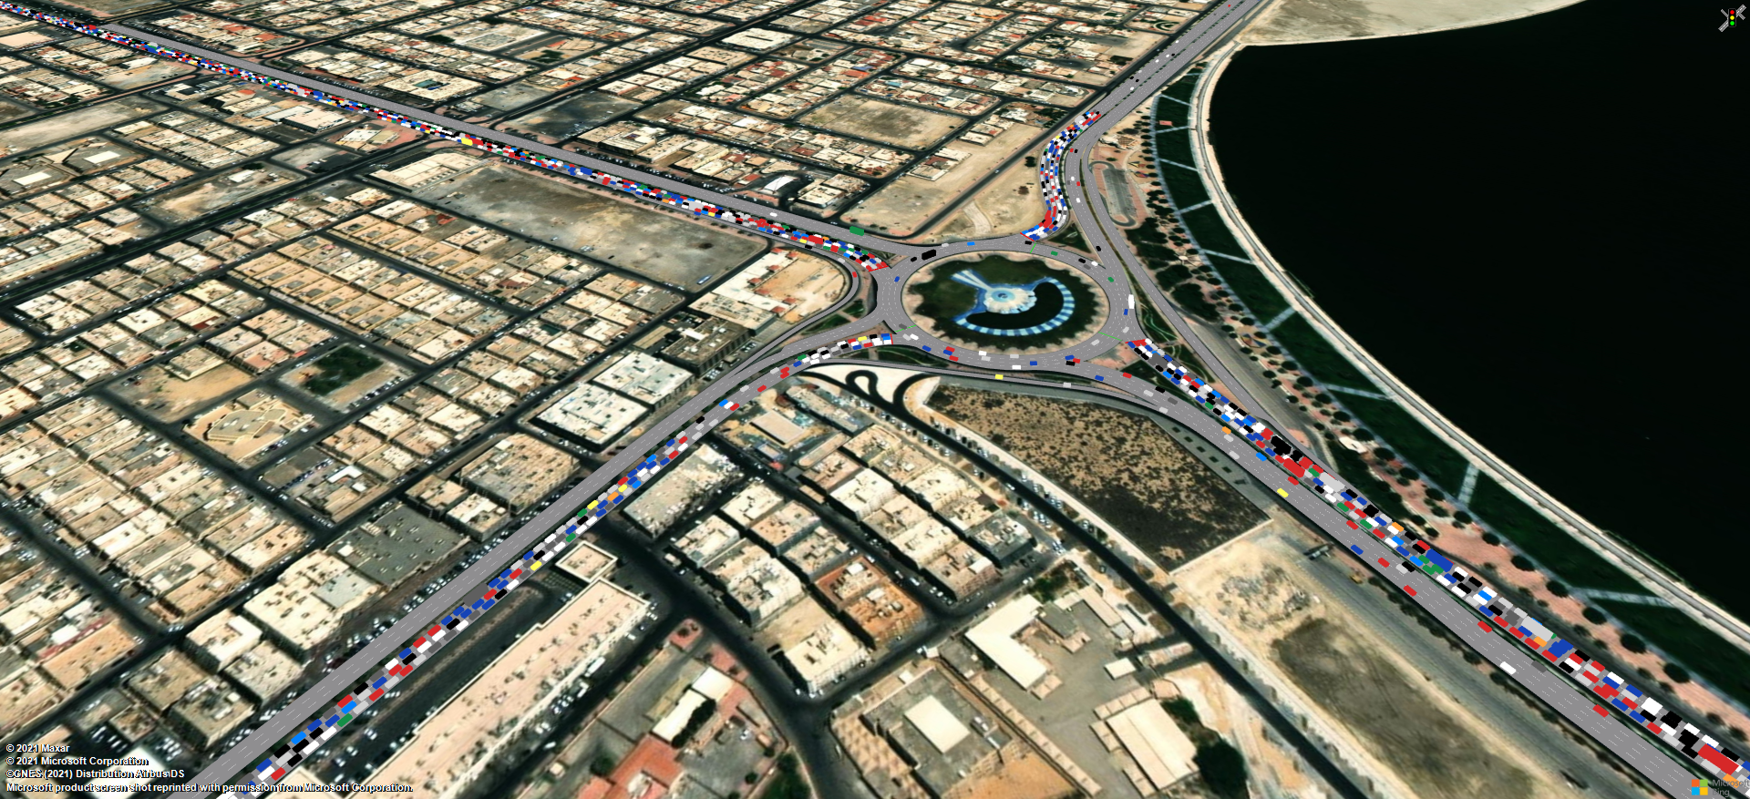
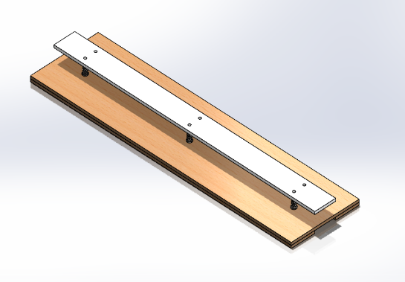
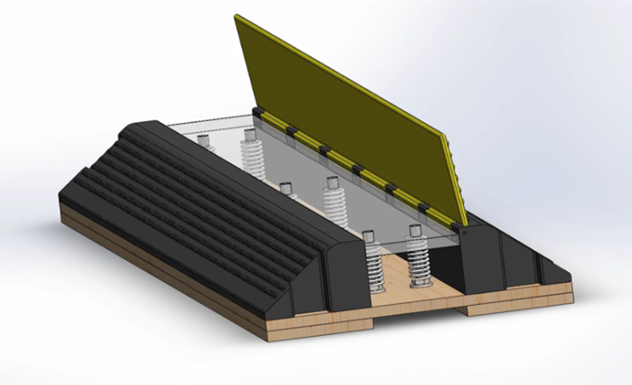
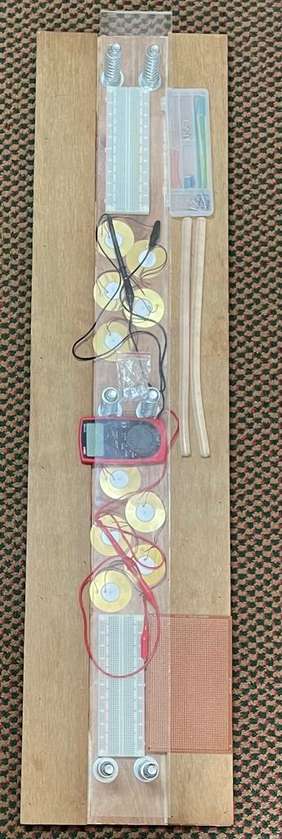
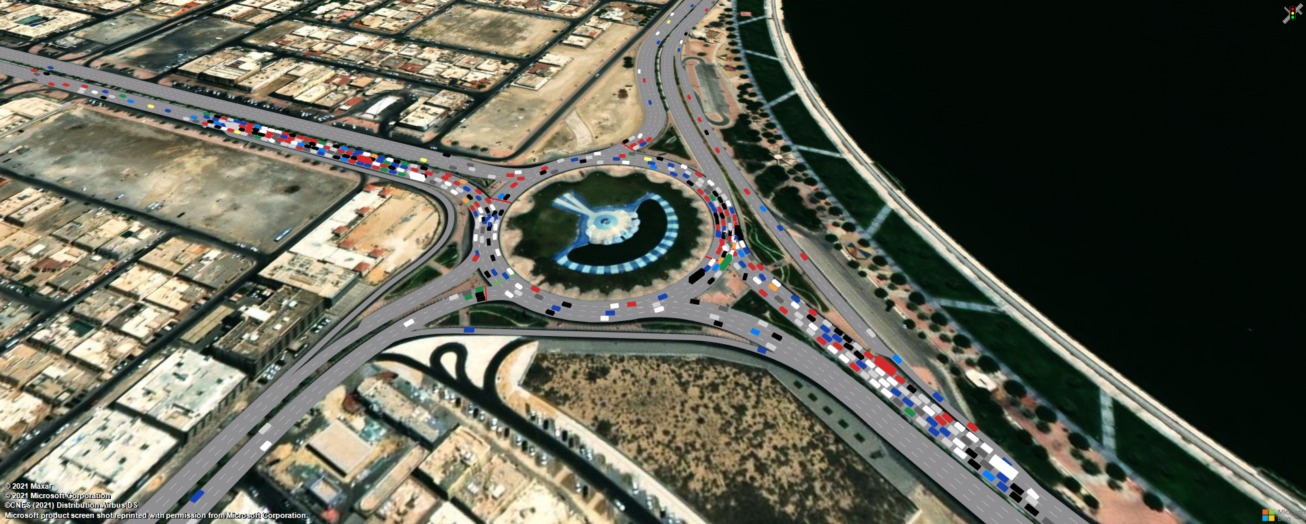
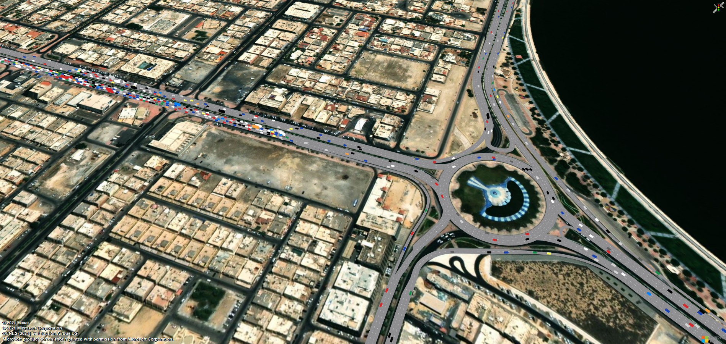
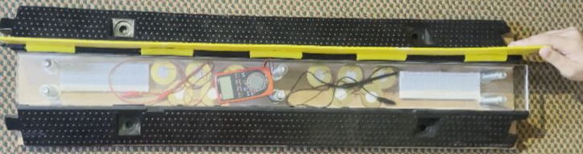
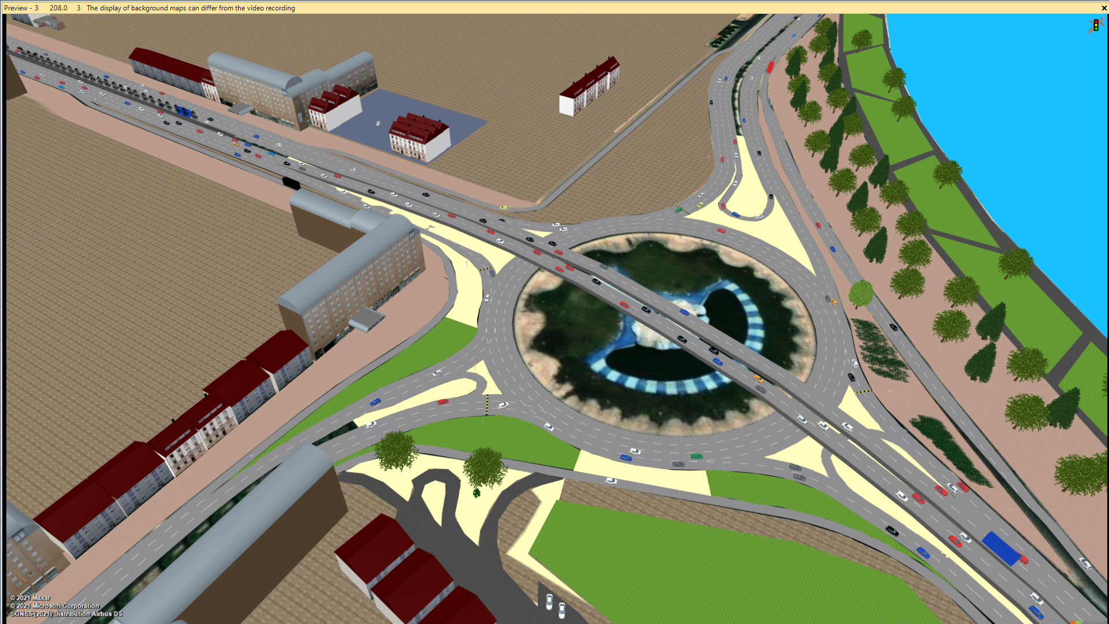
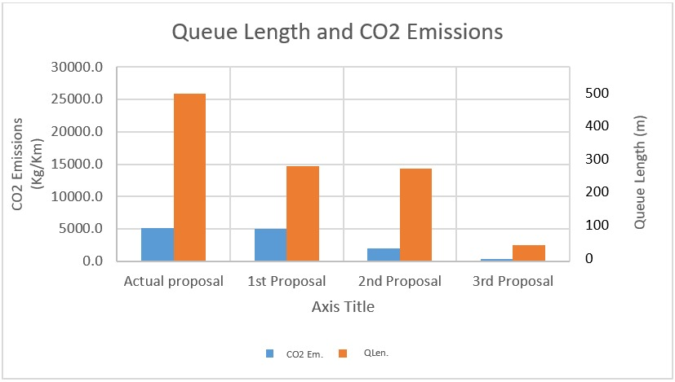
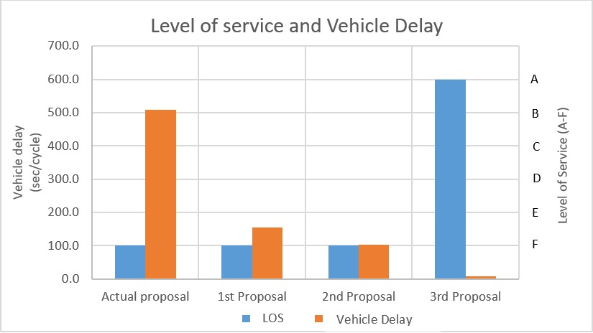
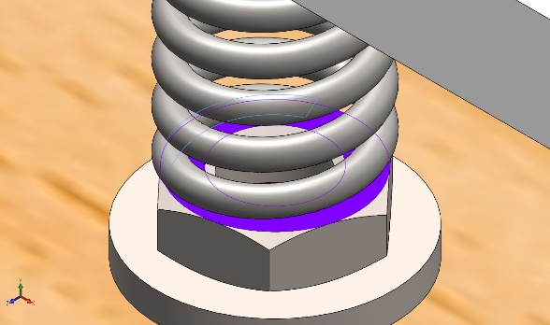
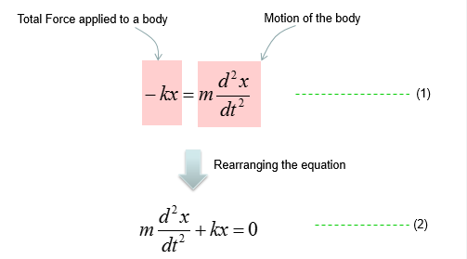
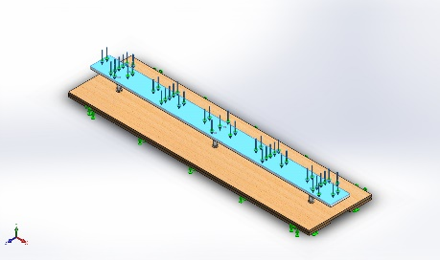
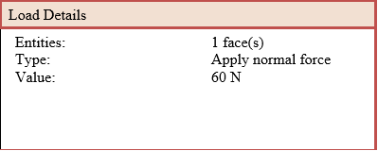
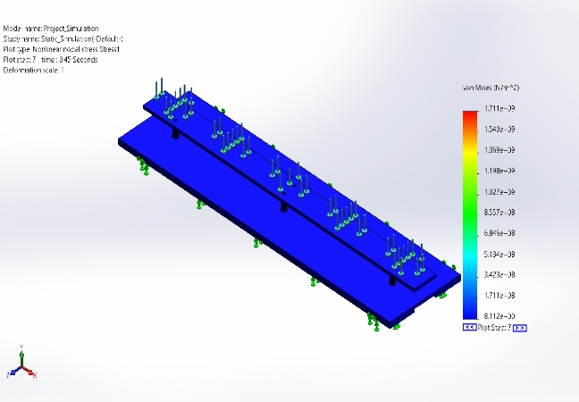
Improving Al-Ssadafah Roundabout Traffic Congestion During Rush Hours by Providing Proposals to Enhance the Current Traffic Operation
Senior Design Project Sec # 02 Group # 1 Advisor: Hammad Raza Khalid
Ali Baradhwan | Mohammad Alderaan
Mohammed Al-Hodairy | Haidar Albahrani​
Introduction / Background
The idea for this project came from the enormous congestion during peak hours in Al-Ssadafah roundabout which located in Dammam city. Two primary traffic control devices regulate this intersection; they are the roundabout and traffic signals. The team has collected data for the current volume and analyzed it. The next step is to propose designs that increase the level of service for the intersection based on the conducted studies. After the simulation, the team will take on the proposals as a solution for the intersection. The solution should satisfy the required level of service to reduce the delay time, fuel consumption and traffic accumulation. Furthermore, the design will utilize an energy-harvesting device to generate power and control traffic. Currently, there are three main approaches to reach the optimum solution. The first one is to adjust the traffic control devices, while the second approach is to modify the intersection accessibility and add control devices. Finally, the group will redesign the intersection.
Problem Statement
This project will conduct a study on AL-Ssadafah Roundabout’s congestion during peak hours by proposing a proper design to enhance the level of service at the intersection. Additionally, utilizing the high volume of vehicle crossing the intersection in generating power using an energy harvesting device that simultaneously function as a traffic control device. The work would be done with scientific theories, software applications and functional designs.
Constraints
Target Specifications
Level of Service (A to F): by increasing LOS up to D and above during rush hours. The other parameters go under it:
  Delay time (s): reducing the delay time up to less than 25 sec depending on the selected proposal.
  Diminishing queue length of the lane (m) by 40% or more.
  Reducing CO2 emissions (kg/km) by 30% as a minimum.
  Lane width 3.65.
Electricity generation (V): Energy harvesting device under the speed pump that can produce electricity up to 25V.
Roundabout 3D Simulation Prototype Design
Speed Bump Prototype Design
Testing / Validation
Final results
To solve the congestion of the roundabout the team has reached beyond the desired results,
Level of service A has been obtained while the existing design has an F LOS.
Delay time was reduced from 509.1 seconds to 9.4 seconds (in reference to table 1).
The average queue length of each lane became 24.6 vehicle/m and which is a way more than 40% of the existing situa2tion.
CO2 emissions have decreased from 25891.7 kg/km to 11239 kg/km which indicates more than 30%.
The speed pumps have regulated the traffic at the entrance of each leg of the round about to give priority for commuters within the roundabout.
Electricity generation (V): Energy harvesting device under the speed pump that can produce electricity up to 25V.
Conclusions
In conclusion, this project provided a proposal which will improve the LOS dramatically (LOS-A) as well as utilizing a traffic control device to regulate traffic and generate electricity to help supply nearby traffic signs.
What have been learned
This project helped gathering knowledge from various field of expertise.
Further possible improvement
The goal of the game is to progress through every level. This is the player becomes accustomed to the game mechanics.
Upon starting the game, the player has several options. They can play the main game, unlocking new levels as they progress, or create their own levels using the level editor. There are also several audio, visual, and game play options that can be adjusted.
N
4 Signals outside the roundabout
3 Signals inside the roundabout
Figure 1. Traffic volume and distribution
Figure 2. Actual situation of Al-ssadafah roundabout
N
Congestion due to high demand on the U-turns
N
Add a signal on the West inside the roundabout
Redesign the signal timing
Figure 1. 1st stage of the prototype in SolidWorks
Figure 2. 2nd Stage of the Prototype in SolidWorks
Removed All signals
Block north and south entrance of the roundabout
Block the western side of the roundabout to force commuters to use AL-khaleej road
Add Six U-turns to increase the accessibility and reduce the conflict points inside the roundabout
Figure 3. 1st stage of the actual prototype
Figure 4 2nd Stage of actual the Prototype
Figure 3. First proposal
Figure 4. Second proposal
N
Removing All signals
Constructing a flyover that connects the East and west of Dammam city which served more than 7000 (veh/hr)
Adding a number of seven U-turns to increase the accessibility and reduce the conflict points inside the roundabout
Adding a speed bumps before each entrance of roundabout in order to give the priority for commuters inside the roundabout and to force the commuters who are approaching the roundabout to reduce their speed
voltage generated ( V ) | Vehicle speed ( km/hr ) | No
12.8 | 5 | 1
10.2 | 10 | 2
7.8 | 15 | 3
5.6 | 20 | 4
Voltage generated ( V ) | load ( N ) | No
18.4 | 20 | 1
20.8 | 25 | 2
22.5 | 30 | 3
25.8 | 40 | 4
Figure 5. Third proposal
Important Equations and Calculations
Electrical circuit of complete system:
Name | Type | Min | Max
Stress1 | VON: Stress at Step No: 7 (1.72769e-314 Seconds) | 8.112e+00 N/m^2 | 1.711e+09 N/m^2

