Slide 1
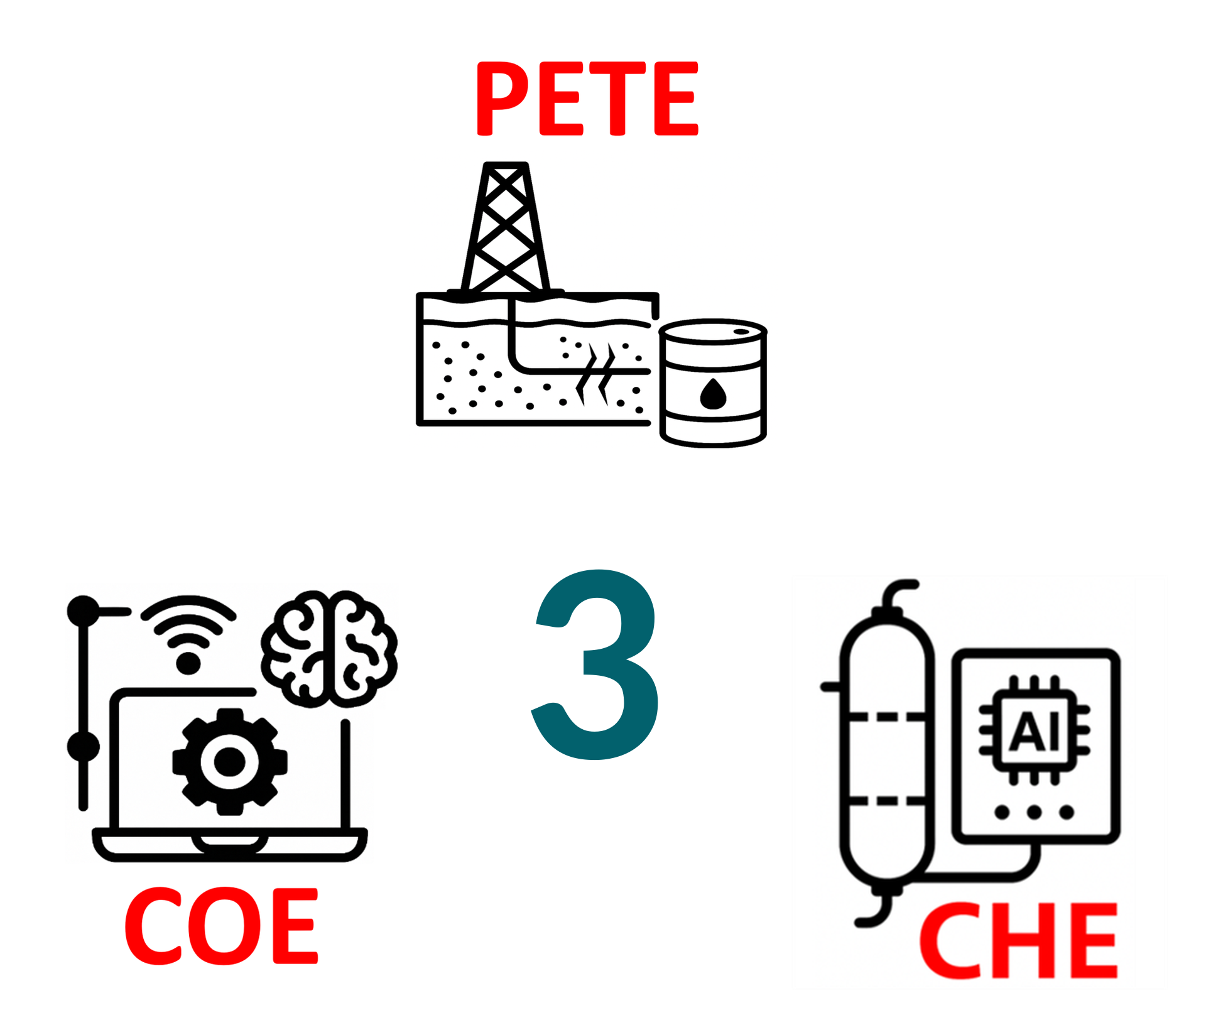
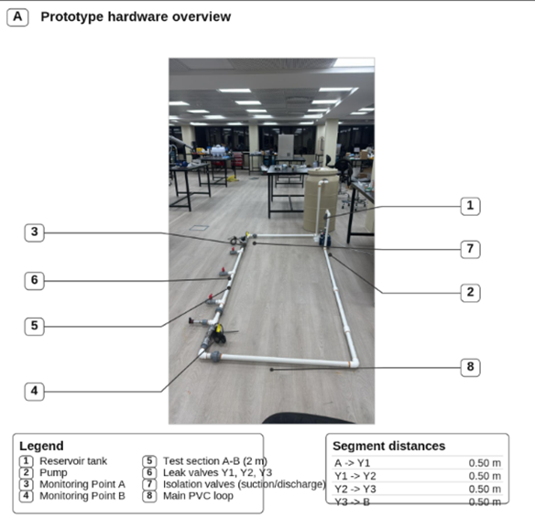
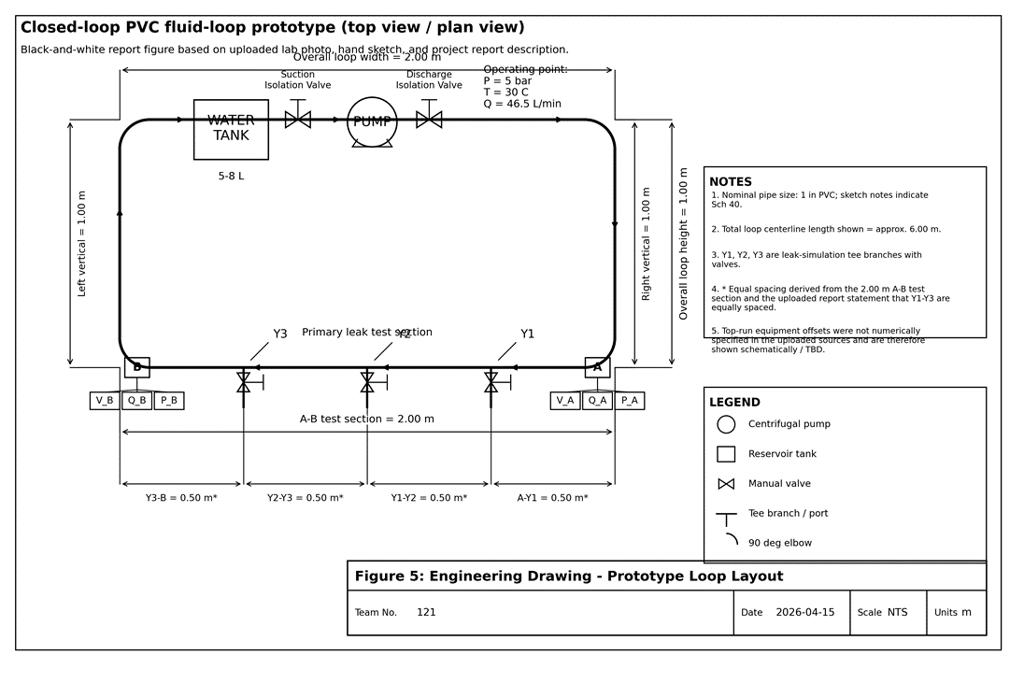
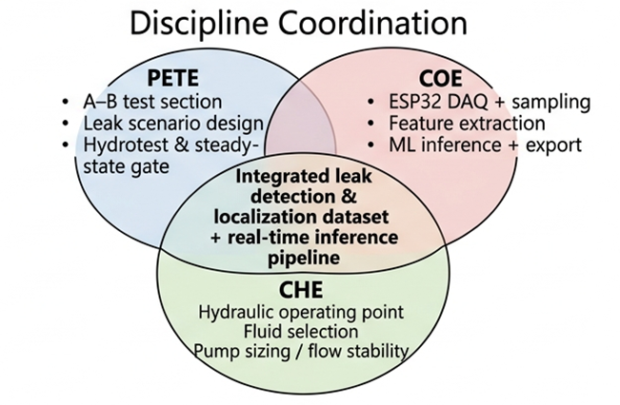
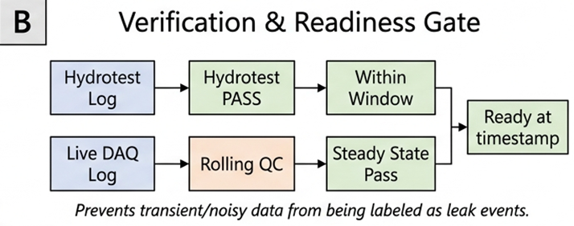
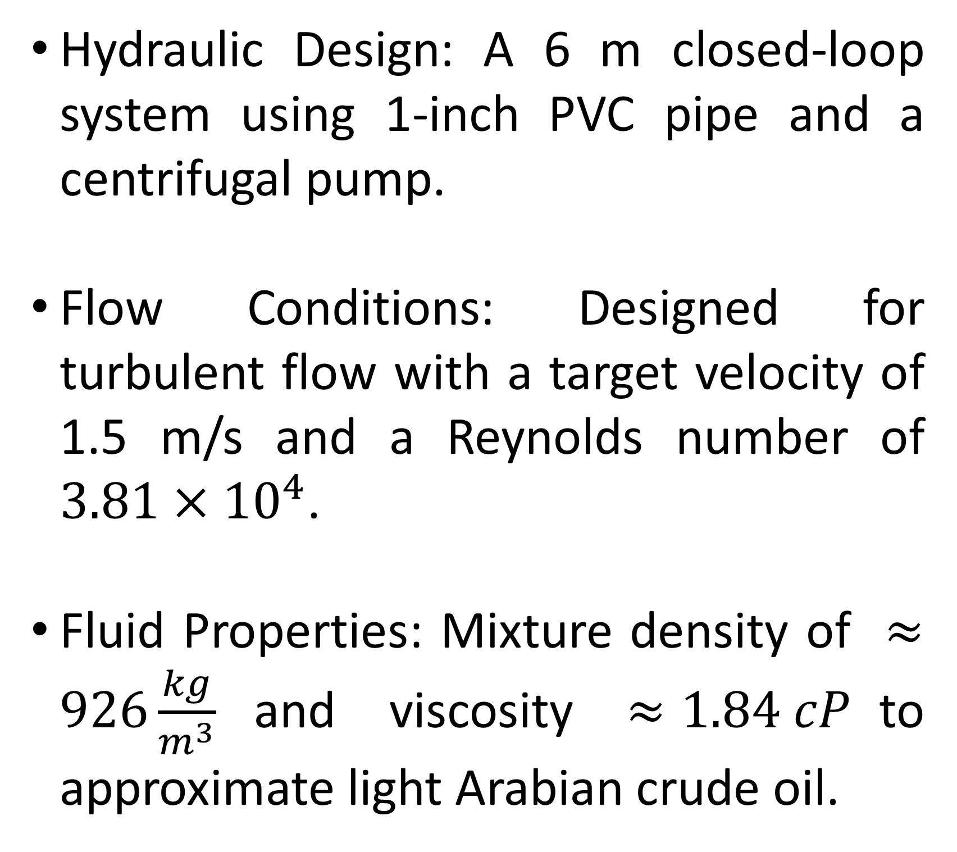
Al-Powered Leak and Anomaly Detection for Oil Pipelines
TEAM
M121
INSERT HERE The Multi-Disciplinary Strength logo
Abdullah Al-Muayli, Talal Alsubaie, Hassan Assiri, Abdullmajed Ahmad
Coach: Dr, Dhafer Al-Shehri
Introduction & Problem
Design & Specifications
Prototype & Verification
Results & Conclusion
Background: Pipeline leak detection is a safety-critical application where false negatives cause environmental harm and false positives lead to economic loss.
Objective: Develop a reliable, AI-driven method to detect and localize micro-leaks in real-time using synchronized sensor data.
Constraints: Includes lab-safe fluids (Water-Glycol mixture) mimicking crude oil, a test loop length of 4–8 m, and a budget of approximately 3,816 SAR
Hydraulic Design: A 6 m closed-loop system using 1-inch PVC pipe and a centrifugal pump.
Flow Conditions: Designed for turbulent flow with a target velocity of 1.5 m/s and a Reynolds number of $3.81×{10}^{4}$.
Fluid Properties: Mixture density of $≈926\frac{kg}{m^{3}}$and viscosity $≈1.84 cP$to approximate light Arabian crude oil.
Hardware Build: Features two monitoring stations (Points A and B) for pressure, flow, and vibration/acoustic data.
Leak Simulation: Three selectable leak locations (Y1, Y2, Y3) spaced at 0.50 m intervals allow for repeatable controlled leak scenarios.
Verification Gates: Data is qualified via hydrostatic integrity tests 7.5 bar, flow regime checks, and steady-state baseline gates.
Detection Performance: The AI model successfully identifies leak events with an incredible 99.76% accuracy and 100% precision.
Localization Accuracy: The regression model successfully predicted the leak location with a mean absolute error of just 0.26 meters.
Key Indicators: Based on feature importance analysis, downstream vibration (Vib_B_mmps_RMS at 27%) and upstream vibration (Vib_A_mmps_RMS at 24%) were the strongest predictors of a leak.
Future Improvements: Upgrade the system to use real steel pipes, build a longer test loop for more realistic flow behavior, and implement higher-accuracy sensors.

