Slide 1
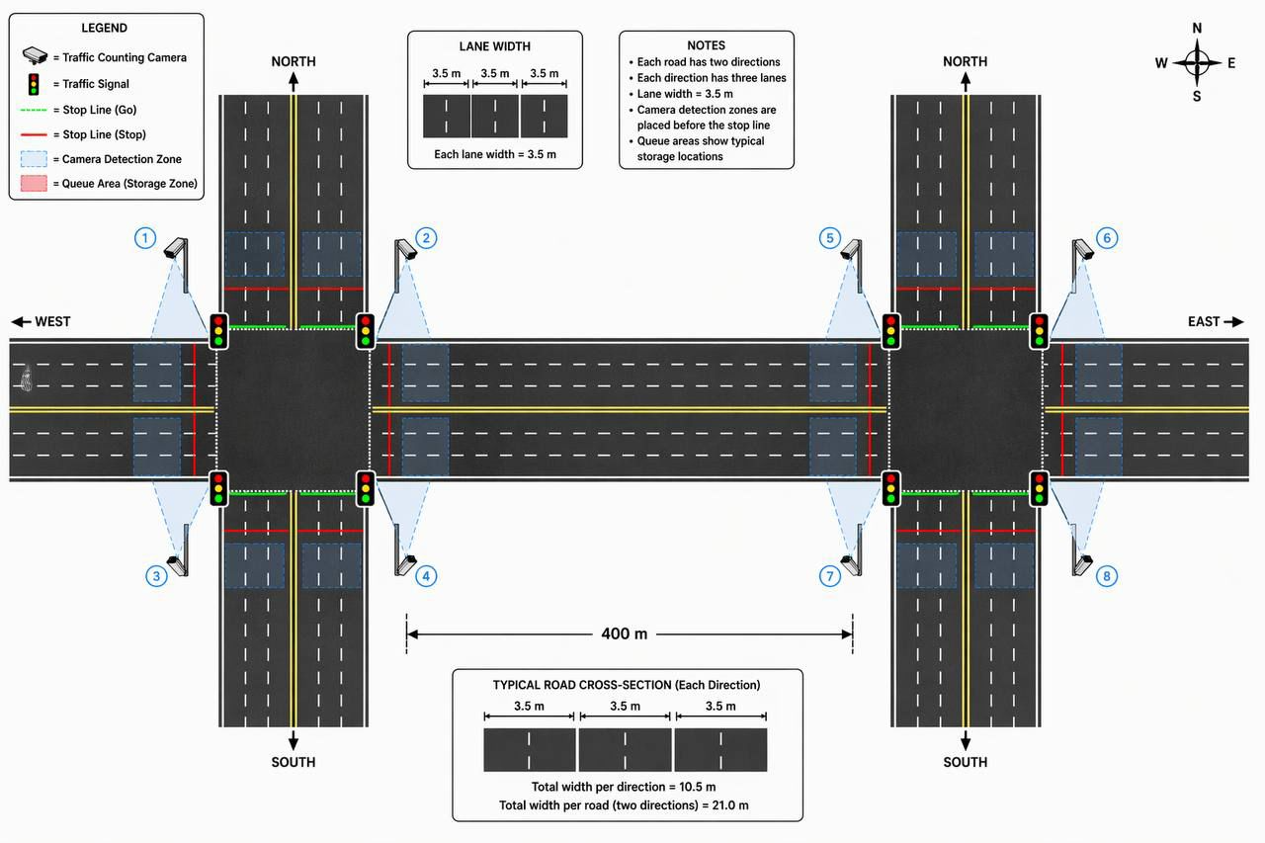
Smart Adaptive Traffic Light Coordination System in the City
TEAM
M120
INSERT HERE The Multi-Disciplinary Strength logo
Ryyan Khan, Mosa Assiri ,Ibrahim Alayban, Mohammed Alfilfil, Hasan Zuhair Alghadban.
Coach: Md Abdullah Al Bari
Problem Statement & Objective
Prototype Development
Validation and Verification
Conclusion
Problem: Fixed-time traffic signals cause delays, frequent stops, and increased emissions because they cannot adapt to real-time traffic conditions. They operate independently without coordinating with adjacent intersections.
Objective: To develop a data-driven, adaptive system that dynamically adjusts signal timings and coordinates multiple intersections to improve traffic flow and reduce travel time.
Novelty: Decentralized onsite treatment which eliminates the need for expensive transportation to centralized facilities.
Hardware: Utilizes microcontrollers and LED traffic signal modules to emulate a physical multi-intersection corridor.
Software: Integrates a Python-based adaptive controller with the Unity engine for real-time 3D traffic simulation.
Integration: Processes live traffic data to dynamically adjust green splits and synchronization offsets across adjacent nodes.
Achieved a 20.8% reduction in average delay, exceeding the 15% target.
Achieved a 23.3% reduction in maximum queue length, exceeding the 20% target.
The traffic classification algorithm reached 100% accuracy across all tested scenarios.
Emergency preemption operated with a 0.00s algorithmic response time, saving 180 seconds for emergency vehicles.
Queue lengths were successfully maintained below the 80% spillback safety threshold
The prototype successfully demonstrates the feasibility of real-time, multi-intersection signal coordination.
Adaptive signal control offers a more cost-effective solution to congestion than physical road expansion.
The system significantly improves urban mobility by reducing travel time, vehicle idling, and emissions
Constraints & All Specifications
Pedestrian movements are not included in the algorithm.
Lane widths are restricted to 3.0–3.6 m.
Reduce average delay by ≥ 15%.
Reduce queue length by ≥ 20%.

