Slide 1
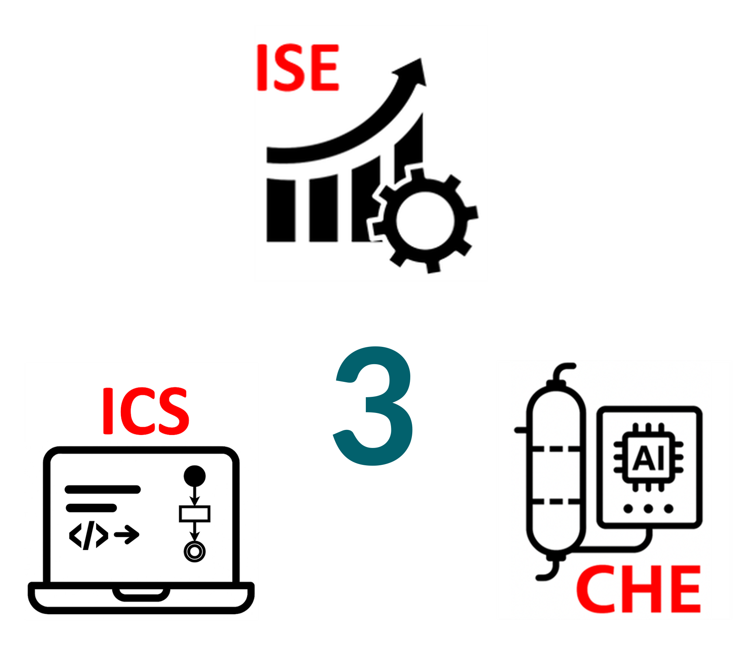
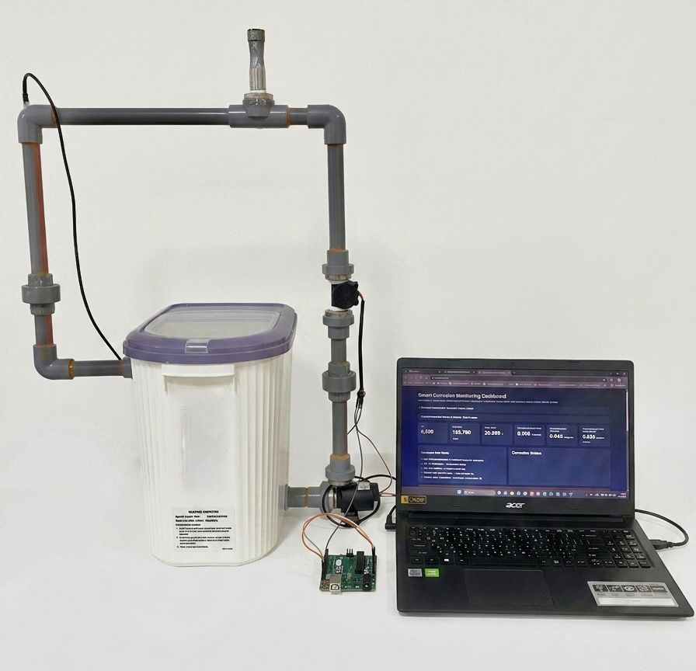
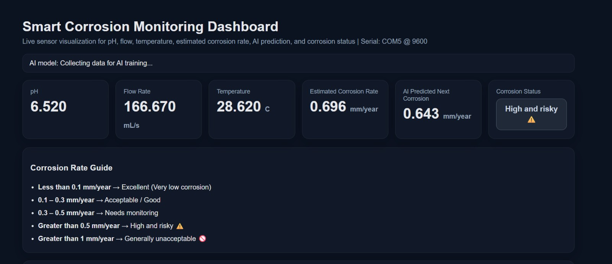
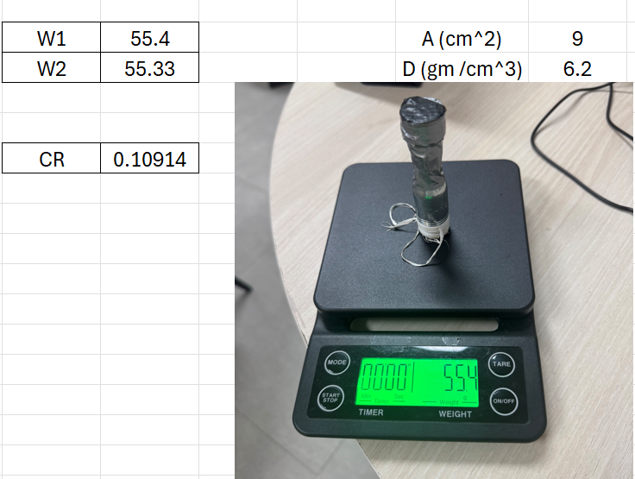
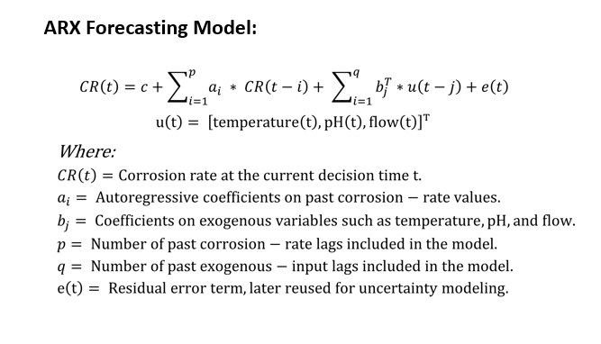
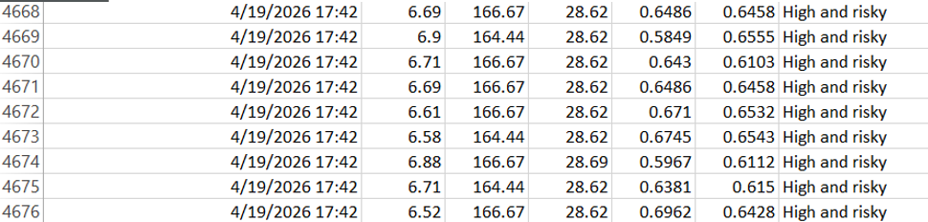
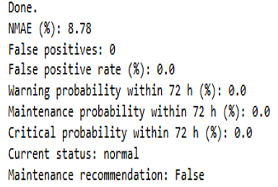
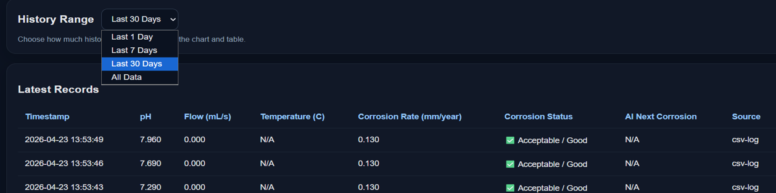
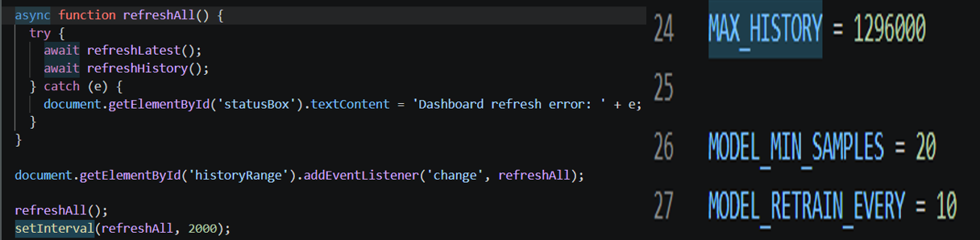
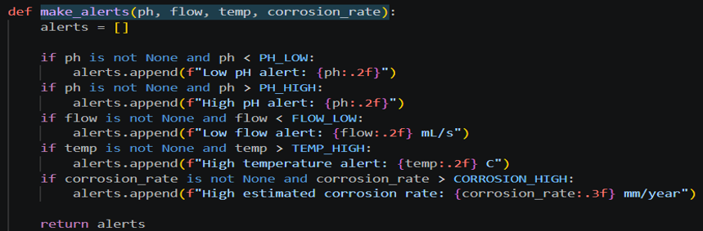
Smart Corrosion Monitoring & Prediction System for Industrial Pipelines
TEAM
M118
Mohammed Alhajri (CHE), Shujaa AlSubaie (CHE), Khaled Alhazmi (CHE), Mohanad Basabaien (ISE), Yazeed Alhammad (ISE), Thamer Aljohani (CS)
Coach: Dr. Omar Hammad
Problem Statement
Prototype Design
Testing & Validation
Corrosion weakens industrial pipelines and causes failures
Traditional inspections are periodic and limited
Continuous corrosion tracking is difficult with current methods
Smart monitoring system enables real-time measurement
System supports early prediction and timely maintenance
Constraints
Specification
Conclusion
Only non-toxic chemicals (NaCl)
open-source software (Python)
Project budget ≤ 13k
Measurement accuracy within ±10%
Prediction of lead time ≥ 72 hours
Data Refresh Rate ≤ 5 sec
False alarms ≤
1 per week
The smart corrosion monitoring system was successfully developed and validated, demonstrating reliable real-time monitoring, accurate corrosion prediction, and stable performance. The results confirm its effectiveness in supporting condition-based maintenance and its potential for future industrial applications.
MAE of the corrosion indicator ≤ 15%
Alert Response Time: ≤ 2 sec
Dashboard stores 30 days of sensor data
Sensor Data Reliability ≥ 98% availability
Corrosion testing follow ASTM G31/G96 standards
Risk and maintenance model based on prototype’s data
Store and process 30-day data
Predictive scheduling reduces inspections by 20%
Continuous 100-hour operation without failure

