Slide 1
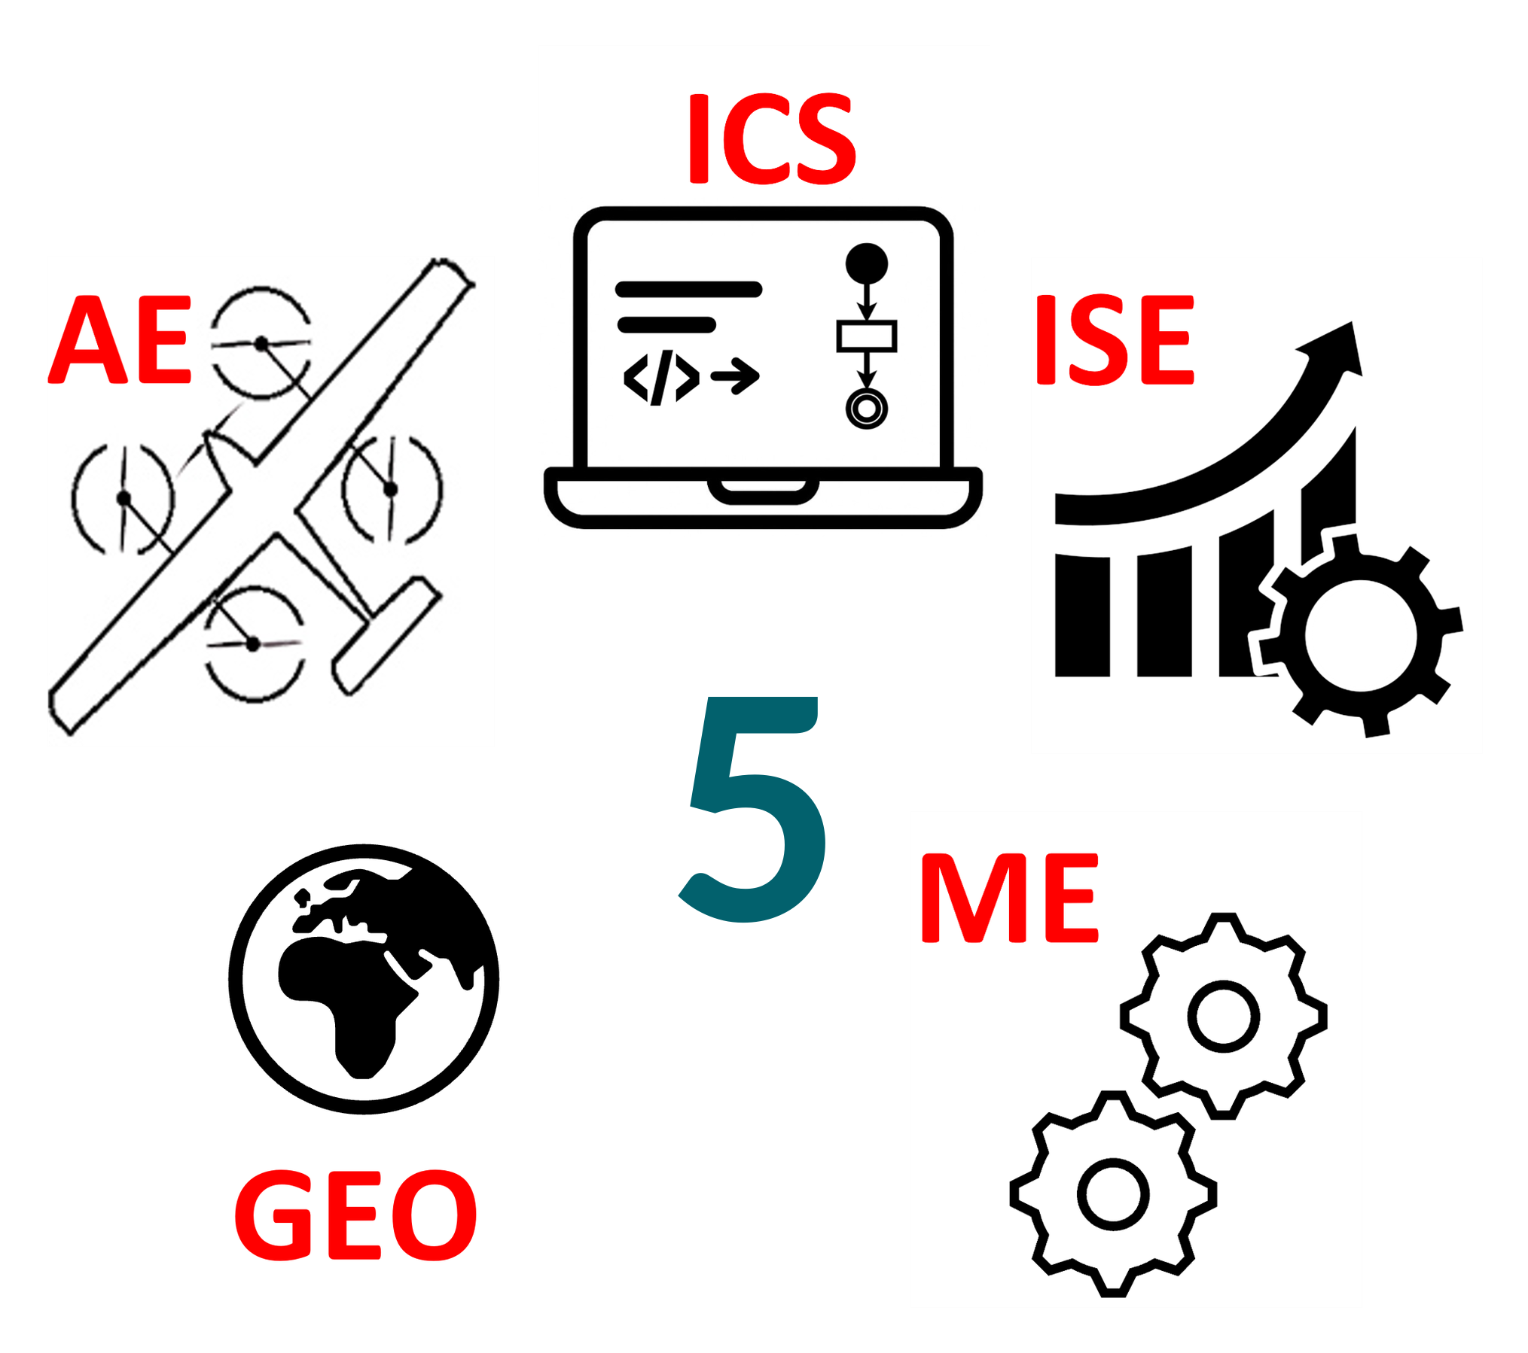
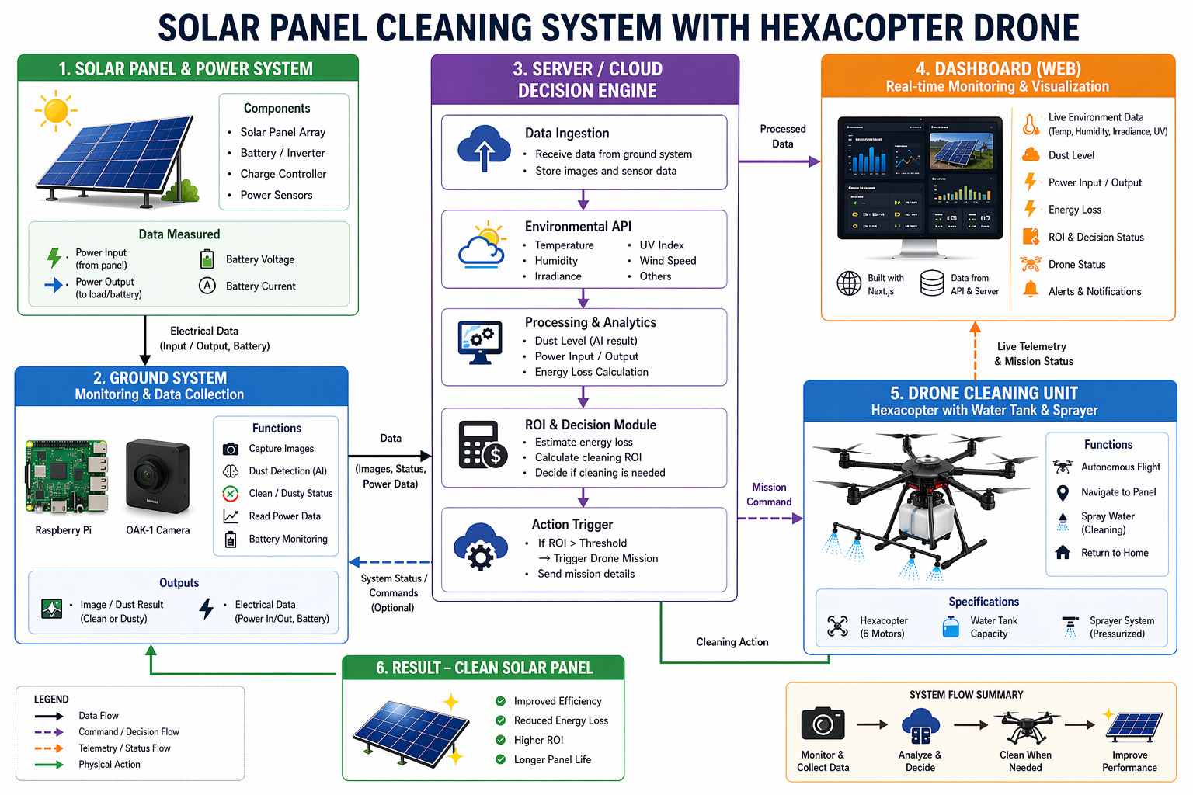
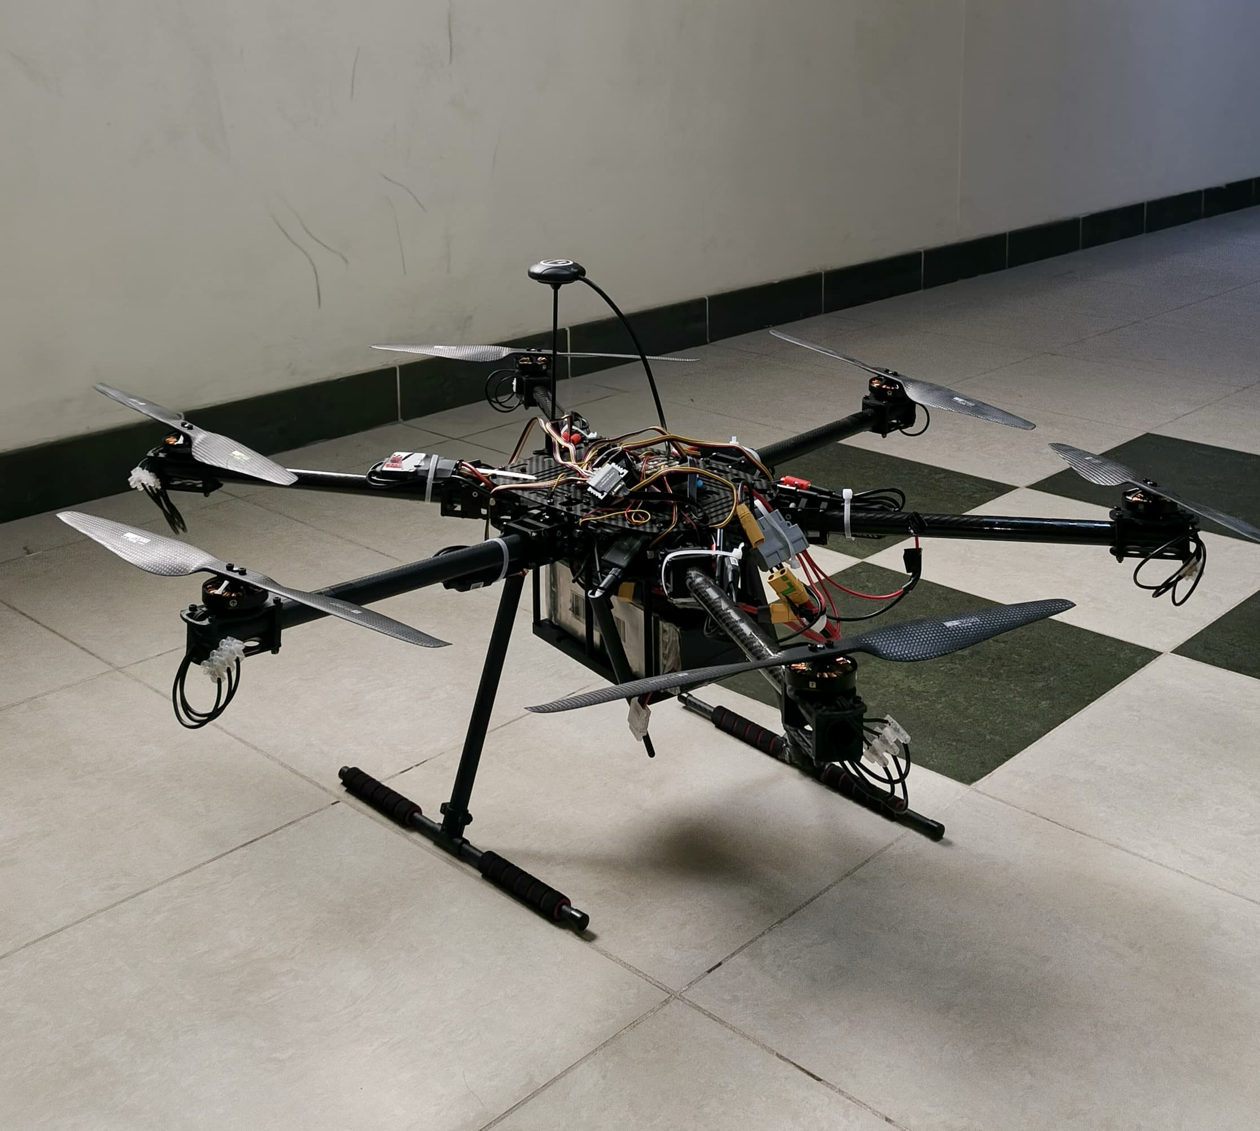
IoT Solar Panel Performance Monitoring & Cleaning Robot
TEAM
M114
Manhal AL Salem (CS) , Ryan Al Harbi (AE) , Ahmed Nahari (ISE) , Abdulaziz Alfozn (GEO) , Mustafa AL Fadul (ME)
Coach: Fahad Alam
Introduction
Prototype
Constraints & Specs
Testing & Conclusion
    Problem Statement
    Solar panels in Saudi Arabia lose up to 30% output from dust accumulation in the Eastern Province.
    Manual cleaning costs ~SAR 1.43/cycle, is hazardous, and lacks real-time intelligent scheduling, and data collection.
    No current system combines autonomous detection, schedule optimization, and drone-based cleaning.
    Objective
    Design an IoT-enabled autonomous drone that detects soiling via computer vision, optimizes cleaning schedules, and executes automated cleaning to restore solar panel energy output.
    Deliverables
    Autonomous cleaning drone
    Computer vision soiling detection
    Environmental real time data
    Mission scheduling optimizer
    Real-time IoT dashboard
System Architecture
Drone
Multidisciplinary Roles
AE: Drone design, rotor sizing, aerodynamics
CS: Vision AI, dashboard, communication , drone software
ISE: Schedule optimization, budgeting
GEO: Environmental sensing
ME: tank system, structural design
Key Constraints
Payload ≤ 4.2 kg | Total weight ≤ 10 kg
Total project cost ≤ SAR 15,000
Max flight altitude ≤ 100 m
Trigger cleaning only if energy recovery > operational cost
Dry-clean only when humidity ≤ 75%
Key Specifications
Battery endurance ≥ 20 min under full load
Op. cost ≤ SAR 0.20/cycle (86% vs. manual)
Live data updated every 10 sec
Drone Position accuracy ± 10 cm
Computer vision must detect dust over high sun glare, shadows , reflections
Integrated Specifications
Maintains ±10 cm positioning accuracy, collects data every 10 S, and uses GEO/ISE to allow cleaning only below 45 C and 5 m/s wind.
Predicts dust-related power loss ≥30 minutes ahead and optimizes a cleaning mission to recover ≥80% of energy within battery limits, logging results to a dashboard.
Testing & Validation
The system accurately detects dust on solar panels and sends the data to a central server, which makes an economic decision on whether to clean the panels immediately or delay the operation. It provides a real-time dashboard with all necessary live data, along with logs for solar panel status and drone flights. Once a decision is made, the system sends the appropriate command to the drone. The drone then executes flights to the solar panels with high accuracy and reliability.
Conclusion
This project delivers an autonomous, cost-effective solution to reduce dust-related losses in solar panels by integrating IoT, AI, and drone technology. It improves energy efficiency, enables smart cleaning decisions, and provides real-time monitoring and data insights.

