Slide 1
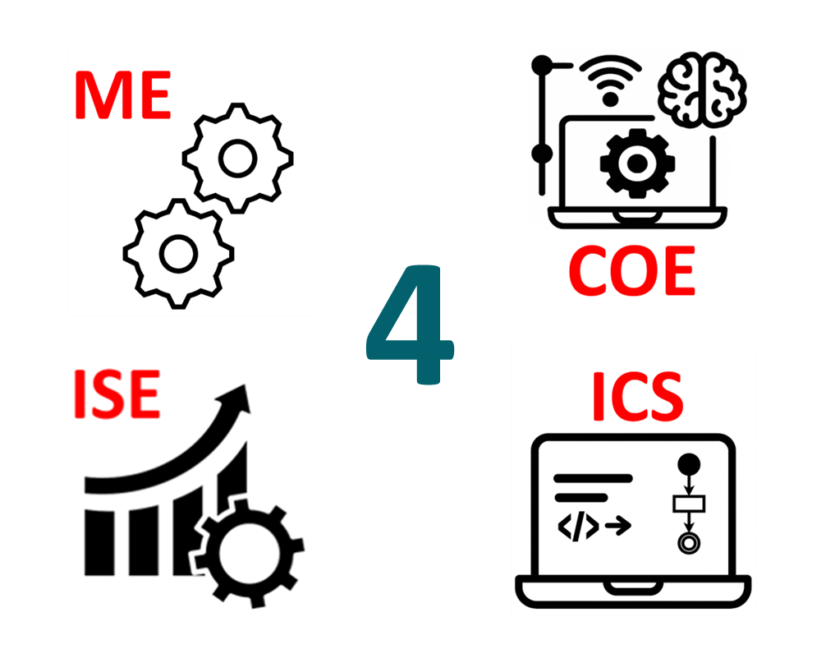
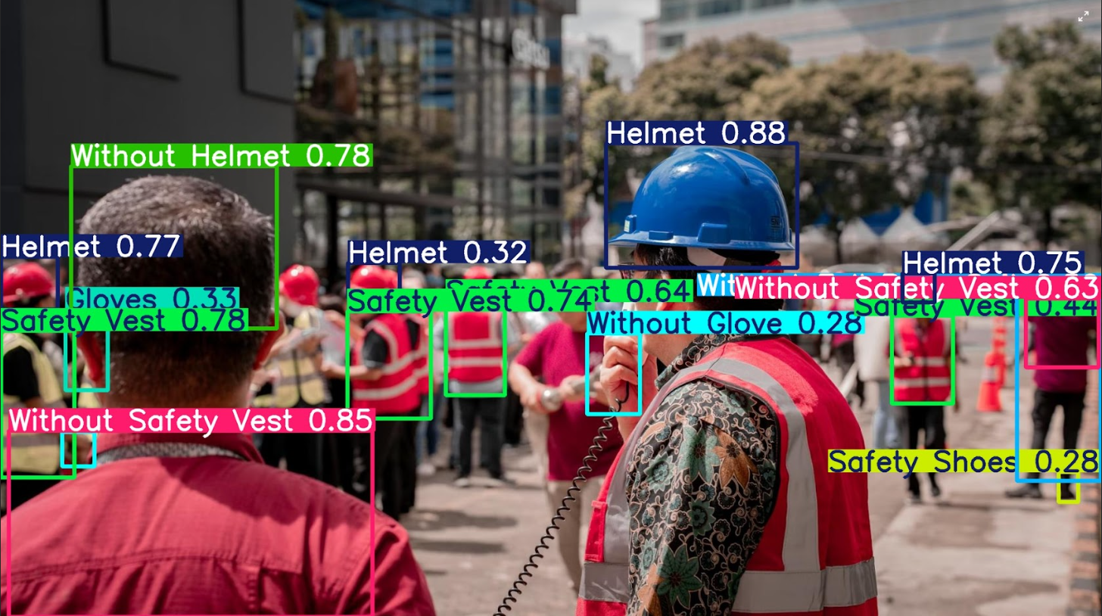
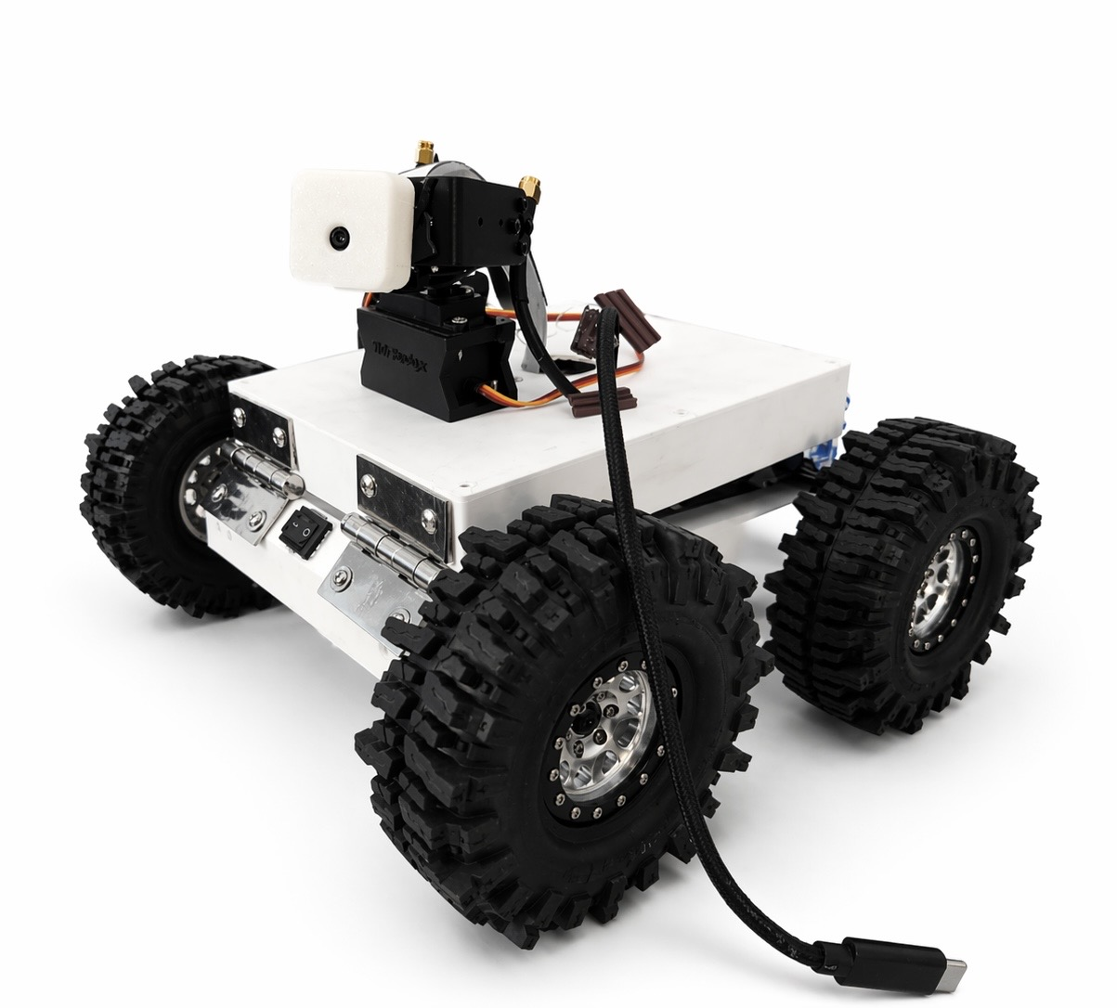
AI-Enabled Autonomous Safety
Monitoring Robot
TEAM
M113
Ali Alramadan, Abdullah Alqudaihi, Hazem Alqerafi, Jehad Alzowaid, Ali Arkobi
Coach: Dr. Majed Alzayer
Background
Specifications & Constraints
Discipline Contributions
Testing
Over 70% of industrial accidents are linked to human error; up to 40% of workers skip PPE requirements
Manual supervision is inconsistent, fatigue-prone, and unable to provide continuous coverage
Need for an automated, real-time safety monitoring system that works without human fatigue or coverage gaps
Physical Specifications & Constraints
ICS — AI & Software
YOLOv8 TensorRT model (18 PPE classes); Flask dashboard with live feed, alerts & analytics tab; system software architecture
COE — Embedded Systems
Raspberry Pi Pico firmware (C); HC-SR04 & VL53L0X obstacle sensing; MQ-7 CO detection; motor driver & I²C/UART comms
ME — Mechanical Design
3D-printed chassis; load & CG analysis; sensor mounting; mobility testing on inclines
ISE — Systems Engineering
Safety compliance workflow; alert prioritization logic; performance metrics; peak-load analysis (≥3 violations/min)
Max dimensions 45×40×35 cm
Max weight ≤12 kg
Chassis density ≤2.7 g/cm³
Load capacity ≥15 kg
Max speed 0.8 m/s
Incline capability ≥5°
Safety Specifications & Constraints
90.3%
PPE Precision
req ≥90%
86.1%
PPE Recall
req ≥85%
Human detection range ≥1.0 m
Collision avoidance ≥95% reliability
Reaction time ≤0.5 s
Min autonomous runtime ≥10 min/cycle
Problem Statement
Manual safety monitoring in industrial workshops fails to provide continuous, unbiased, real-time PPE compliance and hazard detection.
~45 FPS
Inference Speed
req ≥10 FPS
~26 ms
Alert Latency
req ≤2000 ms
AI Specifications & Constraints
PPE precision ≥90%
PPE recall ≥85%
AI inference speed ≥10 FPS
Alert latency ≤2 s, ≥1 Hz
Compliance loop success ≥90% per cycle
Remote model upload ≤150 MB, ≤3 min
Objective
Conclusion
Autonomously patrol indoor workshops and detect PPE violations in real time
Detect CO gas hazards using onboard sensors
Deliver alerts via a live wireless dashboard with ≤2 s latency
Operate fully onboard — no cloud dependency
Prototype
All primary specifications met or exceeded. The system delivers edge-AI PPE monitoring at 4.5× the required inference rate and alerts 77× faster than the 2-second threshold — demonstrating a viable, fully onboard industrial safety solution.

