Slide 1
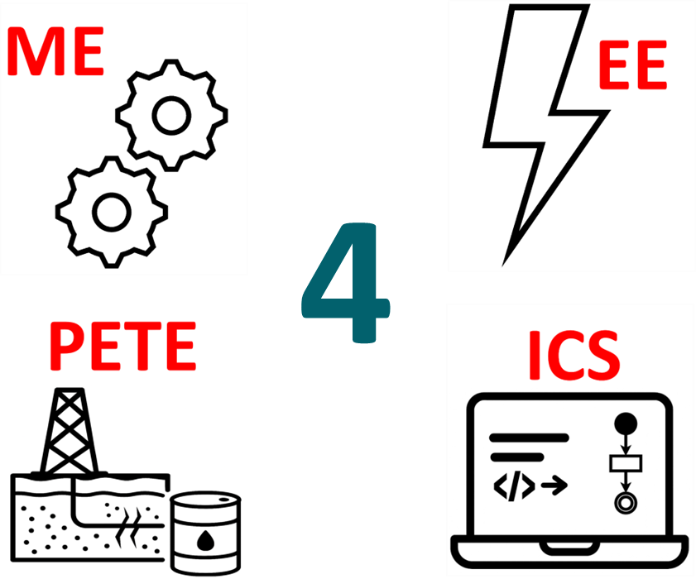
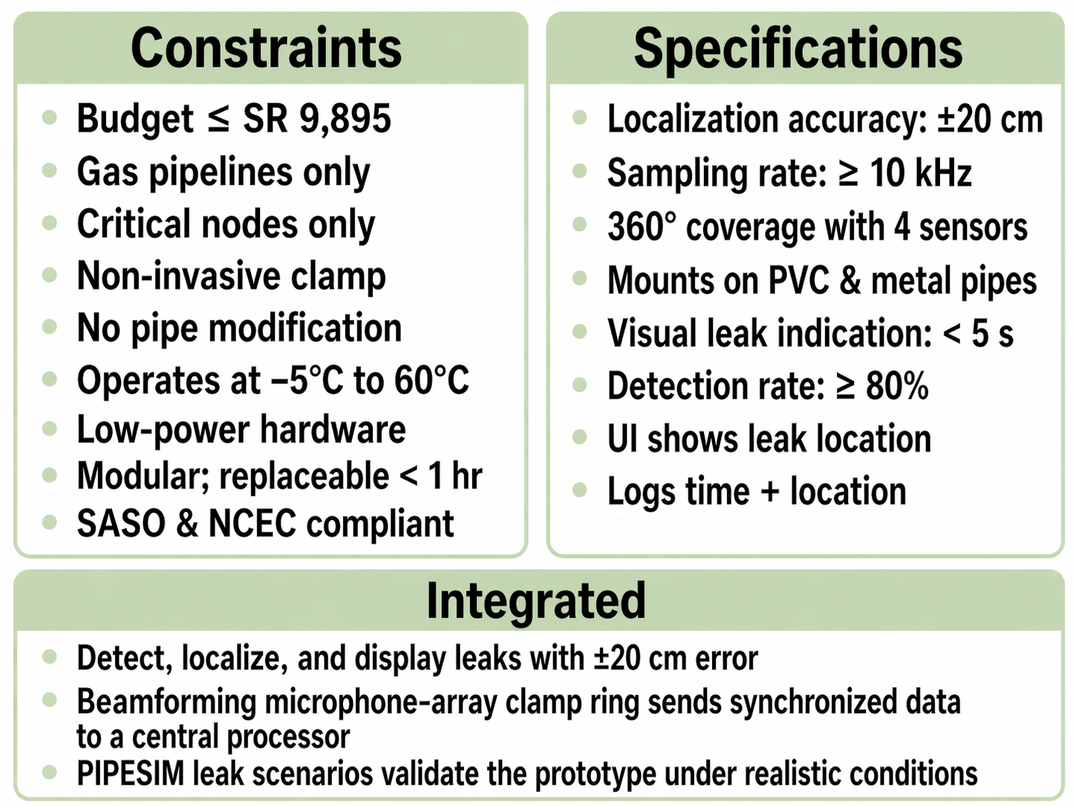
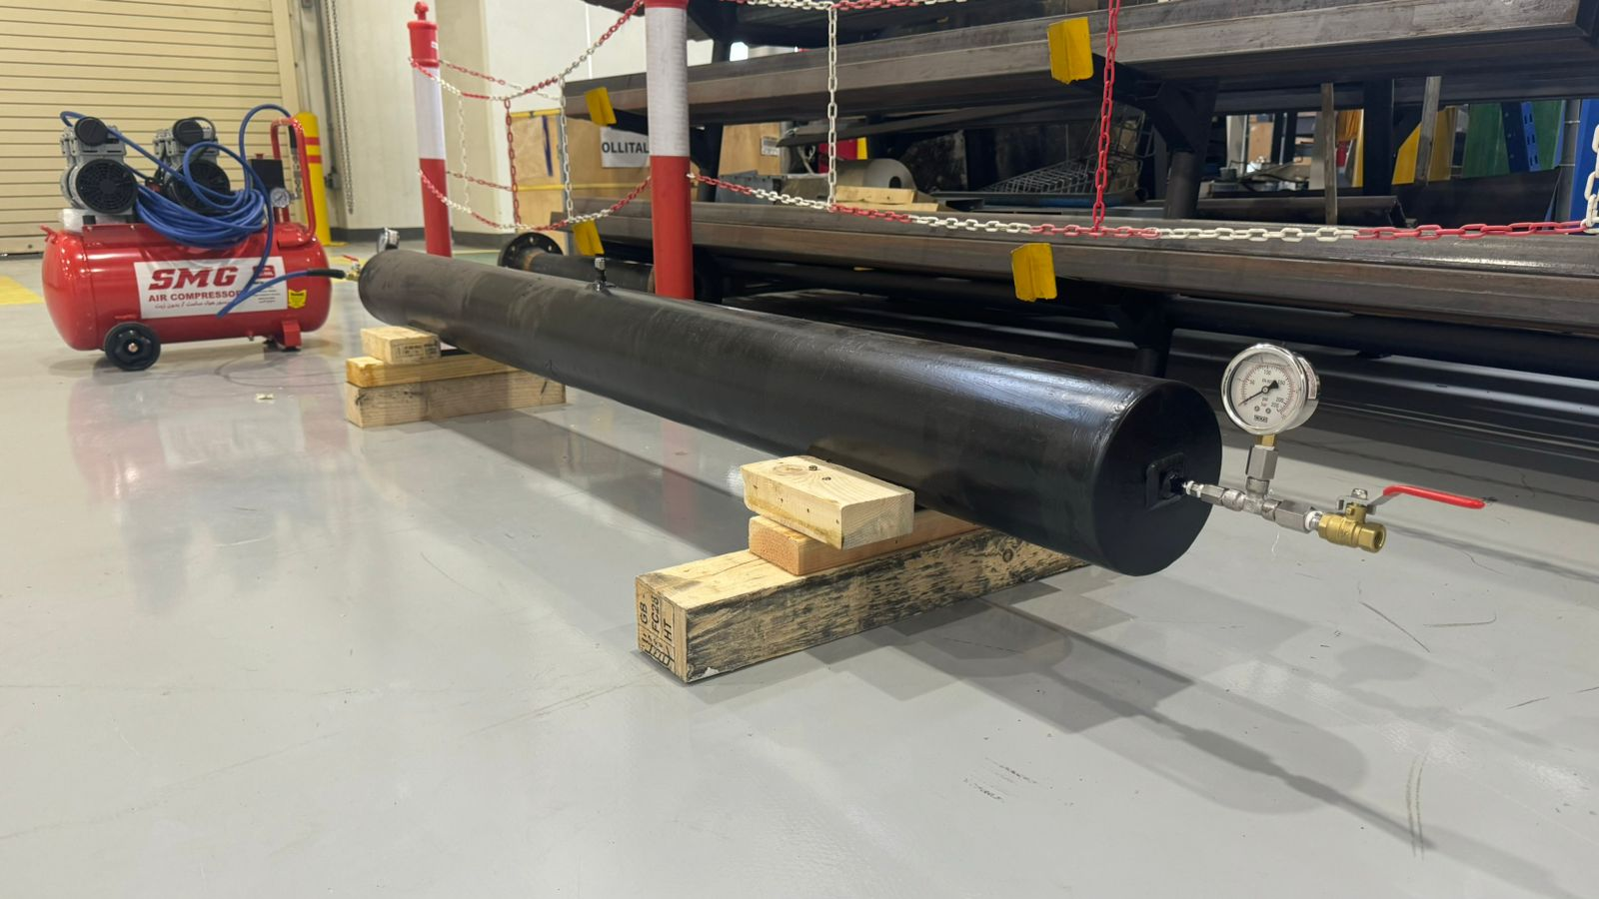
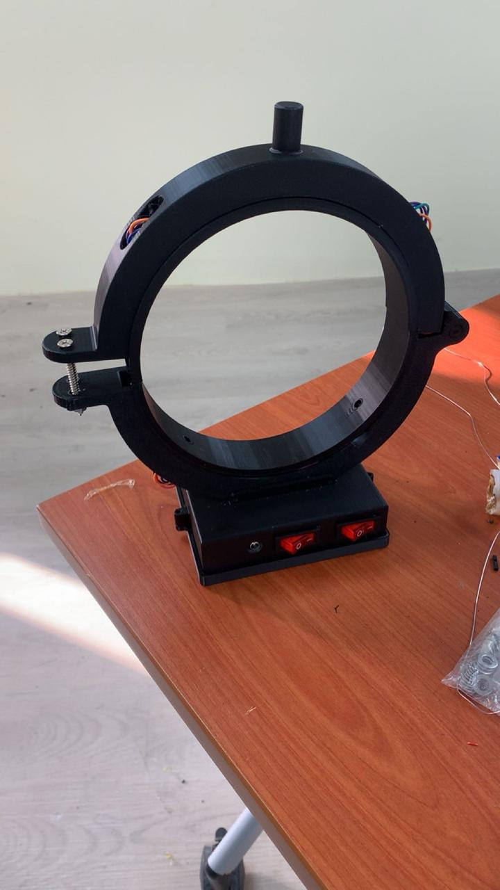
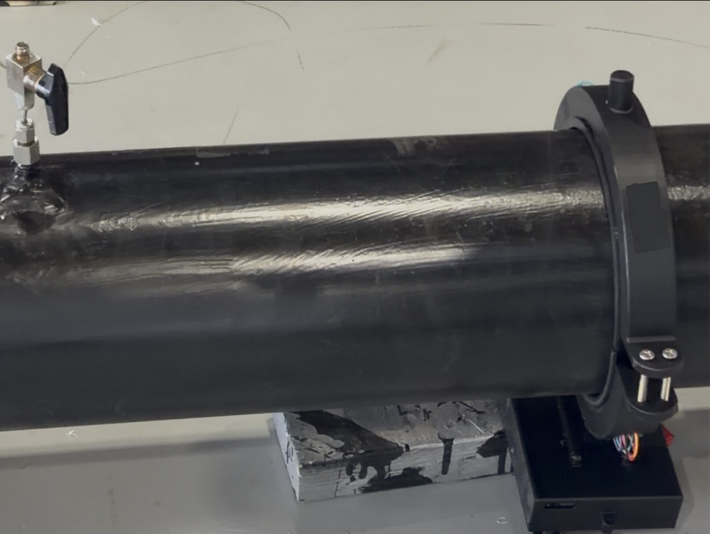

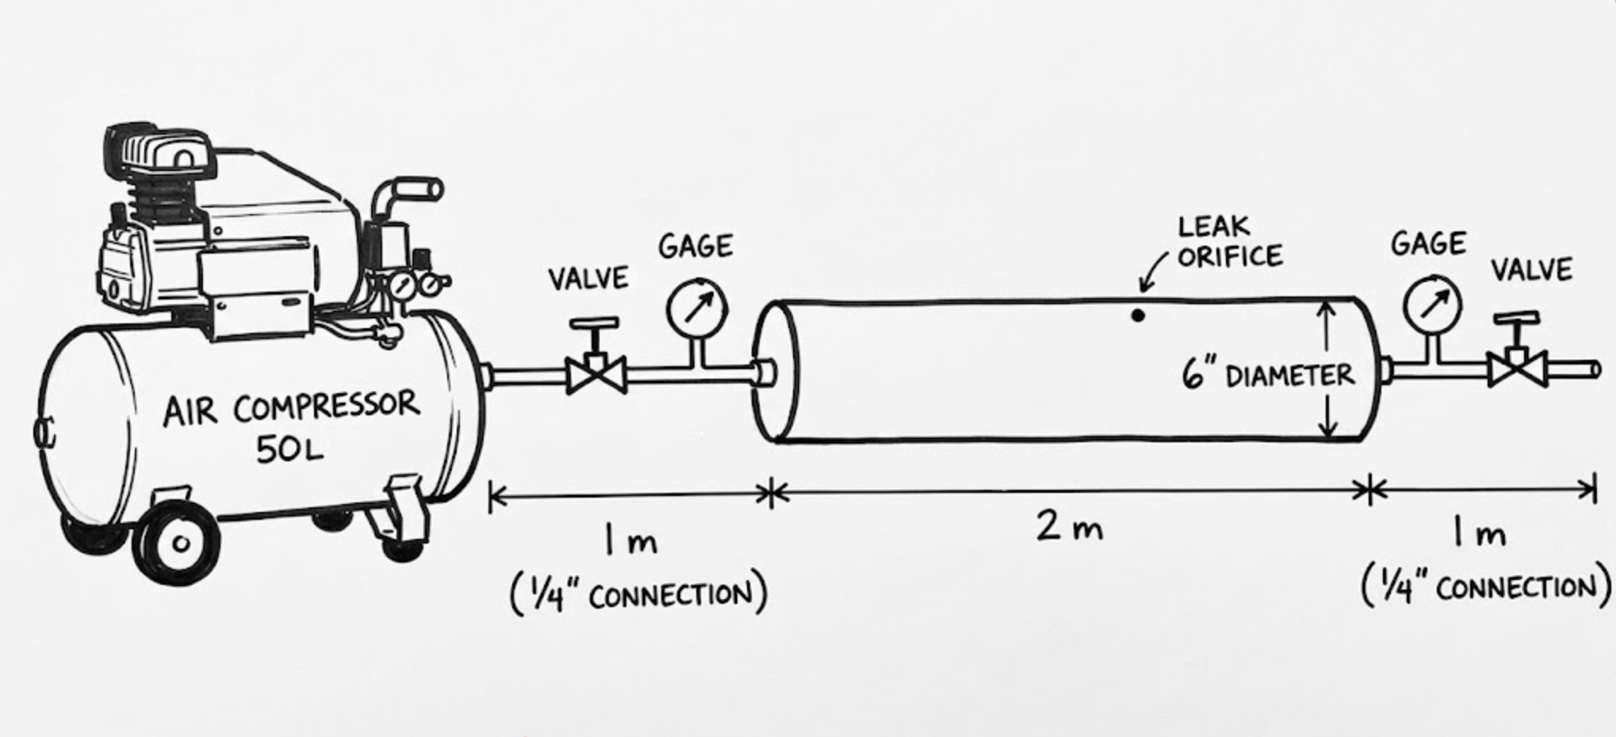
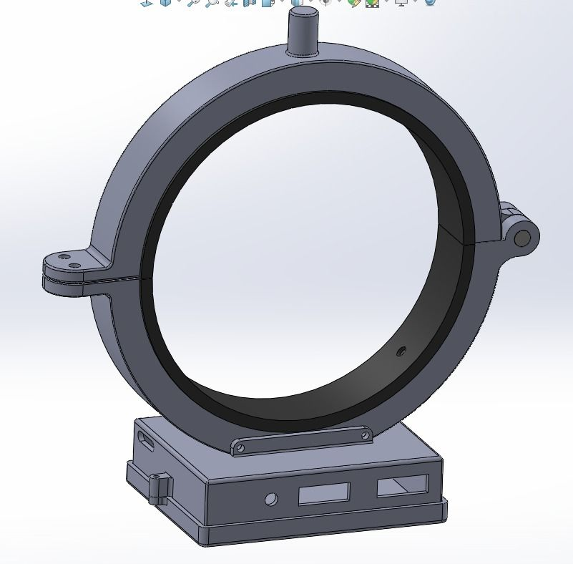
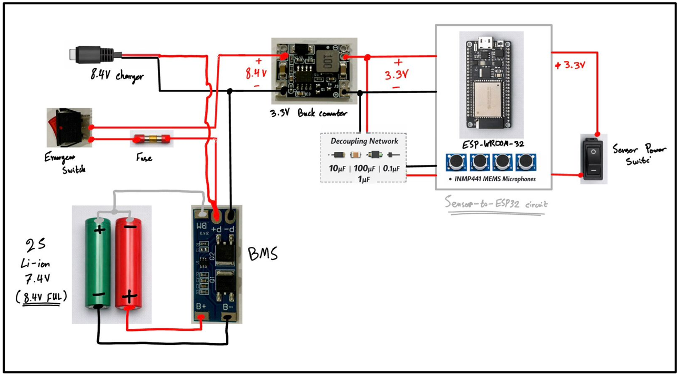
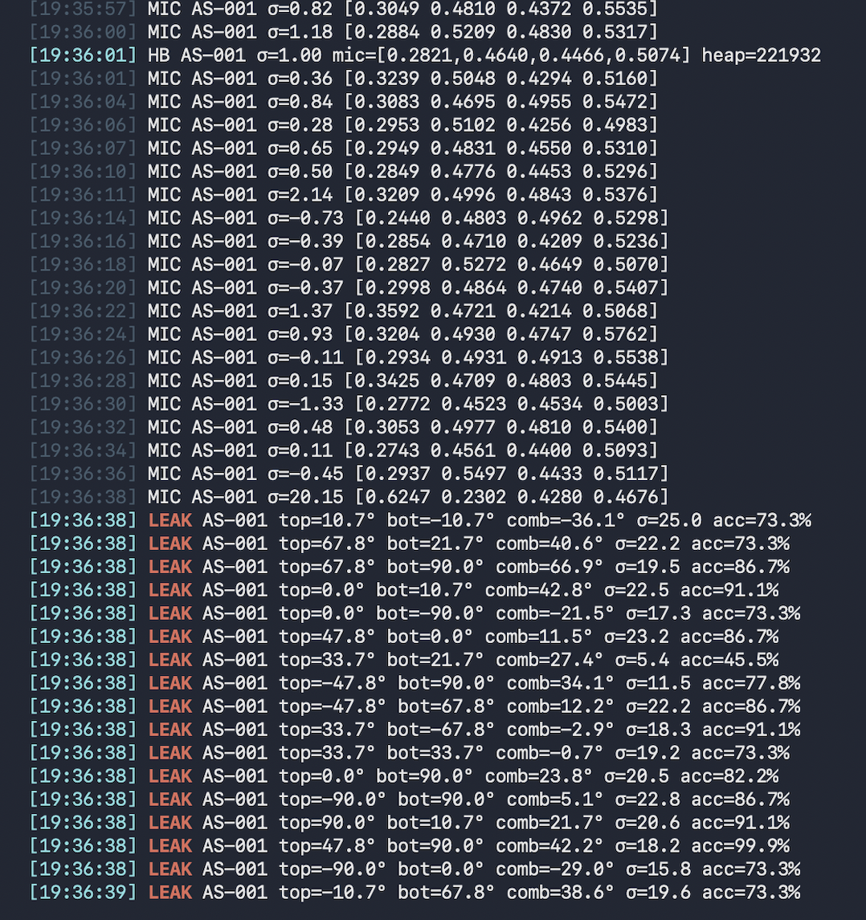
Acoustic Leak Detection in Pipelines Using Microphone Array and Signal Processing
TEAM
M110
Ibrahim Almousa, Yazeed Alghamdi, Ali Alaboud, Mohammed Alothman, Ali Al Khalaf, Khayal Khushaim
Coach: Dr. Hamzah Luqman
Introduction
Testing & Validation
Problem statement
Conventional pipeline leak detection methods are often too slow, intrusive, or insufficiently sensitive to identify small gas leaks early at critical pipeline nodes, increasing safety, environmental, and economic risk.
Objective of Project
Design and validate a low-cost, non-invasive acoustic monitoring system that detects, localizes, and displays gas pipeline leaks in real time under representative operating conditions.
Prototype Design
Conclusion
A non-invasive acoustic monitoring system was developed for gas pipelines, delivering real-time leak detection, fast alert visualization, and accurate localization within a modular, field-practical design. The full prototype was built and validated for SR 2,832 — the majority of which went toward constructing a realistic field-condition test rig using a 2-meter carbon steel pipe, pressure gauges, valves, and an air compressor. The core detection hardware itself remains low-cost and scalable for real deployment.

