Slide 1
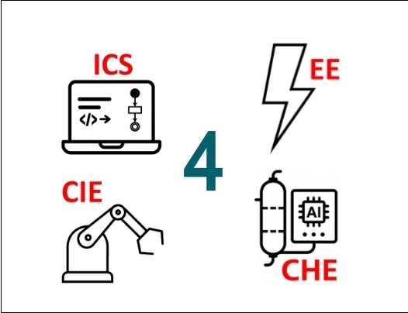
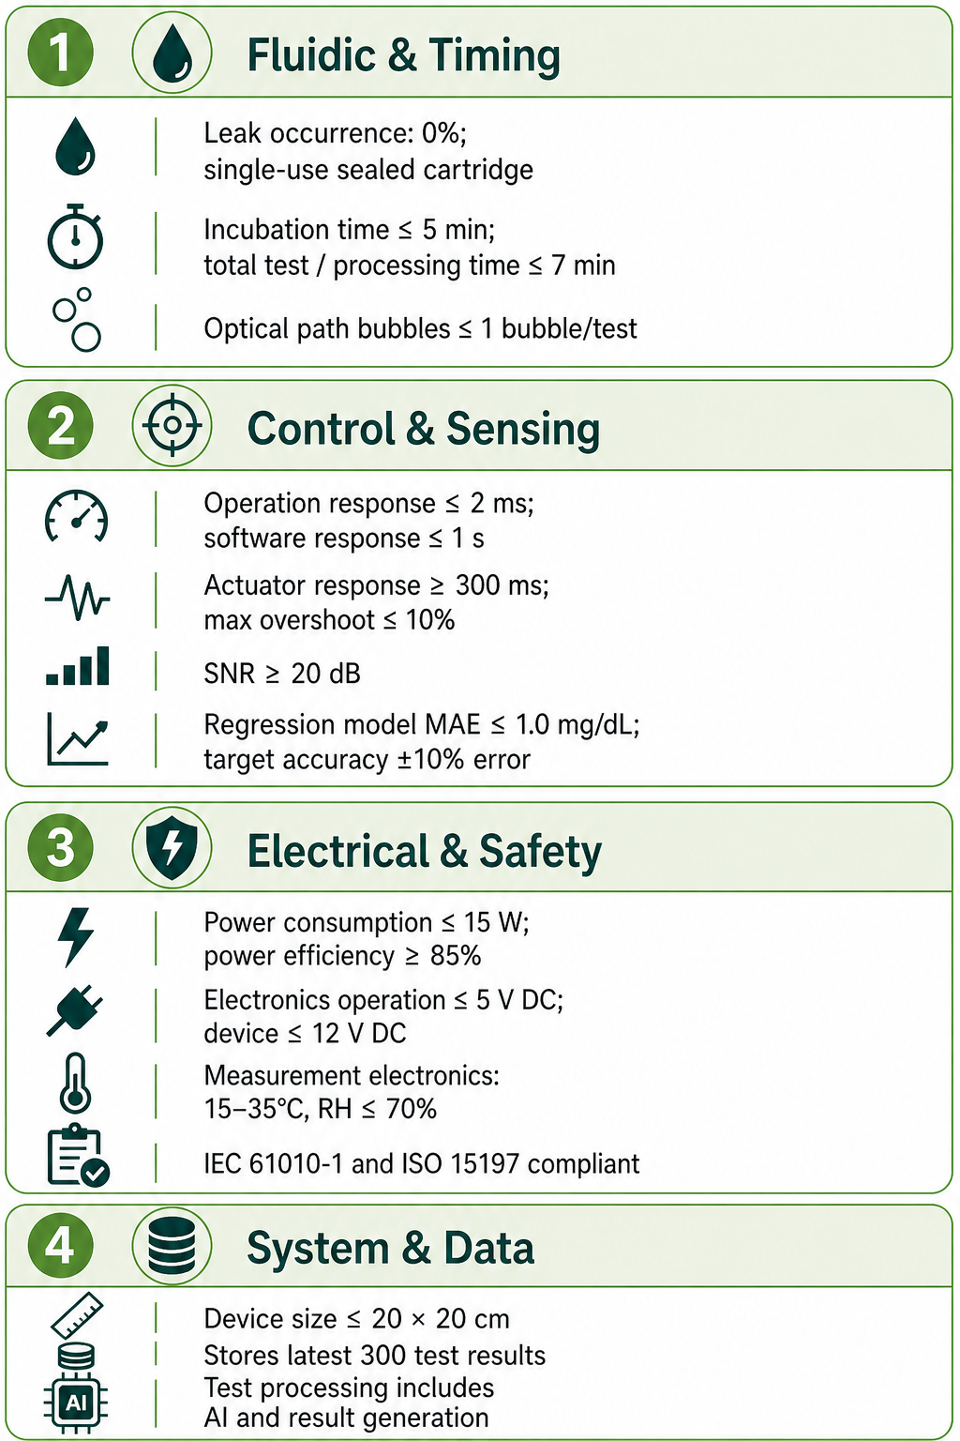
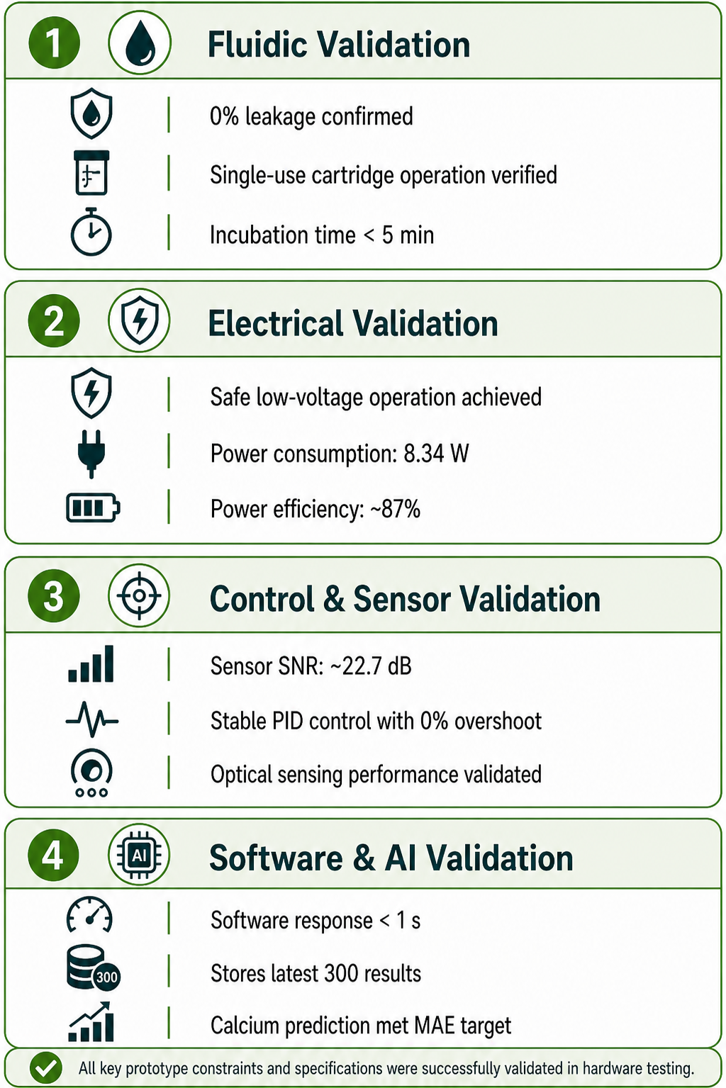
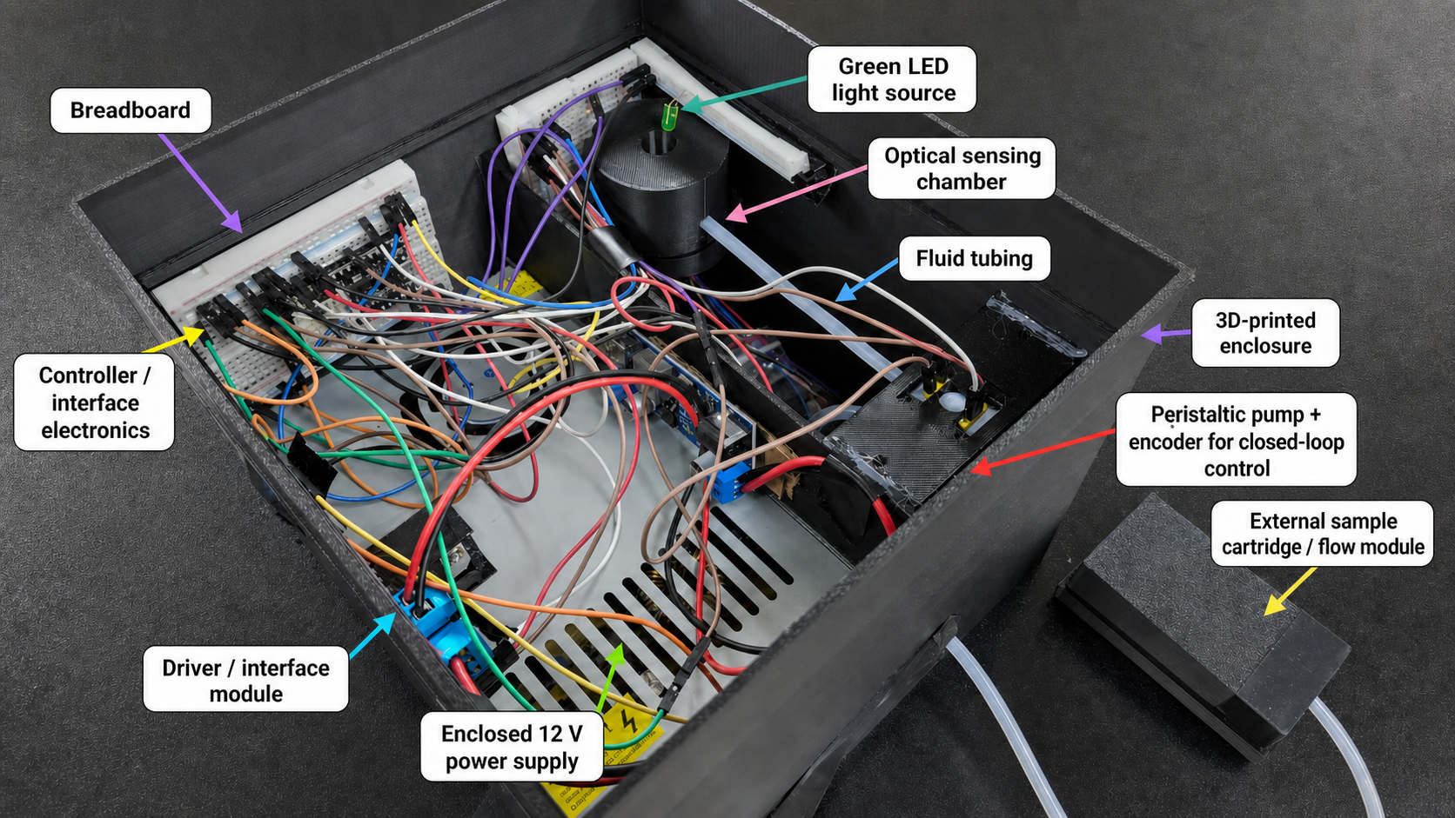
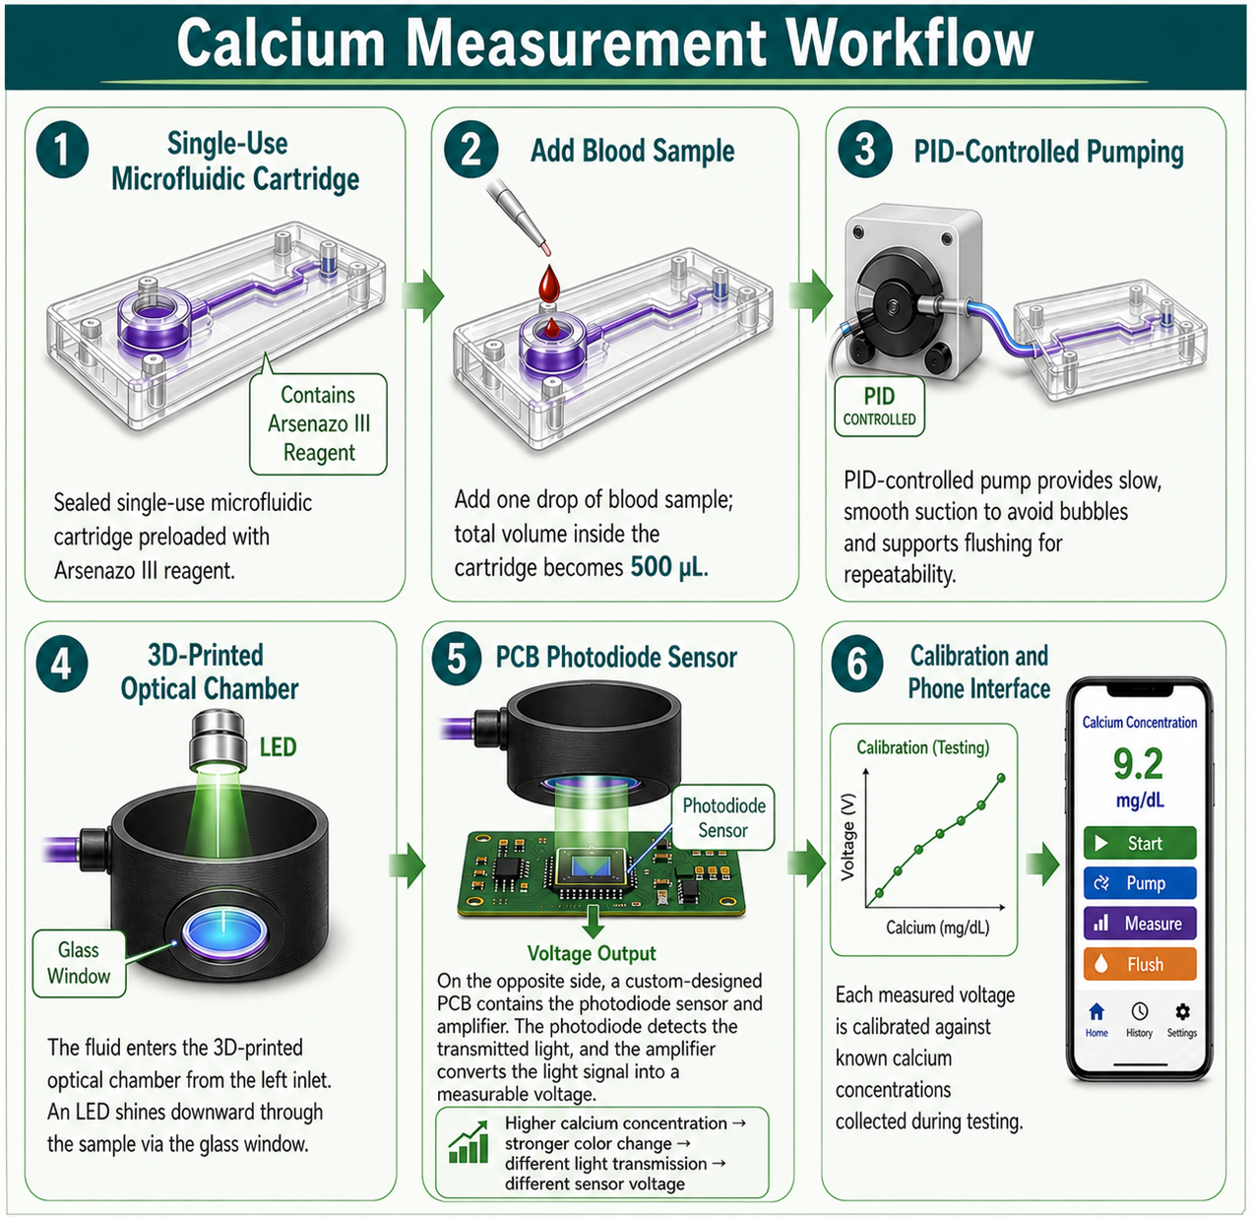
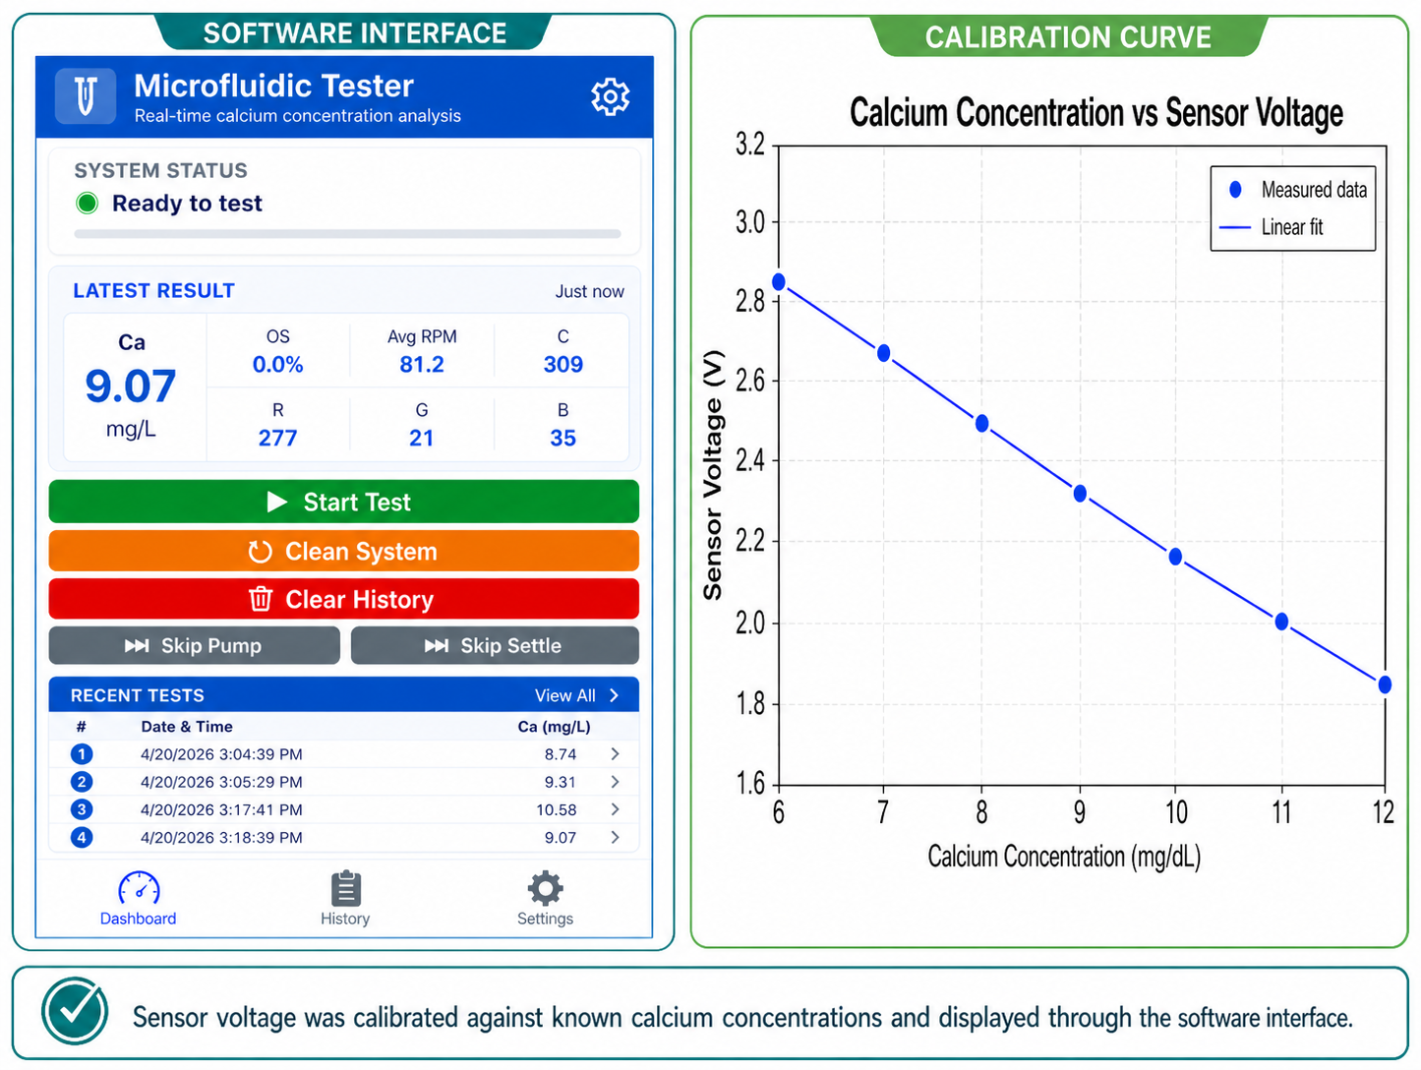

AI-Integrated Microfluidic Device for At-Home Calcium Testing.
TEAM
M108
Nawaf Alosaimi-EE, Kalad Aloqiel-CHE, Naif Alharbi-CHE, Abdulkarim Alabdulghani-CIE, Hasan Alharbi-ICS, Turkey Alanazi-ICS
Coach: Dr. Tanzil UrRahman
Problem Statement
Constraints & Specs
Validation & Verification
Prototype & Process
Patients requiring frequent blood calcium monitoring, such as post-thyroidectomy and endocrine patients, currently rely on time-consuming hospital visits. There is a critical need for a portable, accurate, and rapid at-home diagnostic solution that reduces dependency on traditional clinical laboratories.
Innovation / Novelty
This project introduces a portable calcium sensing device integrating:
Single-use sealed microfluidic cartridge with Arsenazo III reagent
Controlled bubble-reduced sample flow
LED-photodiode optical custom designed voltage sensor
AI regression for calcium concentration estimation
Rapid local results through a user-friendly interface
This enables rapid calcium measurement from a small blood sample without relying on large clinical analyzers.
Interface & Calibration
Future Work
Improve calibration with larger datasets
Enhance cartridge manufacturability
Increase measurement accuracy and repeatability
Expand clinical and usability validation
These improvements will enhance the device’s accuracy, reliability, and readiness for practical healthcare applications.

