Slide 1
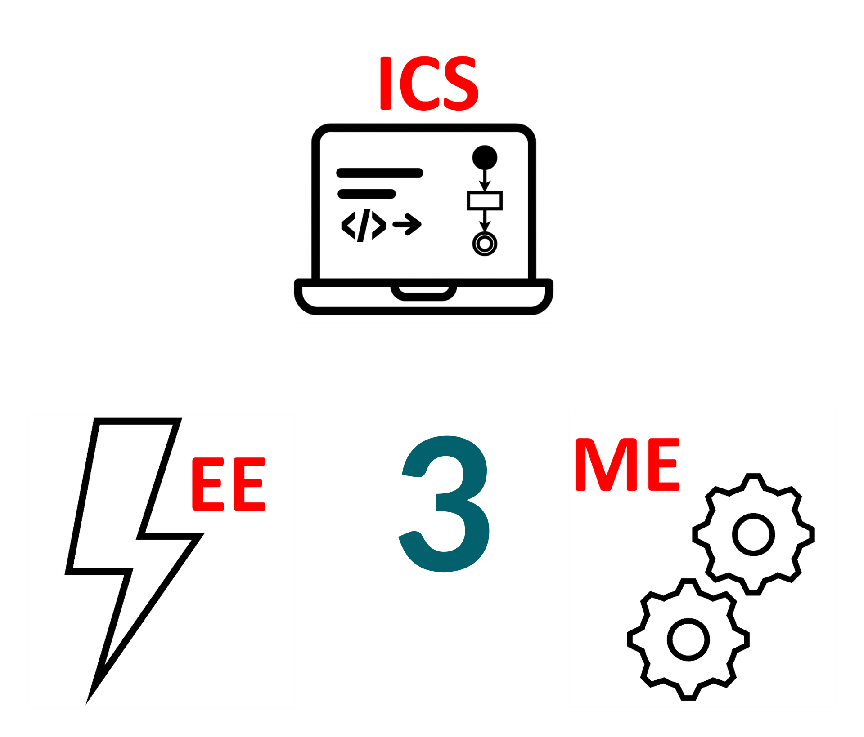
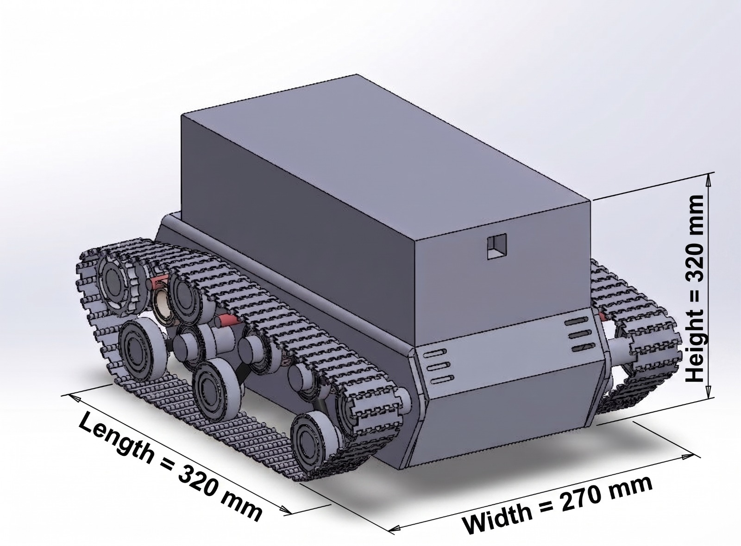
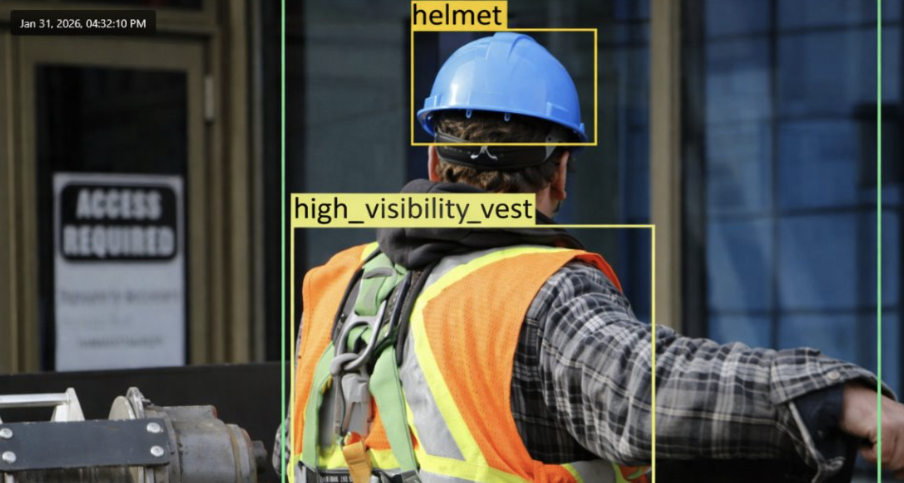
SiteSafe Vision: Real-Time Edge-AI Safety
TEAM
M107
Abdulmajeed Almalki, Abdullah Almalki, Faisal Alshahrani, Saud Bawazir, Osama Hakami
Coach: Dr. Ali Elkhazraji
Background
Constraints
Concept Design
Detection Output
Construction sites are high-risk environments where PPE non-compliance causes accidents
Traditional supervision is manual, inconsistent, and lacks real-time coverage
Edge-AI enables continuous automated monitoring without cloud dependency
Cost < 6,000
IP65 rating
Everything runs locally
No deformation
Height < 60cm
Battery >= 60min
Power <= 280 W
Power efficiency >= 70%
Testing / Validation
Problem Statement
Specifications
Electrical Contribution
Detection Accuracy: 83.9% mAP (≥ 80% required)
Processing Speed: 10 FPS (≥ 5 FPS required)
Alert Latency: <1 second via WebSocket (≤ 5s required)
False Alarm Rate: ~8.4%/day with cooldown (≤ 10% required)
Power Consumption <= 60W
Battery >= 20 hours
Power efficiency >= 90%
Suspension vibration ≤ 2.6 mm
Manual monitoring is inconsistent, while cloud solutions suffer from latency and downtime. For reliable construction safety, a real-time, local PPE detection system is essential.
Accuracy >= 80%
2+ days alert log
Designed a protected 12 V power distribution system with fuse isolation and a main switch, ensured stable voltage under full-load conditions, and led full prototype assembly with system-level testing.
Limit vibration <= 3 mm
Latency <= 5s
Real-time status
AI Process >= 5 FPS
Objective
Mechanical Contribution
ICS Contribution
Develop a local edge-AI system to detect PPE violations in real time
Generate instant alerts and log incidents without cloud connectivity
Stay within budget using off-the-shelf embedded hardware
Designed a tracked chassis for uneven terrain, with a multi-layer structure for organized components and added suspension to reduce vibration and improve stability.
Trained a YOLOv8n model on 13,140 images achieving 83.9% mAP, deployed with NCNN on Raspberry Pi 5 at ~10 FPS, with a FastAPI backend streaming live video to a React dashboard, real-time WebSocket alerts (<1 s), and SQLite logging with timestamps.
Conclusion
Fully functional edge-AI PPE monitoring prototype developed
All constraints and specifications met or exceeded
Real-time detection, instant alerts, fully local operation

