Slide 1




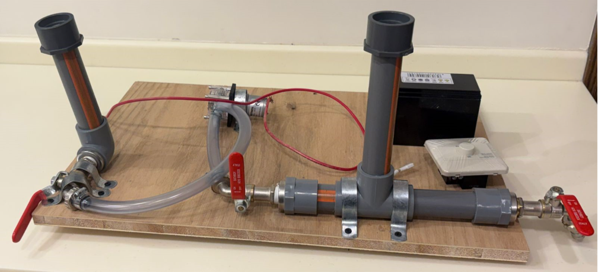
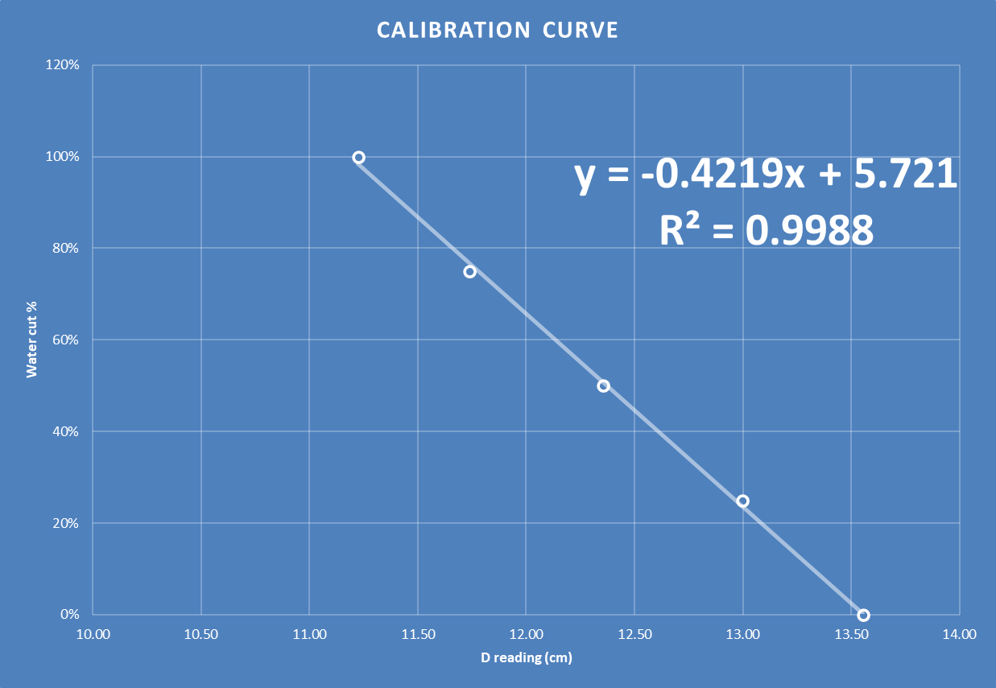
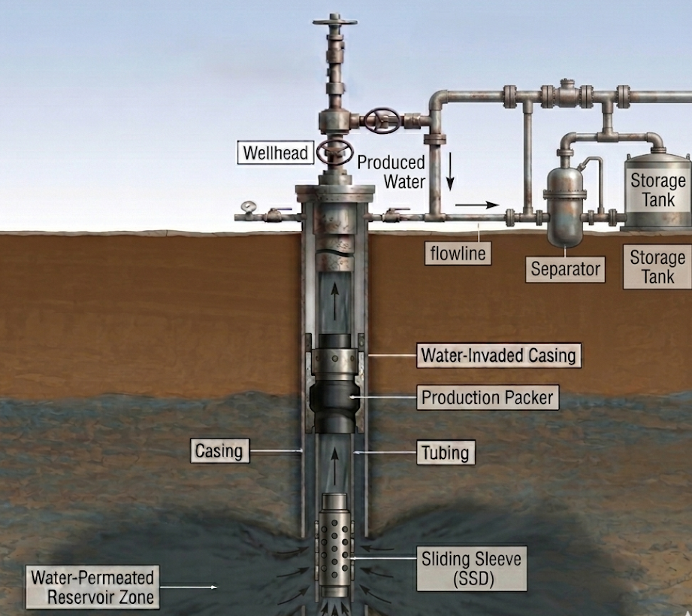
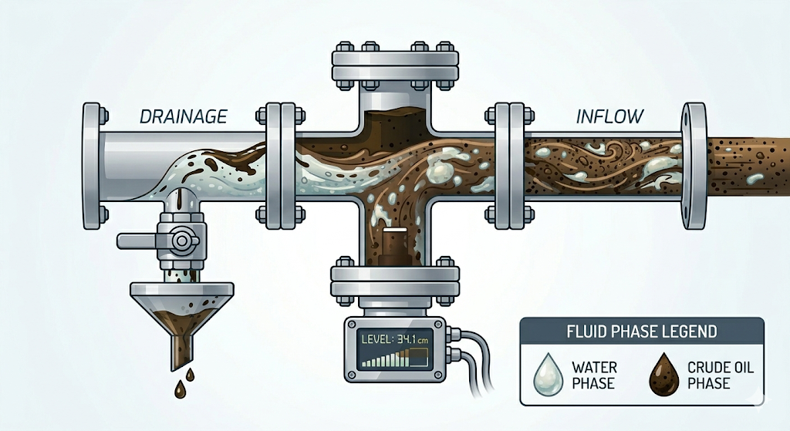
Reducing water cut in smart wells via ultrasonic sensors and flow control equipment
TEAM
M106
5
Mohammed Sahwan, Hadi Alsalem, Hassan Alshaer , Mohammed AlShareef, Abdulrahman Abdalla
Coach: Dr. Ayman Al-Lehyani
Introduction
Constraints
Prototype Design
Test & Validation
Problem: Traditional water cut monitoring relies on surface measurements.
Solution: Installing an ultrasonic sensor in the downhole completion of the well to detect water encroachment
Pressure Safety: 1450 psi
Operating Temperature: 0 to 120°C
Hardware Efficiency: ≤ 16GB RAM
Fluid Density: ≥ 0.1 g/cm³ difference.
Power Consumption: Total ≤ 10W.
Processing Speed: latency ≤ 500 ms.
Measurement Cell (Pipes)
Ultrasonic Sensor
5 emulsion samples using crude oil with 28 API and synthetic formation water with a density of 1.13 g/cc
Arduino control unit (Mega 2560)
Specifications
Velocity of sound in saline water = 1750 m/s
A constant volume of fluid was added, and measurements were taken from the sensors
Variation in the reading in oil sample is used (empirical correlation)
Emulsion: Handles ≤ 90% emulsified volume.
Signal Quality: SNR ≥ 30 dB.
Electronics Power: Sensors < 3W.
Data Integrity: 99% logging success.
UI Latency: Dashboard updates < 1.0s.
Response Time: Valve trigger ≤ 2s.
Model Logic: F1-Score ≥ 0.85.
Actuation: Valve closure ≤ 5s.
Conclusion
The prototype accomplished the main goal of phase detection. Although future improvements are required to optimize precision, this technology provides a highly practical solution for the oilfield.
Delayed Detection = Lost Production

