Slide 1

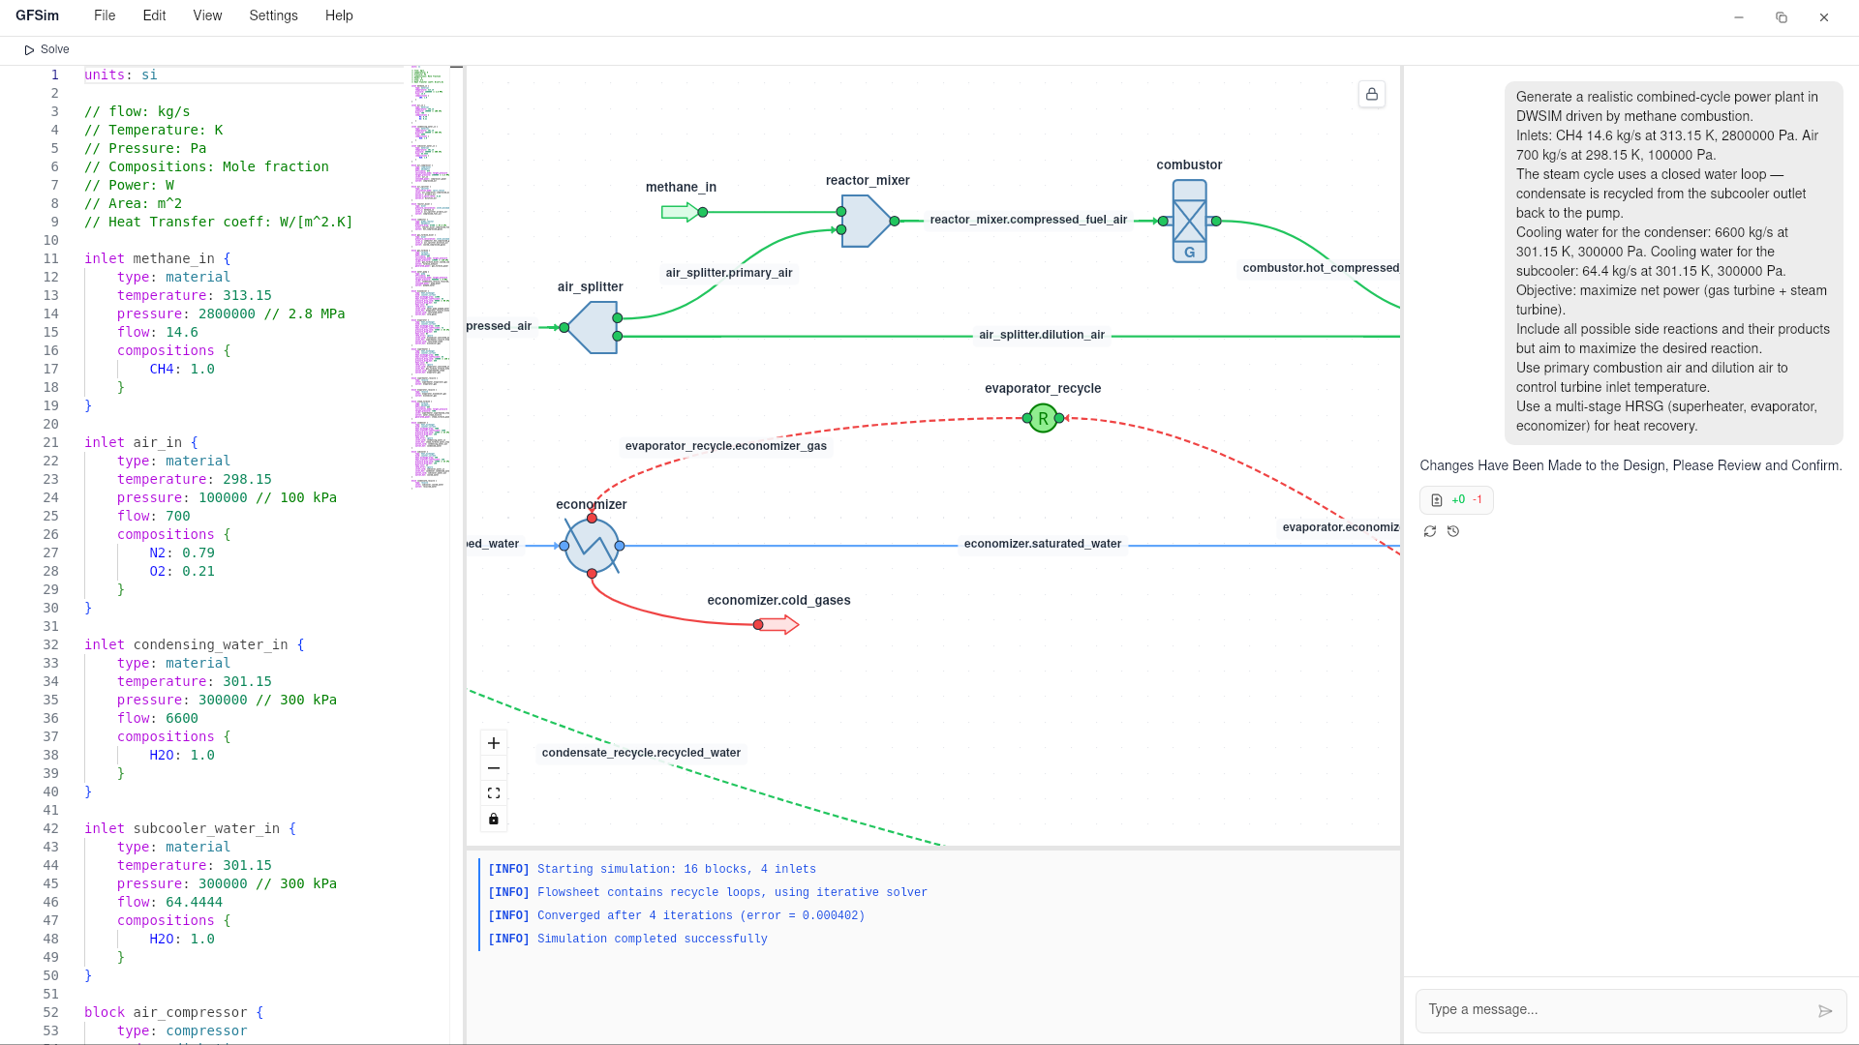
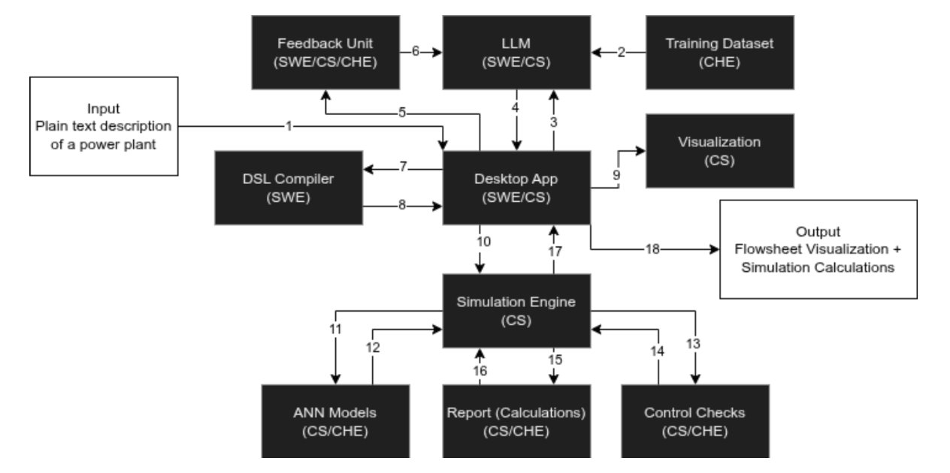
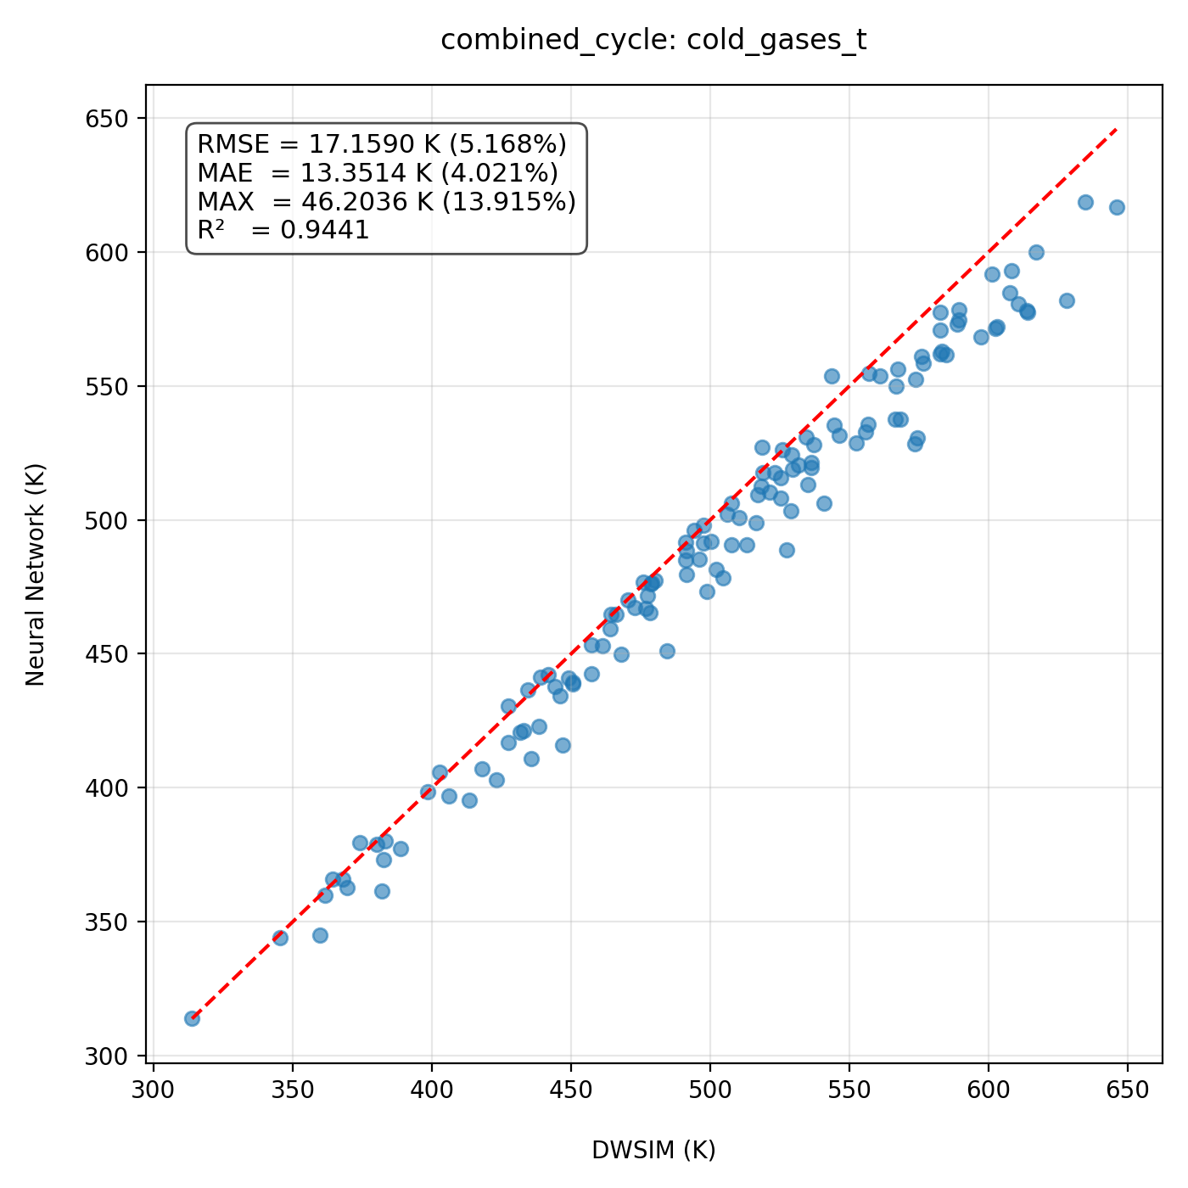
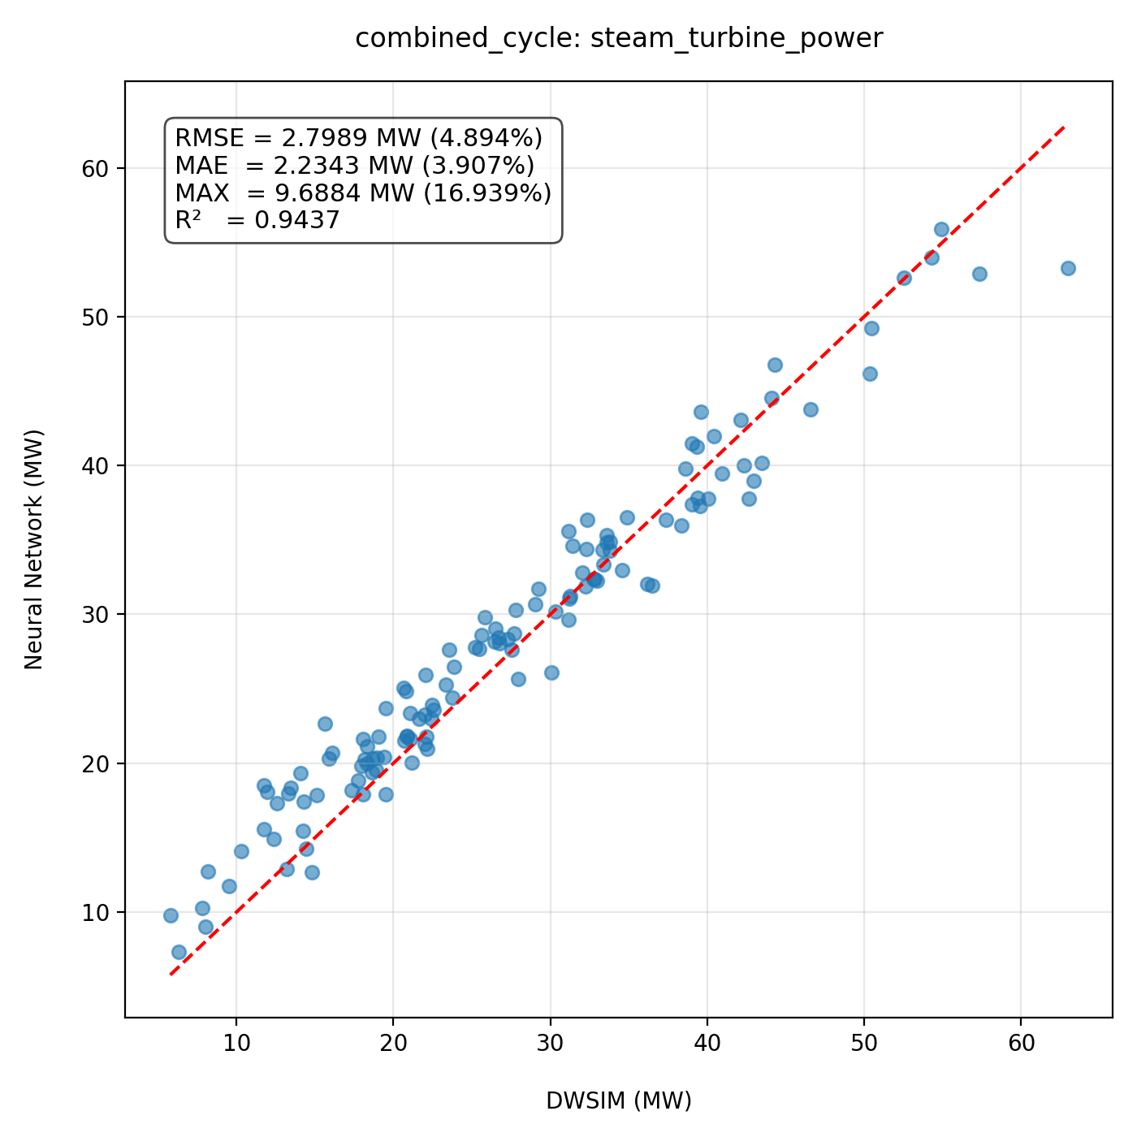
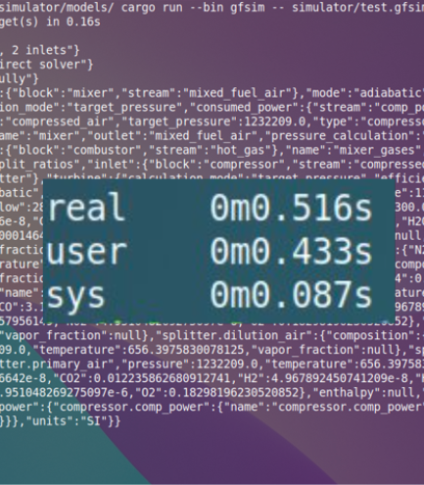
LLM Assisted, Data-Driven Power Generation Simulator
TEAM
M103
Hadi Alqattan, Ammar Alyousif, Elias Almumatin, Reda Al Sulais, Mohammed Abusaleh
Coach: Dr. Majed Alzayer
Background
Final Prototype
Concept Design
Process simulation is essential in chemical engineering, yet current tools require extensive manual flowsheet design, making modeling slow. Additionally, iterative thermodynamic solvers are computationally intensive, resulting in long runtimes that constrain analysis and automation.
Objective
Develop an LLM-assisted power generation simulator that reduces manual effort by translating high-level natural language description into structured flowsheets. It also improves performance by replacing iterative thermodynamic calculations with surrogate regression models.
Constraints
C1: Accuracy limited by sim software.
C2: Runs on average company laptop.
C3: Windows compatible.
C4: Supports sufficient operation units.
C5: Cost ≤ SR 2,500.
C6: Supports SI & Imperial units.
Specifications
Testing and Validation
Conclusion
S1: Power plant modeling ≤ 2h
S2: ≤ 2 major modeling errors
S3: Generated DSL has 0 syntax errors
S4: Outlet temp & power error < 5%
S5: Pressure & mass flow accu. ≥ 99%
S6: Rendering time < 500 ms
S7: Simulation convergence ≤ 5 s
S8: 7 chemicals in database
S9: Supports 6 operation units
S10: Detect ≥ 3 critical safety violations
Simulation
convergence time
The results shows that combining LLM-based flowsheet generation with surrogate regression models can reduce manual effort and computational cost, leading to faster and more efficient process simulation.

