Slide 1
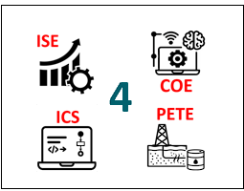
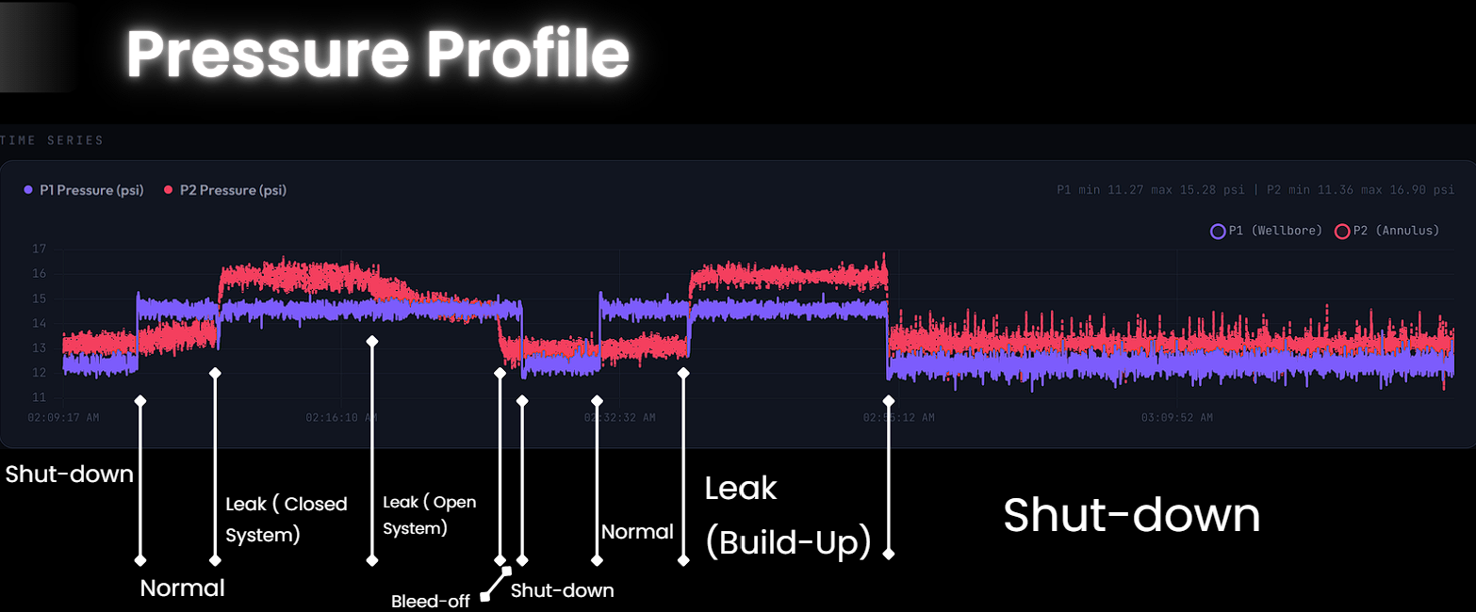
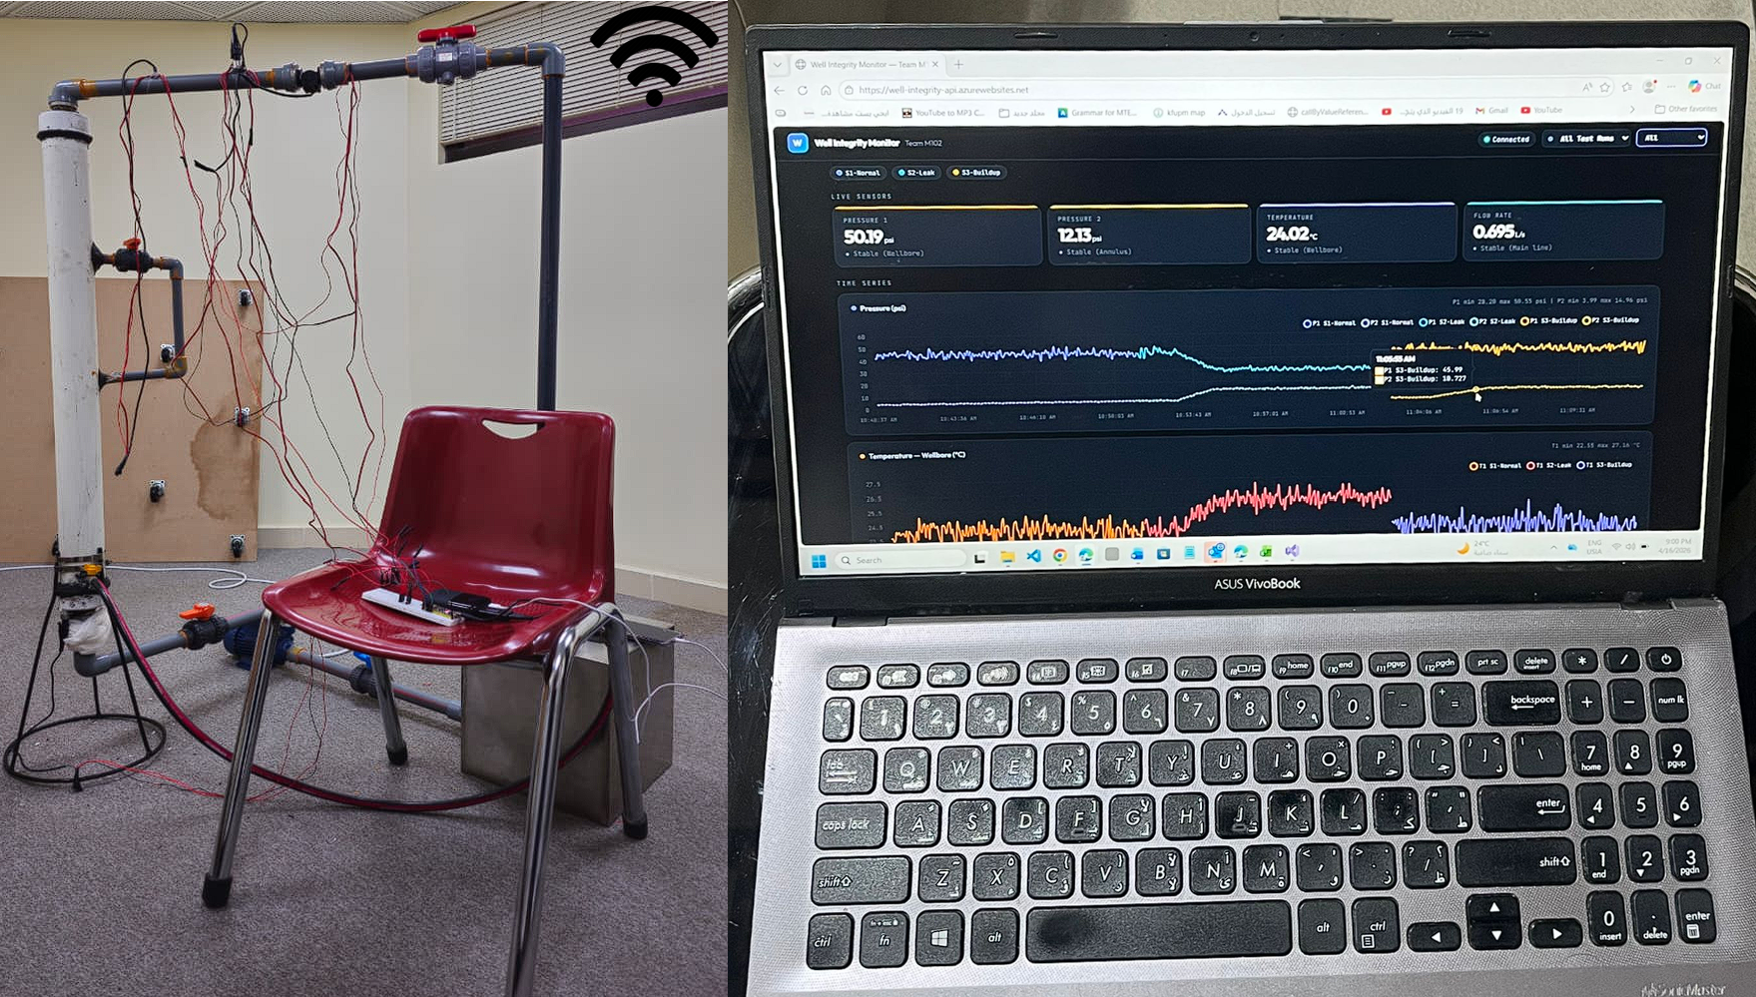
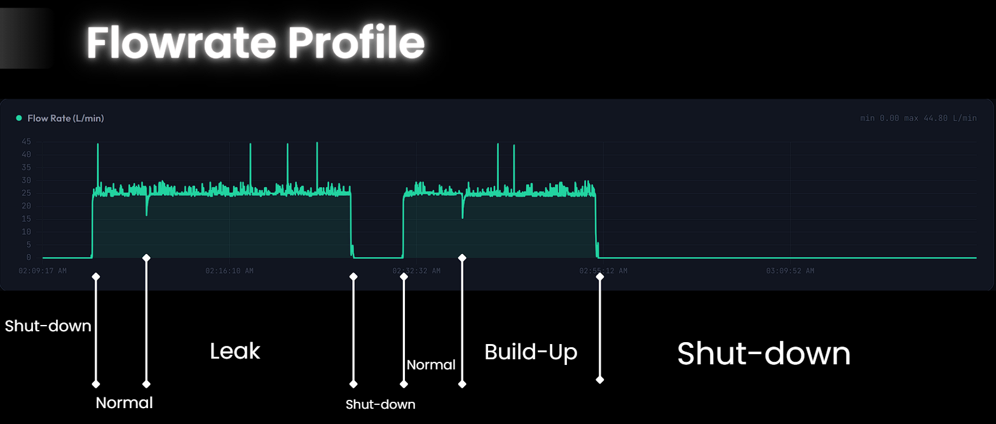
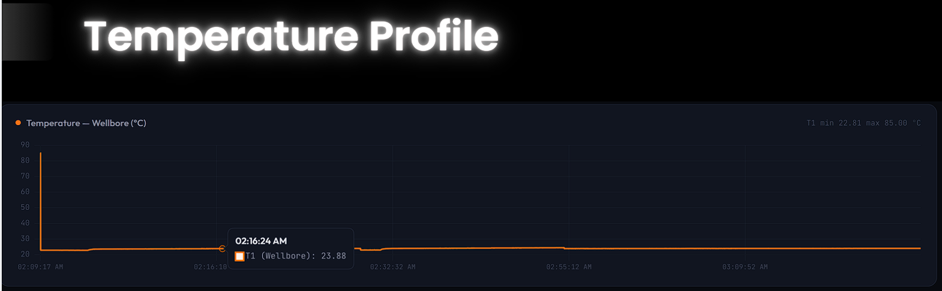
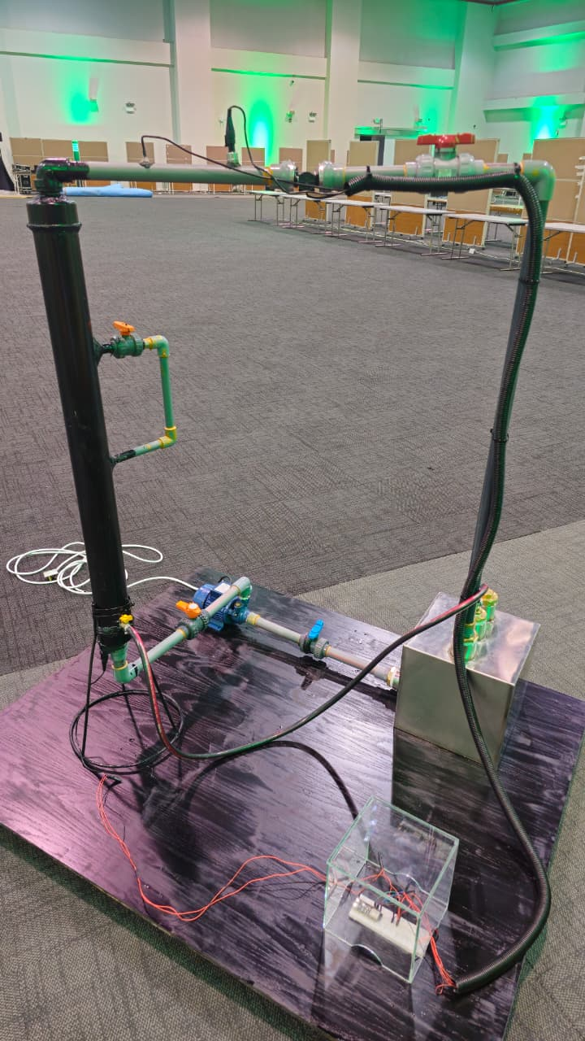
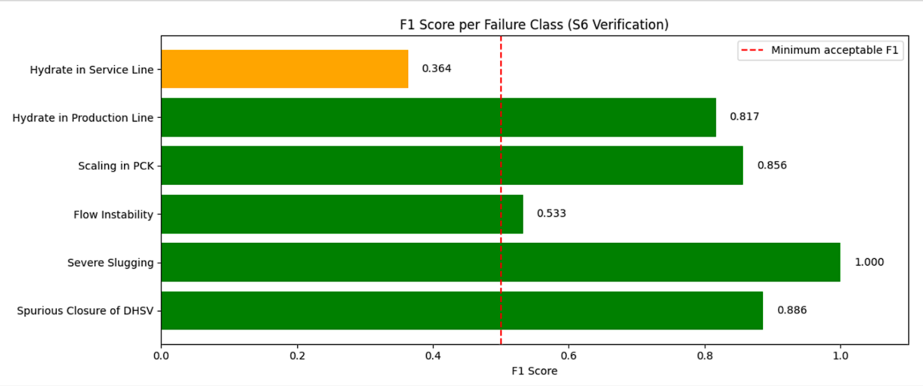
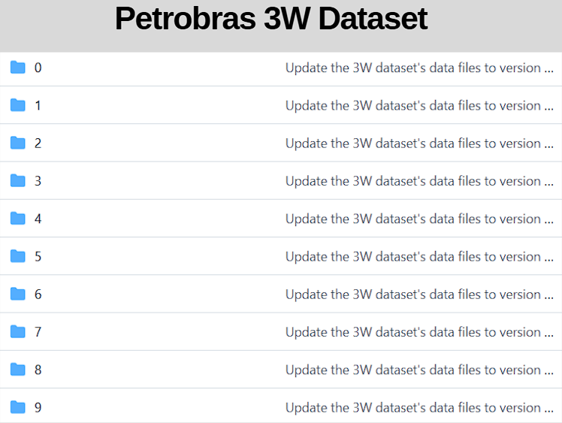
IoT-Based Well Integrity Monitoring System
with AI-Powered Predictive Analytics
TEAM
M102
Mohammed Alghirash, Hassan Albasher, Mohammed Alelaiw, Mohammed Aljubaili, Abdullah Alharbi
Coach: Majed Al Zayer
Overview
Prototype
Testing & Validation
Current well integrity monitoring is mostly periodic, allowing leaks and barrier failures to go undetected for long periods. This increases the risk of production loss, safety incidents, and environmental damage.
This project addresses this gap by enabling continuous, real-time monitoring of pressure, temperature, and flowrate with automated alarms for early detection of abnormal behavior.
Concentric Well Model (1 / 3 in)
Tubing–annulus pressure behavior (≤ 50 psi)
Leak Simulation
Adjustable valve for controlled communication
Dashboard Visualization
Live pressure, temperature, and flow monitoring
Sensors
Pressure (±1 psi), Temp (±1°C), Flow (±0.1 L/s)
Cloud Integration (API + Database)
Reliable data transmission (≤ 1% loss)
Analytics & Validation
Threshold-based detection + statistical verification
Constraints & Specifications
Constraint | Value
Max Operating Pressure | ≤ 50 psi
Total Cost | ≤ 11,000 SAR
Sampling Rate (ESP32) | ≥ 1 Hz
Power Consumption | ≤ 500 mA @ 5V
AI Requirement | Real / Synthetic Dataset
Validation | ≥ 20 Trials @ 95% Confidence
Deployment | Cloud-Based System
Specification | Target Value
Leak Detection Trigger | ΔP ≥ 5 psi within 60 s
Measurement Accuracy | ±1.0 psi, ±1 °C
Sampling Rate | ≥ 1 Hz
Data Integrity | Data loss ≤ 1%
System Stability | Interruptions ≤ 30 s
Alarm Response Time | ≤ 3 s
Statistical Confidence | 95% Confidence (ME ≤ 1 psi)
AI Capability | ≥ 3 failure scenarios
Scenario Flexibility | 3 Scenarios supported
❖ Physical Prototype
❖ Software System
The LSTM AI model has been trained on normal operations well conditions from petrobras 3W dataset and succeeded in detecting +3 different well failures.
Control System
Real-time data ESP32-based acquisition (≥ 1 Hz)
Leak conditions produce pressure redistribution (annulus pressure increase and tubing pressure decrease) along with flow reduction, validating the detection approach.
AI Predictive (Proof of Concept)
Standalone model trained on real-world well data to capture multi-scenario failure patterns and extend system capability toward predictive analytics.
Conclusion
Early leak detection through continuous real-time monitoring
Enhanced safety and reduced production losses via timely fault identification
Cost-effective and scalable testbed for validating well integrity monitoring systems
Strong foundation for future predictive analytics and advanced monitoring applications

