Slide 1
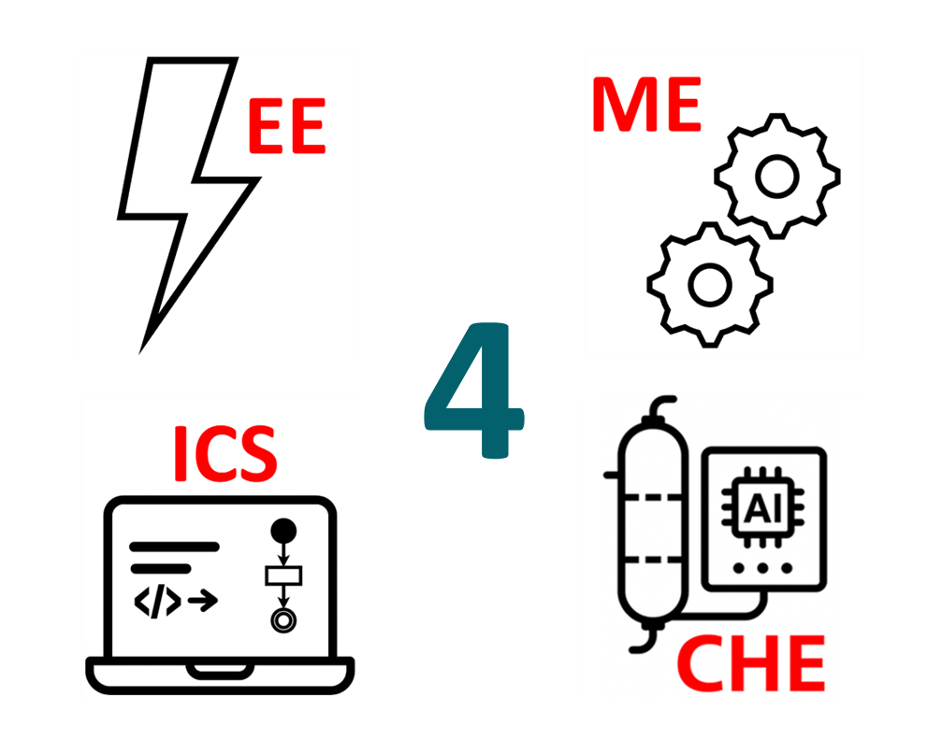
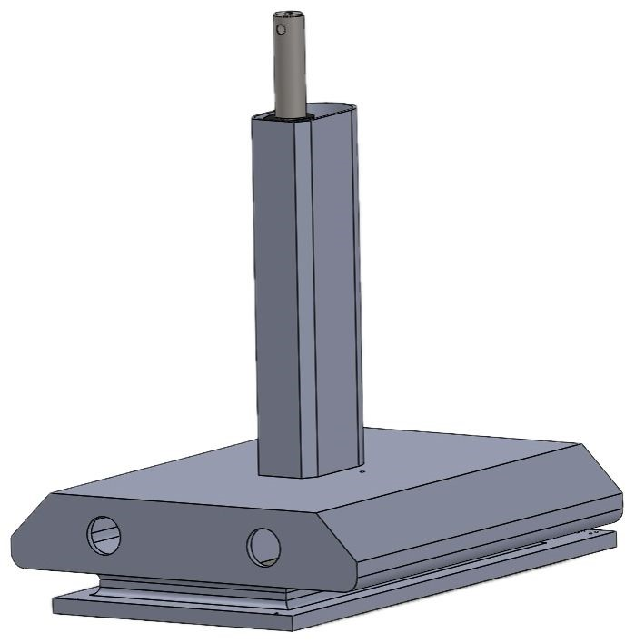
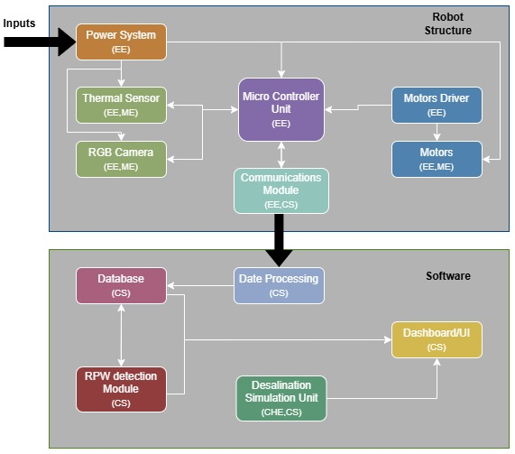
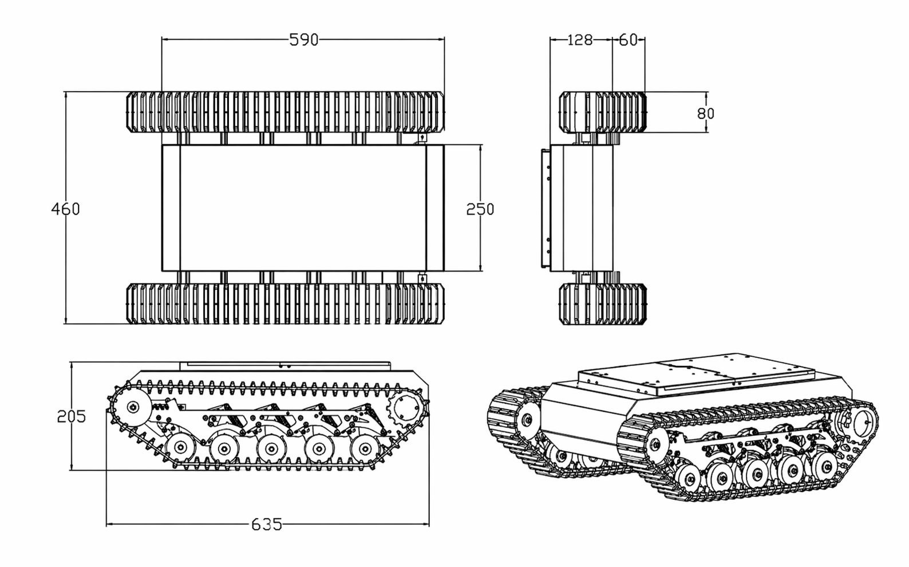
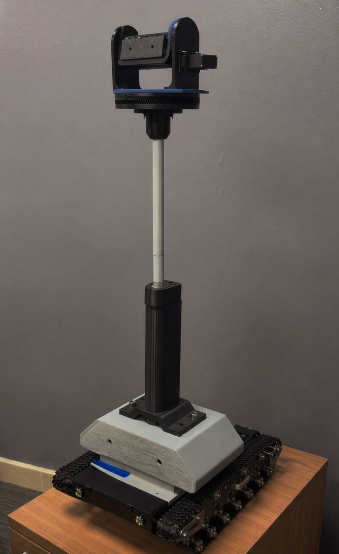
PalmRover+: Robot-Based Palm Health Scanning and Water Desalination Simulation with an integrated Software Platform
TEAM
M095
Ali Alalwan, Ahmed Alfaraj, Hamza Al Qattan, Manaf Alalsayedsalih, Ayman Alharbi, Jawad Alshabib
Coach: Dr. Omar Abdelaziz
Background
Design
System Architecture
Constraints
Today, the Kingdom sits among the world’s leading date producers. Yet, the sector faces growing challenges related to pest detection, and farm management efficiency. Palm tree farmers face a difficult challenge when dealing with pest infections (Such as the red palm weevil). Traditional monitoring methods are manual, time-consuming, and reactive. This leads to yield losses and excessive chemical usage.
The arm shall support a minimum load of 3 kg safely.
Soil salinity in the palm root zone must remain ≤ 4 dS/m to prevent stress and environmental damage.
Sensors limited to components rated IP65 dust-protection, and tolerance of 10–90% non-condensing humidity.
Power system constrained to a min battery capacity of 20 Ah at 12 V.
Field conditions require a communication range of 100m in open areas (60 m under partial obstructions)
Solution
Prototype
Validation
Specifications
We believe that a robotic data-driven system is the solution for the challenges that the sector faces. A robot equipped with cameras scanning palm trees on the farm and feeding the captured images into an AI detection model to find likely infections. The key advantages of the system include Individualized monitoring, scalability, Unified data platform
Detection accuracy was measured by testing the model on a validation dataset.
The desalination system was validated using WAVE (RO unit performance) and Aspen HYSYS (system integration). The results confirm permeate quality below 4 dS/m and proper control logic to isolate off-spec water.
We verified the constraints using robot specs and design checks. It meets slope, obstacle, and clearance requirements, and the shell does not affect movement.
Infection detected with ≥ 90% accuracy
Optimize thermal data acquisition latency to enable rapid scan-and-go cycles.
power system autonomy is sufficient to support the robotic workload of 100–200 trees per day.
RO system monitors permeate water quality and isolates the tank salinity exceeds 4 dS/m.
The camera shall be mounted at a height (≥ 200 mm).

