Slide 1
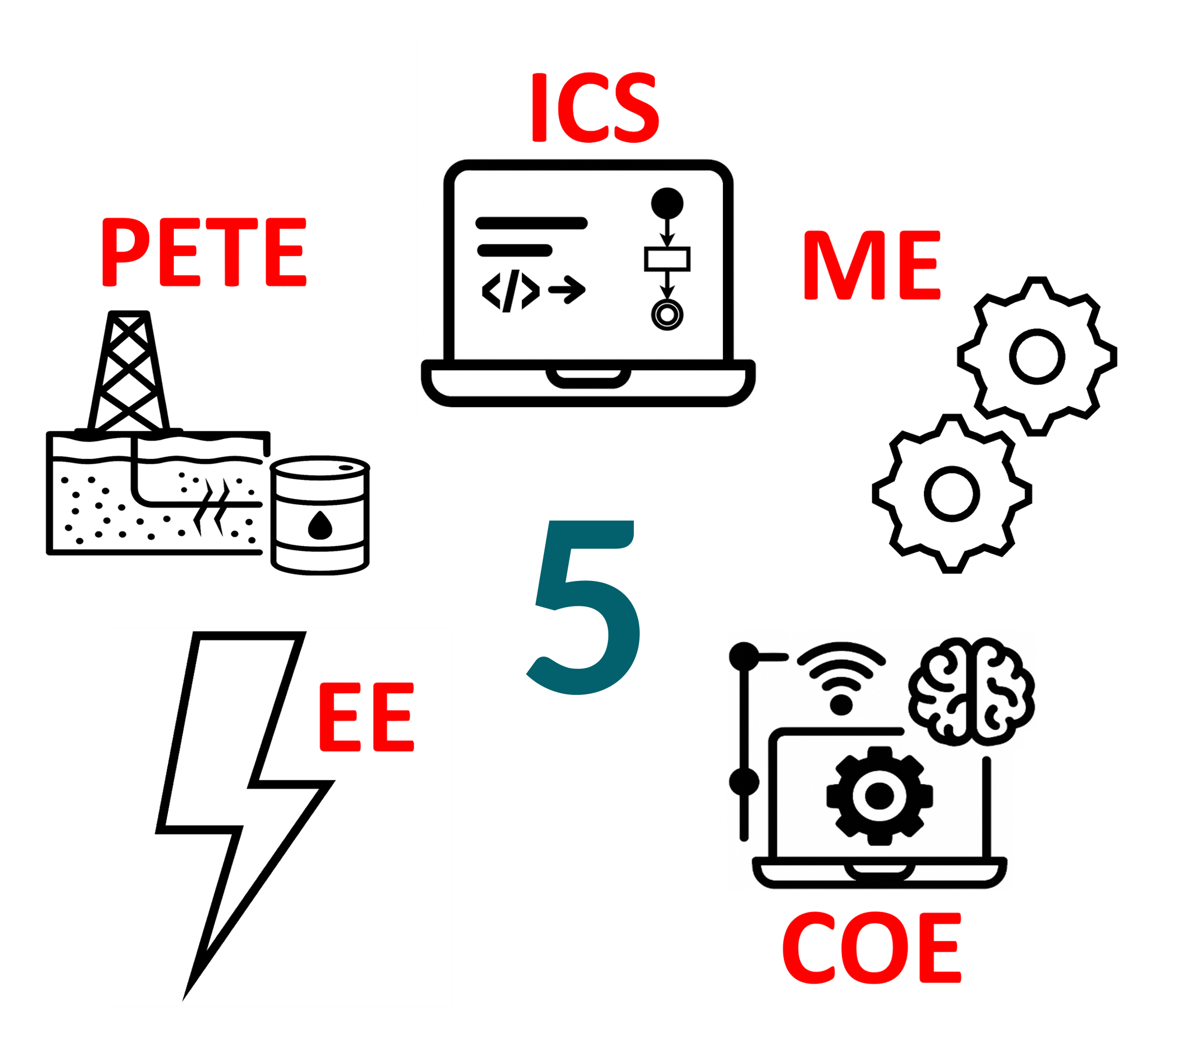
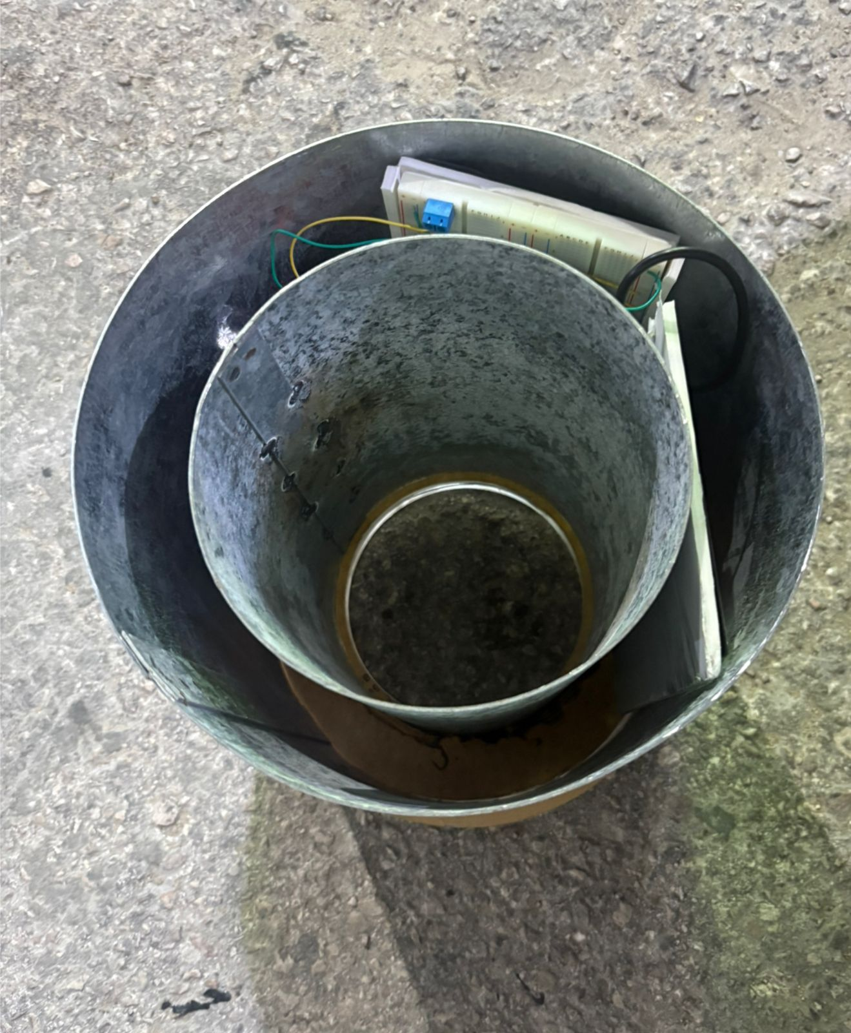
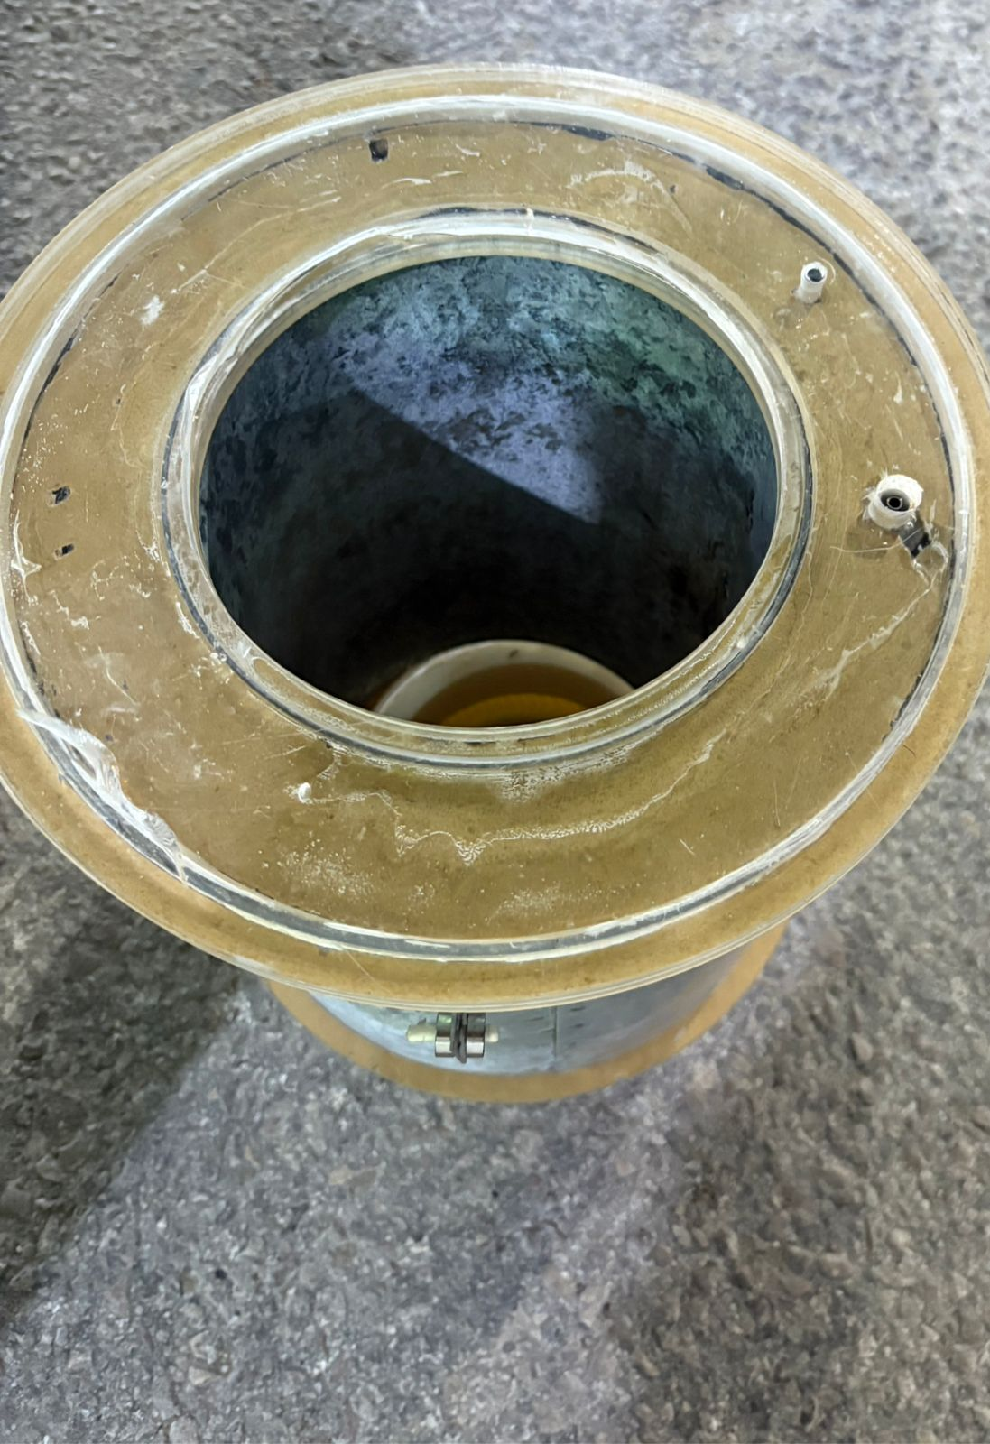
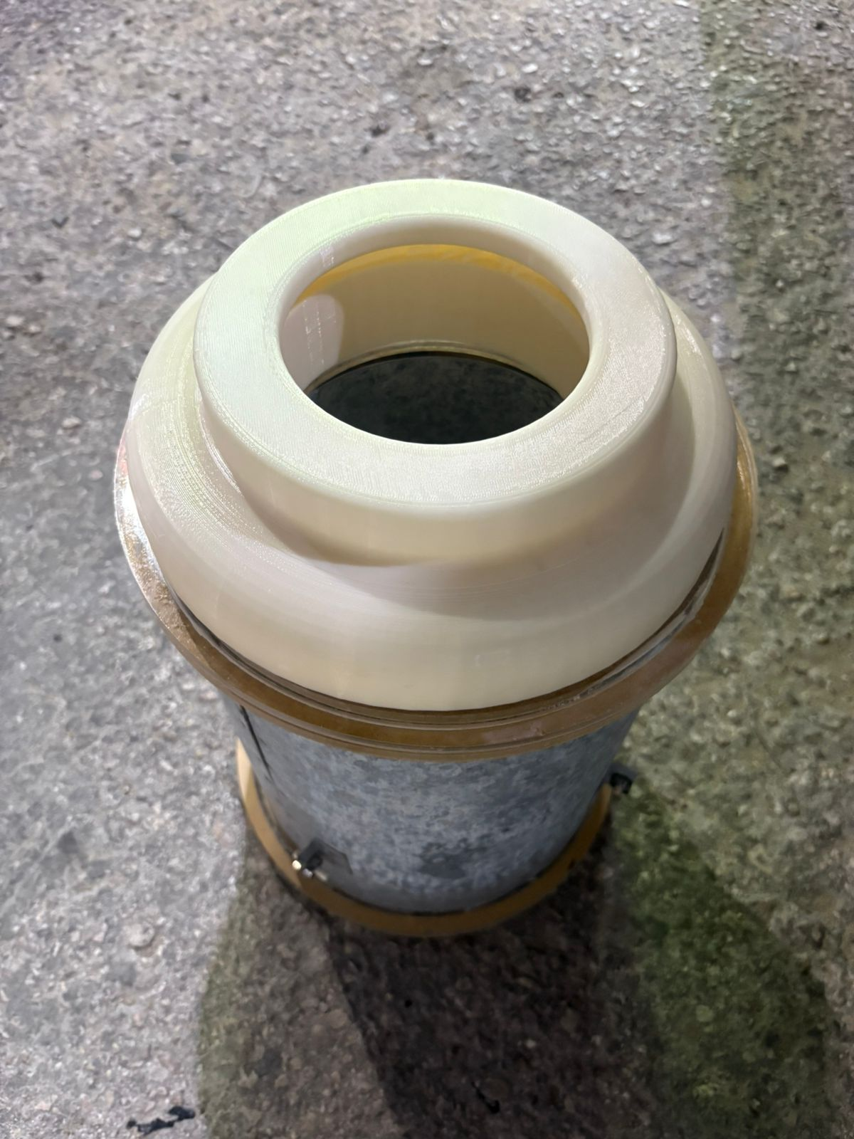
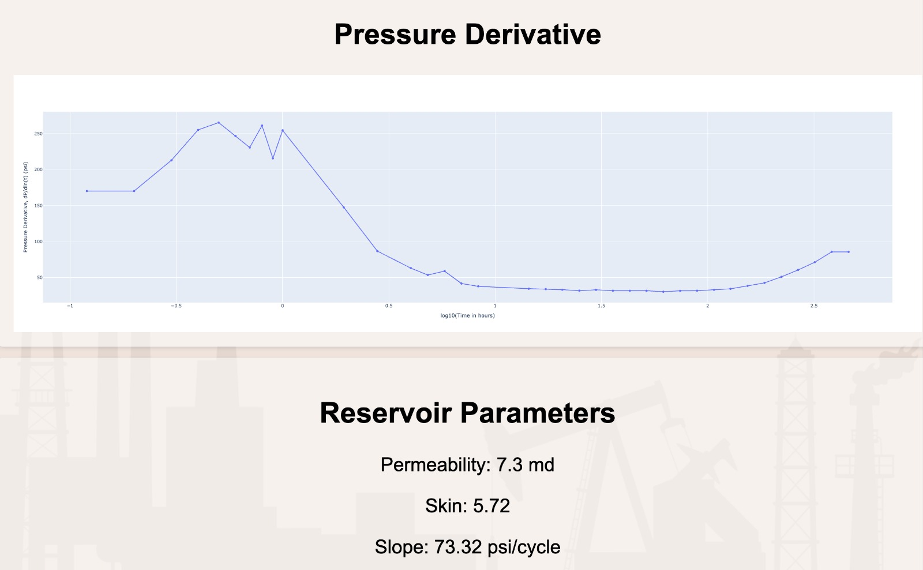
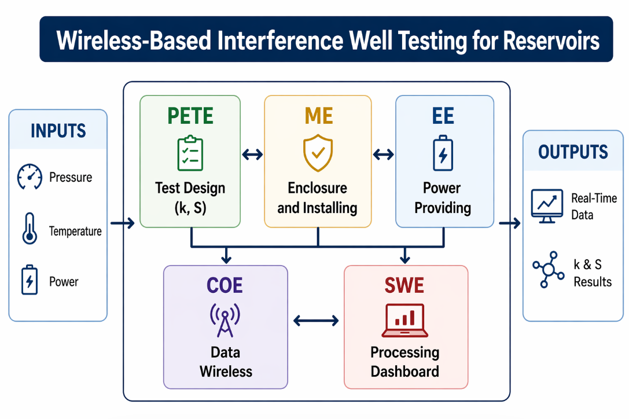
Wireless-Based Interference Well Testing for Reservoirs
TEAM
M093
Moayad Aldumaikhi (PETE) | Rakan Alshehri (PETE) | Faisal Alsalem (SWE) | Mansour Alqarni (ME) | Yazeed Albeshri (EE) | Mohammad Alahmari (COE)
Coach: Dr. Fadi Al-Badour (ME)
Background
Constraints
Prototype Design
Well testing evaluates reservoir connectivity (transmissibility, skin).
Susceptible to clock drift → data inaccuracies.
Causes ~$180k deferred production per 3-day test.
Environment temperature: 70°C
Average power ≤ 5 W per node; battery life ≥​ 14 days at defined duty cycle
Deployable on Windows server/VM using Docker or Compose, no paid cloud dependency
Well-test error +- 20% for Skin factor (S) & Permeability (k)
Maximum application payload per acoustic transmission frame shall be ≤ 64 bytes
Control unit
Upper cover (hook)
Temperature Sensor
Pressure Sensor
Problem Statement
Conventional gauges lack real-time data, causing misalignment, increased NPT, delayed decisions, and production losses.
Signal unit
Objective
Specifications
Testing Model&Dashboard
Conclusion
Develop a low-cost wireless system for real-time, accurate well testing and improved efficiency.
Mass ≤ 8 kg; Installing success 80%
Automated IARF detection; PTA completed in < 1 min
Sensor fault detected & flagged within 10 seconds
≥99% dashboard availability with auto generated plots for immediate verification
Bandwidth ≤ 5 kbps per node; encryption enabled
4-hr runtime, ≥90% sensing accuracy, and ≤0.5 s/hr clock drift.
Permeability(k) error 4.6%, Skin error 10.6% (within ±20%), IARF detection
All core constraints & specs met across 5 disciplines (PETE, ME, EE, SWE, COE)
Transforms well testing: weeks-delayed → near real-time wireless workflow
Cost < SAR 3,500 — viable, low-cost solution for mature oilfield deployment
Future Work: Real scale prototype & Feasibility analysis for mass production.
System Architecture

