Slide 1
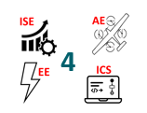
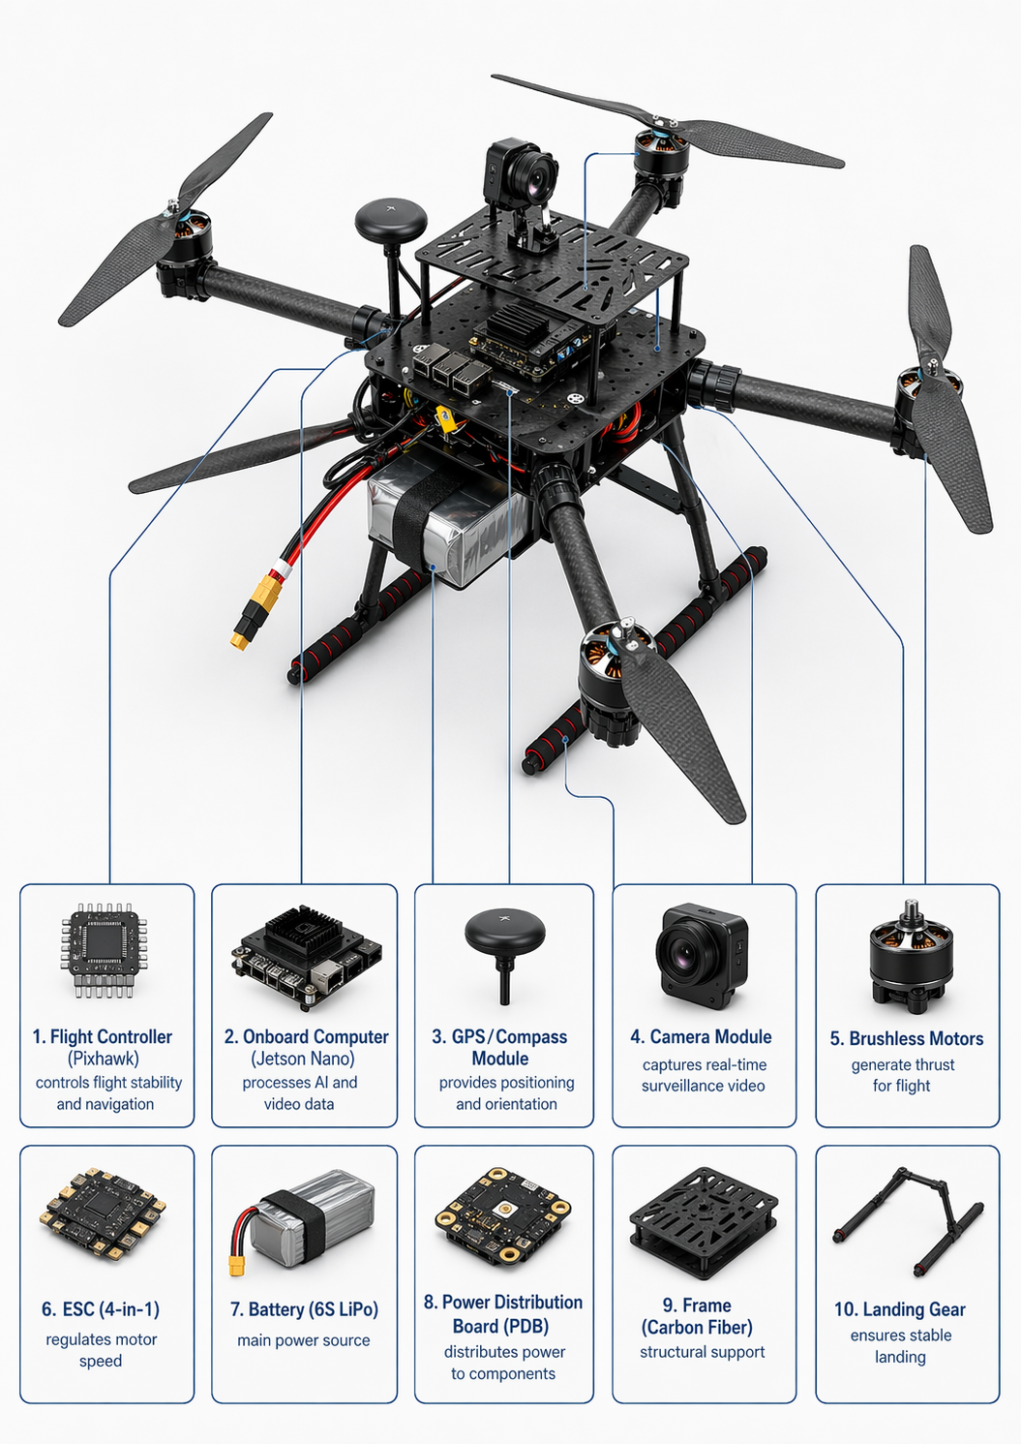
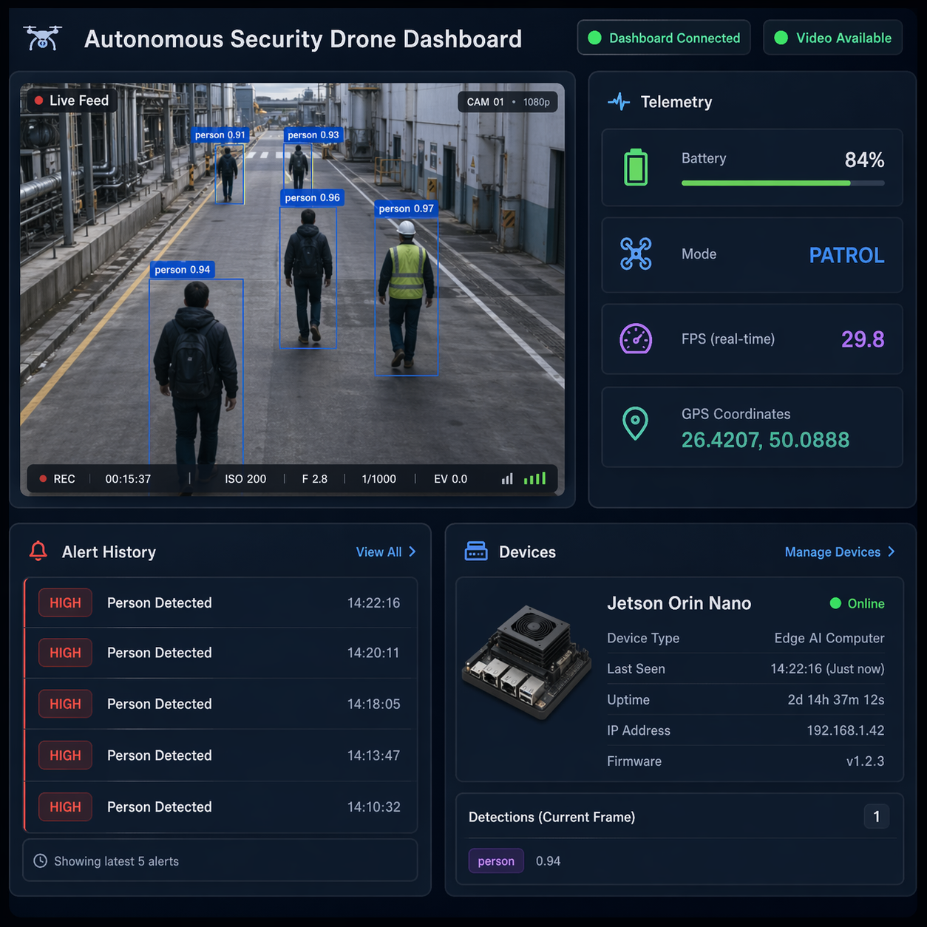
Autonomous Security & Surveillance Drone for Industrial Environments
TEAM
M092
INSERT HERE The Multi-Disciplinary Strength logo
Ahmed Alanazi, Bandar Alruwaili, Saeed Alnahdi, Nawaf Alzahrani, Naif Alqahtani, Faisal Alsulami
Coach: Omar Eldalgamouny
Objective
Specifications
Prototype Development
TESTING & VALIDATION
To design and build an autonomous drone system that monitors industrial environments in real time, detects security events using onboard AI, and transmits live telemetry and video to a remote dashboard with high reliability and power efficiency.
Total weight ≤ 5.5 kg
Flight endurance ≥ 25 min
AI detection accuracy ≥ 80%
LoRa range ≥ 300 m
Return-to-home ≤ 10 sec
Landing precision ≤ 0.5 m
Voltage stability ±3% on all rails
Jetson Nano supply: 19V, ≥ 5A
Dashboard latency ≤ 5 sec
Alert latency ≤ 15 sec
System availability ≥ 95%
Operator training time ≤ 1 hr
High-risk area coverage ≥ 95%
Power stability no resets on Jetson
Voltage regulation ±3%
LoRa range ≥ 300 m
Return-to-home ≤ 10 sec
Dashboard latency ≤ 4 sec
AI detection 82% accuracy
Flight endurance 23–26 min
PROBLEM STATEMENT
Conclusion
Industrial facilities require continuous security monitoring. Fixed camera systems offer limited coverage and slow response. This project delivers an intelligent, mobile UAV that patrols dynamically, detects anomalies instantly, and alerts operators in real time under strict power and weight constraints.
This project delivers a fully autonomous, AI-powered drone platform capable of real-time industrial surveillance with minimal human intervention. It addresses a growing market need for intelligent, mobile security solutions in factories, warehouses, and utility facilities replacing costly fixed camera infrastructure. The system's modular architecture, reliable power design, and integrated dashboard make it scalable and deployable across various industrial settings, offering a cost-effective alternative to traditional security systems.
Constraints
Maximum power consumption ≤ 350W
battery recharge time ≤ 3 hours
Maximum drone weight ≤ 6 kg
Must comply with Saudi GACA
Must use standard communication stack
detection model run onboard

