Slide 1
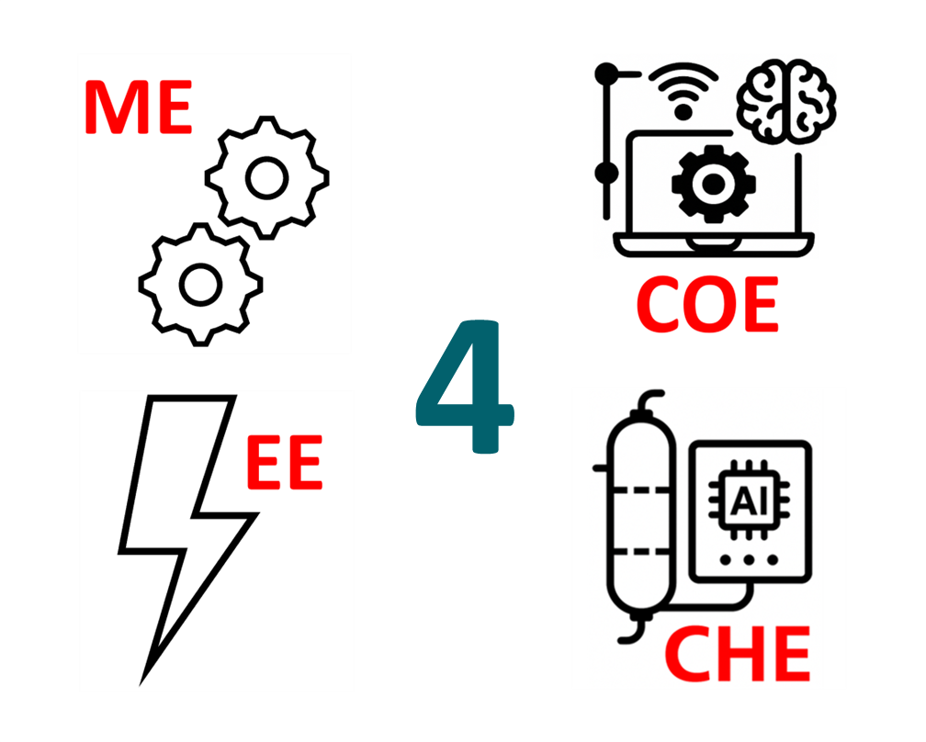




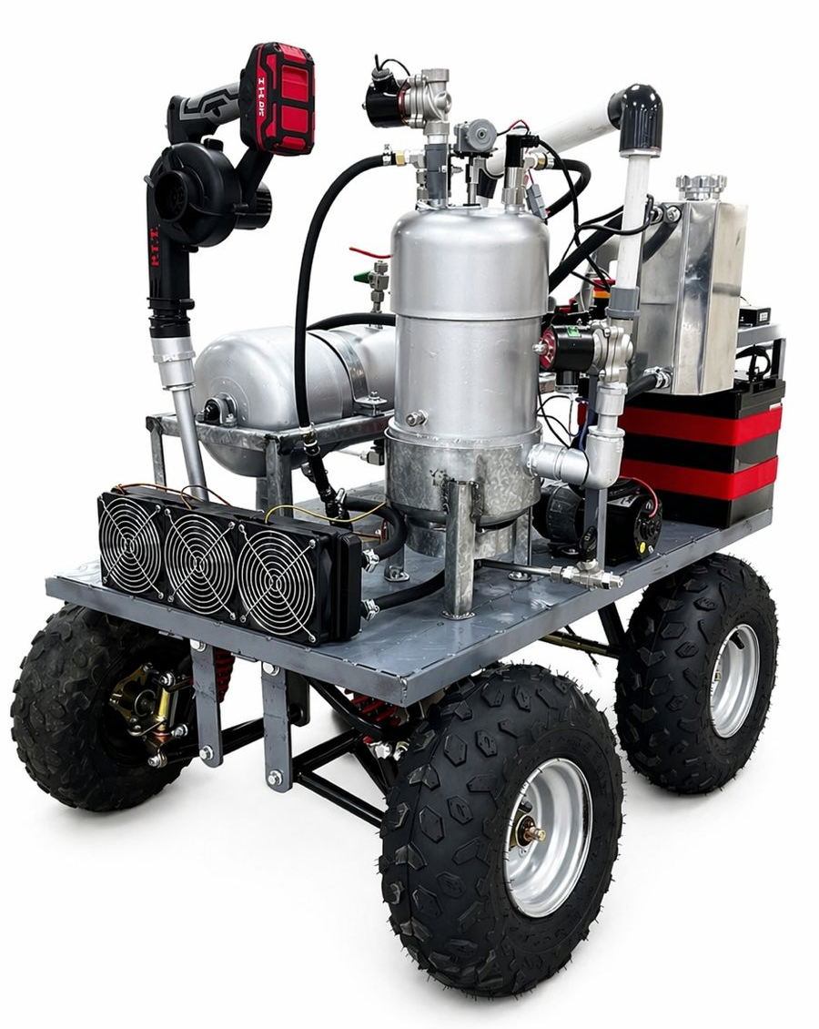
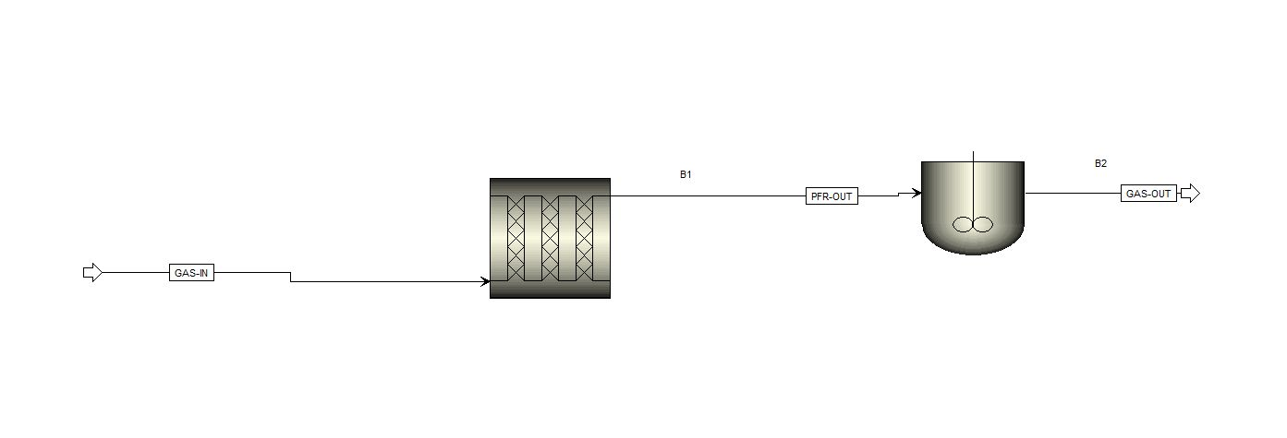
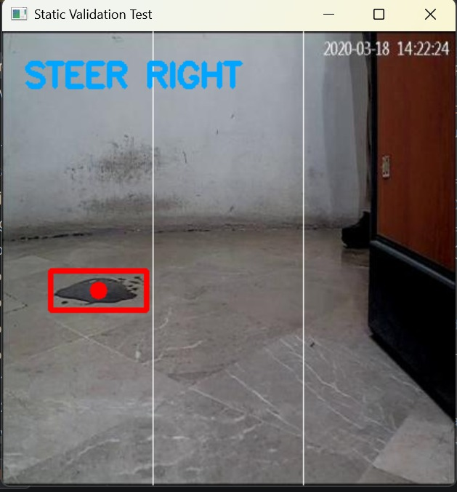
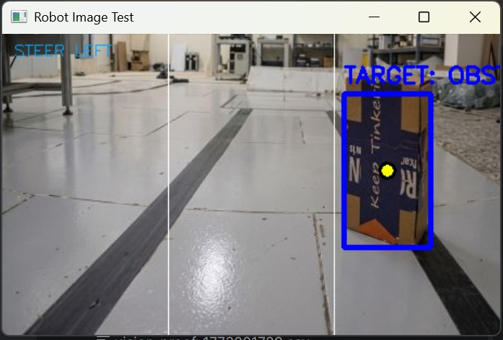
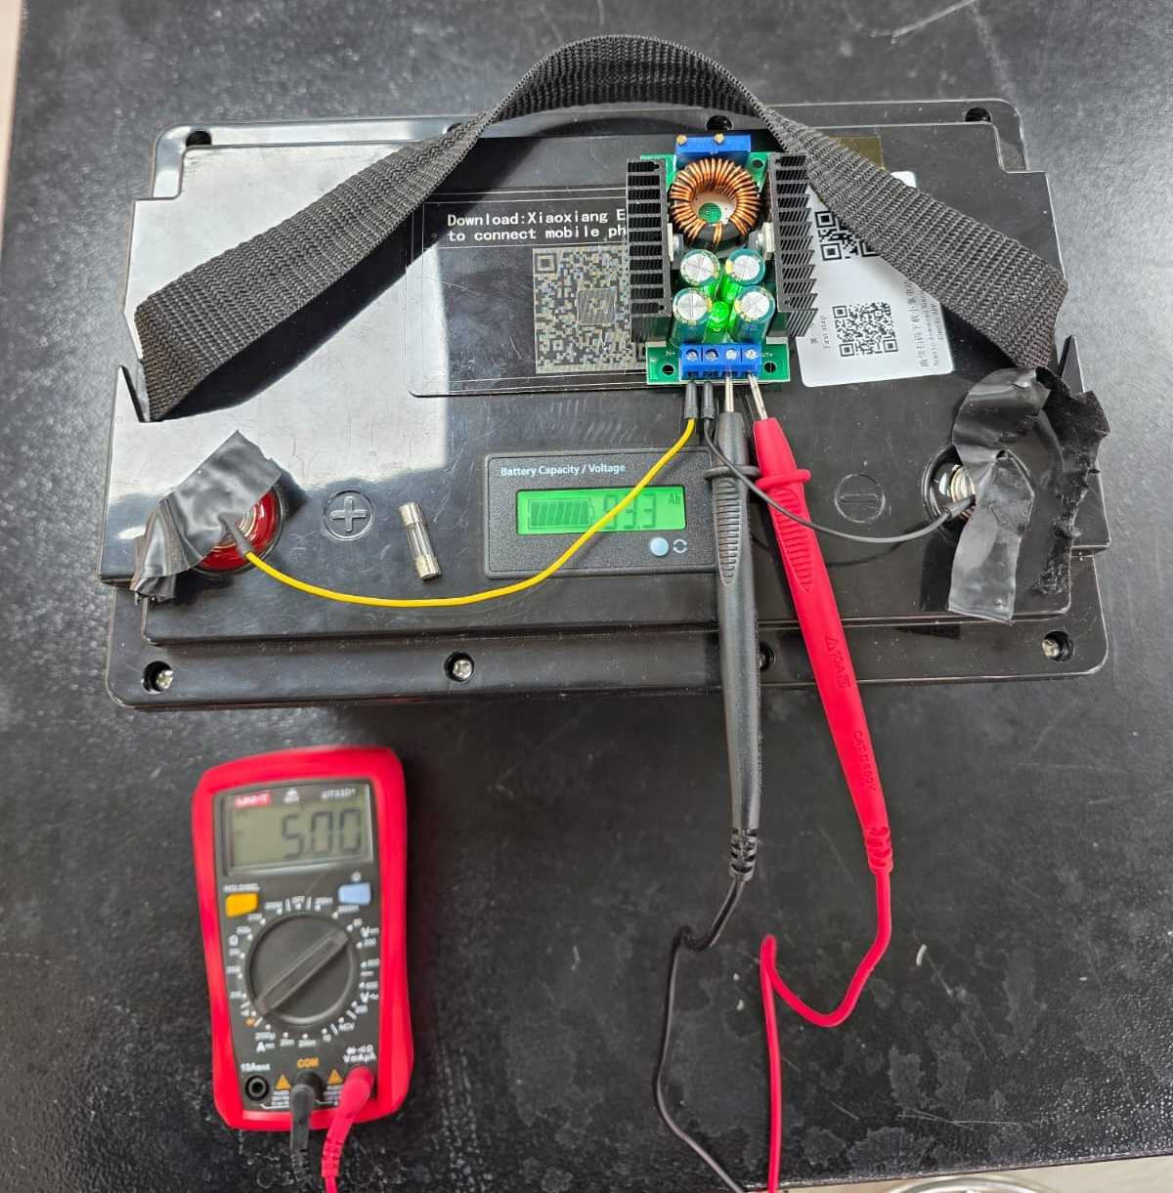
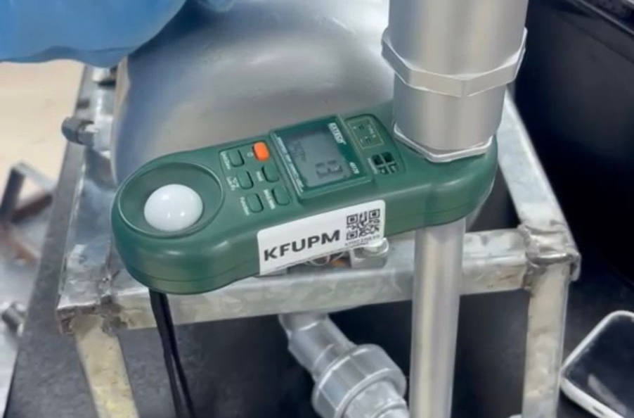

Autonomous Dual-Mode H₂S Removal and Safety Robot
TEAM
M091
4
Mohammed Al Hamood, Ali Al Rumaih, Mohammed Aldubais, Hidar Alshihab, Abdullah Obaidan, Zeyad Alghamdi
Coach: Dr. Brahim Brahmi
Introduction
Prototype Design
Testing/Validation
Problem Statement
Aspen Plus Simulation
Sludge/Obstacle Detection
Industrial environments lack a compact and autonomous system capable of rapidly detecting and actively mitigating hazardous H₂S releases to protect personnel.
To design an autonomous, compact system that scrubs H₂S efficiently and convert it to safer output addressing safety, performance and reliability.
Intrinsic voltage < 30V DC
MCU clock > 100MHz
MPU clock > 1.4 GHz and > 4GB RAM
4. Undesired ≤ 1 ppm gas
and ≤ 500 ppm liquid
5. less than 1 m³
1. Voltage regulators efficiency ≥ 85%
2. Operation time ≥ 4 Hours
3. H₂S Removal Efficiency ≥ 90%
4. Handle Temperature < 50 C
5. Can reach > 5 km/h
6. collision-Free Operation ≥ 95%
Project Objective
Step-Down Conversion
Flow Rate Measurement
Constraints
Specifications
Conclusion
The objectives were met: autonomous, mobile, portable integrated subsystems: power, control, cooling, computer vision, chemical process. the constraints and specifications met 70%.
Future improvements: multi-gas detection, including tanks for the solutions and for the waste, upgrade the reactors' material from PVC to stainless steel and reduce system weight.
8. Wireless communication > 500 meters
9. Weight < 60 Kg​
10. Inlet flow rate 100-300 L/min​
11. Reactor temperature ± 15 C ​
​

