Slide 1
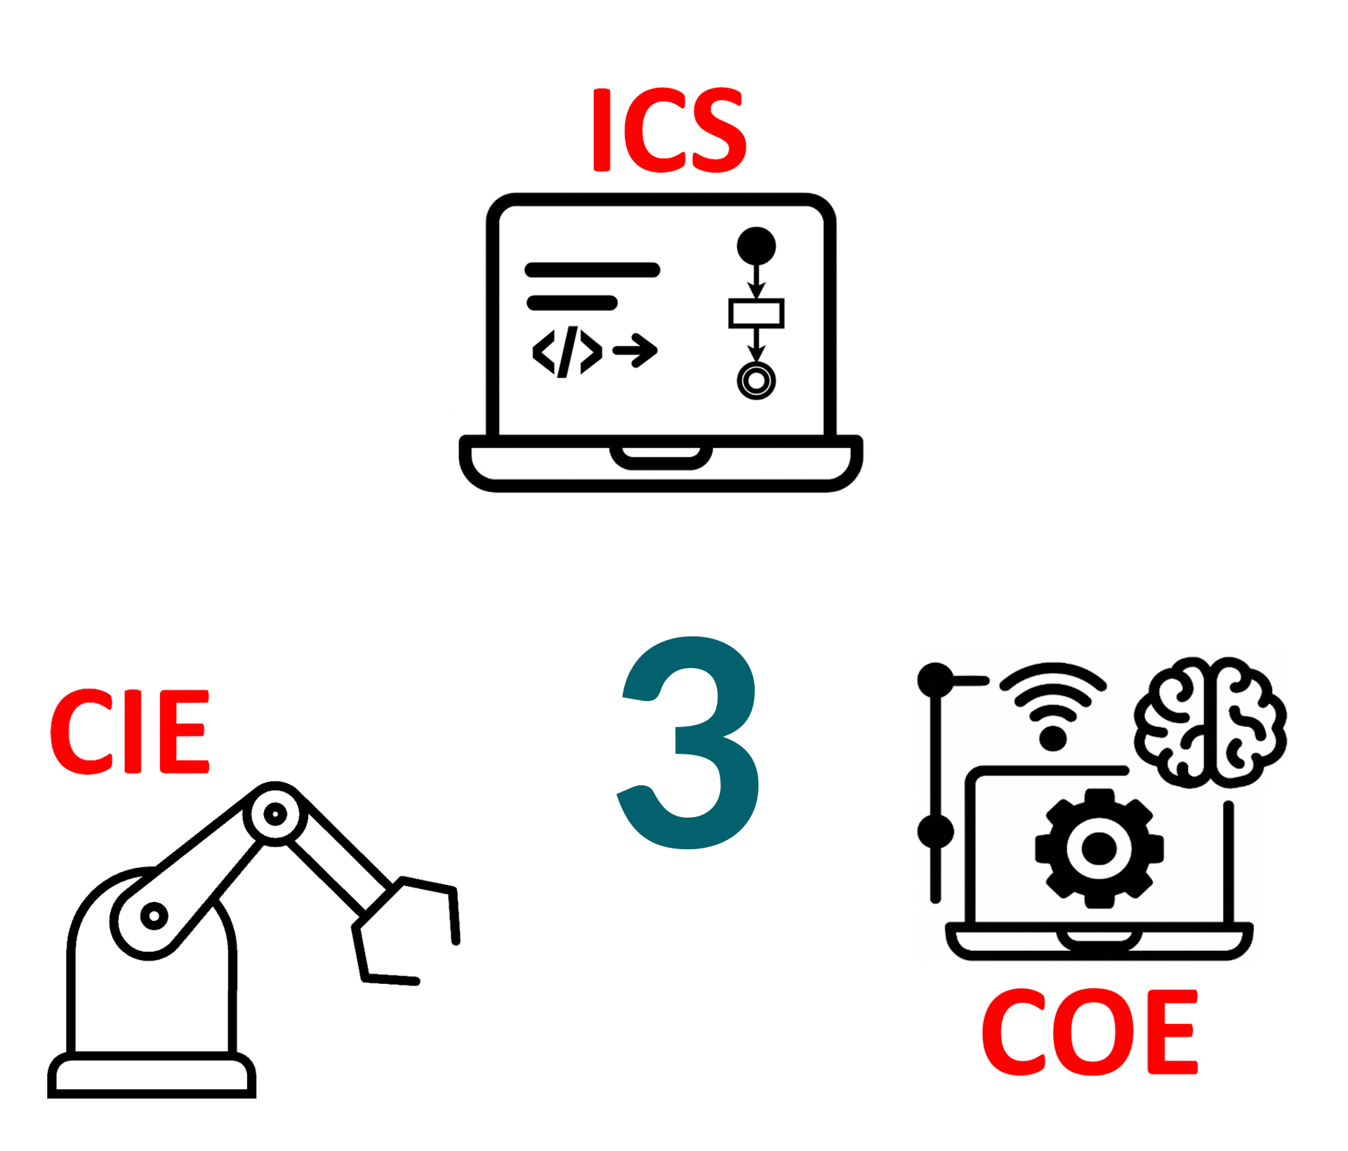
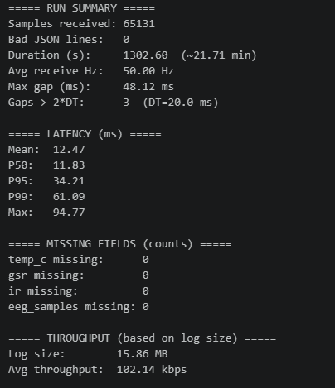
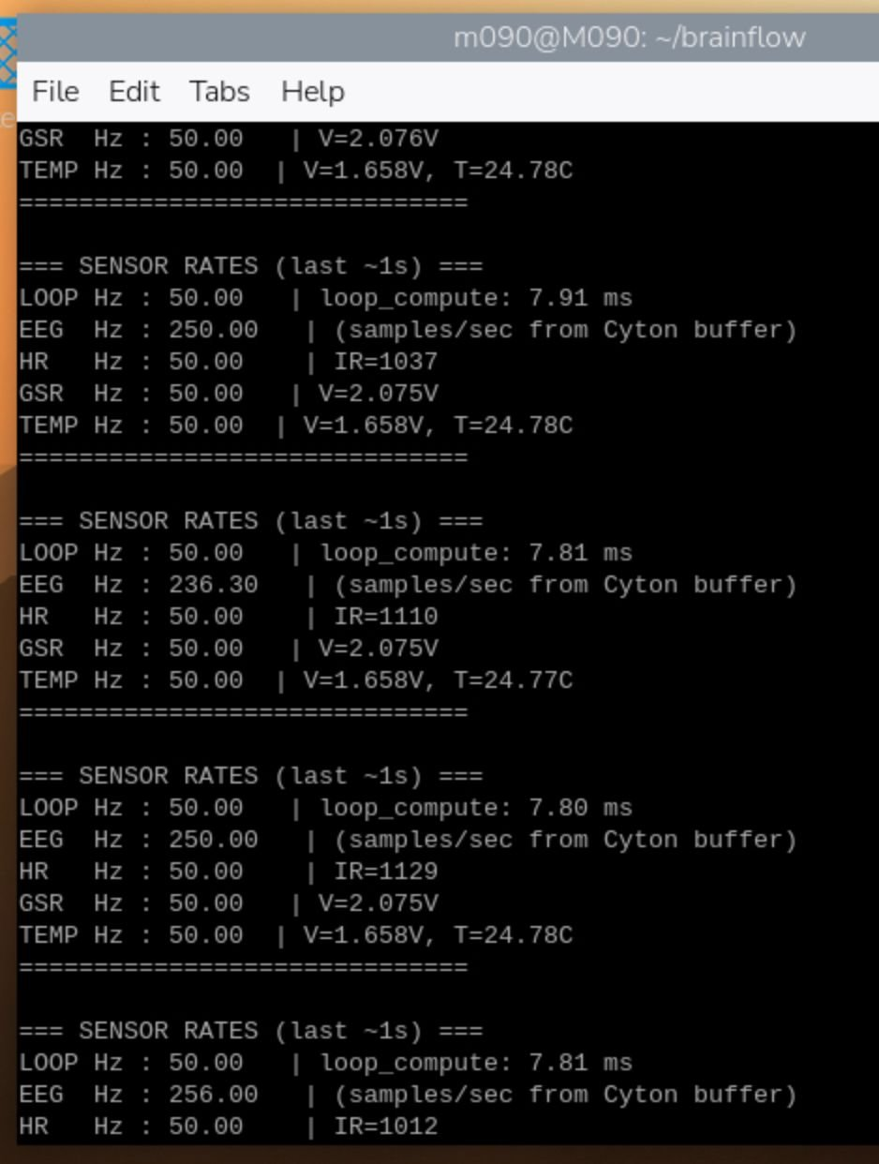

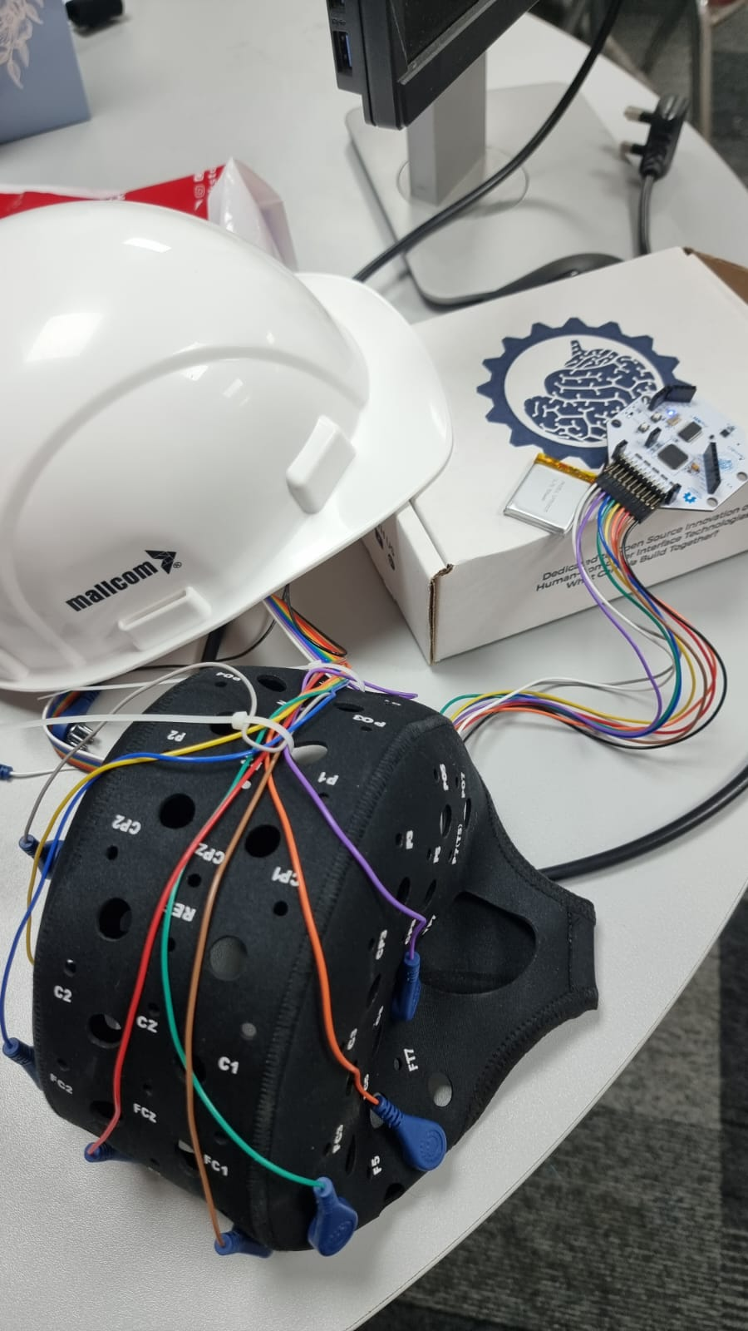

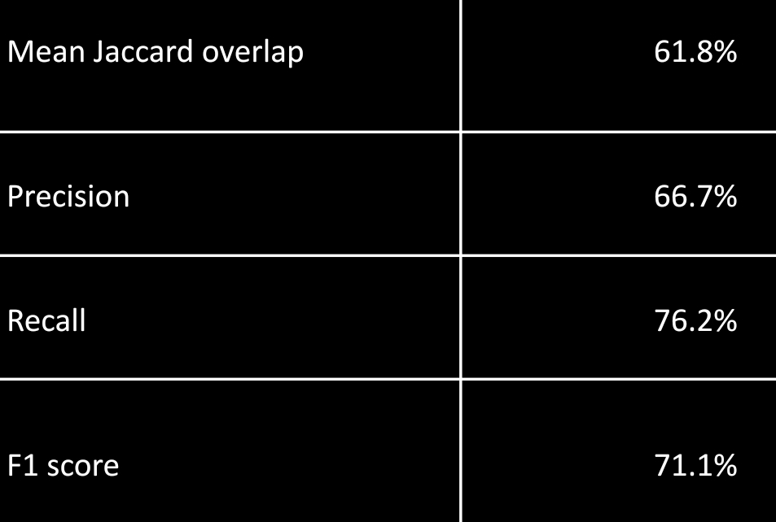
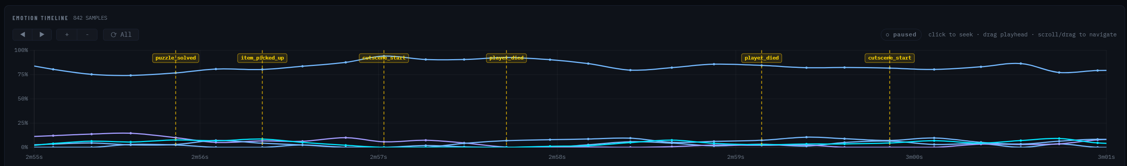
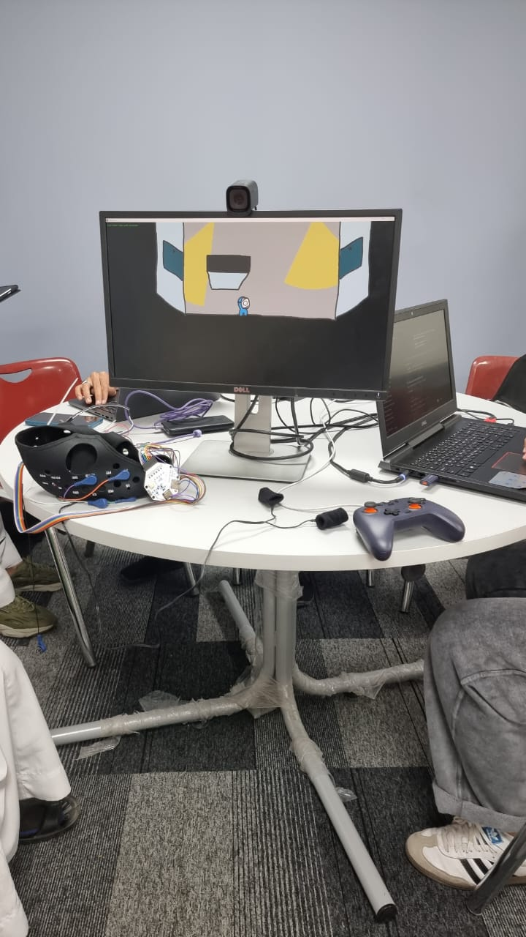
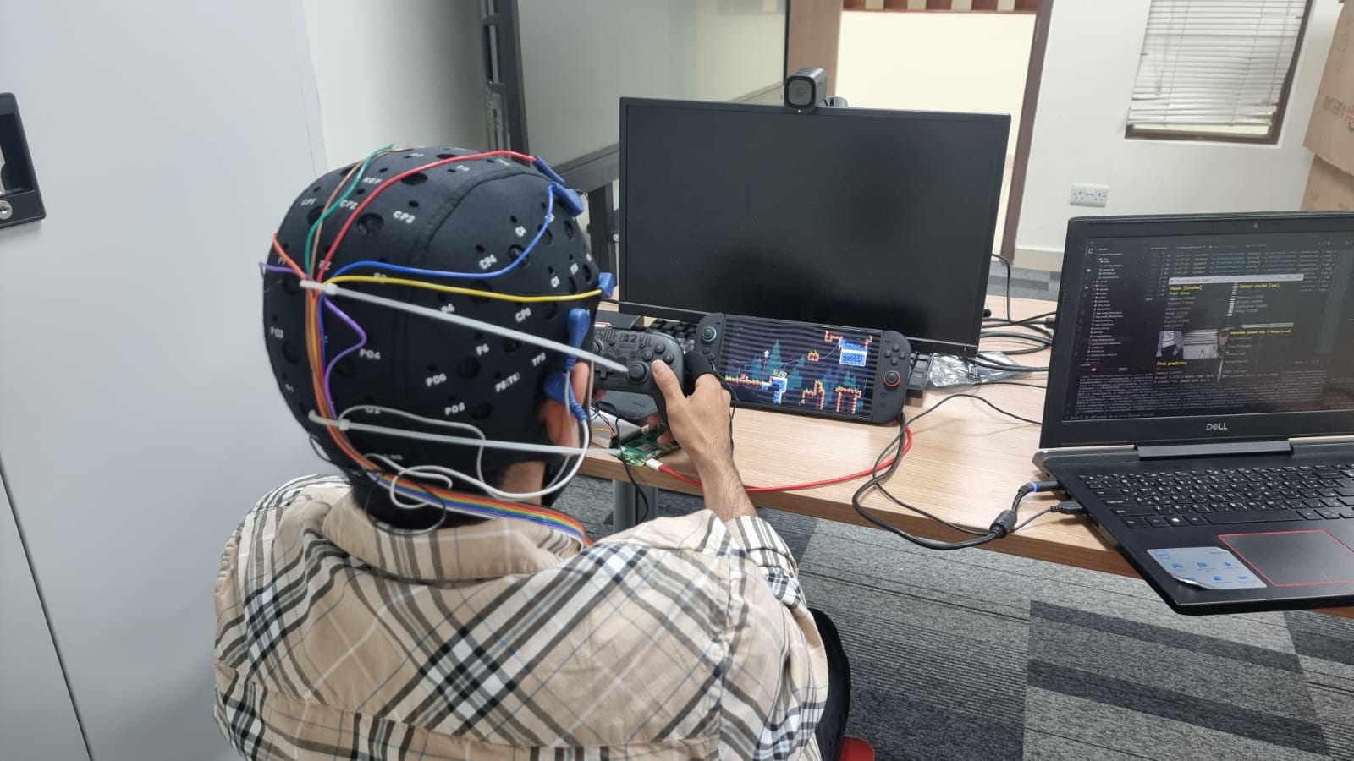
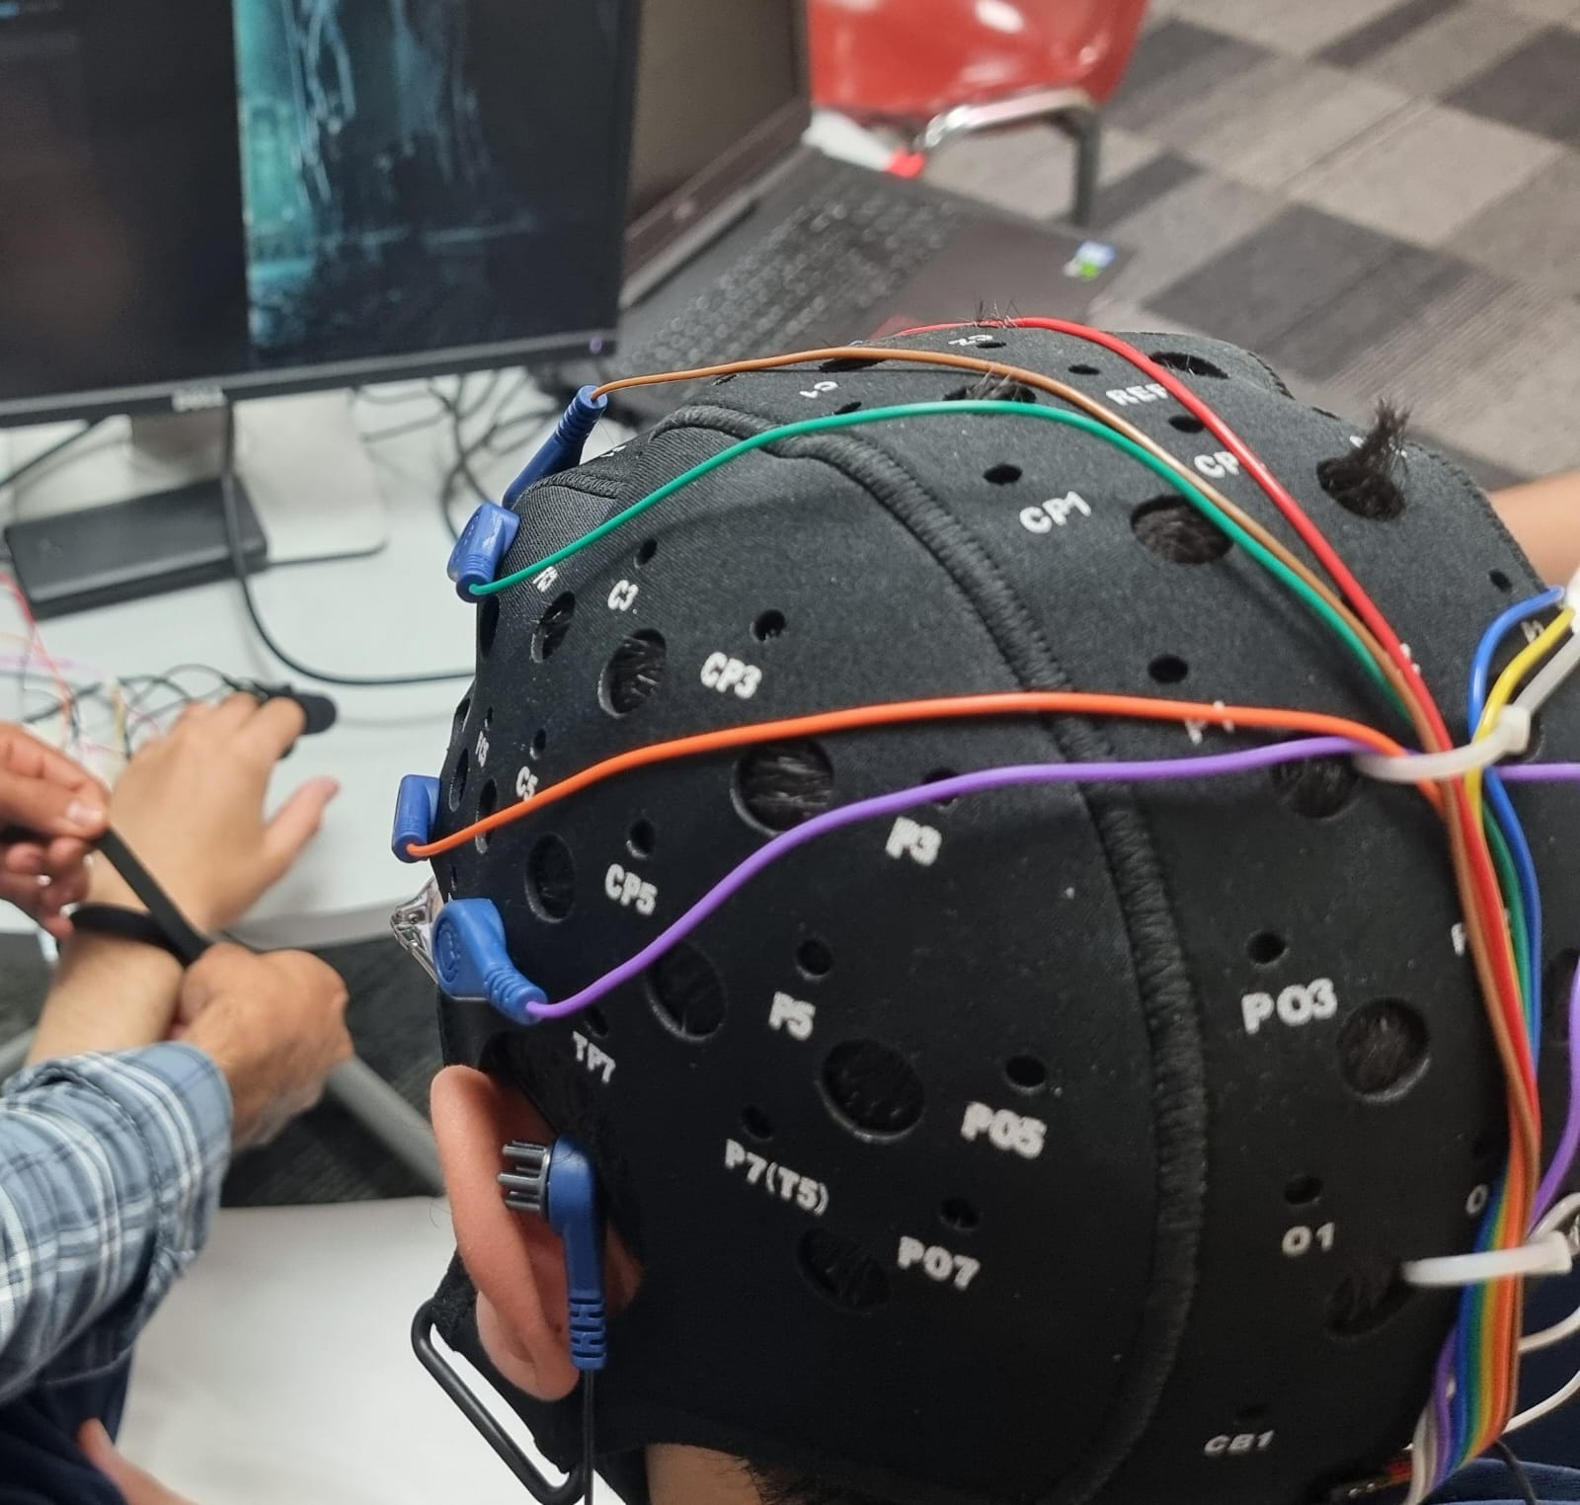
Emotion-Responsive Game Testing System Using
Multimodal Biometric Sensing
TEAM
M090
Abdullah Alarafat, Mohammed Althobaiti, Mohammed Alosayef, Abdullaziz Althukair,
Rayan Alregaib, Haider Alkhalifah
Coach: Dr. Uthman Baroudi
Background & Solution
PROBLEM STATEMENT
TEST & VALIDATION
Background:
Game testing relies on surveys and interviews
Feedback is subjective and delayed
Solution:
a real-time emotion tracking system
Uses biometric signals (EEG, heart rate, GSR, facial expressions)
Align emotions with in-game moments for accurate analysis
Current game playtesting methods lack an objective, real-time
approach to analyze player emotions aligned with in-game events.​
PROTOTYPE
CONCLUSION
SPECIFICATIONS
Real-time emotion tracking using biometric data
Objective insights into player experience
Improved support for game design decisions
Data fusion Algorithm >= 65% ​​ | Dashboard stores >= 20 player sessions​​
Dashboard refresh rate >= 15 FPS, latency 0.3s | Increasing accuracy, using >= 3 different sensors​​
System operate for at least 20 minutes with good performance | Data is aligned with the game footage with a margin of error of +-100ms seconds.​​

