Slide 1



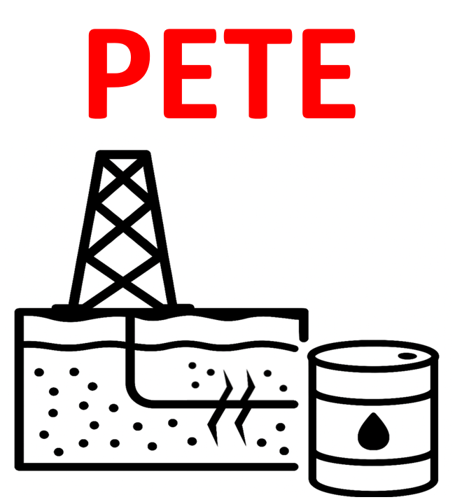
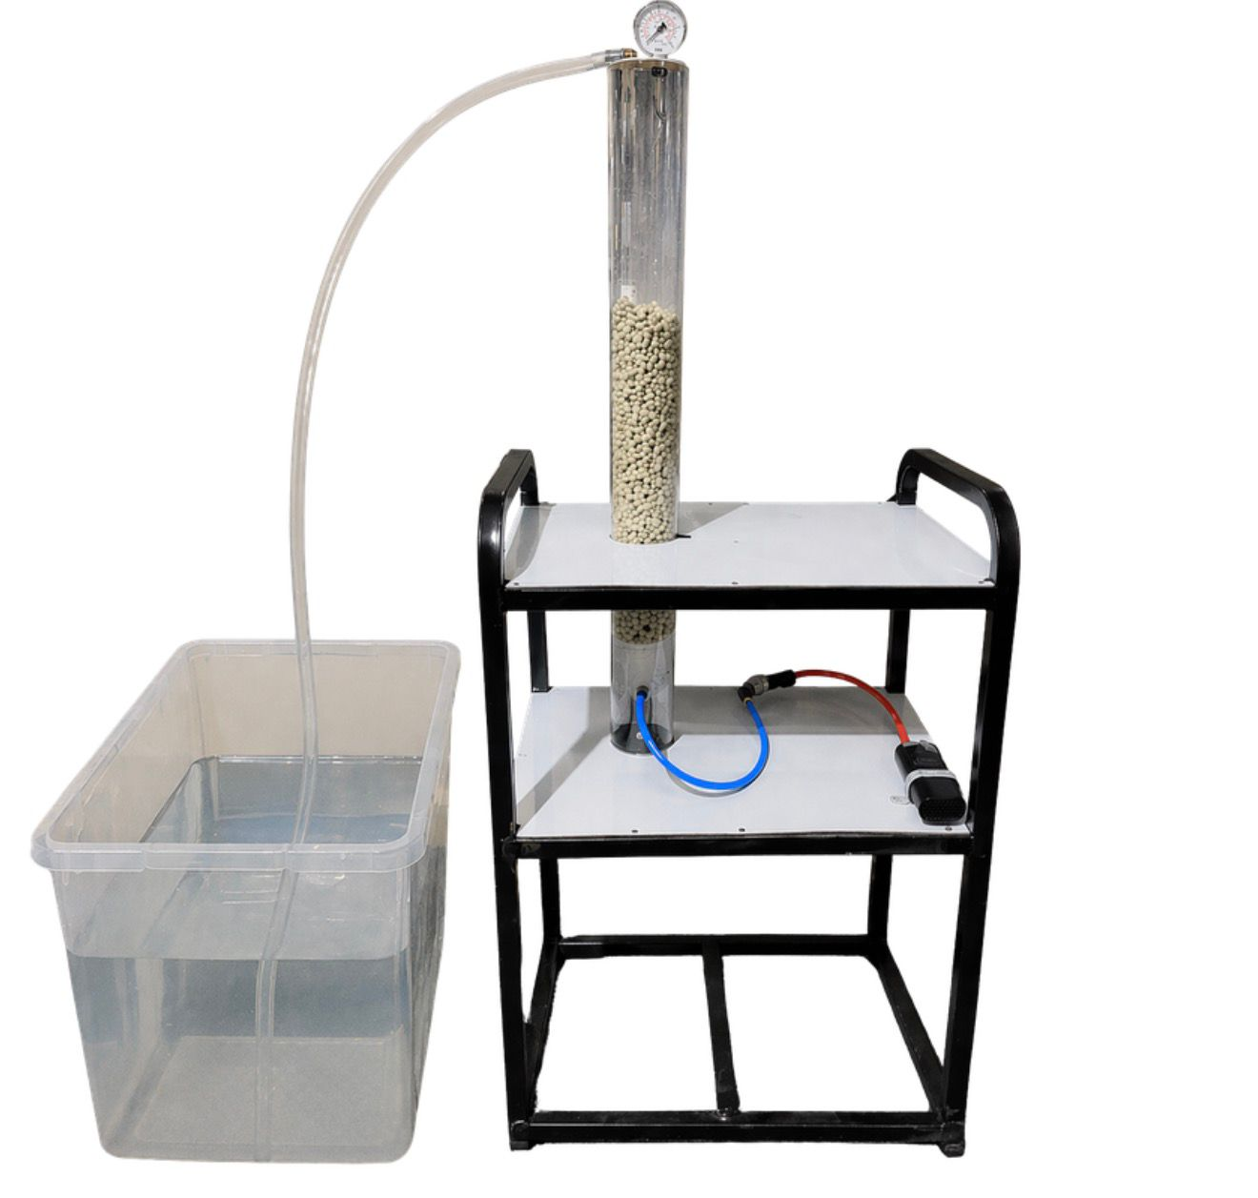
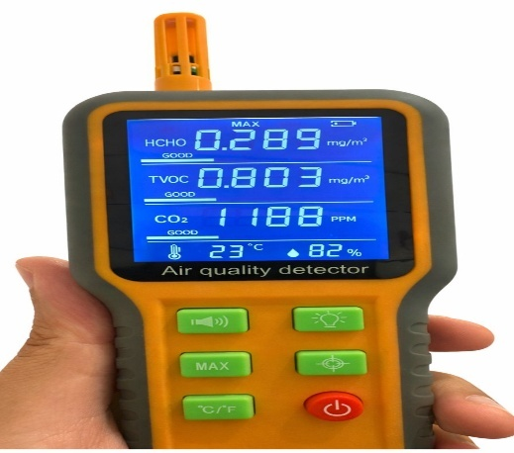
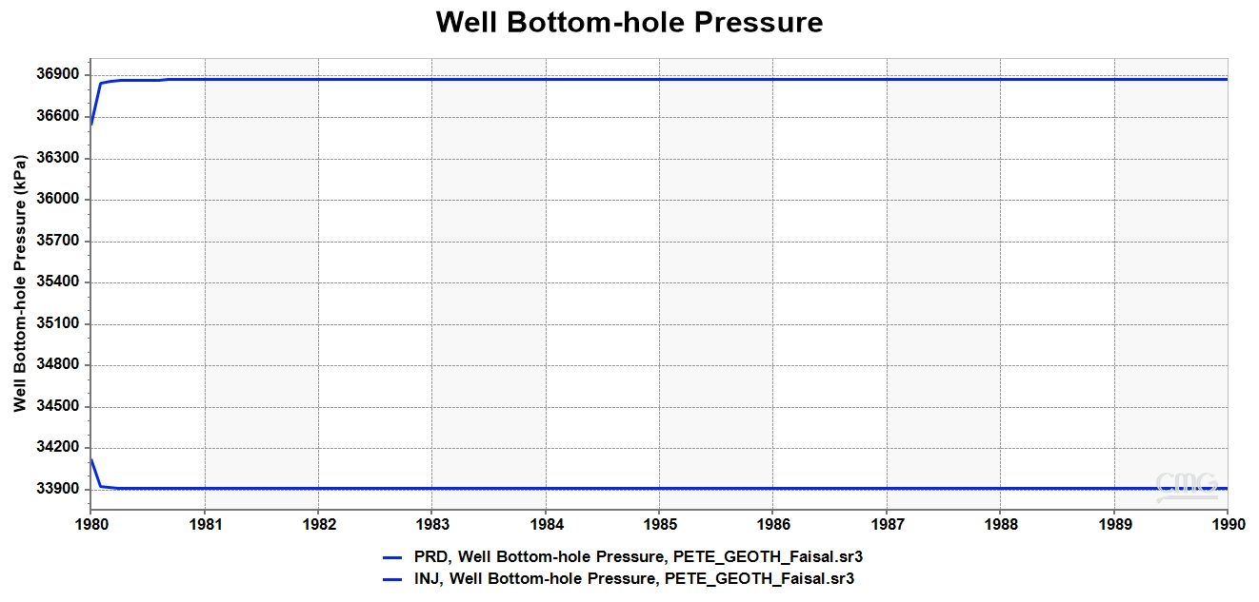
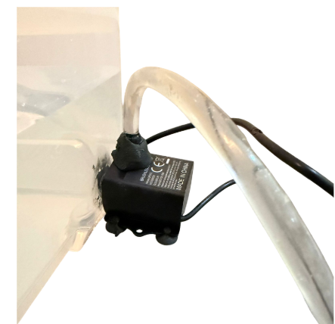
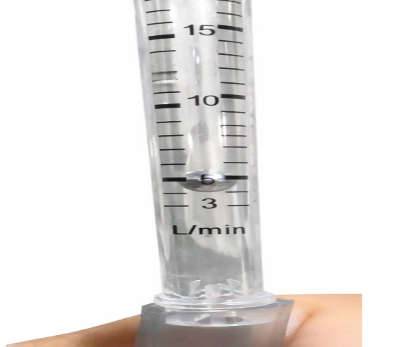
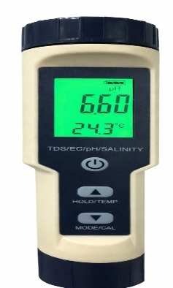
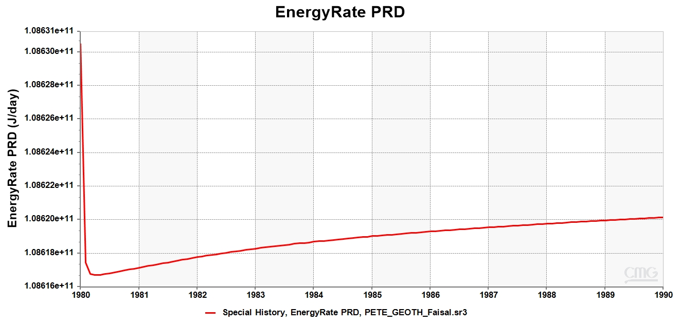
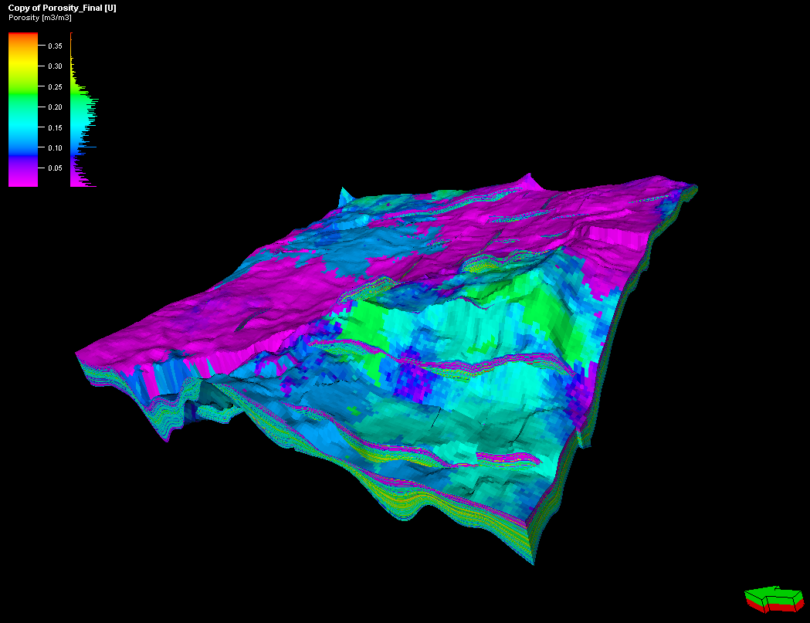
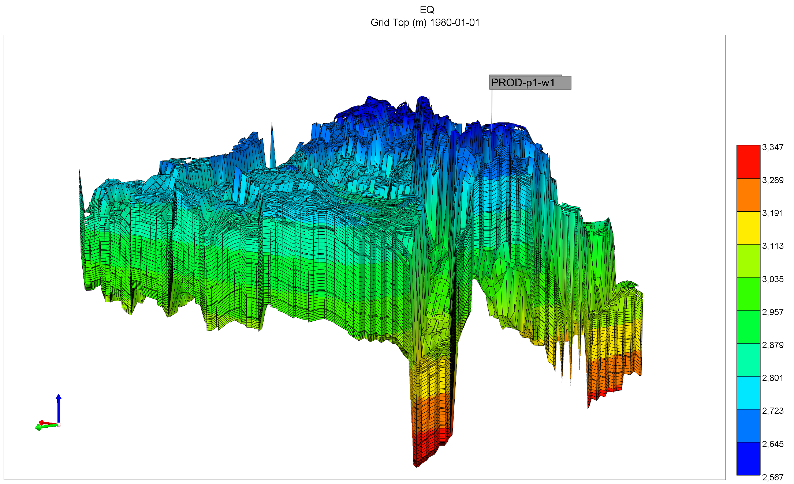
Hybrid Geothermal-Carbon Capture System (HGCCS) for Sustainable Energy and Environmental Protection
TEAM
M088
4
Aboud Alamoudi, Faisal Alarfaj, Abdullah Alanazi , Mohammed Jaddawi, Nami Aldossary, Ahmed Alaboud
Coach: Fadi Al-Badour
Background
Specifications
Validation & Verification
Growing CO₂ emissions and high carbon-capture energy demand create a need for cleaner, more efficient solutions. This project develops a HGCCS that uses geothermal energy to support CO₂ capture and storage, reducing emissions while improving sustainable energy use.
Leakage ≤10%; packed height ≥0.5 m; outlet pH ≥4.
Internal column pressure near atmospheric with ~1.2 bar(abs) water inlet.
Reservoir PHI ≥4%, Kh ≥1 mD, drawdown ≤60 bar, and production temperature ≥80 °C.
Integrated specifications
Geothermal power ≥100 kW.
CO₂ capture ≥0.2 L/min at 4 L/min CO₂ feed.
Geothermal gradient target > 40 C/km
Prototype (CHE & ME) (Fig. 3): Near-atmospheric pressure, near zero leakage stable operation, and pH ≥ 4 confirmed proper absorber performance.
GEOL: Reservoir met porosity (≥4%), permeability (≥1 mD), temperature (~170°C), and safe location criteria.
PETE: Well pressures remained within safe limits and below fracture pressure Fig. 4.
Integrated: CO₂ capture target achieved and geothermal output exceeded requirements.
A: Water Tank and Pump
B: air quality detector
C: Digital pH meter
B
Fig 4. Well Bottom-hole pressure during the operational lifespan (Data obtained from Groningen field)
Key Results
Estimated CO₂ removal ≈98.8%, which exceeds the ≥0.2 L/min capture target at 4 L/min CO₂ feed.
Uniform geothermal gradient requirement was satisfied with a 45°C/km model basis.
The simulated geothermal output exceeded the 100 kW requirement by more than an order of magnitude.
Problem Statement
High energy demand and cost limit conventional carbon capture, creating a need for a geothermal-powered system that captures CO₂ and supports safer long-term storage.
Prototype Development
A
The prototype was developed as a connected digital and physical system. First, the GEOL model defined the reservoir structure, porosity (Fig. 1) & permeability. Then, the PETE simulation (Fig. 2) used this model to study water injection, hot fluid production, pressure behavior, and geothermal energy output.
The physical prototype, shown in Fig. 3 is a packed-column CO₂ absorber. A CO₂-air mixture enters from the bottom while water flows from the top. The packing material increases contact between gas and water, allowing CO₂ to dissolve into the liquid. The transparent acrylic column also allows clear observation of the flow during testing.
≥ 0.5m
Objective
C
Design an integrated HGCCS that extracts geothermal heat, powers a water-based packed absorber, and reinjects CO₂-rich water into a depleted reservoir under safe, measurable, and repeatable conditions.
Years
Constraints
Fig 3. The physical prototype of carbon capture
Absorber column must be transparent for clear flow observation.
Absorber must operate below flooding conditions.
Injection pressure must stay below fracture pressure.
Reservoir temperature must reach ≥170°C at ~2.9 km depth.
CO₂ injection zone must be away from major faults.
Fig 5. The Daily energy rate for the production well (Data obtained from Groningen field)
Conclusion
The HGCCS prototype successfully connected geothermal modeling, reservoir simulation, and physical CO₂ absorption into one integrated system.
Testing and simulation results showed that the main constraints and specifications were met, including safe pressure limits, stable absorber operation, and sufficient geothermal performance.
The project demonstrates a feasible pathway for using geothermal energy to support CO₂ capture and safer long-term storage.
Fig 1. 3D Porosity model generated in Petrel for Groningen gas field
Color Code: GEO PETE CHE ME
Fig 2. The static model of the reservoir

