Slide 1
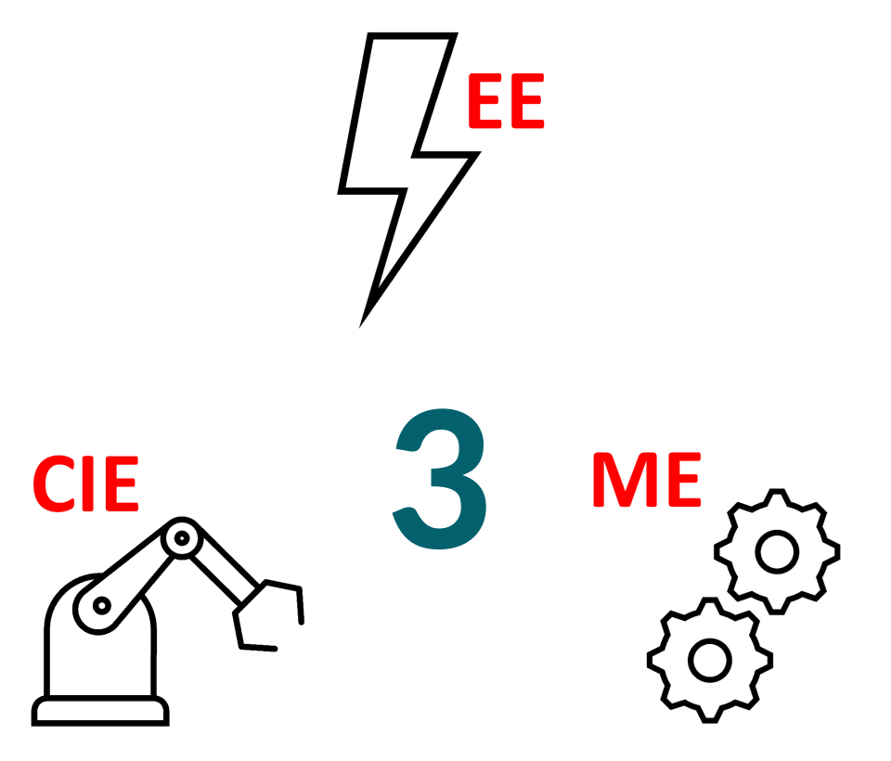
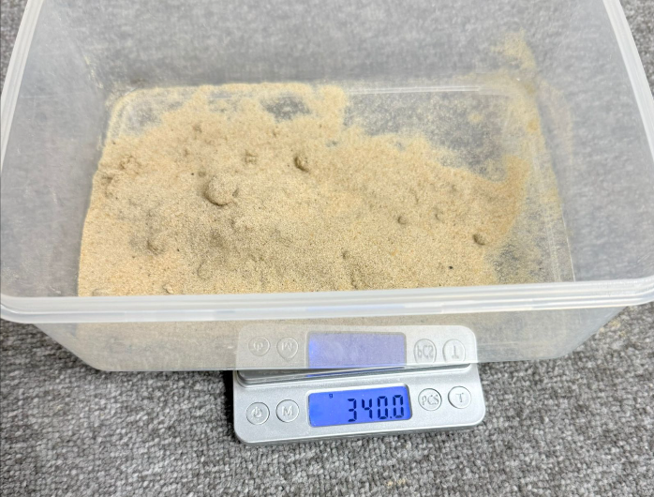
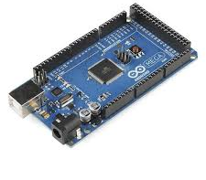
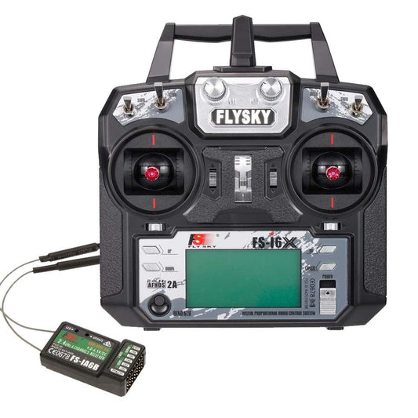
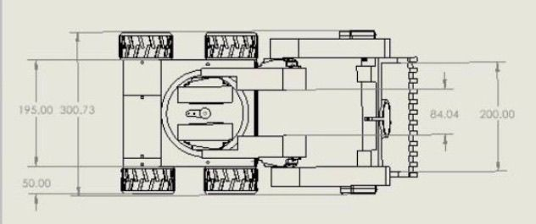
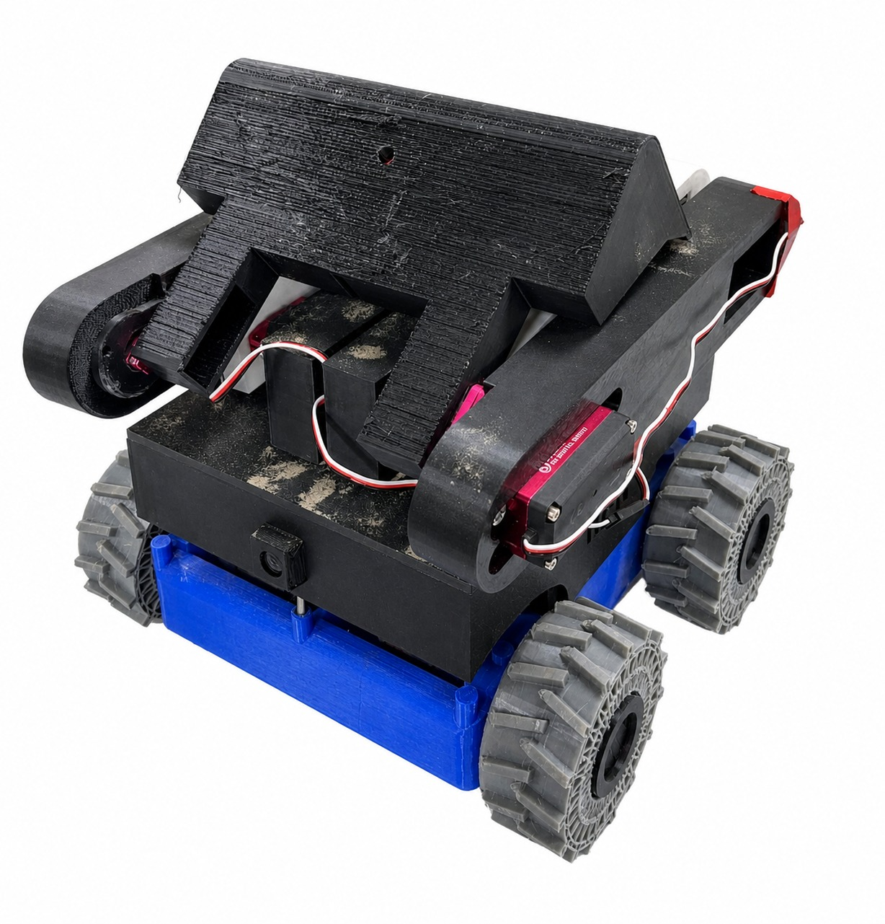
IAM3D Remote Operations Vehicle for the Excavation
of Resources (R.O.V.E.R.)
TEAM
M086
Abdullah Alashban, Suliman Alsobi, Yaser Alqahtani, Moataz Alqahtani, Ali Aldahwali, Ahmed Albalawi
Coach: Eng. Mohamed Ahmed
Problem Statement
Specifications
Testing and Validation
FPV rovers exist for teleoperation, but none combine sand excavation, compact additive manufacturing, and a precise fast arm in one safety-compliant design.
1 | 3D-printed parts ≥ 70% of total part count
2 | Transport ≥ 150 g of mixed resources with >0.1 m/s on sand
3 | Controlling the ROVER using a wireless controller with >20 m range
4 | All subsystems operate with no fault ≥ 3 consecutive runs
5 | The scoop shall collect ≥ 150g of mixed resources
Measured rover mass: 5.3Kg
Power Distribution Efficiency under stall load: 91%
Rover speed measured on sand surface: 0.66 m/s
Added 3 fuses for extra safety
Project Objective
Prototype Development
Build a compact FPV rover that moves fast on uneven sand terrain, transports heavy excavated material reliably, and operates a precise, safe robotic arm for resource collection and deposit.
FPV
(First Person View)
Arduino Mega
RC
Smart Ventilation Design for Electronics cooling
Full 3D additive material Designed and fabrication
Constraints
1 | Size (30.48 × 30.48 × 30.48)
2 | Batteries max 4S configuration and must have a kill switch
3 | Chassis must be fabricated using additive manufacturing
4 | FPV control and camera system shall maintain signal range >20 m
5 | Power distribution efficiency >85%
Hight Torque Motores for heavy weight lifting
Differential locomotion type for easier manoeuvrability and Controllability
Conclusion
A compact, fully 3D-printed FPV
rover capable of precise sand excavation and resource deposit was successfully built and validated, meeting all speed, power, and arm performance targets.
TPU Material for more resistance on sand
FPV camera provides live visual feedback

