Slide 1



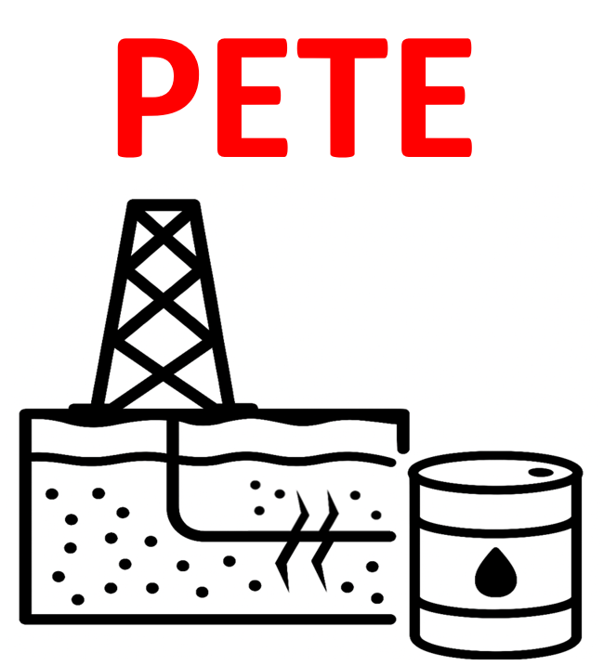
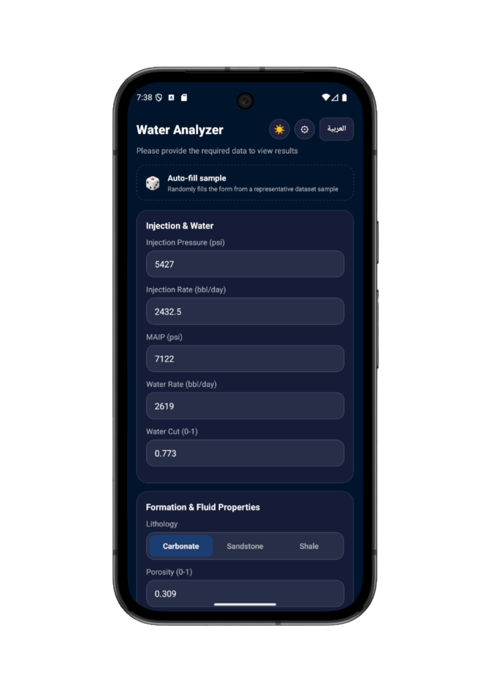
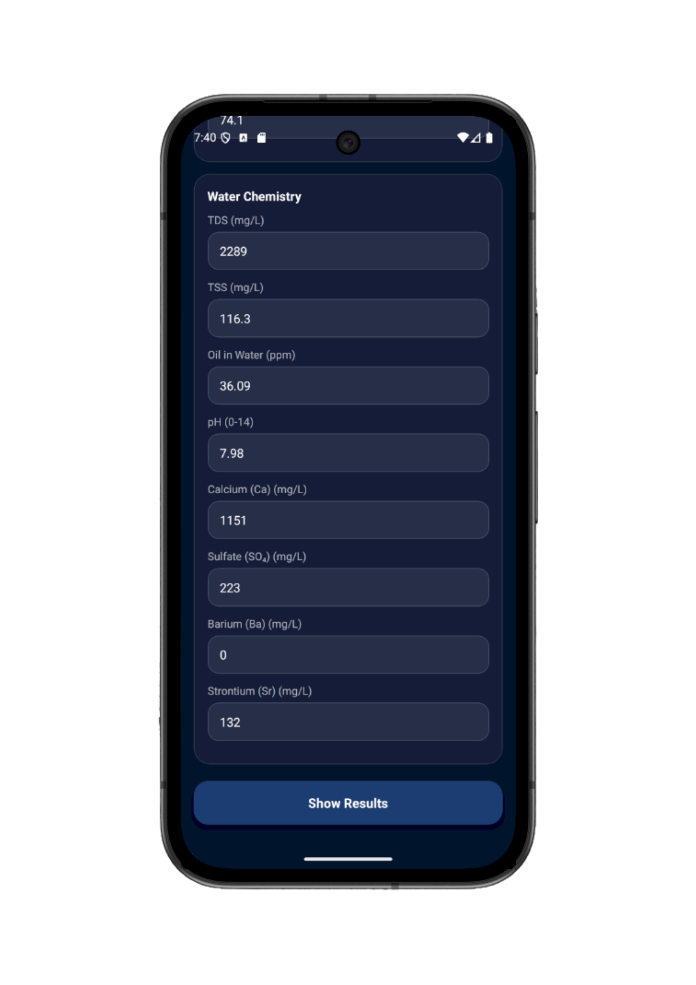
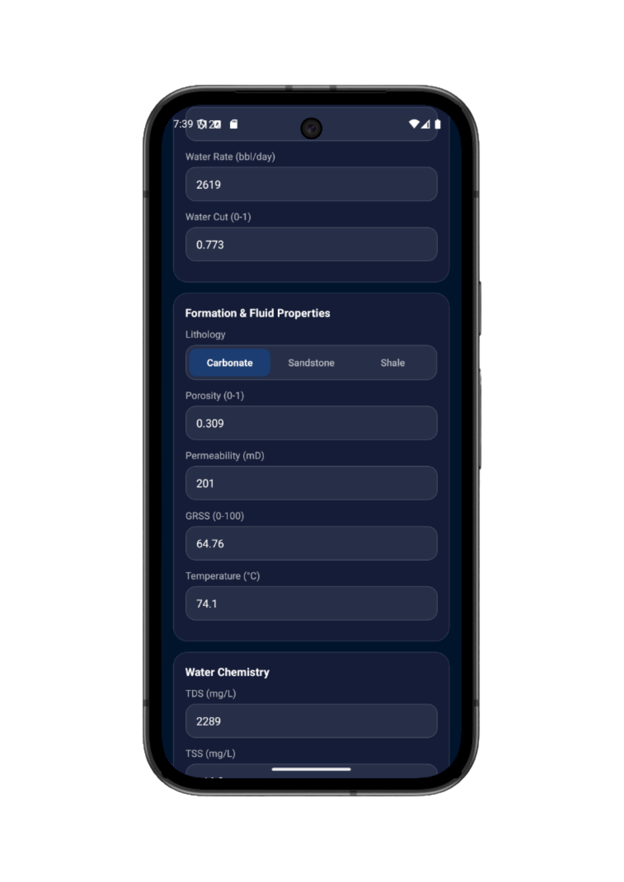
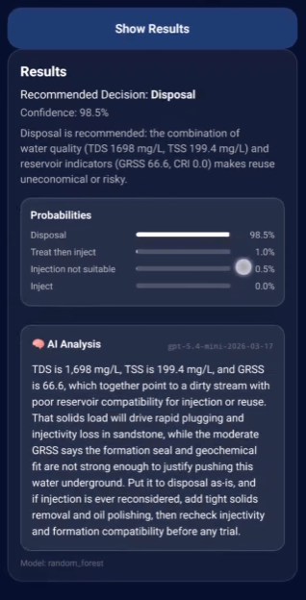
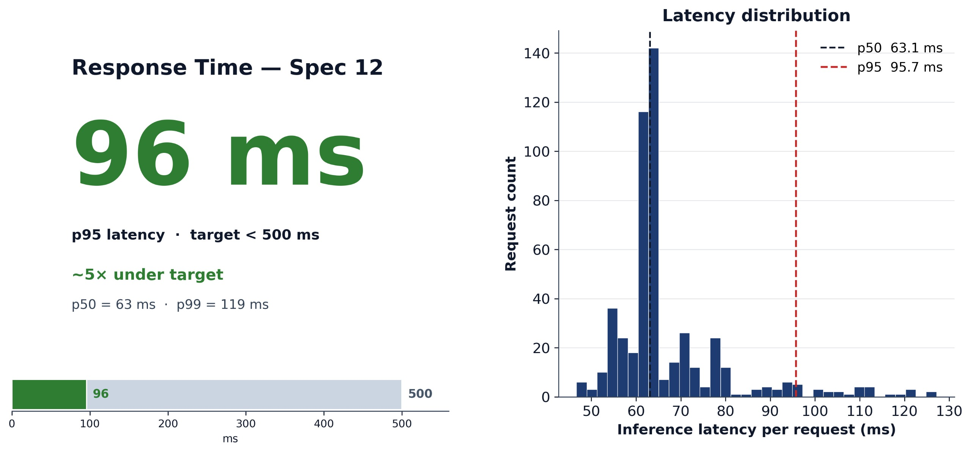
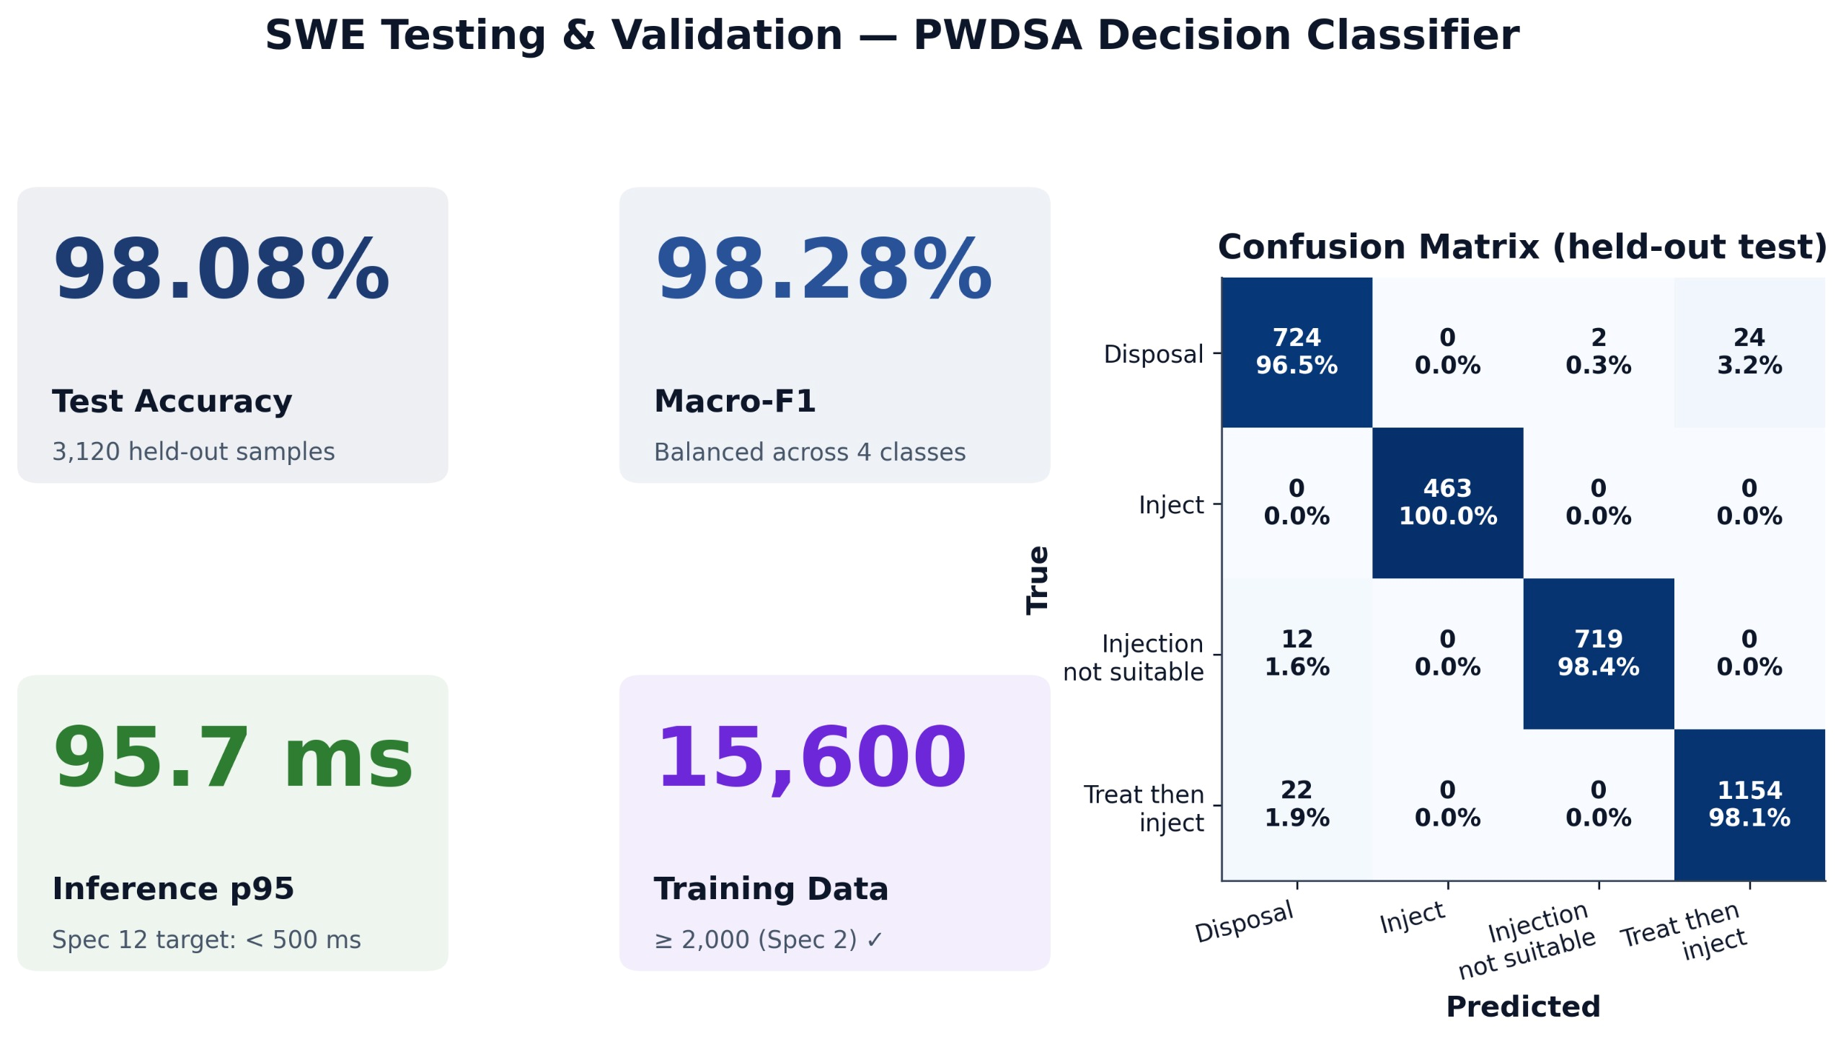
Development of a Decision-Support Application for Produced Water Treatment​ and Reuse in Petroleum Operations
TEAM
M084
INSERT HERE The Multi-Disciplinary Strength logo
4
Fahad Alqahtani (PETE), Homoud Alshammari (PETE), Saud Maashi (SWE), Abdullah Alhydary (SWE), Abdullah Baba (GEO), Abdullah Alhifthi (CHE)
Coach: Sadam Hussein Al Azani
Problem Statement
Application Design & Methodology
Constraints
Water injection is used to maintain reservoir pressure and improve recovery, but choosing the right conditions is still difficult. Engineers must make safe decisions when reusing produced water while considering reservoir properties, lithology, fluid compatibility, and operational limits. Since these factors are often studied separately, uncertainty increases. This shows the need for an integrated, data driven system to support clear and consistent decisions.
Petroleum Engineering:
Injection Pressure
Injection Rate
MAIP
Water Rate
Water Cut
Chemical Engineering:
TDS
TSS
Oil in Water
pH
Minerals
Injection pressure < fracture pressure
Injectivity index ≥ minimum threshold
Modular microservices architecture
Regulatory update module
GRSS ≥ 80 for reinjection approval
Mandatory depth for aquifer safety
Use approved treatment chemicals
Restrict hazardous treatments
Geology:
Lithology
Prosily
Permeability
GRSS
Temperature
Analysis: Provides deep AI analysis with up to accuracy of %98
Specifications
Testing & Validation
Conclusion
Water quality within defined ranges
Dataset size ≥ 2000 samples
Output clear decision summary
Monthly system updates
Geological features database
100% decision coverage for all cases
Chemicals–rock evaluation
At least one feasible treatment option
GIS-based visualization of suitable zones
Apply safety margins
Bilingual system (Arabic & English)
Fast response time (< 0.5 sec)
The system provides a clear and integrated way to evaluate water injection strategies. It combines reservoir, geological, and fluid data to improve the reliability of decisions. Engineers can assess conditions more consistently and reduce uncertainty when using produced water for injection. Overall, the system helps make safer and more confident decisions while improving injection performance.

