Slide 1




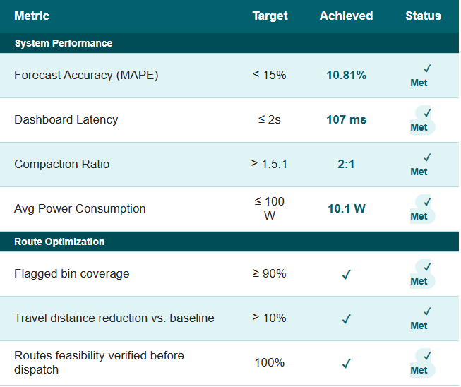
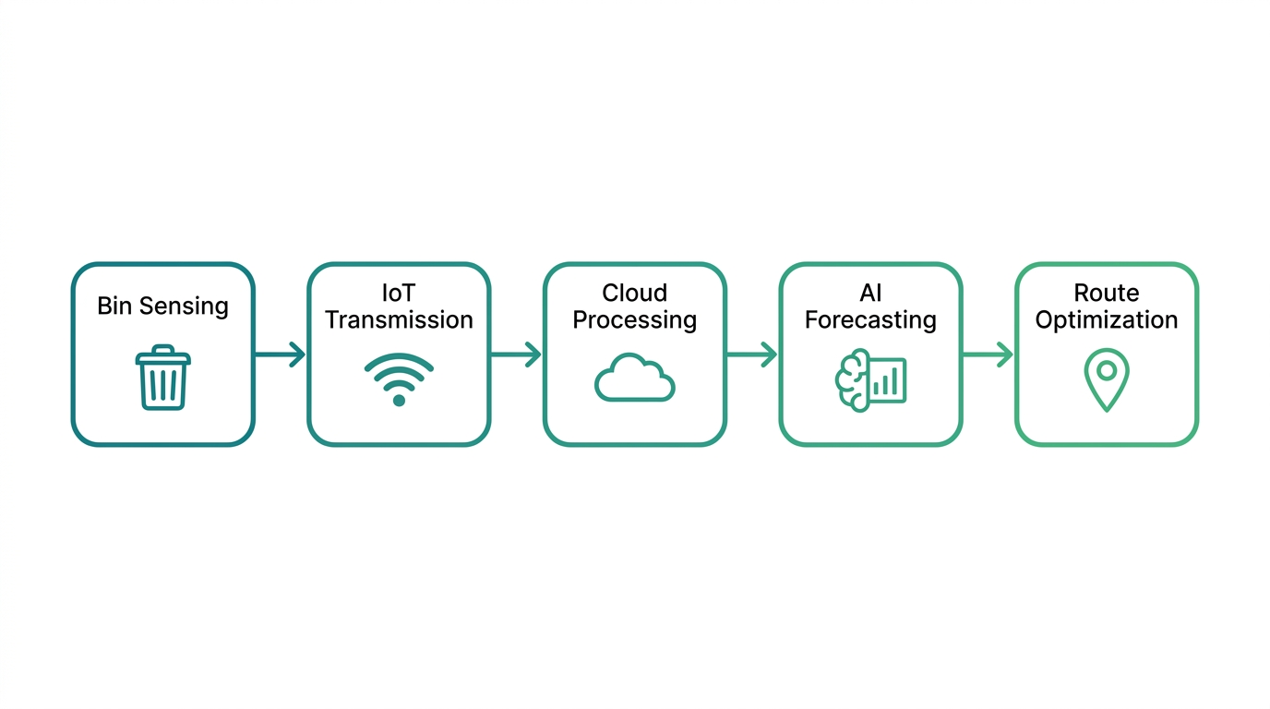
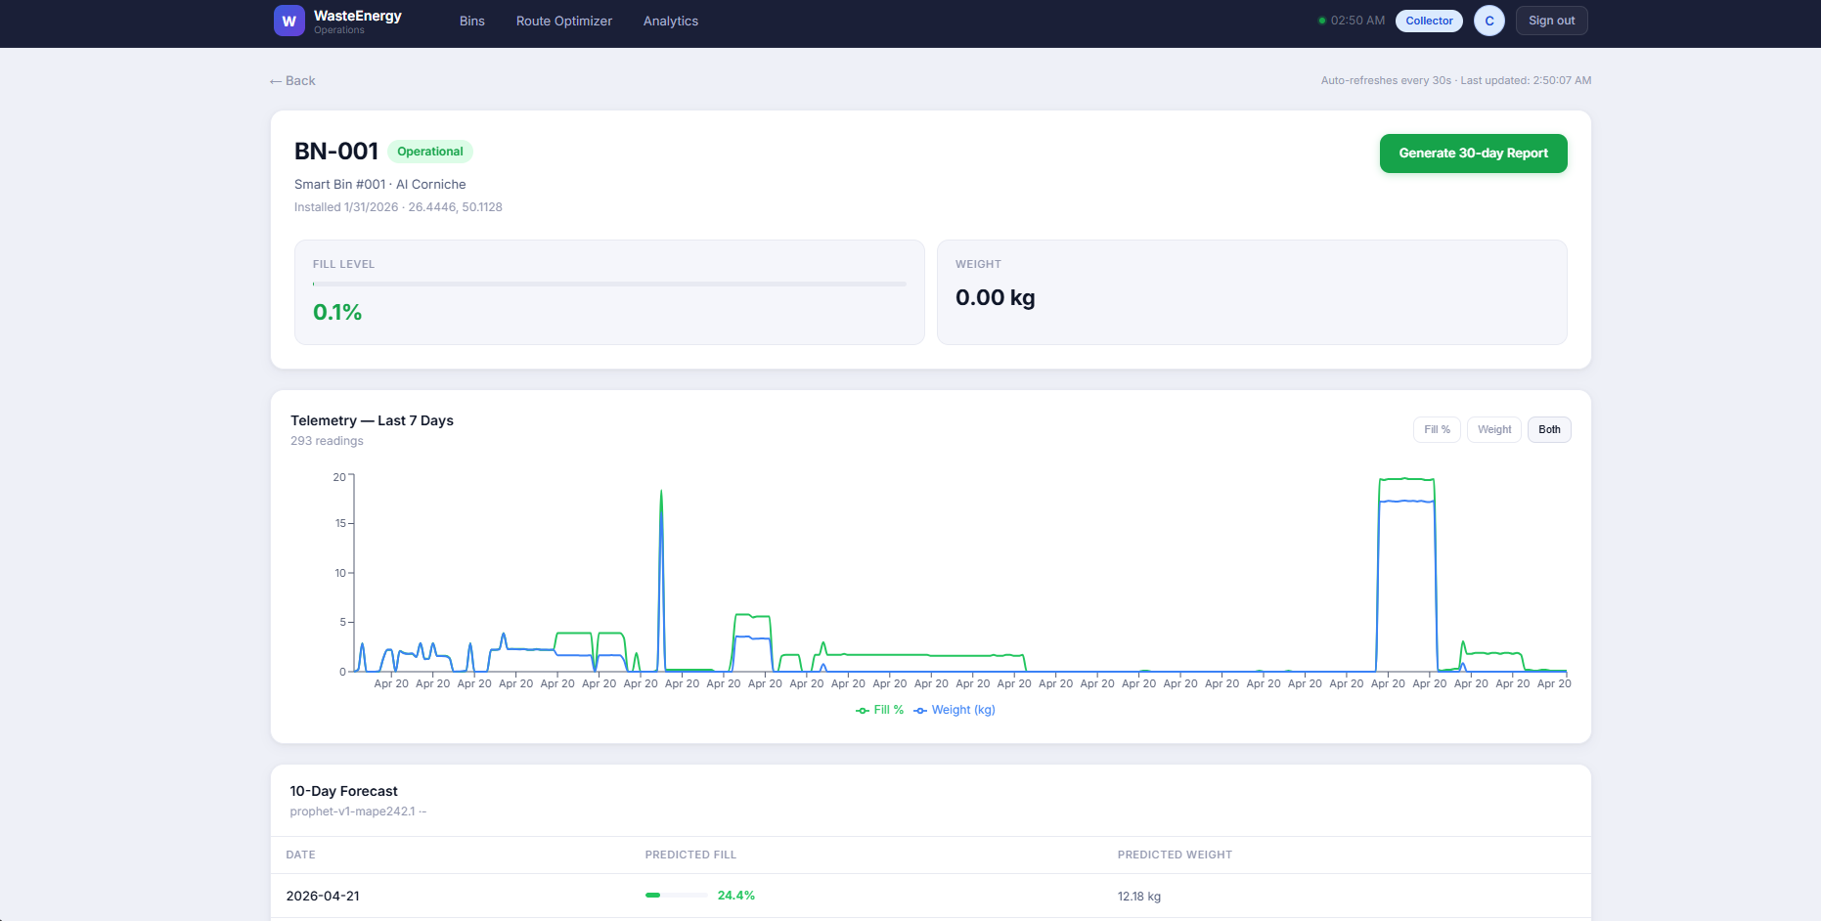
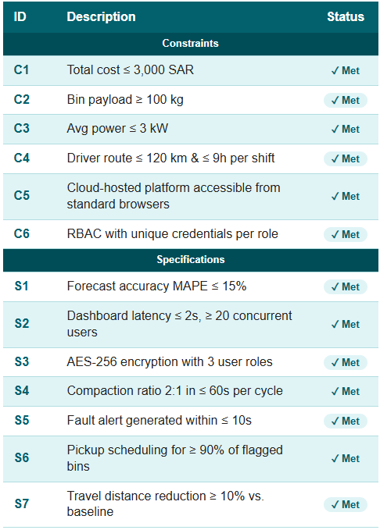
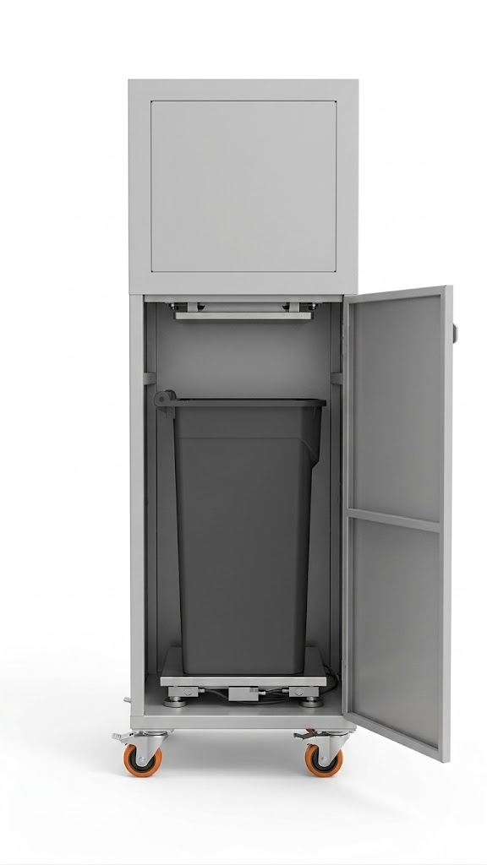
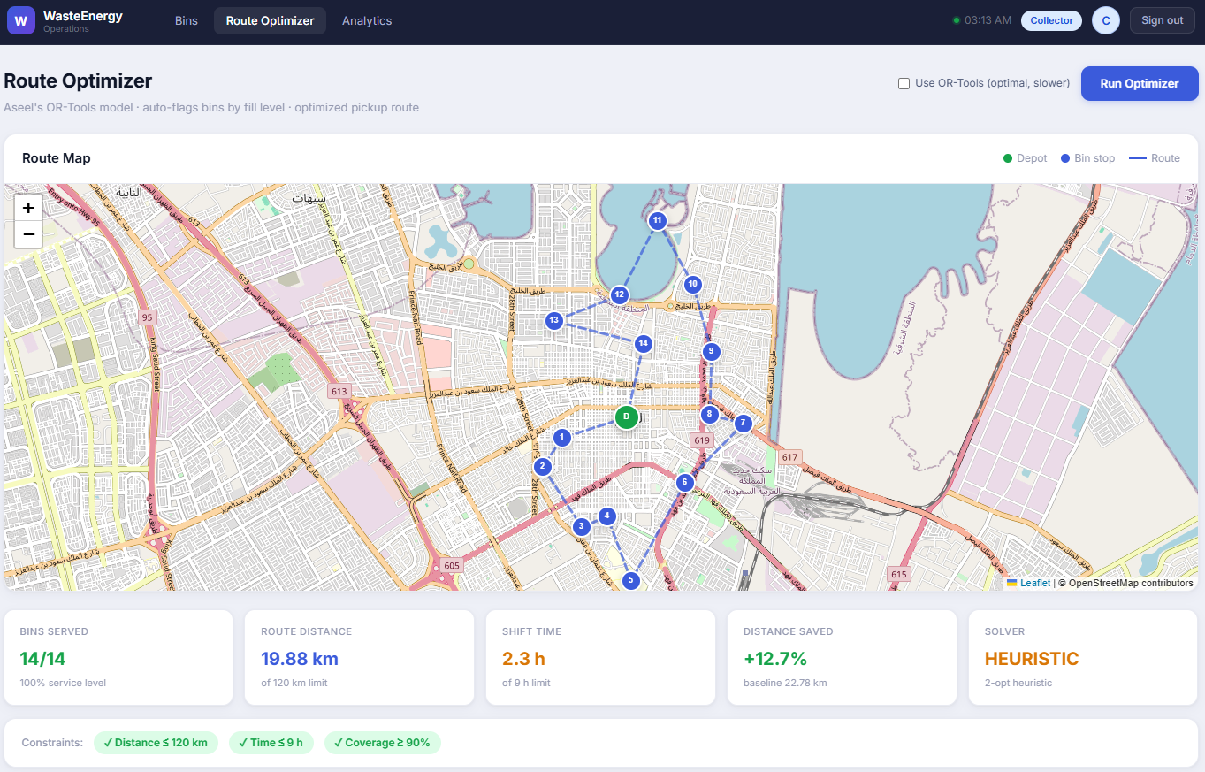
AI-Driven Food Waste Reduction & Energy Conversion for Restaurants
TEAM
M079
4
Aseel Ba Shammakh, Yousef Alsudais, Abdulmohsen Alghamdi, Sultan Alatawi, Tamam Aleidihi, Faisal Hejji
Coach: Dr. Sadam Al Azani
Problem Statement
System Overview
Dashboard
Key Results
Restaurants and waste collectors lack predictive visibility into food waste generation, resulting in reactive collection, overflow risks, hygiene issues, and lost energy value.
The system consists of five integrated layers working together to transform raw waste data into actionable decisions.
A cloud-hosted role-based platform providing real-time bin monitoring, alerts, forecasting, and pickup scheduling.
Constraints & Specifications
Smart Bin Prototype
A smart bin integrating load cell sensing, automated compaction, and IoT connectivity for real-time telemetry transmission.
Route Optimization
Conclusion
The ISE module generates daily pickup plans by prioritizing flagged bins, minimizing travel distance, and satisfying shift constraints.
The prototype successfully demonstrates an end-to-end AI-driven food waste management system. All constraints and specifications were met, achieving real-time monitoring, accurate forecasting, automated compaction, and optimized collection scheduling aligned with Saudi Vision 2030.

