Slide 1
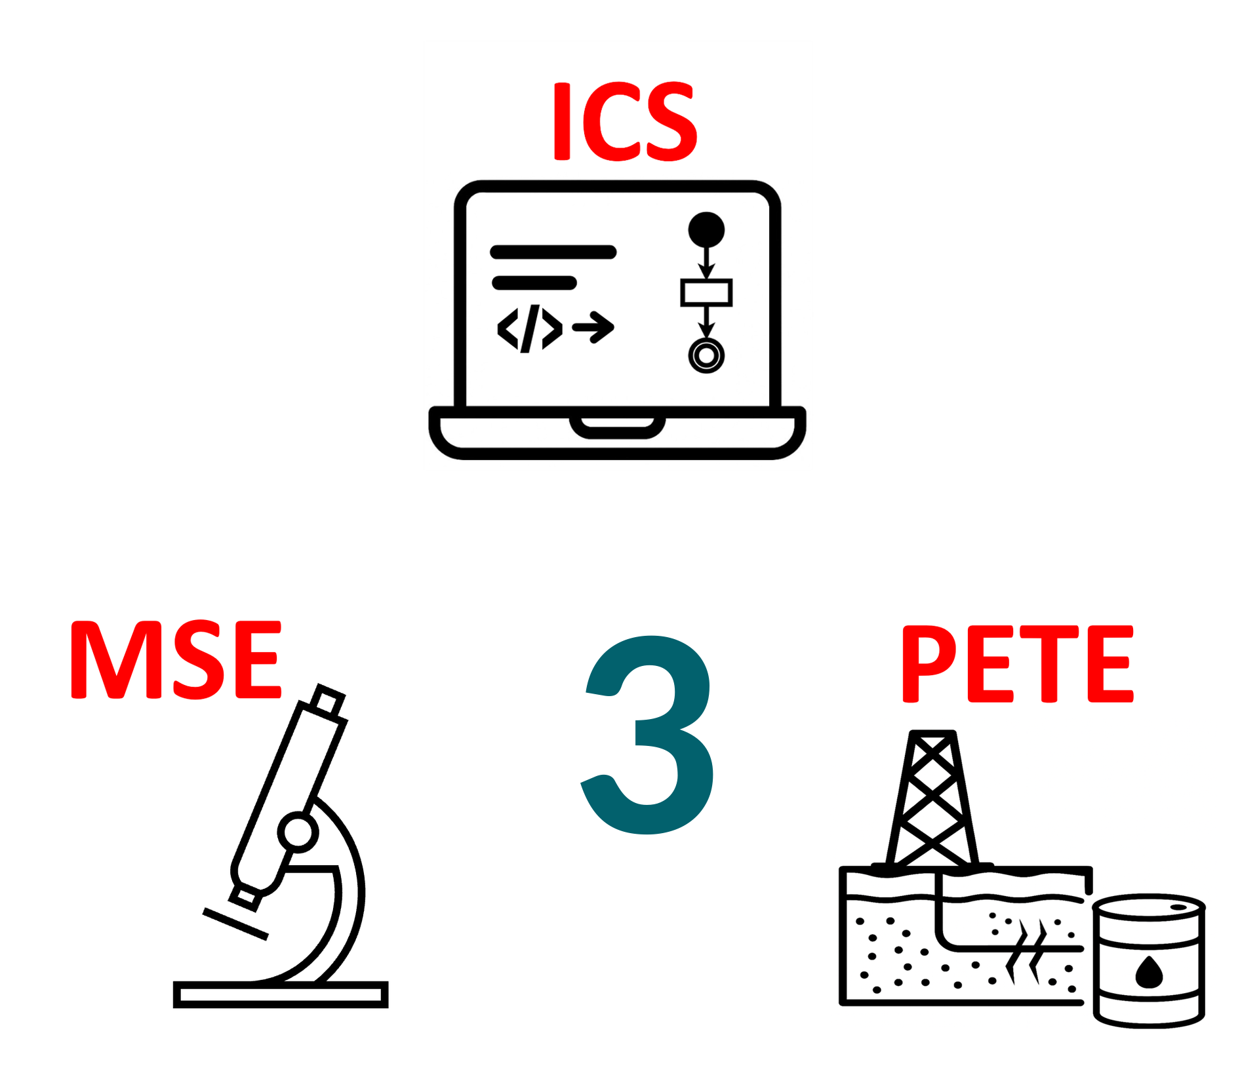
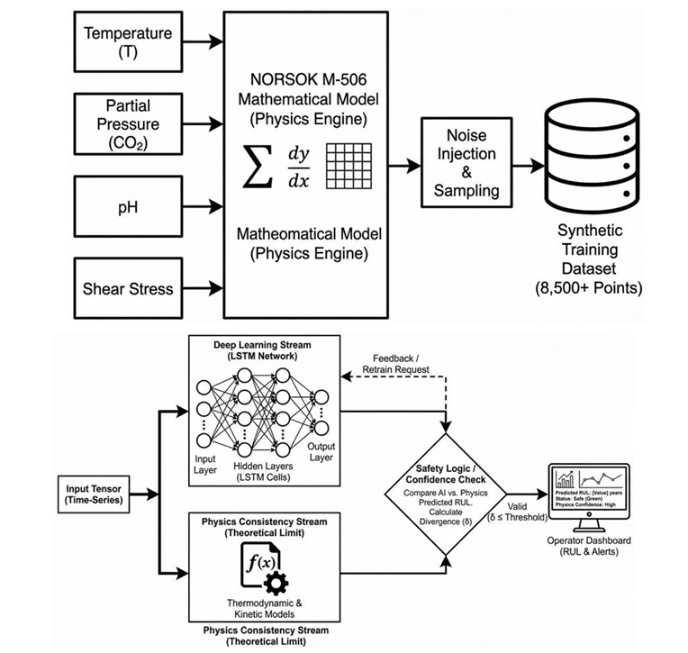
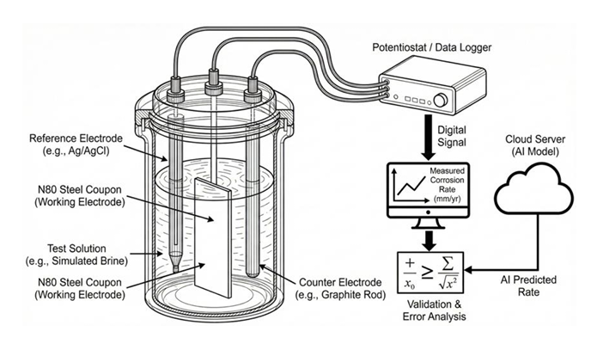
Advanced Casings Corrosion Detection Techniques
Using Machine Learning in Oil Wells.
TEAM
M078
INSERT HERE The Multi-Disciplinary Strength logo
Rashed Al-Qahtani, Faihan Aldossary, Abdullah Alismail, Faisal Alzahrani, Abdulrazzak Ghazal, Anas Alhanaya
Coach: Murtada Aljawad
Introduction & Problem
Constraint & Specifications
Prototype Design
Conclusion
Problem Statement
Constraints
The prototype is a complete predictive-maintenance system
Includes:
Data generation (synthetic but realistic)
Machine learning model
Operator dashboard
The system successfully combines engineering models with AI
Provides a scalable and cost-effective solution
Enables early prediction of corrosion failures
Improves safety, maintenance planning, and efficiency
Current methods cannot predict corrosion early.
Lack of real-time monitoring and intelligent decision-making.
Limited availability of real-world corrosion data for training models.
Limited casing samples & suppliers
Limited access to field data
Must comply with industry standards
Limited computational resources
Limited lab access & equipment
Minimum 500 data points / 50 well logs required
Must follow ASTM G31 testing standard
High computation → requires GPU
System Architecture
Objectives
Layer 1: Data Generation
Based on corrosion models (CO₂, H₂S, etc.)
Layer 2: AI Model
Learns degradation patterns from time-series data
Layer 3: Dashboard
Displays predictions for operators
Develop an AI-based system for corrosion prediction
Achieve accurate and real-time analysis
Improve safety and reduce operational cost
Specifications
Prediction time < 0.5 sec
Corrosion rate MAE < 5%
Dataset ≥ 8000 simulation points
Training data ≥ 500 points / 50 logs
Lab validation using API 5CT casing
Reduce monitoring cost by ~30%
Reduce high-risk operations by ~25%
Solution
Implement an AI-based predictive maintenance system
Train ML models on realistic corrosion data
Provide results through an operator dashboard
Integrated Specifications
Detect ≥ 10% wall loss with ≥ 90% accuracy
Corrosion type classification accuracy ≥ 70%
Predict up to 5 years (12-month intervals, 95% CI)
Output index 0–100 (Corrosion Failure Index)
Monitor up to 10 wells (16GB GPU)

