Slide 1
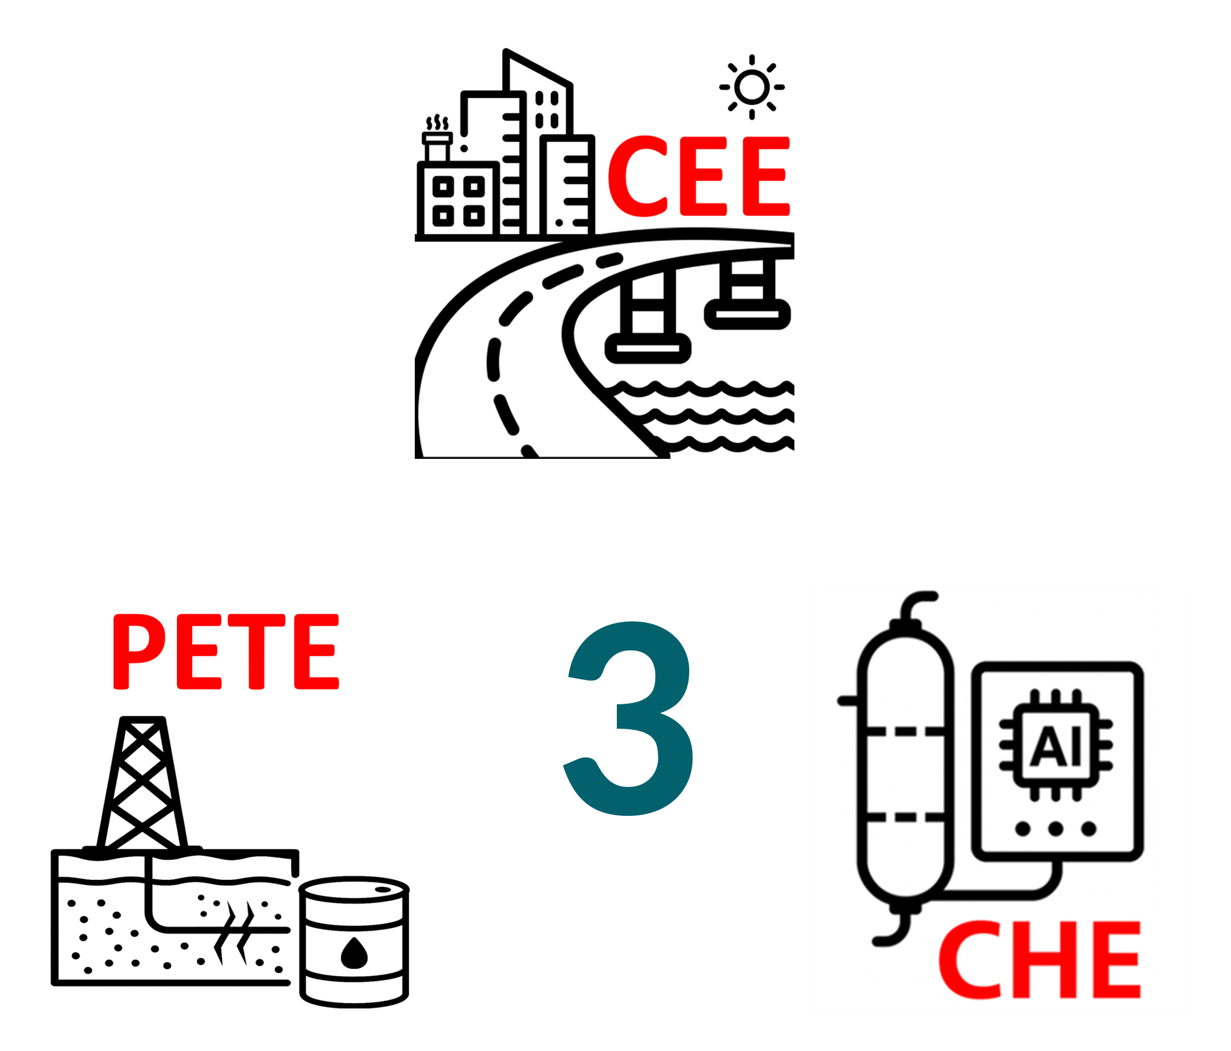
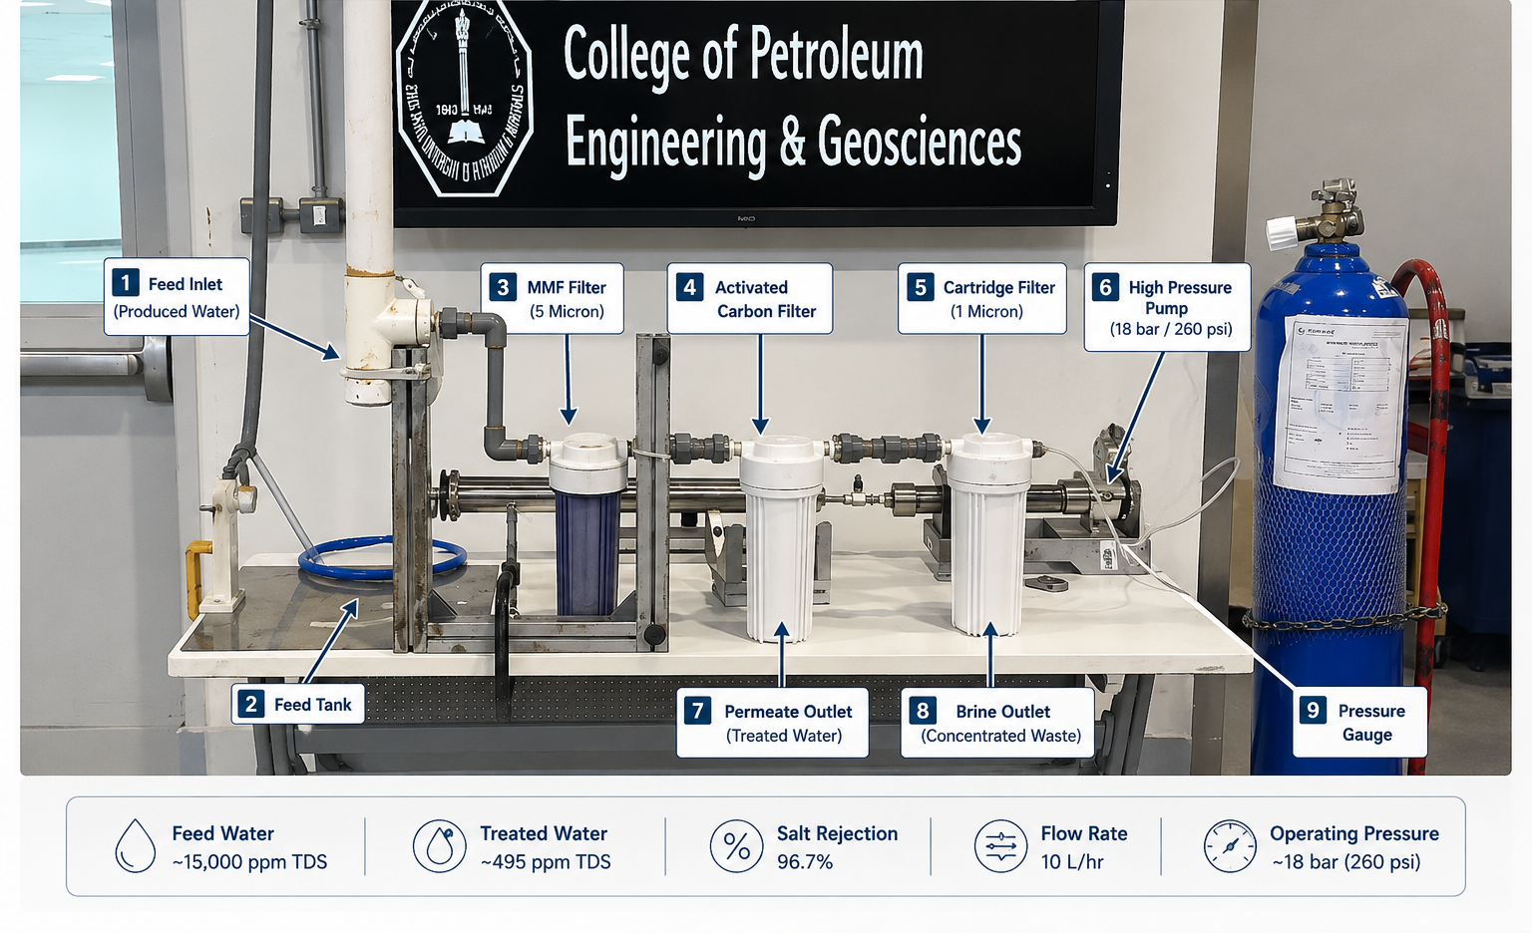
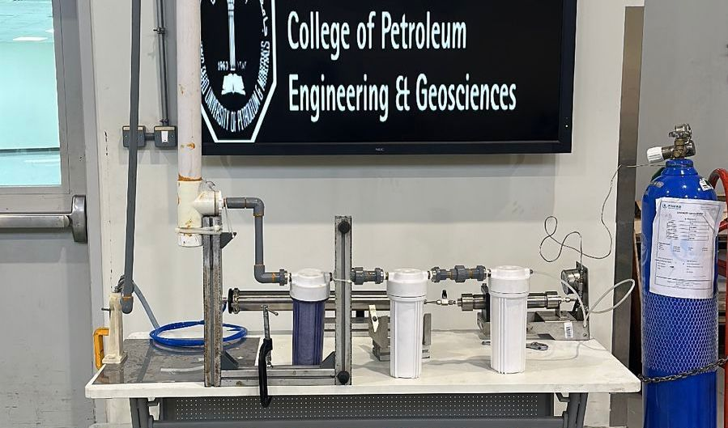
Produced Water Desalination and Treatment System for Oilfield Applications
TEAM
M077
INSERT HERE The Multi-Disciplinary Strength logo
Abdullah Al-Harbi (PETE), Abdulrahman Alfawaz (PETE), Omar Almutairi (CHE), Abdulaziz Alzahrani (CHE), Homoud Al-Kuthamy (CE).
Coach: Dr. Murtada Al-Jawad.
Problem Statement & Objective
Prototype Development
Validation and Verification
Conclusion
Problem: Produced water disposal is costly and environmentally risky due to high salinity (~15,000 ppm TDS).
Objective Design a portable modular desalination skid for onsite produced water treatment and reuse.
Novelty: Decentralized treatment eliminates transportation to centralized facilities.
Prototype Overview
The prototype uses a BW-2521 reverse osmosis membrane to desalinate produced water (10,000–15,000 ppm TDS).
Main Components
Pretreatment filters
High-pressure pump
RO membrane
Pressure monitoring system
Permeate and brine outlets
Performance
≥95% salt rejection
Operating pressure: ~250 psi
Portable modular skid design
Salinity Test:
15,000ppm→495ppm
✔ 96.7% Removal
Load Test:
The skid successfully supported all components with zero deflection.
Flow Test:
Consistent output of 10 L/hr achieved at 18-bar operating pressure
Portable onsite treatment was successfully demonstrated.
Salinity reduced from 15,000 ppm to 495 ppm.
System achieved 96.7% salt rejection.
The skid meets portability, safety, and efficiency requirements.
Constraints & All Specifications
7
Parameter | Target | Achieved
Weight | <50 kg | 33 kg
TDS Removal | >95% | 96.7%
Energy Use | <1.5 kWh/L | 1.2
Safety Factor | >1.5 | 10.74
RO Membrane
(BW-2521)
2
Multi Media Filter
3
4
5
Filter 1
(5 Micron)
Activated Carbon Filter
Cartridge Filter
(1 Micron)
1
Feed Tank
(Produced Water)
8
6
High Pressure Pump (18bar/260psi)
Outlet
(Treated Water)

