Slide 1
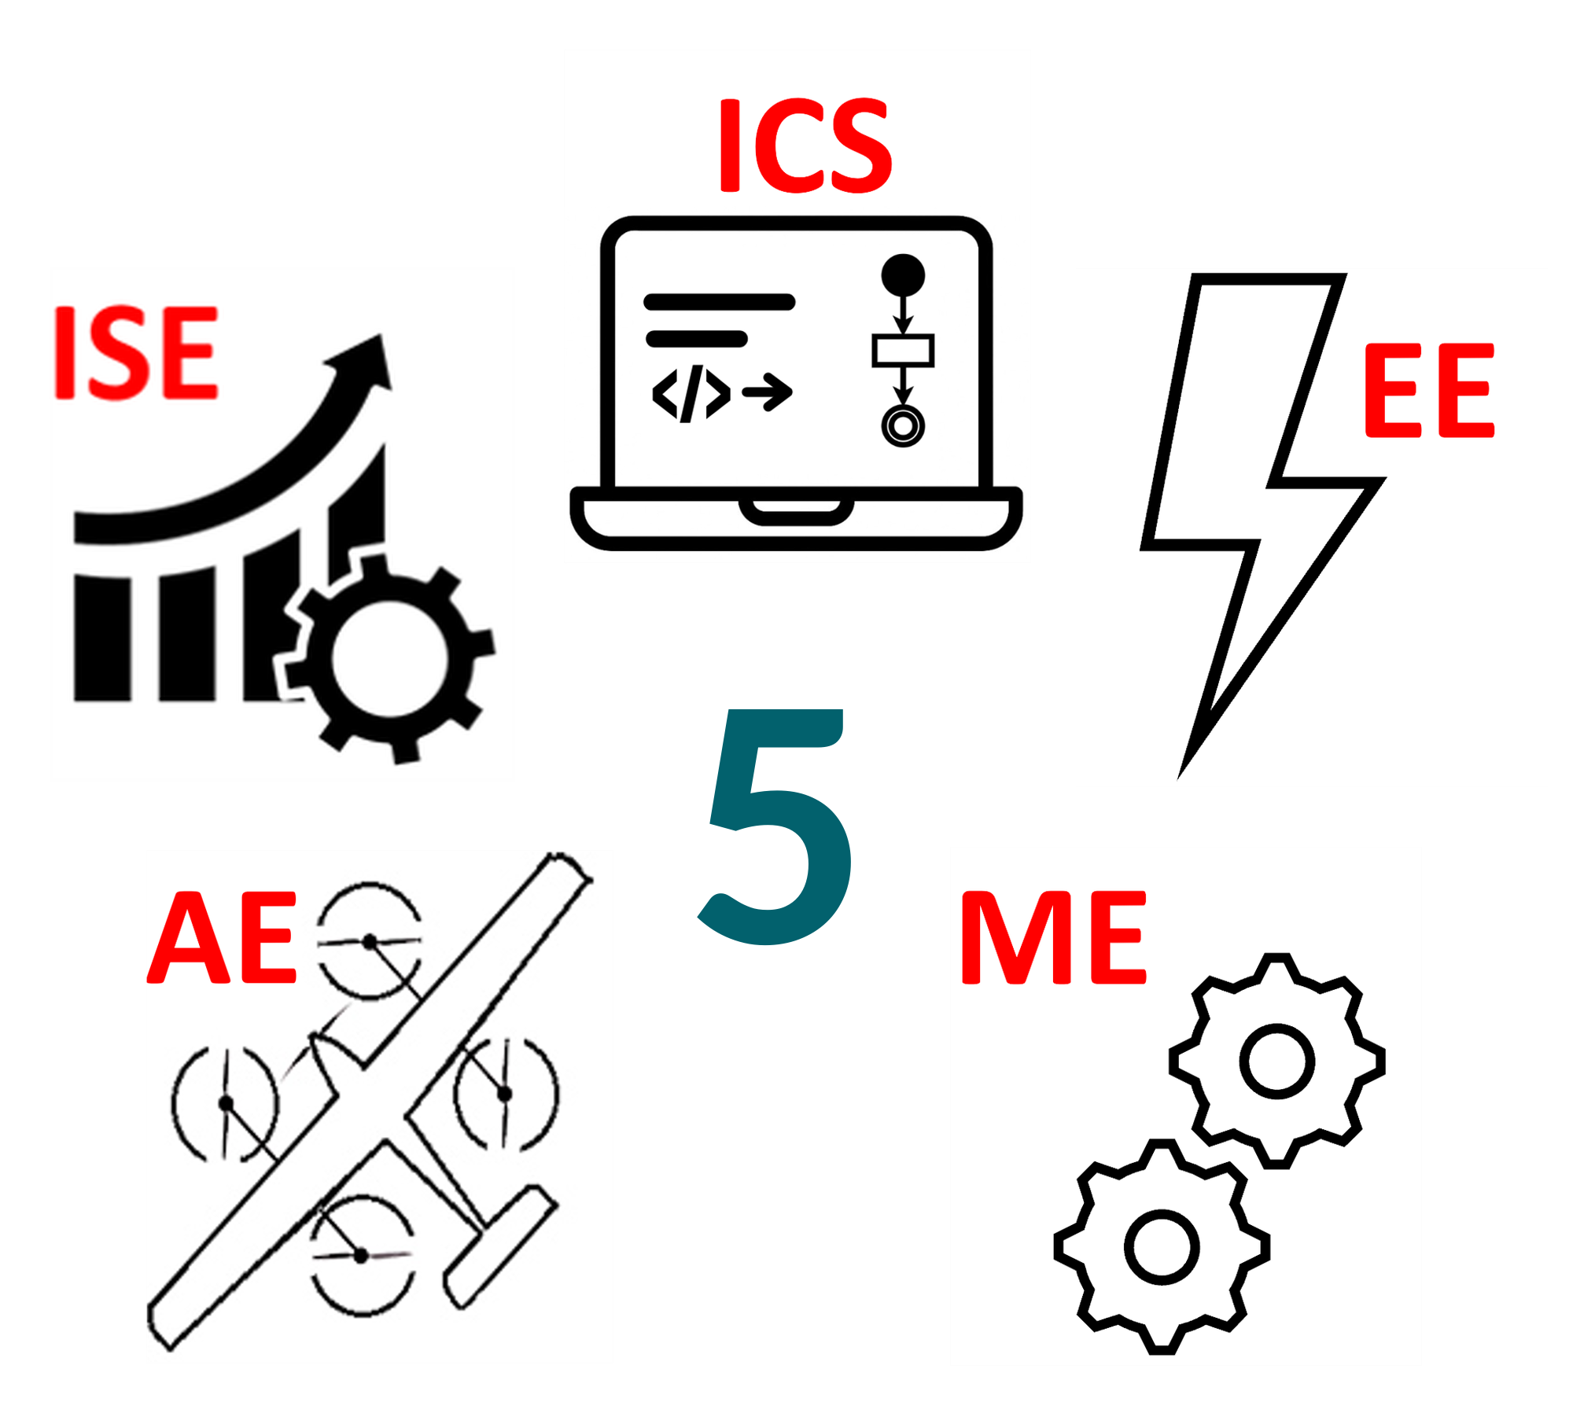
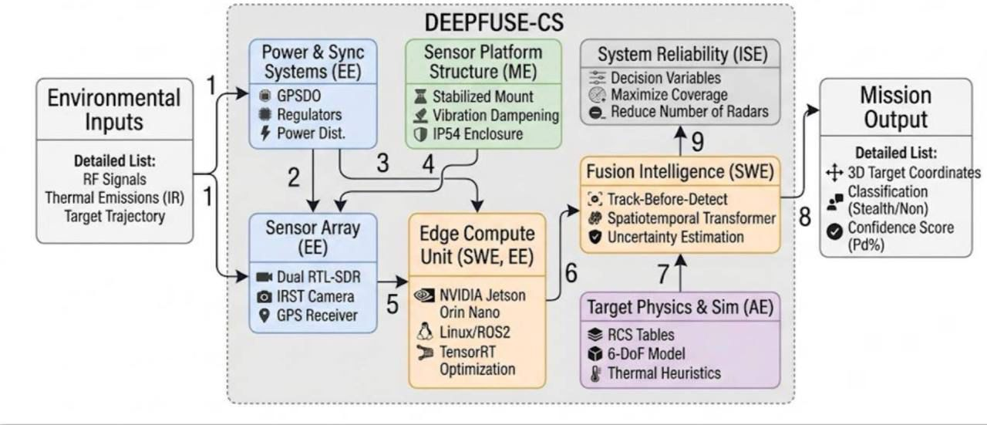
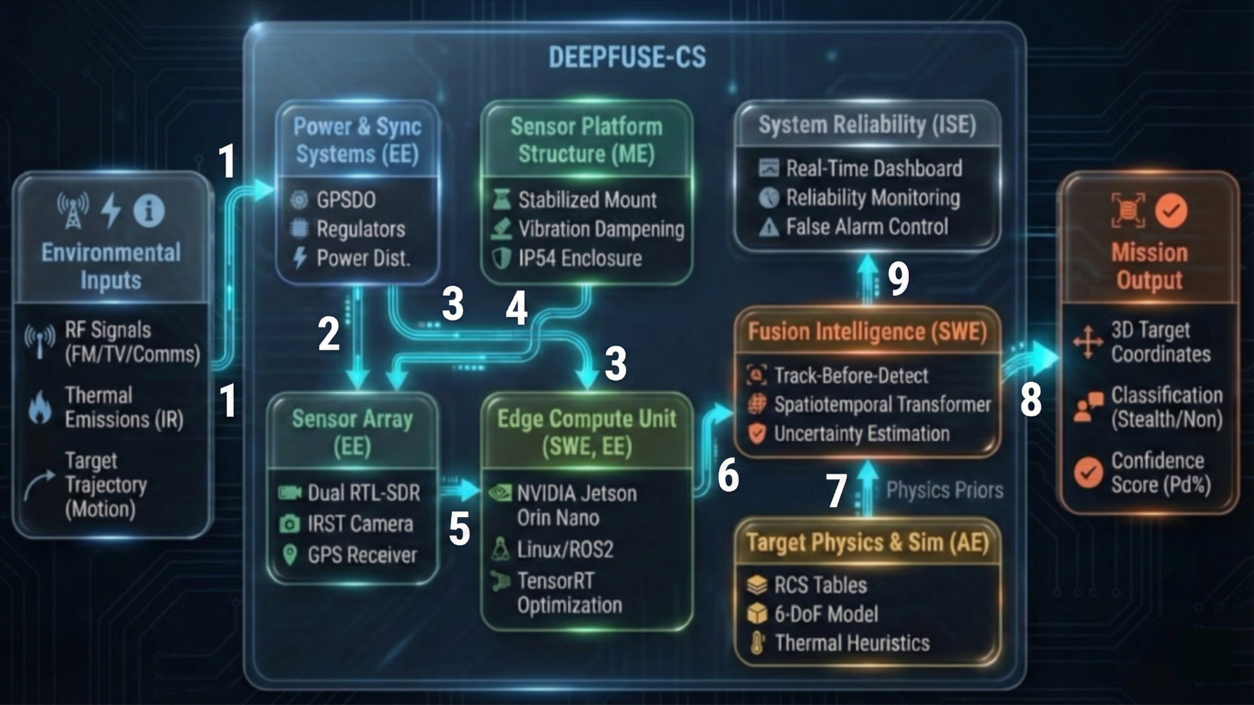
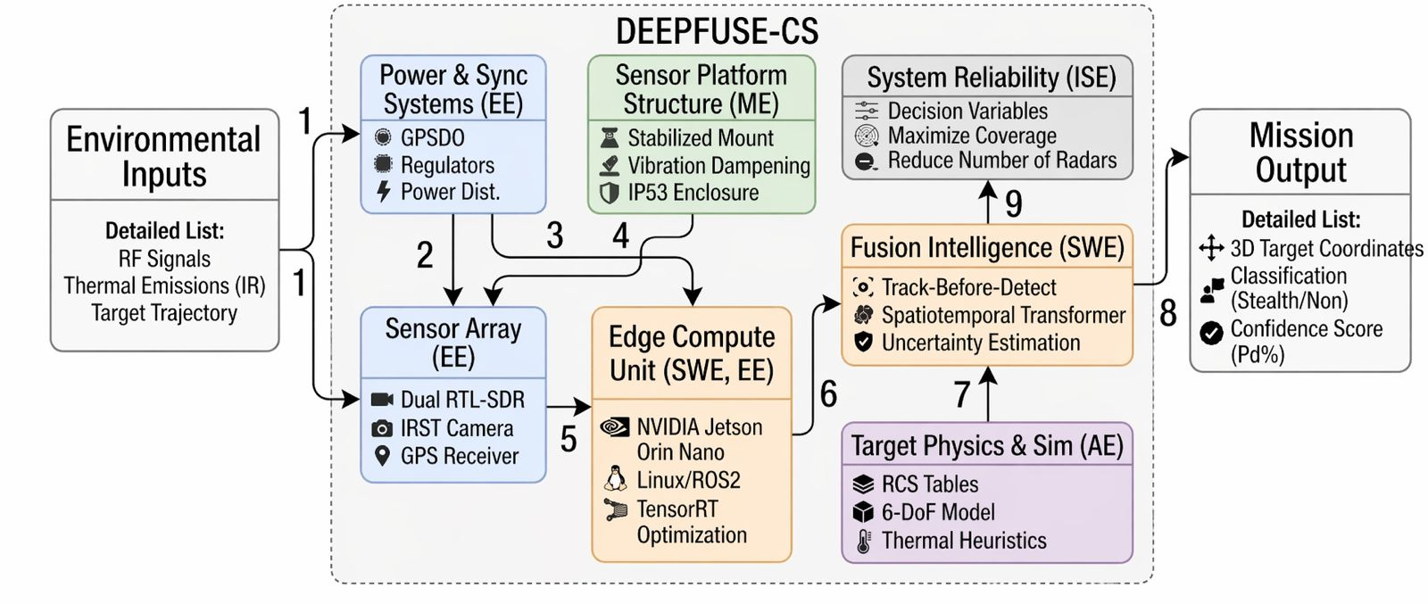
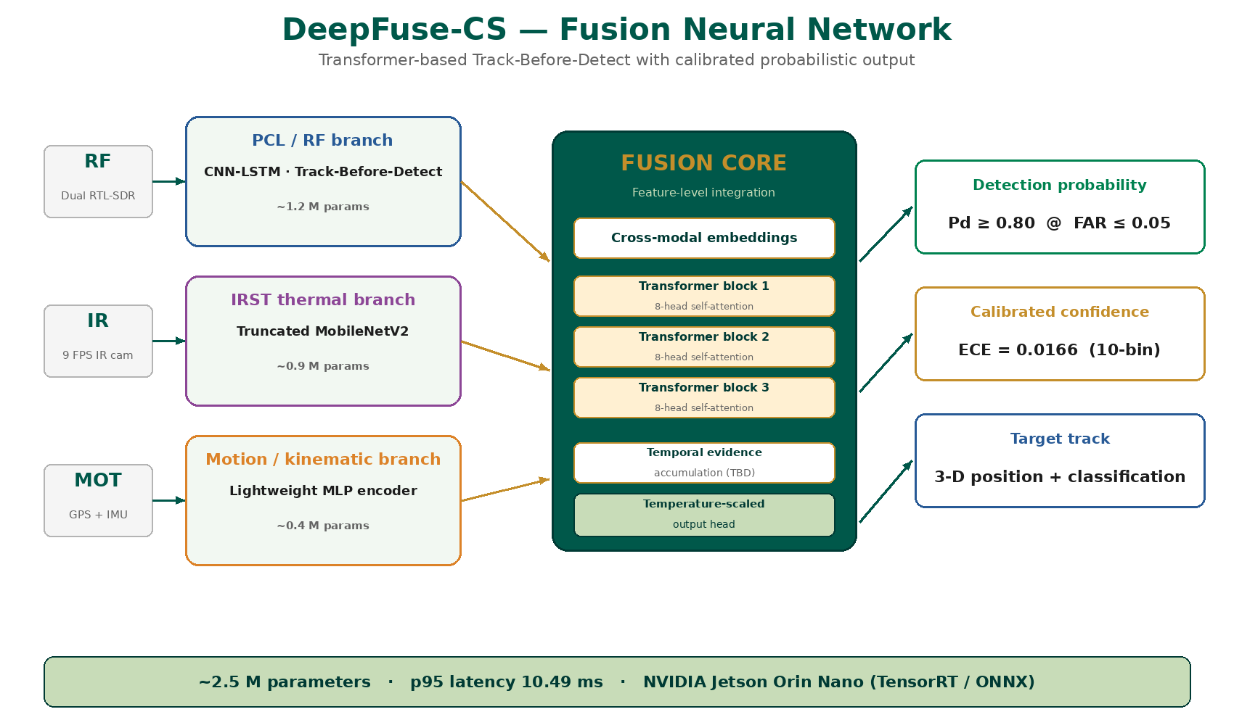
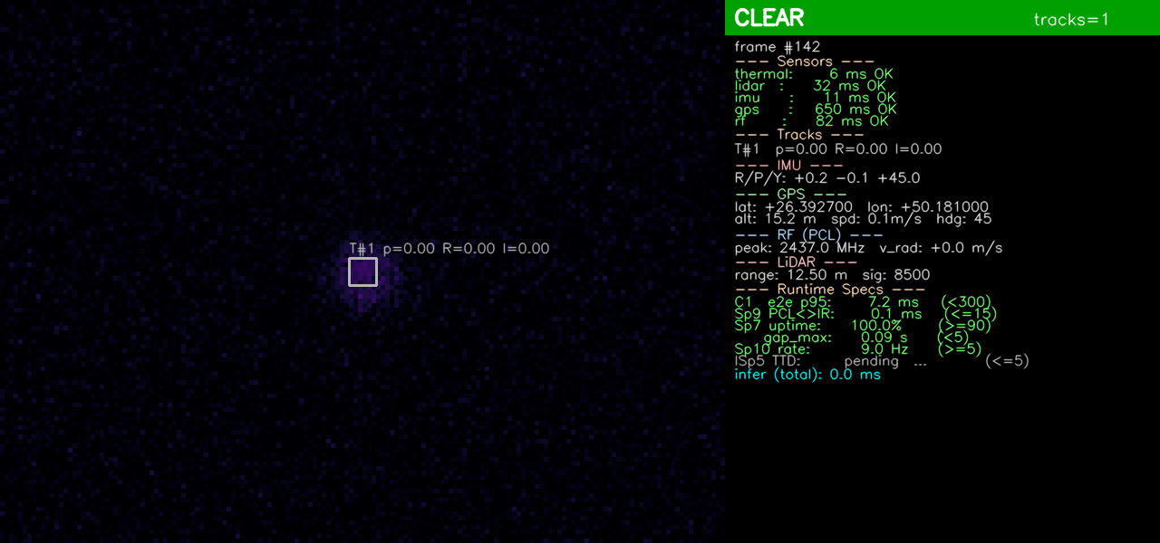
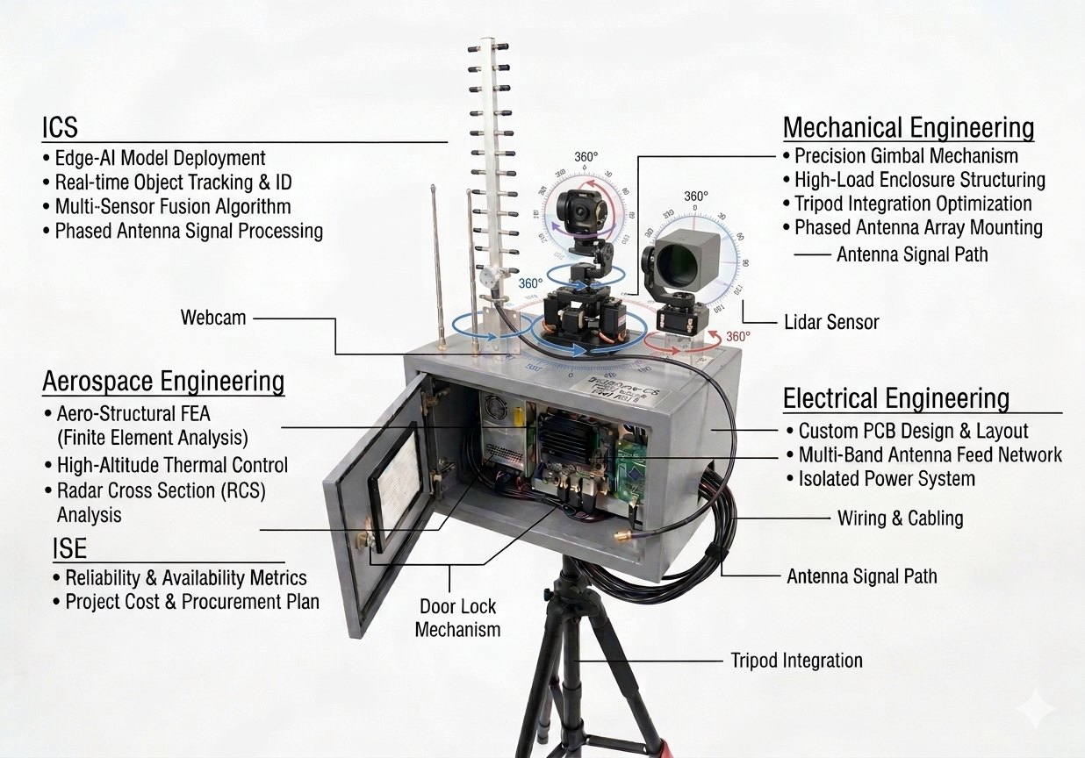
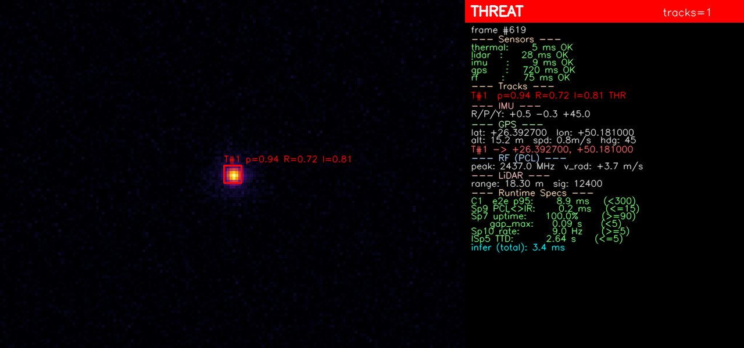
DEEPFUSE-CS: Deep-Learning Counter Stealth via Multi-Sensor FUSION
TEAM
073
Faisal Alhamdi, Naif Alenazi, Abdullah Alluqmani, Mohammed Bedaiwi, Mohammed Bin Mahfodh, Ibrahim Alowaidi
Coach: Dr. Bilal Qureshi
Introduction
Deliverables
Achievements
Constraints and Specifications
Test and Validation
Modern air-space monitoring struggles to detect low-observable (LO) aerial targets using a single sensing modality. Stealth platforms shape their radar cross-section, absorb RF energy, and manage their thermal signature so they fall below fixed detection thresholds.
DeepFuse-CS is a multi-sensor edge-based detection system that fuses RF (PCL / SDR), IRST thermal, and motion signals in real time inside a Transformer-based Track-Before-Detect engine that accumulates weak evidence across time and sensors.
Unlike radar-only or camera-only systems, DeepFuse-CS performs deterministic, synchronized multi-sensor integration on low-power edge hardware — enabling reliable detection under strict real-time constraints.
Verification across all 5 disciplines
• Real-time dashboard streams 5 Hz detections and sensor-health telemetry.
• Wind-tunnel + outdoor gust test: mount holds alignment to ≤ 1° at 10 m/s.
• Placement MILP: ≥ 90 % area coverage, ≥ 70 % multi-angle observability.
• Export-control checklist cleared at every design gate (CDR · PPR · UP2 · FPR).
Every specification & constraint — met.
Real-time fusion on the edge: p95 latency 10.49 ms (10× under the 100 ms budget). Synchronized RF + IR ingestion with p95 timing skew 13.17 ms and drop-rate 10.5 %. Confidence calibrated to ECE = 0.0166 — well below the 0.08 ceiling. Detection performance Pd ≥ 0.80 / FAR ≤ 0.05 across SNR −5…+5 dB.
SWE SOFTWARE ENGINEERING
C1
Real-time p99 latency ≤ 100 ms / cycle
S1
Pd ≥ 0.80 @ FAR ≤ 0.05
S10
Dashboard update ≥ 5 Hz (≤ 200 ms)
IS1
ECE ≤ 0.08 (calibrated confidence)
EE ELECTRICAL ENGINEERING
C3
Inter-receiver sync ≤ 100 ns (GPSDO / PTP)
C7
SDR bandwidth ≤ 20 MHz / channel
S2
Operational SNR ≥ −5 dB (PCL chain)
C4
Power ≤ 40 W over 0–60 °C range
ME MECHANICAL ENGINEERING
C5
Payload ≤ 3 kg · structural SF ≥ 1.3
S3
Angular deviation ≤ 1° at 3 Hz vibration
S4
Enclosure IP53 · wind ≤ 10 m/s
Prototype
S9
Alignment drift ≤ 3 mm / 0.5° in 1 h
AE AEROSPACE ENGINEERING
S5
RCS: 3 aspect bins, 0.01 – 10 m² range
S6
IR contrast ΔT ≥ 1 °C above background
C5E
Ethics: 100 % unclassified, research-only
ISE INDUSTRIAL & SYSTEMS ENGINEERING
C8
12 candidate radar-placement sites
S3i
Area coverage ≥ 90 %
Problem Statement
S4i
Multi-angle observability ≥ 70 %
S7
System availability ≥ 90 % in 1 h
Design a research-safe system that reliably detects and tracks low-observable aerial targets under low-SNR conditions, using 100 % unclassified data and COTS hardware only.
Performance targets
Pd ≥ 0.80 @ FAR ≤ 0.05 over SNR ∈ [−5, +5] dB
Real-time p99 latency < 100 ms per detection cycle
Calibrated confidence: ECE ≤ 0.08 (10-bin)
System availability ≥ 90 % during 1-hour run
Scope boundaries
Research, evaluation and training only — no targeting, no engagement, no autonomous decision-making. ITAR / EAR cleared; aligned with KFUPM ethics and Saudi Vision 2030.
Conclusion
DeepFuse-CS delivers a working, reproducible, ABET-compliant counter-stealth demonstrator.
Fusion TBD detector meets Pd ≥ 0.80 / FAR ≤ 0.05 across SNR −5…+5 dB with p95 latency 10.49 ms.
ECE = 0.0166 — operators see meaningful probabilities, not opaque binary decisions.
Physical mount: SF ≥ 1.3, IP53, wind ≤ 10 m/s, drift ≤ 3 mm / 0.5° after 1 h.
Placement MILP: ≥ 90 % area coverage, ≥ 70 % multi-angle observability.
100 % unclassified, ITAR/EAR-cleared; Saudi Vision 2030 aligned.
Future work: multi-target tracking, on-device TensorRT optimization, wider-bandwidth SDR field trials.

