Slide 1
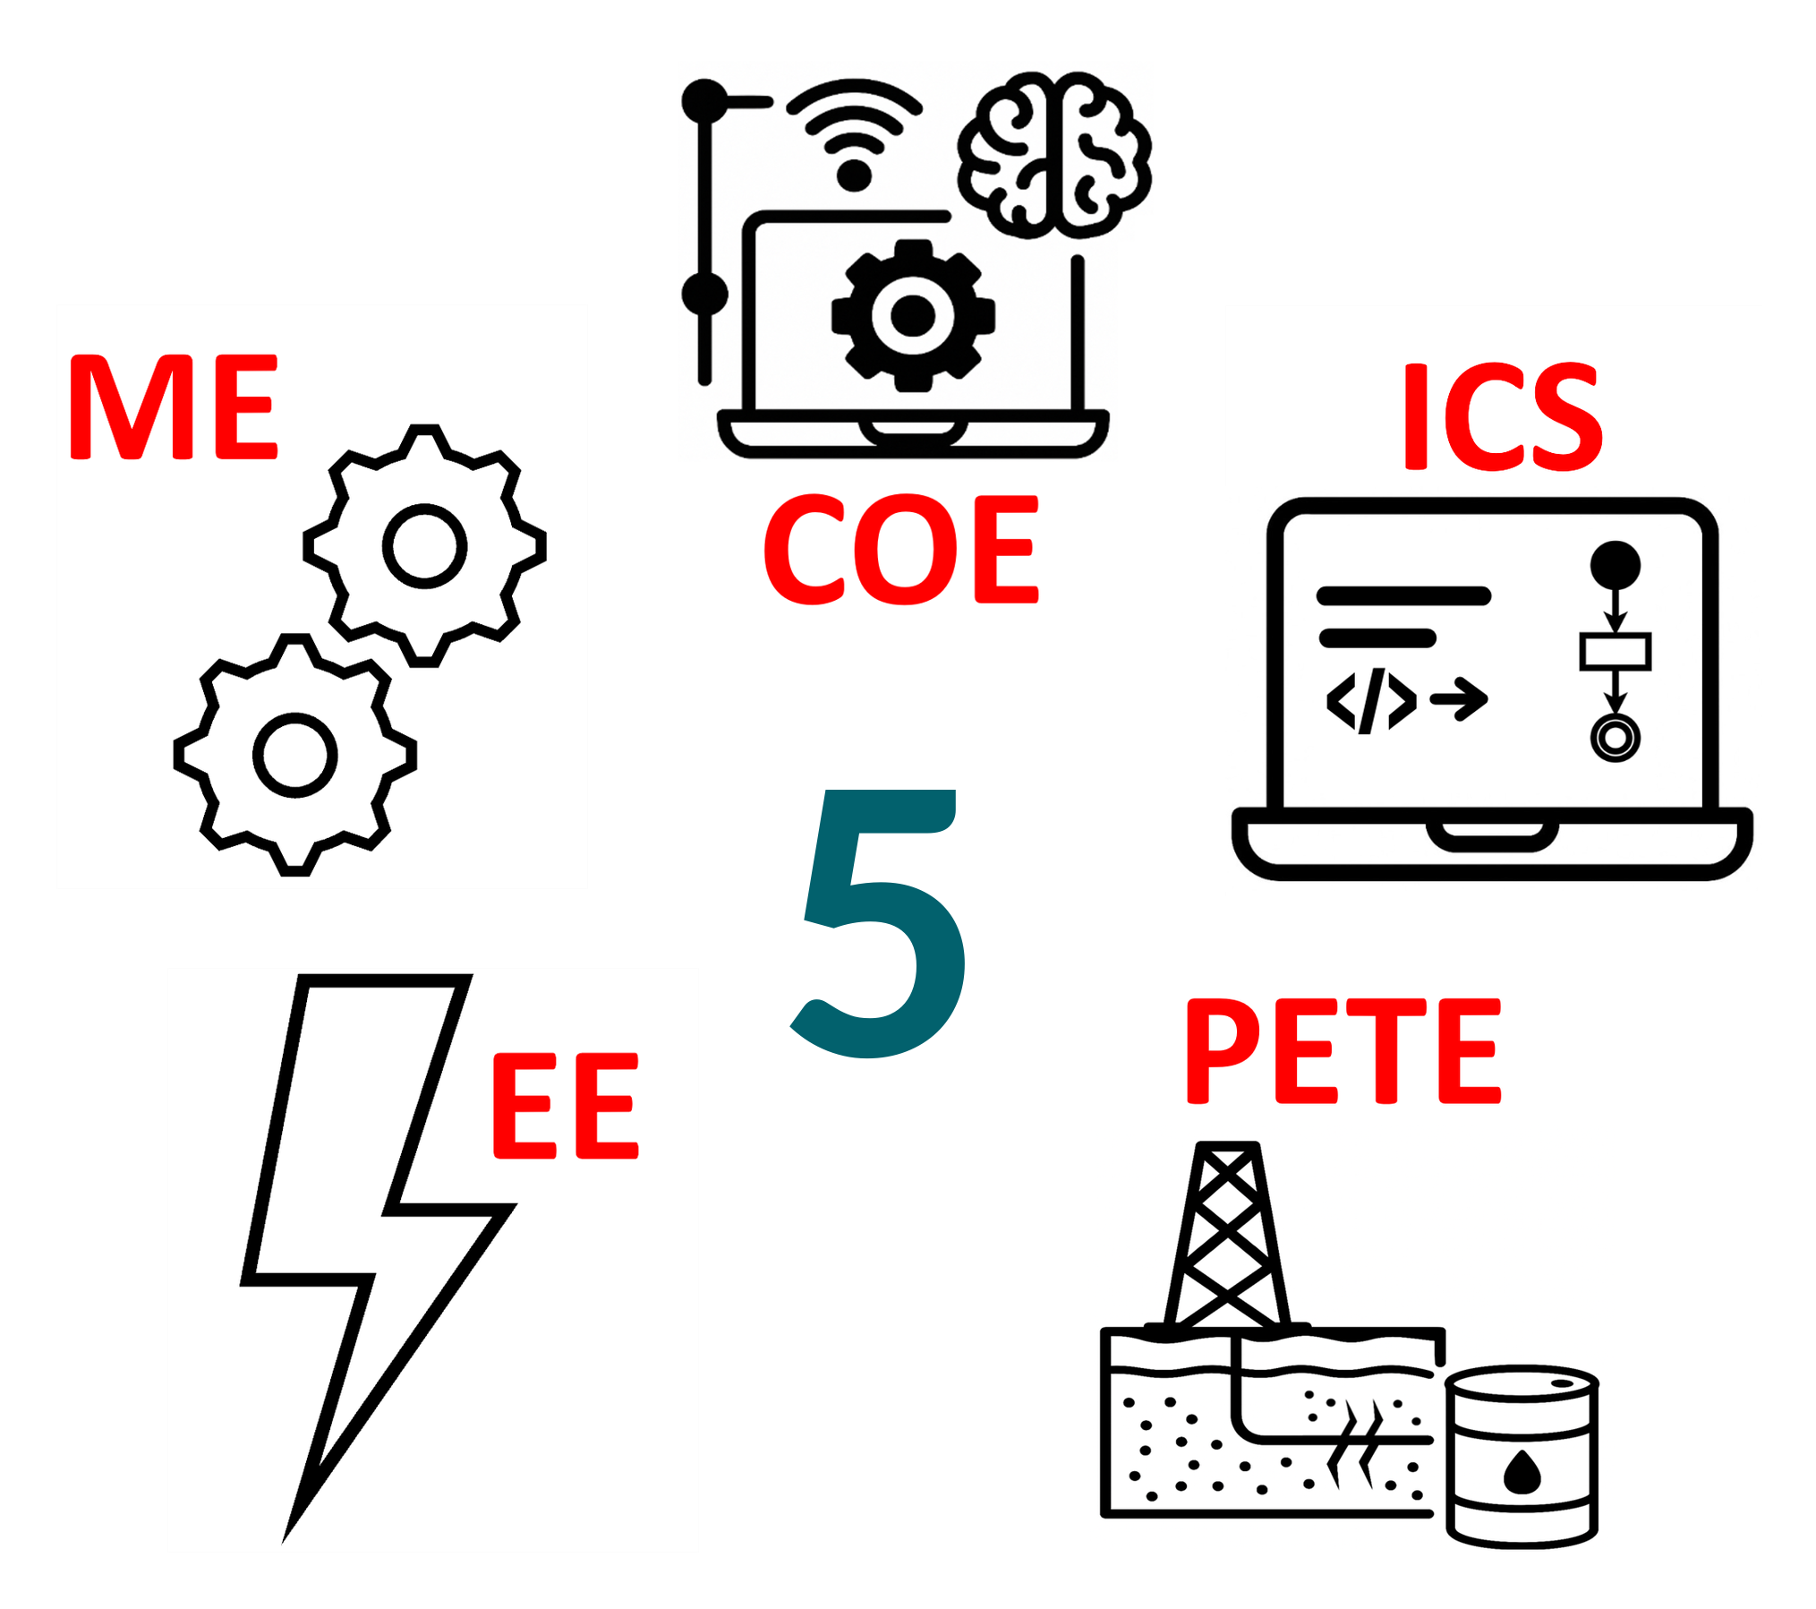
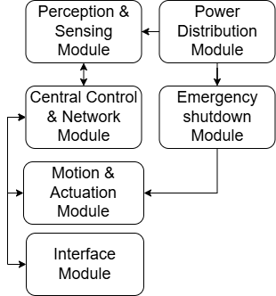
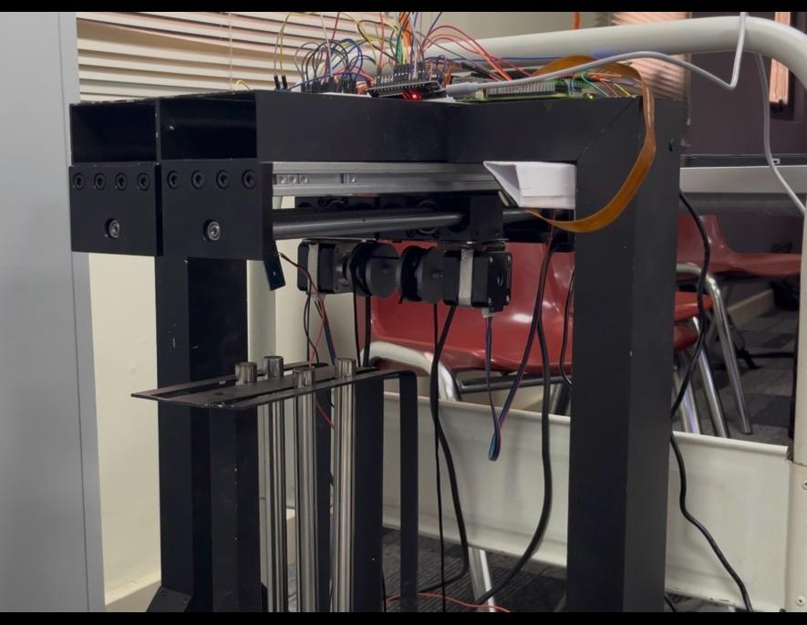
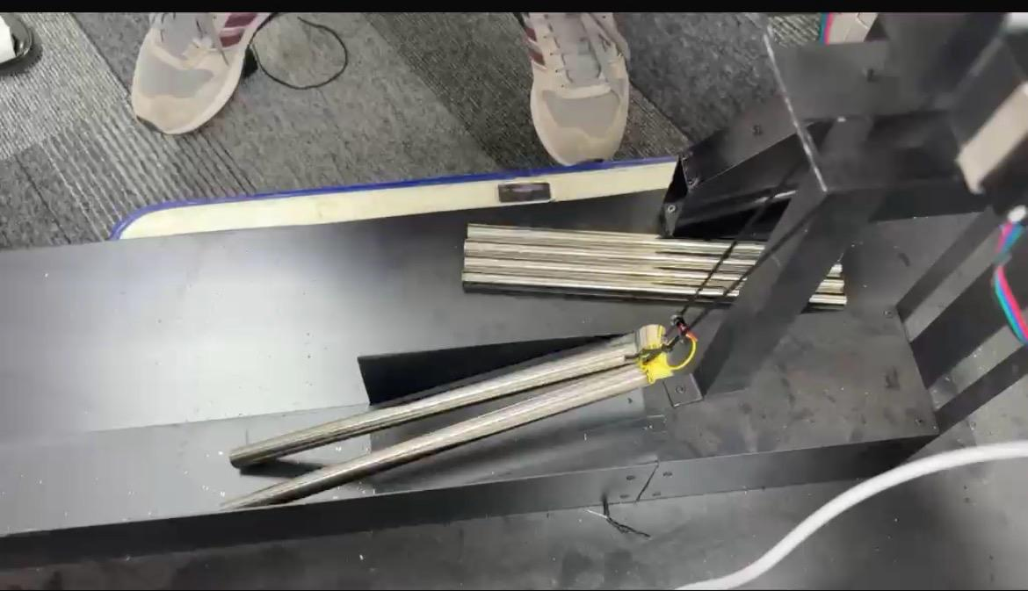
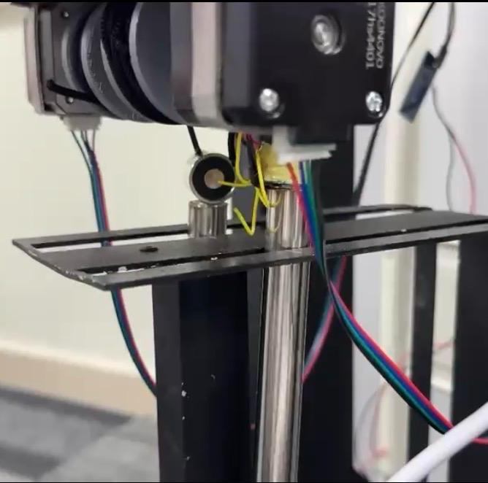
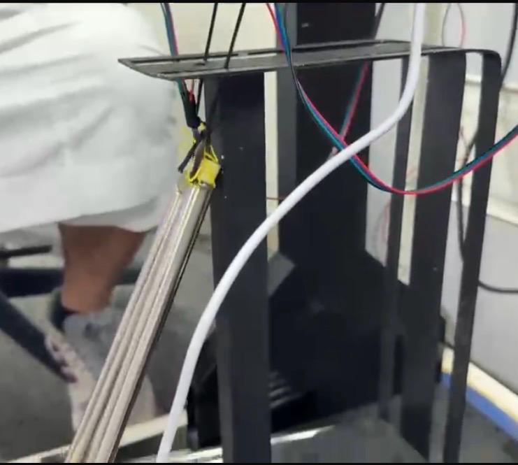
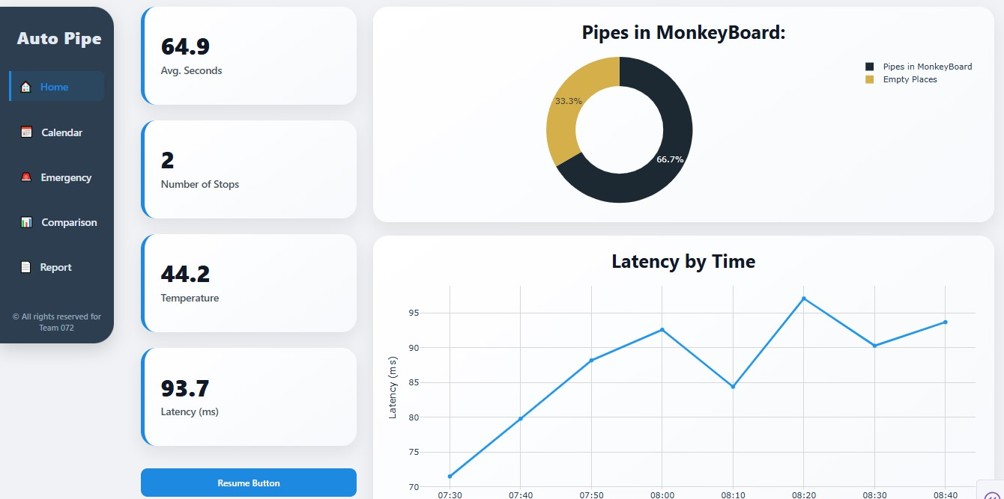
Multi-Pipe Automated Handling System for Drill Rigs
TEAM
M072
Moad Binmatlig, Ibrahim Alruwaished, Abdulrahman Aljunaid, Saifullah Bukhari, Mohammed Mokli, Mohammed Alkhaldi
Coach: ⁠Mohamed Zhani
Objective
Specifications
Constraints
System Design
Develop a fully automated, multi-pipe handling system using electromagnetic lifting and smart control architectures to eliminate human intervention.
Red-zone exposure: 90% reduction
E-stops: 3 stations
Batch size: 2–5 per run
Event logging: 100% rate, ±500ms accuracy
Server logs: 100% integrity, 30-day retention
Uptime: 90% of rig hours
Safety factor: >1.5
Pipe positioning: 60–90s (Tripping Schedule sync)
Leg cross-section: ≥30×30mm for 10kg load
Computer Vision accuracy: ≥85% testing score
Similarity analysis: Dimensionless kinematic/dynamic checks
Gantry drive: Compatible linear belt system
Ambient temp: Operational up to 60C
Inventory UI: 1s refresh, <0.5s delay
Load capacity: 200–300kg (Real) / 0.3–0.4kg (Prototype)
Elevator alignment: ±5mm tolerance via sensor fusion
GUI latency: <100ms visual updates
Initial cost: ≤ current method
Frequency: 60Hz operation
Pipe handling: 2 horizontal drill pipes
Security: Cybersecurity protocols for sensitive data
Structural integrity: Support full load
Prototype similarity: Maintain real design/material behavior
Weather: Resistant to high temp/wind
Rig geometry: Gantry must fit existing rig
Prototype Development
1
2
4
3
Validation & Verification
Metric | Specification Requirement | Results
Cycle time | 60 - 90 Seconds | 90s (success)
Safety Response | <50ms E-stop latency | 20ms (success)
Vision Accuracy | >85% Accuracy | 90% (success)
Alignment | ±5mm Precision | ±5mm (success)
Data integrity | 100% logging | 100% verification (success)
Communication | 100ms latency | 70ms (success)
Results & Conclusion
Results: The prototype successfully executed its objective successfully.
Conclusion: This system provides a scalable, automated alternative to manual pipe handling, significantly reducing rig floor hazards and advancing drilling efficiency through smart automation.
System Dashboard

Slide 2
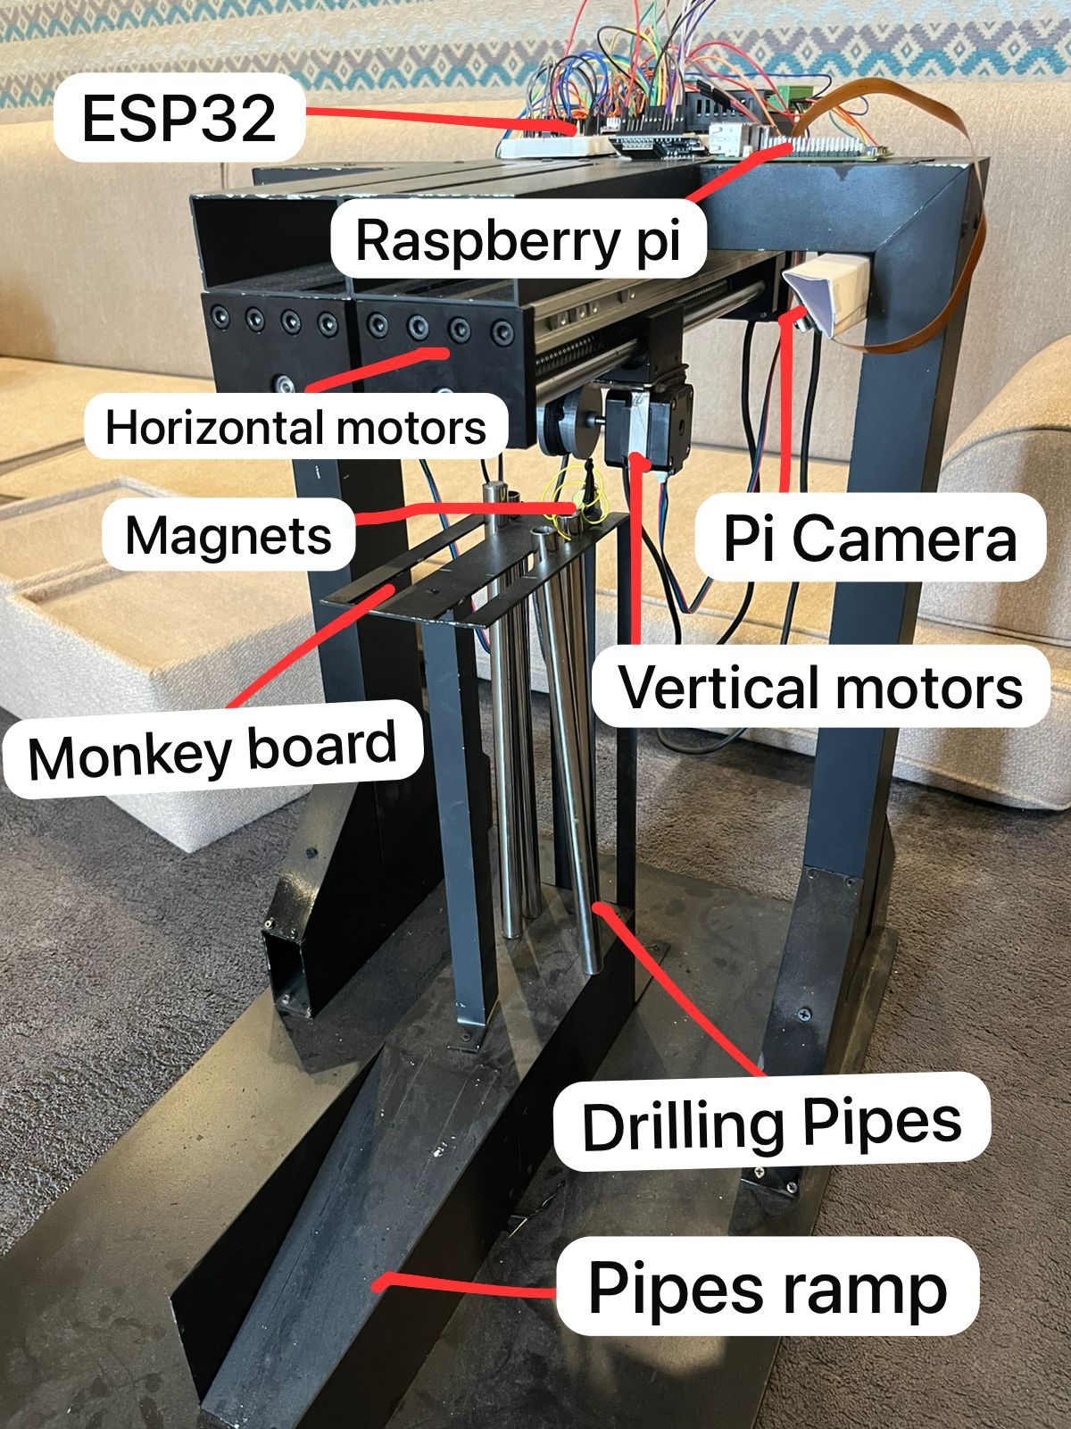
Multi-Pipe Automated Handling System for Drill Rigs
TEAM
M072
Moad Binmatlig, Ibrahim Alruwaished, Abdulrahman Aljunaid, Saifullah Bukhari, Mohammed Mokli, Mohammed Alkhaldi
Coach: ⁠Mohamed Zhani
Objective
Specifications 1
Specifications 2
System Design
Develop a fully automated, multi-pipe handling system using electromagnetic lifting and smart control architectures to eliminate human intervention.
Red-zone exposure: 90% reduction
E-stops: 3 stations
Batch size: 2–5 per run
Event logging: 100% rate, ±500ms accuracy
Server logs: 100% integrity, 30-day retention
Uptime: 90% of rig hours
Safety factor: >1.5
Pipe positioning: 60–90s (Tripping Schedule sync)
Leg cross-section: ≥30×30mm for10kg load
Computer Vision accuracy: ≥85%testing score
Similarity analysis: Dimensionless kinematic/dynamic checks
Gantry drive: Compatible linear belt system
Ambient temp: Operational up to 60C
Inventory UI: 1s refresh, <0.5s delay
Load capacity: 200–300kg (Real) / 0.3–0.4kg (Prototype)
Elevator alignment: ±5mm tolerance via sensor fusion
GUI latency: <100ms visual updates
Prototype Development
1
2
Validation & Verification
Results achieved:
Cycle time: 90s
Safety Response: 20ms
Vision Accuracy: 87%
Alignment: ±5mm
Data Integrity: 100%
Communication: 70ms
All success compared to specifications
3
Constraints
Initial cost: ≤ current method
Frequency: 60Hz operation
Pipe handling: 2 horizontal drill pipes
Security: Cybersecurity protocols for sensitive data
Structural integrity: Support full load
Prototype similarity: Maintain real design/material behavior
Weather: Resistant to high temp/wind
Rig geometry: Gantry must fit existing rig
4
Results & Conclusion
Results: The prototype successfully executed its objective successfully.
Conclusion: This system provides a scalable, automated alternative to manual pipe handling, significantly reducing rig floor hazards and advancing drilling efficiency through smart automation.

Slide 3
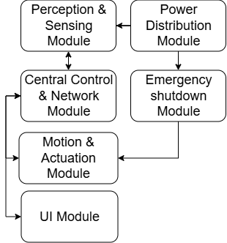
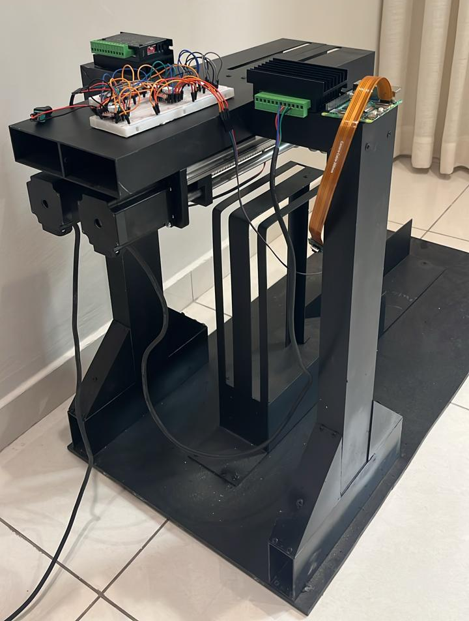
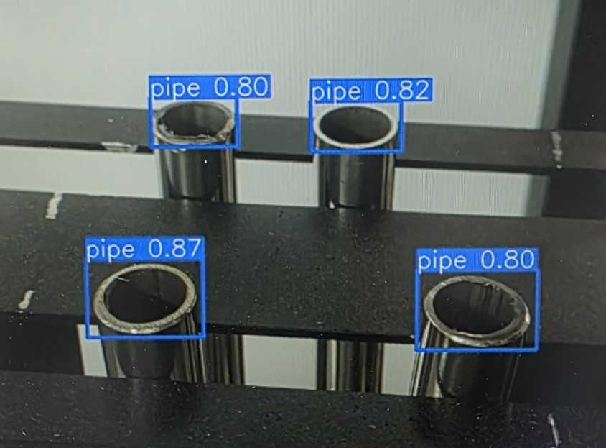
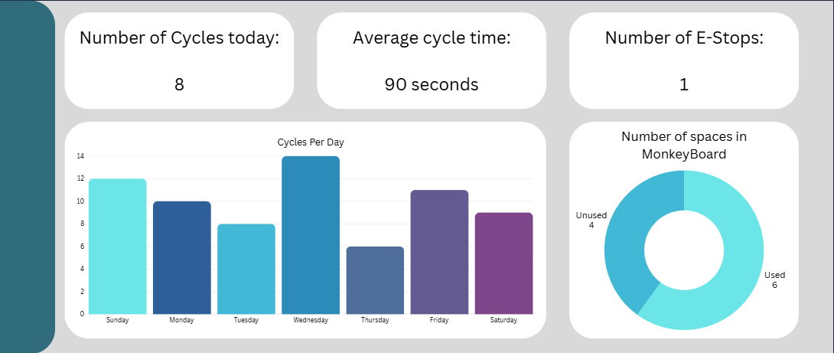
Multi-Pipe Automated Handling System for Drill Rigs
TEAM
M072
Moad Binmatlig, Ibrahim Alruwaished, Abdulrahman Aljunaid, Saifullah Bukhari, Mohammed Mokli, Mohammed Alkhaldi
Coach: ⁠Mohamed Zhani
Objective
Constraints
Specifications
System Design
To develop a fully automated, multi-pipe handling system using electromagnetic lifting and smart control architectures to eliminate human intervention.
Initial cost: ≤ current method
Frequency: 60Hz operation
Pipe handling: 2 horizontal drill pipes
Security: Cybersecurity protocols for sensitive data
Structural integrity: Support full load
Prototype similarity: Maintain real design/material behavior
Weather: Resistant to high temp/wind
Rig geometry: Gantry must fit existing rig
Red-zone exposure: 90% reduction
E-stops: 3 stations
Batch size: 2–5 per run
Event logging: 100% rate, ±500ms accuracy
Server logs: 100% integrity, 30-day retention
Uptime: 90% of rig hours
Safety factor: >1.5
Pipe positioning: 60–90s (Tripping Schedule sync)
Leg cross-section: ≥30×30mm for 10kg load
CV accuracy: ≥85% testing score
Similarity analysis: Dimensionless kinematic/dynamic checks
Gantry drive: Compatible linear belt system
Ambient temp: Operational up to 60°C
Inventory UI: 1s refresh, <0.5s delay
Load capacity: 200–300kg (Real) / 0.3–0.4kg (Prototype)
Elevator alignment: ±5mm tolerance via sensor fusion
GUI latency: <100ms visual updates
Prototype Development
Validation & Verification
Metric | Specification Requirement | Results
Cycle time | 60 - 90 Seconds | 90s (success)
Safety Response | <50ms E-stop latency | 20ms (success)
Vision Accuracy | >85% Accuracy | 90% (success)
Alignment | ±5mm Precision | ±5mm (success)
Data integrity | 100% logging | 100% verification (success)
Communication | 100ms latency | 70ms (success)
Results & Conclusion
Results: The prototype successfully executed its objective successfully.
Conclusion: This system provides a scalable, automated alternative to manual pipe handling, significantly reducing rig floor hazards and advancing drilling efficiency through smart automation.

Slide 4
Multi-Pipe Automated Handling System for Drill Rigs
TEAM
M072
Moad Binmatlig, Ibrahim Alruwaished, Abdulrahman Aljunaid, Saifullah Bukhari, Mohammed Mokli, Mohammed Alkhaldi
Coach: ⁠Mohamed Zhani
Objective
Specifications
System Design
Prototype Development
To develop a fully automated, multi-pipe handling system using electromagnetic lifting and smart control architectures to eliminate human intervention.
Red-zone exposure: 90% reduction
E-stops: 3 stations
Batch size: 2–5 per run
Event logging: 100% rate, ±500ms accuracy
Server logs: 100% integrity, 30-day retention
Uptime: 90% of rig hours
Safety factor: >1.5
Pipe positioning: 60–90s (Tripping Schedule sync)
Leg cross-section: ≥30×30mm for 10kg load
CV accuracy: ≥85% testing score
Similarity analysis: Dimensionless kinematic/dynamic checks
Gantry drive: Compatible linear belt system
Ambient temp: Operational up to 60°C
Inventory UI: 1s refresh, <0.5s delay
Load capacity: 200–300kg (Real) / 0.3–0.4kg (Prototype)
Elevator alignment: ±5mm tolerance via sensor fusion
GUI latency: <100ms visual updates
Constraints
Initial cost: ≤ current method
Frequency: 60Hz operation
Pipe handling: 2 horizontal drill pipes
Security: Cybersecurity protocols for sensitive data
Structural integrity: Support full load without deformation
Prototype similarity: Maintain real design/material behavior
Weather: Resistant to high temp/wind
Rig geometry: Gantry must fit existing rig
Validation & Verification
Metric | Specification Requirement | Results
Cycle time | 60 - 90 Seconds | 90s (success)
Safety Response | <50ms E-stop latency | 20ms (success)
Vision Accuracy | >85% Accuracy | 90% (success)
Alignment | ±5mm Precision | ±5mm (success)
Data integrity | 100% logging | 100% verification (success)
Communication | 100ms latency | 70ms (success)
Results & Conclusion
Results: The prototype successfully executed its objective successfully.
Conclusion: This system provides a scalable, automated alternative to manual pipe handling, significantly reducing rig floor hazards and advancing drilling efficiency through smart automation.

Slide 5
Multi-Pipe Automated Handling System for Drill Rigs
TEAM
M072
Moad Binmatlig, Ibrahim Alruwaished, Abdulrahman Aljunaid, Saifullah Bukhari, Mohammed Mokli, Mohammed Alkhaldi
Coach: ⁠Mohamed Zhani
Objective
Specifications
System Design
Prototype Development
To develop a fully automated, multi-pipe handling system using electromagnetic lifting and smart control architectures to eliminate human intervention.
90% reduction in red-zone exposure hours
3 E-stop stations
Batch size between 2-5 per run
100% event logging rate, timestamped with 500ms accuracy
The system shall upload operation logs to the server ensuring 100% data integrity and 30-day retention
Continuous operation for 90% of rig time hours without shutdown
Factor of safety must be more than 1.5
The system must position the pipe within 60-90 seconds to match the rig's specific "Tripping Schedule."
The cross section of the supported legs must be at least (30*30)mm for a 10 kg load
The Computer vision model should score no less than 85% in accuracy during testing
The dynamic and kinematic similarity check must be performed using dimensionless numbers
A linear belt as a movement system for the gantry crane should be included and be compatible with the mechanical design
Constraints
The initial cost should not exceed the current method
Operate on 60Hz frequency
The system must safely handle two drill pipes from the horizontal position that the rig procedure provides
Cyber security procedure in dealing with sensitive data
The structure can endure the full needed load without fail or without any huge deformation
The prototype design must maintain similarity to the real design and material behavior
Harsh weather conditions (e.g., high temperature, wind.. etc)
The gantry frame must fit within the existing rig geometry
Validation & Verification
Metric | Specification Requirement | Results
Cycle time | 60 - 90 Seconds | 90s (success)
Safety Response | <50ms E-stop latency | 20ms (success)
Vision Accuracy | >85% Accuracy | 90% (success)
Alignment | ±5mm Precision | ±5mm (success)
Data integrity | 100% logging | 100% verification (success)
Communication | 100ms latency | 70ms (success)
Results & Conclusion
Results: The prototype successfully executed its objective successfully.
Conclusion: This system provides a scalable, automated alternative to manual pipe handling, significantly reducing rig floor hazards and advancing drilling efficiency through smart automation.

Slide 6
Multi-Pipe Automated Handling System for Drill Rigs
TEAM
M072
Moad Binmatlig, Ibrahim Alruwaished, Abdulrahman Aljunaid, Saifullah Bukhari, Mohammed Mokli, Mohammed Alkhaldi
Coach: ⁠Mohamed Zhani
Objective
Specifications
System Design
Prototype Development
To develop a fully automated, multi-pipe handling system using electromagnetic lifting and smart control architectures to eliminate human intervention.
Red-zone exposure: 90% reduction
E-stops: 3 stations
Batch size: 2–5 per run
Event logging: 100% rate, ±500ms accuracy
Server logs: 100% integrity, 30-day retention
Uptime: 90% of rig hours
Safety factor: >1.5
Pipe positioning: 60–90s (Tripping Schedule sync)
Leg cross-section: ≥30×30mm for 10kg load
CV accuracy: ≥85% testing score
Similarity analysis: Dimensionless kinematic/dynamic checks
Gantry drive: Compatible linear belt system
Ambient temp: Operational up to 60°C
Inventory UI: 1s refresh, <0.5s delay
Load capacity: 200–300kg (Real) / 0.3–0.4kg (Prototype)
Elevator alignment: ±5mm tolerance via sensor fusion
GUI latency: <100ms visual updates
Constraints
Initial cost: ≤ current method
Frequency: 60Hz operation
Pipe handling: 2 horizontal drill pipes
Security: Cybersecurity protocols for sensitive data
Structural integrity: Support full load without deformation
Prototype similarity: Maintain real design/material behavior
Weather: Resistant to high temp/wind
Rig geometry: Gantry must fit existing rig
Validation & Verification
Metric | Specification Requirement | Results
Cycle time | 60 - 90 Seconds | 90s (success)
Safety Response | <50ms E-stop latency | 20ms (success)
Vision Accuracy | >85% Accuracy | 90% (success)
Alignment | ±5mm Precision | ±5mm (success)
Data integrity | 100% logging | 100% verification (success)
Communication | 100ms latency | 70ms (success)
Results & Conclusion
Results: The prototype successfully executed its objective successfully.
Conclusion: This system provides a scalable, automated alternative to manual pipe handling, significantly reducing rig floor hazards and advancing drilling efficiency through smart automation.

