Slide 1





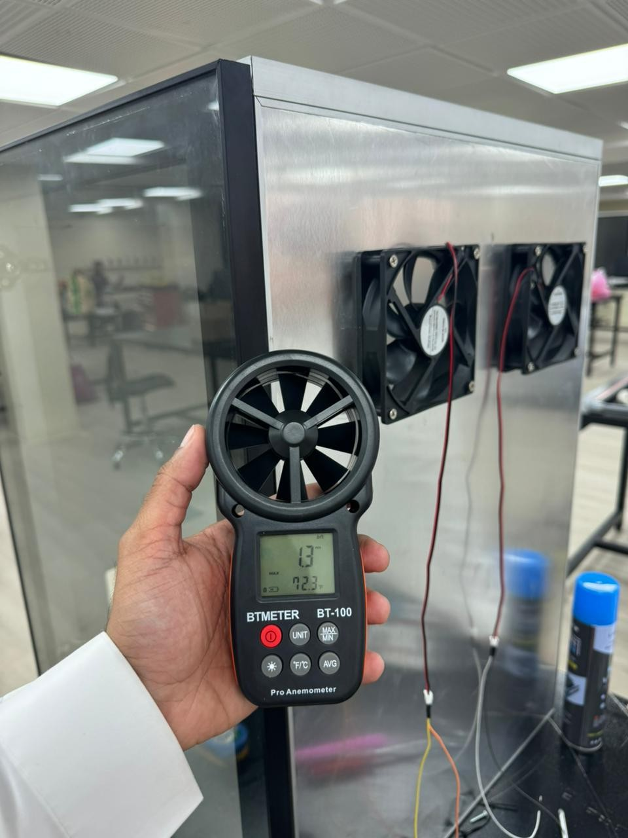
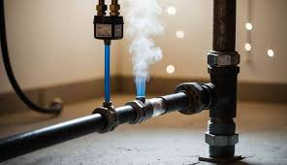
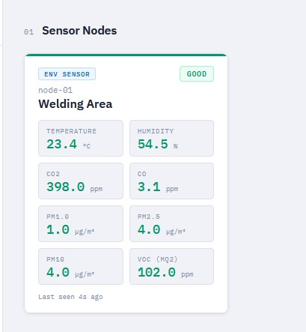
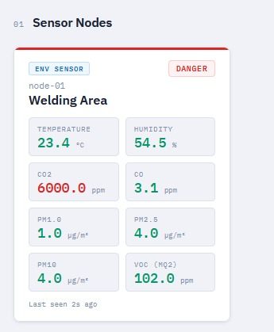
Intelligent Industrial Air Quality Advisory System
TEAM
M071
SWE-Muhammad Alhosainy, COE-Ahmed Alghamdi, ME-Saeed Al-Jaran, EE-Mohammed Alas, CS-Basil Alharbi, CHE-Fayez Alzaid
Coach: Hamzah Luqman
Problem Statement
Constraints & Specifications
System Architecture
Results & Conclusion
Current industrial air quality systems rely on threshold-based alarms that only react after dangerous concentrations are reached, causing alarm fatigue and failing to predict worker exposure. There is a critical gap between pollutant accumulation and alarm trigger — leaving workers at risk during the most dangerous window.
Category | Type | Requirement / Detailed Specification
Safety | C1 | Controlled Testing: Gas calibration must be conducted in sealed environments with concentrations strictly below Threshold Limit Values (TLV).
Environmental | C2 | Industrial Durability: Hardware must operate reliably in environments up to 50°C and 85% humidity (non-condensing).
Networking | C3 | Latency: End-to-end communication from the sensor node to the dashboard must be ≤ 3.0 seconds.
Security | C4 | Data Privacy: All telemetry must be stored on a local industrial server (Raspberry Pi) rather than public clouds to ensure factory data sovereignty.
Accuracy | S1 | Gas Sensing: Maintain a deviation of < 10% compared to reference industrial-grade gas detectors.
Modeling | S2 | Predictive Logic: The Time-to-Harm prediction must maintain a calculation error of < 10% using the 4th-order Runge-Kutta method.
Purge System | S3 | Mechanical Response: The ventilation subsystem must achieve a 99% reduction in hazardous gas concentration within 30 seconds.
Reliability | S4 | Data Buffering: Sensor nodes must support at least 48 hours of local buffering to prevent data loss during network outages.
Stability | S5 | System Uptime: The integrated system must maintain ≥ 90% operational uptime during 48-hour endurance test cycles.
Usability | S6 | Advisory UI: The dashboard must provide bilingual (AR/EN) alerts categorized into Safe (Green), Warning (Yellow), and Danger (Red) levels.
Sensing: CO2, CO, VOC, and PM2.5 sensor array
Integrated with ESP32 and Raspberry Pi;
Intelligence: backend engine using RK4-based transient mass balance modeling & Harmness Index;
Hardware: modular aluminum enclosure with dual axial fan purge system;
Interface: Flutter dashboard displaying real-time risk levels (Safe, Warning, Danger).
Validation & Results
Predictive Accuracy: Validated time-to-harm logic with < 2.5% model error.
Mechanical Purge: Achieved 99% gas reduction in 30 seconds (113.26 m^3/h)
Connectivity: 95% of data packets delivered in ≤ 2.1 seconds, meeting industrial latency standards.
Uptime: System maintained > 90% operational stability during 48-hour endurance testing.
Objective
To develop an Intelligent Air Quality Advisory System that combines multi-pollutant sensing with a predictive time-to-harm model, delivering a real-time Harmness Index and automated reports — shifting industrial safety from reactive alarms to proactive evaluation.
The prototype demonstrated stable and reliable operation, accurate environmental sensing, and real-time data processing, confirming the feasibility of using an intelligent air quality monitoring system to enhance environmental awareness and reduce the need for manual monitoring.

