Slide 1
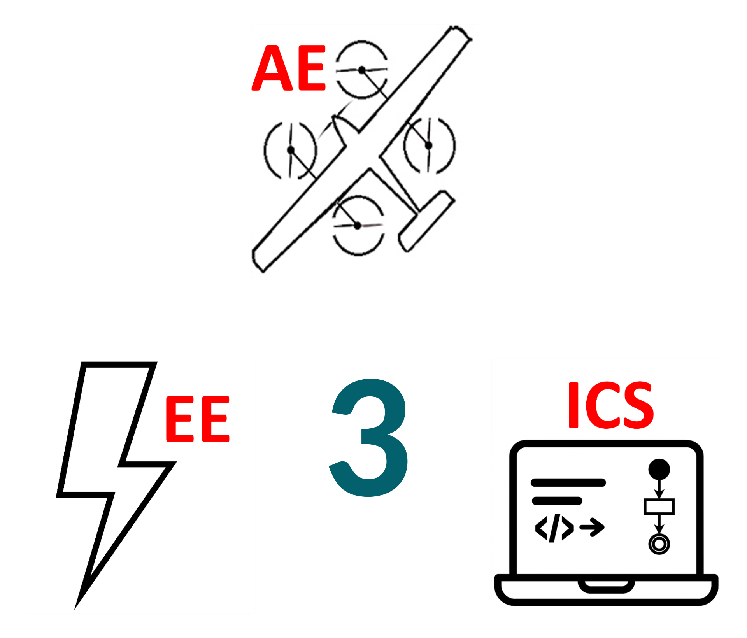
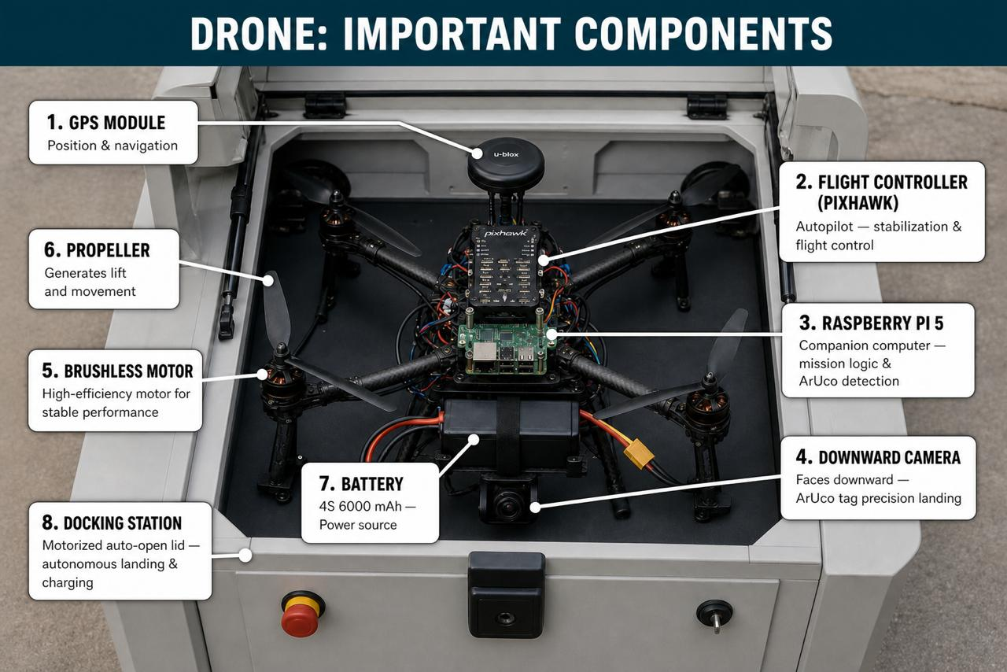
SkyLink: Autonomous Drone Docking and Communication Network for Smart City Monitoring in Saudi Arabia
TEAM
M070
Ahmed Alharbi (AE)| Abdulaziz Alnfeae(AE)| Fares Alghamdi (EE)| Omar Abdalla (SWE) | Abdulaziz Alharthi (SWE)| Abdullah Madoun (SWE) Coach: Mohammad Irfan Alam
Background
Results
All key specifications achieved
Reliable autonomous inspection operation
Detection accuracy ≥ 75%
Data processing time < 5 minutes
Testing
Flight endurance ≈ 21 minutes
Stable operation under wind conditions
Autonomous return at 20% battery
Successful docking and charging verified
Constraints & Specifications
Rapid urban growth in Saudi Arabia increases demand for efficient infrastructure inspection
Traditional methods are manual, slow, and costly
Drones enable fast, safe, and automated data collection
SkyLink introduces an autonomous drone with smart docking for continuous monitoring
Constraints:
Flight range ≤ 100 m
Charging power ≤ 50 W
Wind limit ≤ 3 m/s (testing)
Docking station height ≤ 2 m
Specifications:
Flight time ≥ 20 min
Speed: 3–7 m/s
Camera resolution ≥ 1080p
Detection accuracy ≥ 75%
Problem Statement
Conclusion
educed inspection cost by ~30%
Achieved flight time ≈ 21 minutes
Detection accuracy reached ≥ 75%
Autonomous docking success rate ≈ 100%
Rapid urban expansion in Saudi Arabia has increased the need for efficient infrastructure monitoring. Current inspection methods are manual, time-consuming, costly, and pose safety risks. Additionally, the lack of continuous monitoring leads to delayed damage detection and reduced system reliability.

