Slide 1
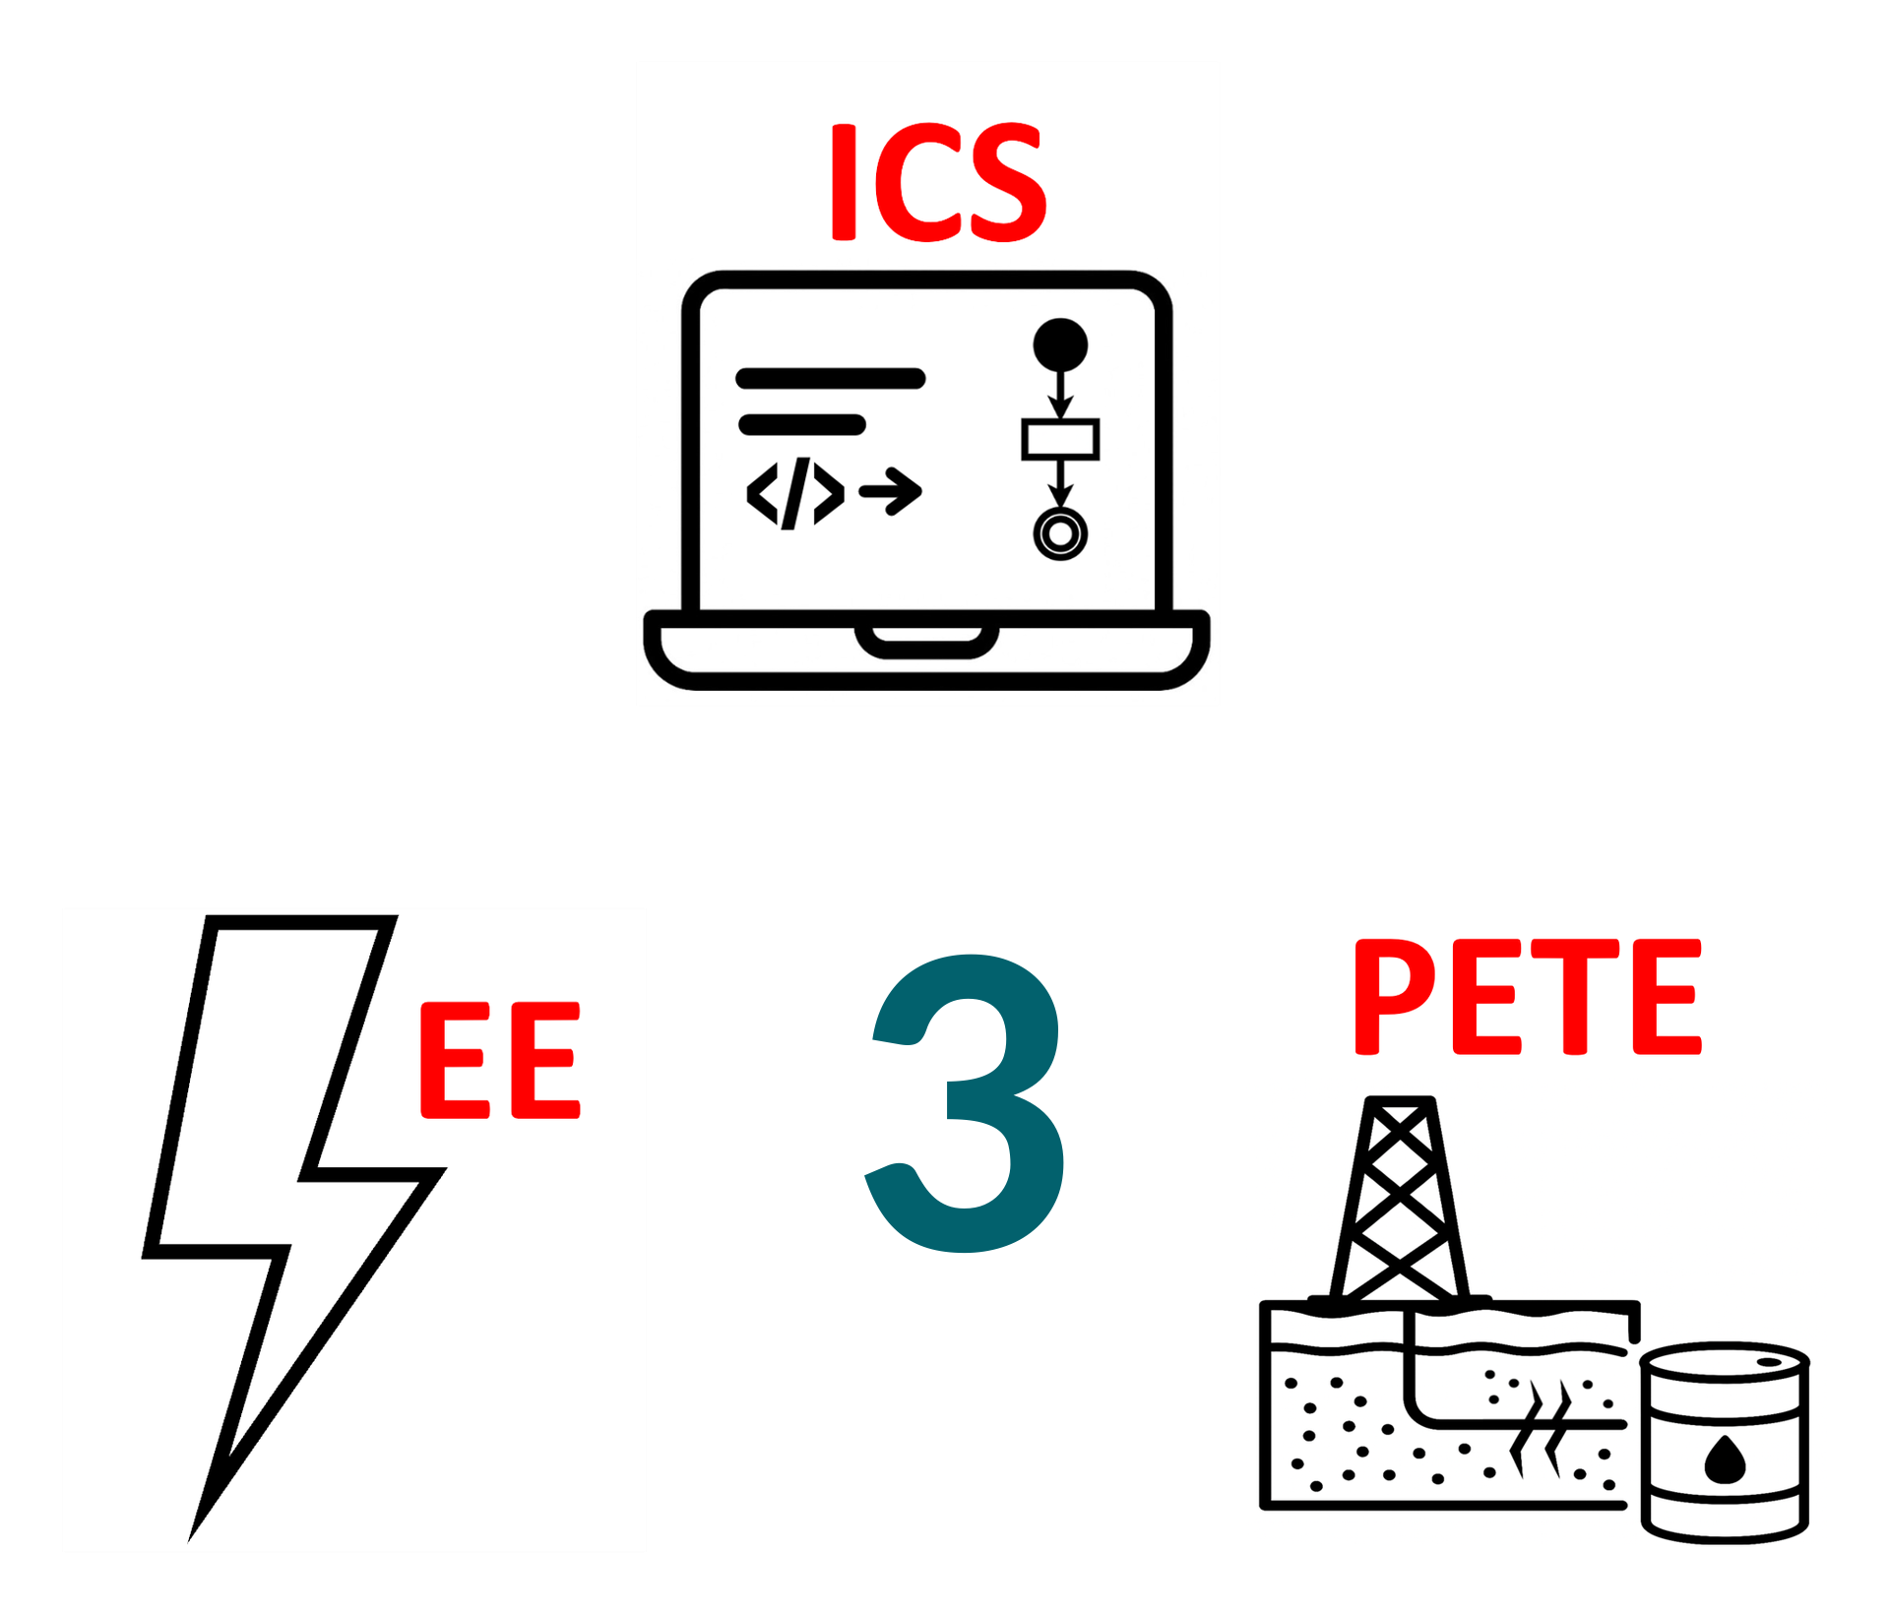
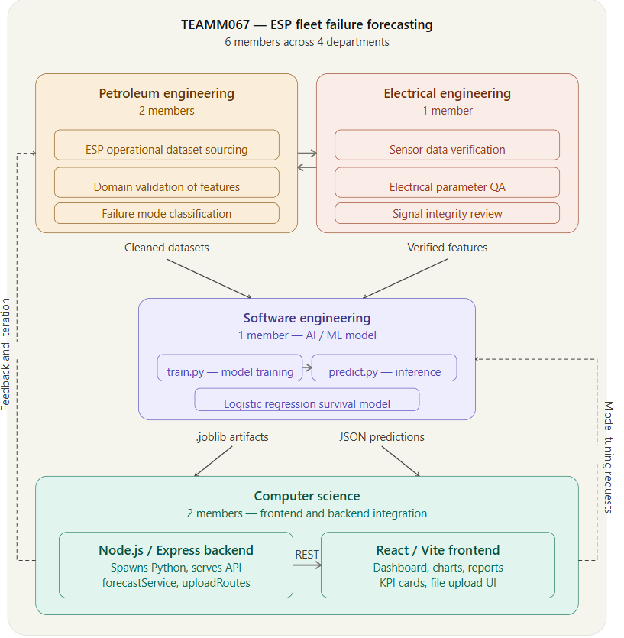
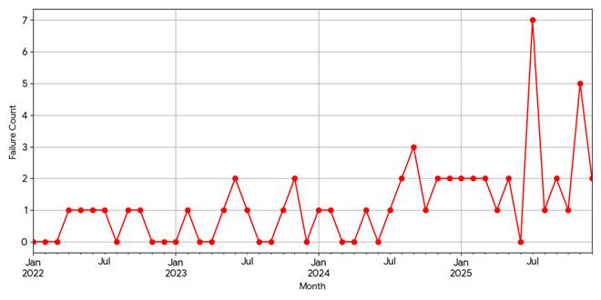
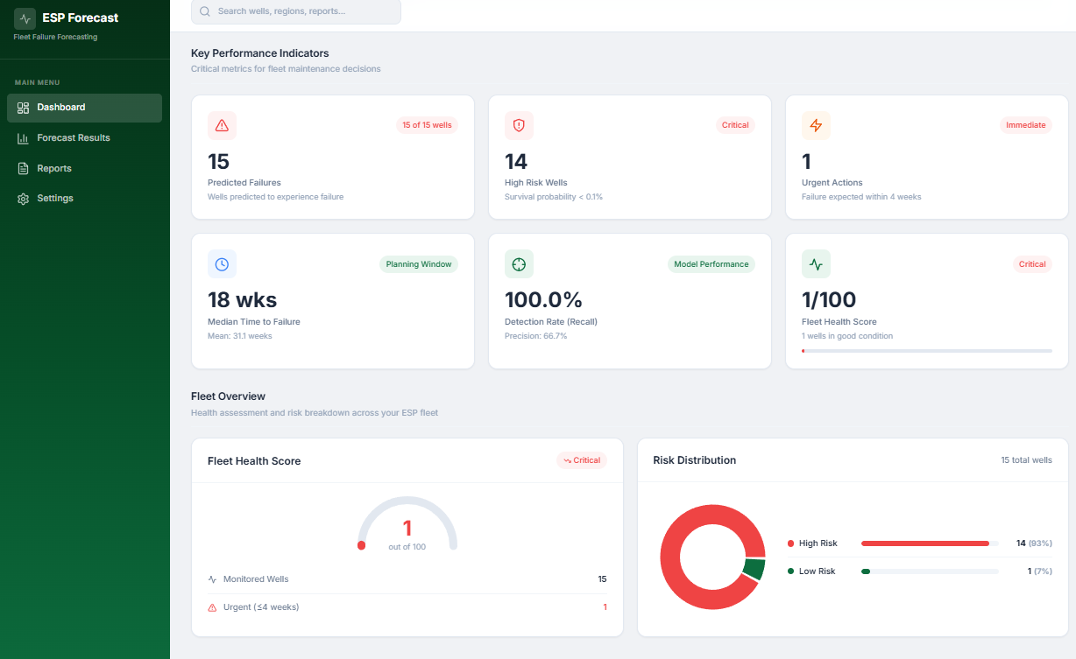
Forecasting ESP Failures Using AI & ML Models
TEAM
M067
Ahmed Alhumaid (CS) • Basel Alzahrani (SWE)
Salim Alghamdi (PETE) • Hussain AlQahtani (PETE)
Hussain Al Sulaiman (EE) • Hussain Al-Ibrahim (CS)
Coach: Dr. Hamzah Luqman
Context & Need
Requirements
Prototype Design
Validation & Outcomes
Introduction / Background
Constraints
Integrated Prototype
Testing / Validation
ESP failures create uncertainty in budgeting, spare-part procurement, and maintenance readiness, while current planning often depends on historical averages and engineering judgment. Therefore, a data-driven and auditable forecast is needed to support proactive annual planning.
• C1: Use only standard production / ESP run-pull report parameters.
• C2: Use electrical fields only when the source is reputable; otherwise discard them.
• C3: Use open-source software and libraries only.
• C4: Anonymize well IDs and sensitive operational identifiers.
90%
Hit Rate
within ±6 weeks
0.97
ROC-AUC
ranking quality
0.47
PR-AUC
positive-class focus
0.029
Brier
calibration
6.4 wks
Timing MAE
best timing rule
Problem Statement
Conclusions
No auditable fleet-level tool was available to estimate next-year ESP failures from validated historical records, so the proposed solution was designed to remain planning-focused, usable within a company intranet, and understandable to non-programmers.
All Specifications
The prototype delivers an auditable annual ESP failure forecast with monthly detail through an integrated workflow that combines data validation, lifecycle modeling, fleet aggregation, and dashboard-based reporting. Overall, it serves as a practical planning tool for budgeting, procurement timing, and spare readiness.
Code | Requirement
S1 | 100% audit logging (dataset/model/timestamp)
S2 | <25% data discard + includes ≥1 failure case
S3 | ≥1 EE feature with ≥25% coverage
S4 | ≥70% success rate on held-out test
S5 | .csv/.xlsx upload ≤150 MB
S6 | 12-month table + yearly total
S7 | Flag 100% invalid / missing EE fields
S8 | Leakage-prevention partition verified
IS1 | ≥36 consecutive validated months
IS2 | End-to-end report <30 min
IS3 | Forecast shown in <6 steps
IS4 | Annual run for planning
IS5 | ≥3 years of history
Observed Fleet Behavior
Verification Summary
Planning Dashboard
• Constraints verified: standard inputs, reputable EE sources, open-source tools, anonymization.
• Specs 1–8 verified; held-out hit rate 90% vs. ≥70% target.
• Integrated specs verified: ≥36 validated months, ≥3 years history, <30 min runtime, <6 steps.
• User test verified: CSV/XLSX ≤150 MB and 5-step workflow.
• Audit verified: dataset/model versions and timestamps logged; no raw Well_ID in outputs.
Objective of Project
• Forecast expected ESP failures for the next 12 months.
• Convert validated historical records into a Jan–Dec forecast and yearly total.
• Support budgeting, spare planning, and maintenance readiness for PETE/EE users.

