Slide 1
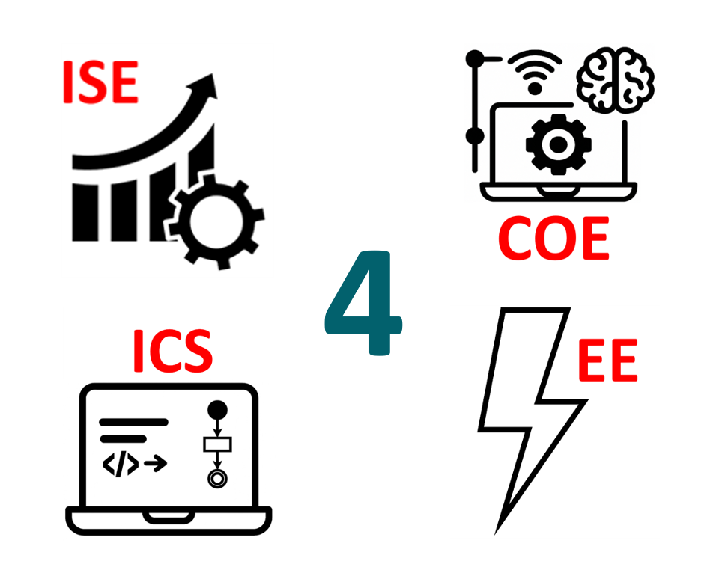
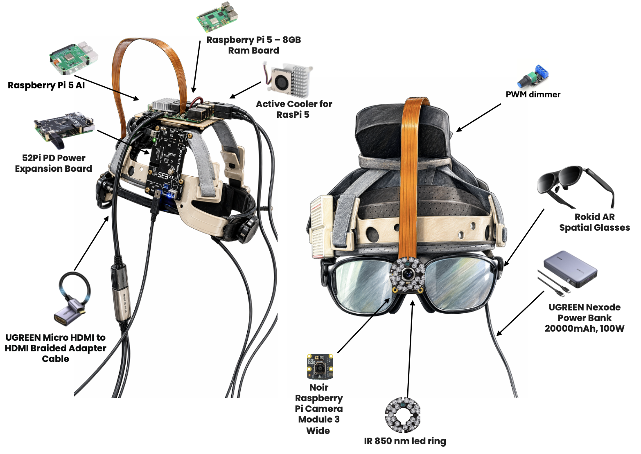
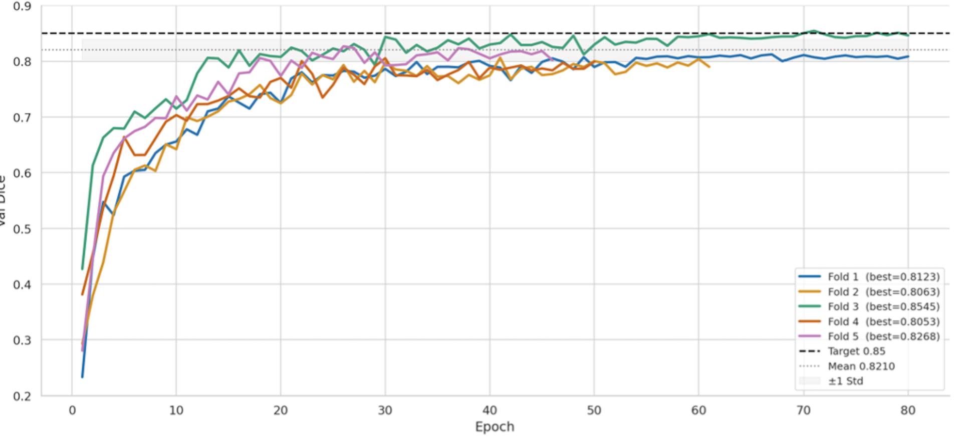
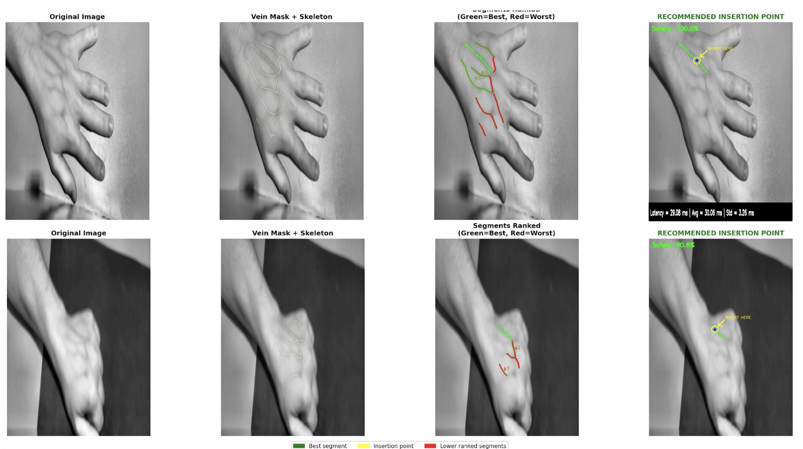
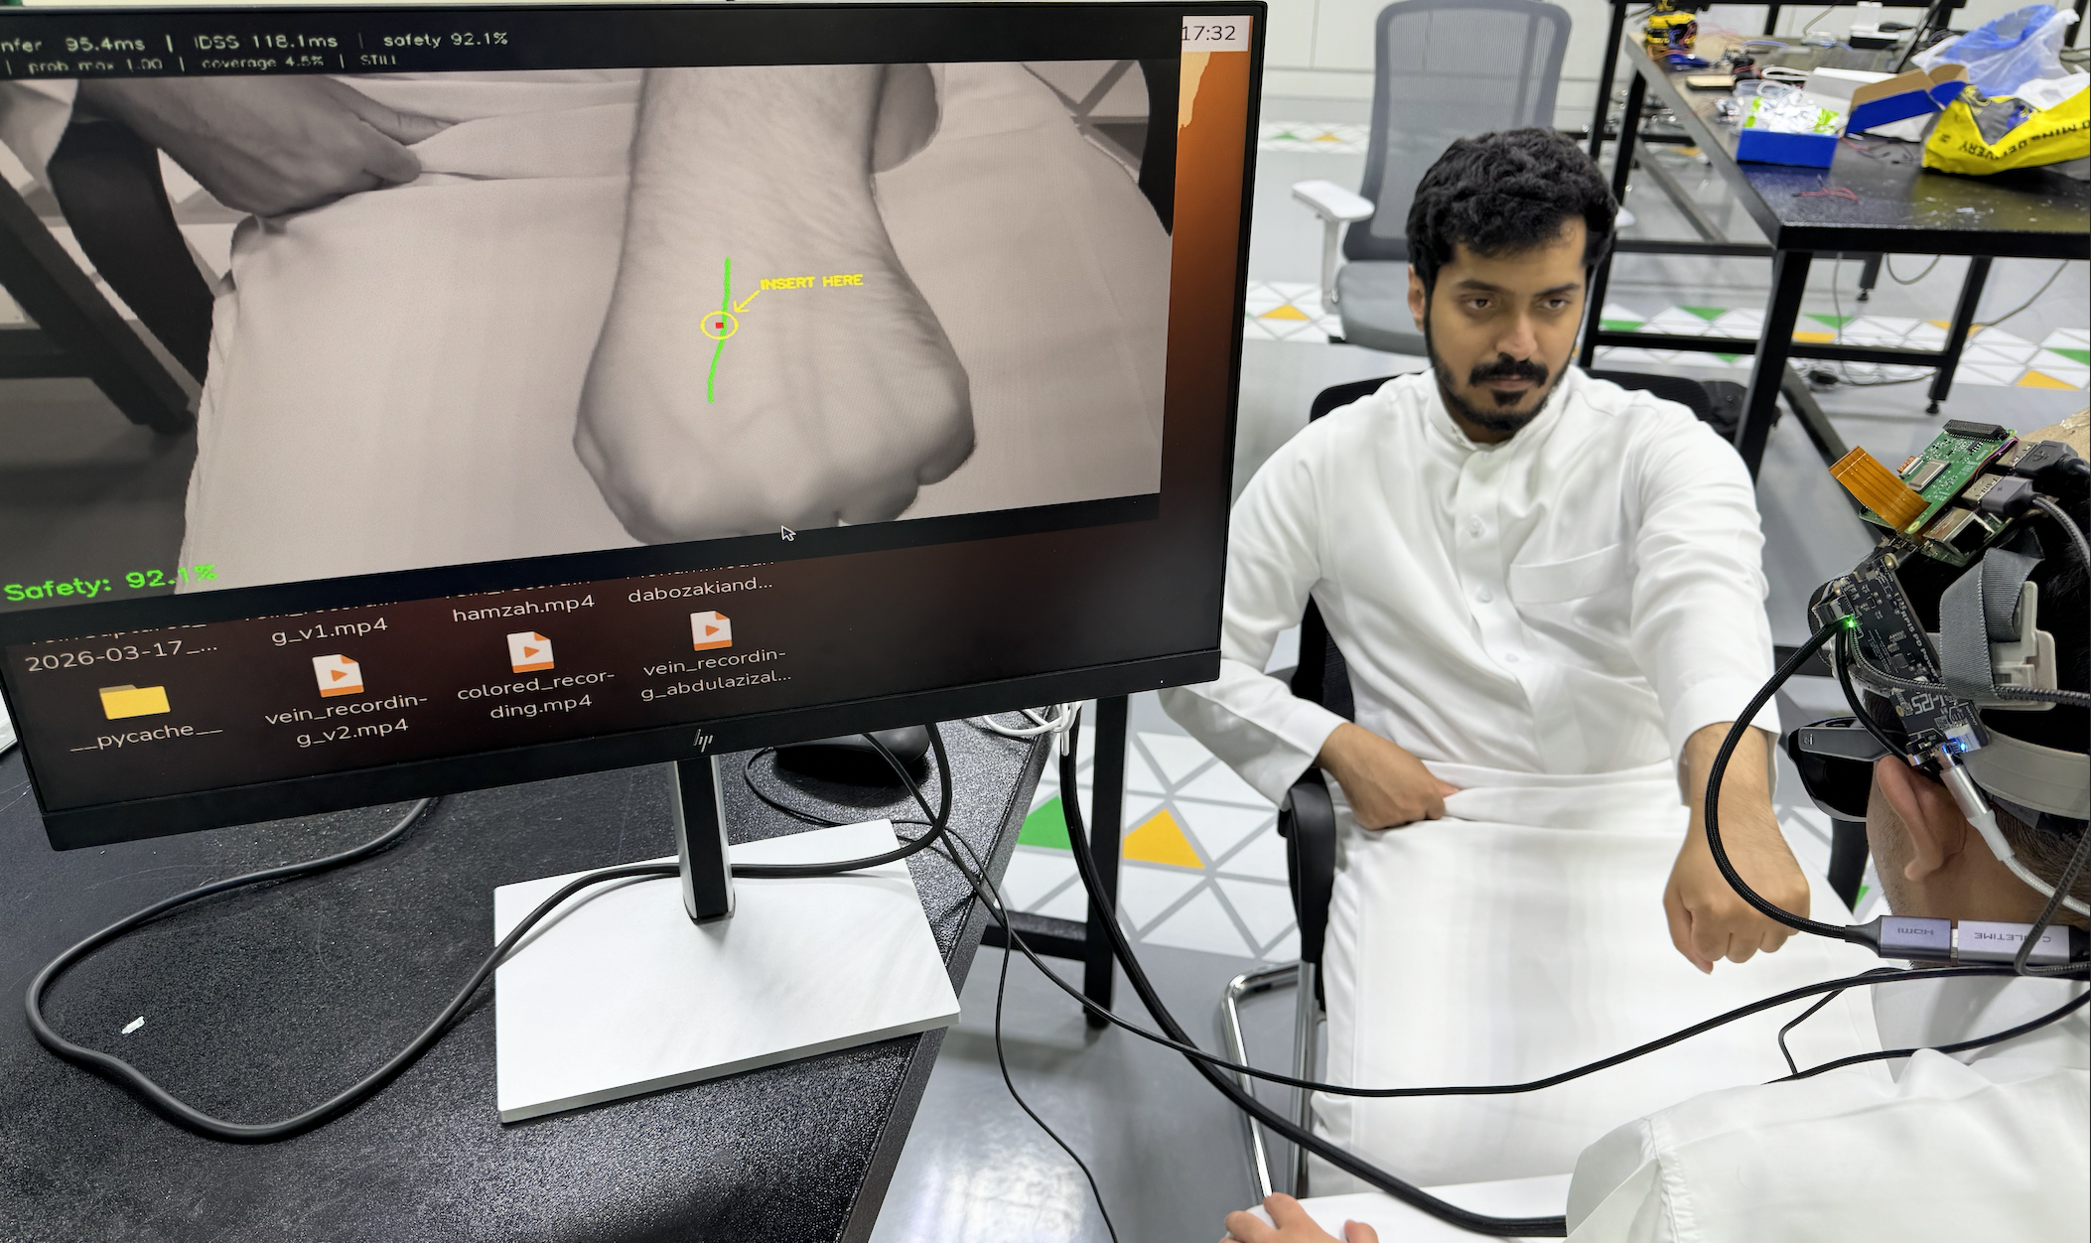
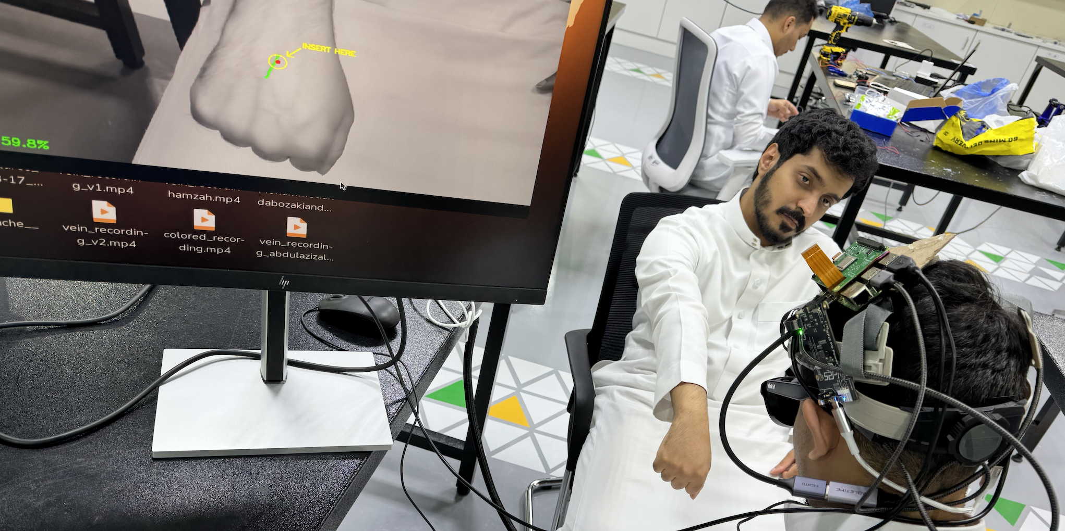
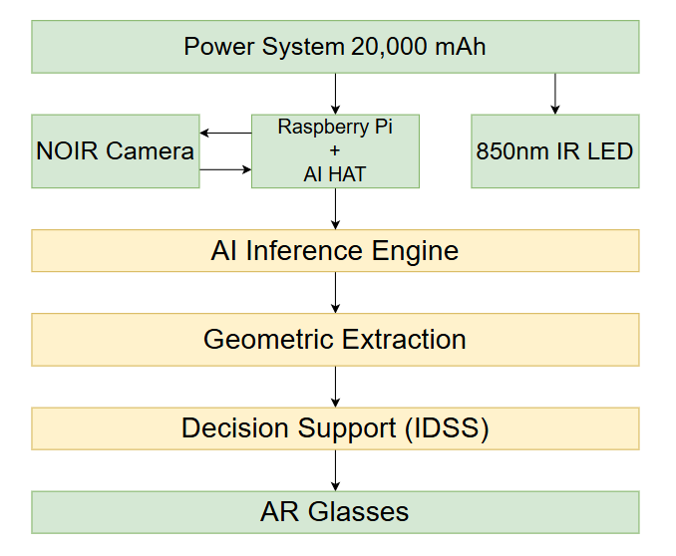
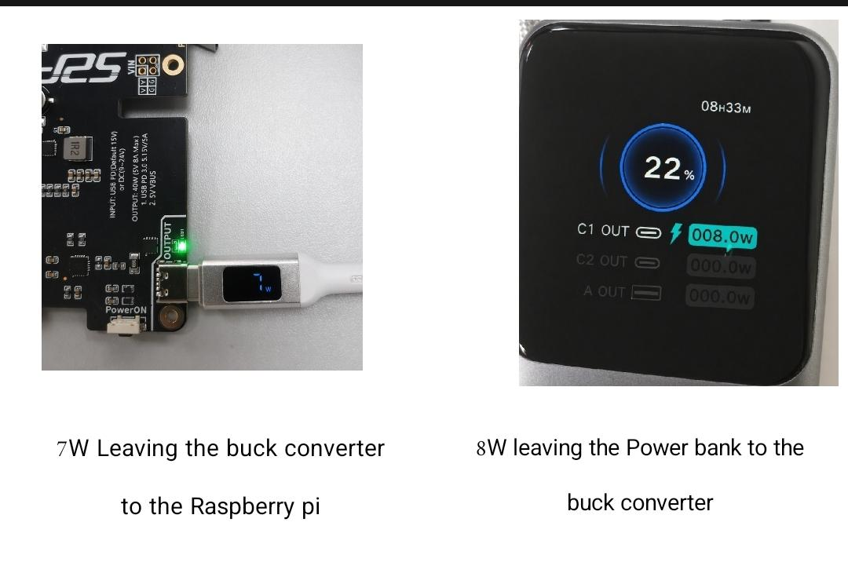
Near-infrared Vein Detection AR Glasses with
Safest-Segment Recommendation
TEAM
M066
Abdulaziz Almoghairi, Thamer Alotaibi, Hisham Alghamdi, Nawaf Alshammari, Saqer Alshehri, Abdulaziz Alrashidi
Coach: Hamzah Luqman
Introduction
Prototype Design
Testing & Validation
IV insertion is often challenging, leading to multiple attempts, patient discomfort, and delays, while existing systems offer limited guidance on optimal site selection. To address this, a near-infrared augmented reality system visualizes veins in real time and uses AI with rule-based analysis to recommend the safest insertion point.
U-Net (MobileNetV2
+ scSE) at 448×448. Dice score reaches 0.8545, exceeding
the 0.85 target.
The Intelligent Decision Support System scores each detected vein segment using weighted clinical criteria and ranks them to identify the safest IV insertion point, displayed live on AR glasses in under 150 ms.
Constraints & Specifications
Constraints Video format 1080p @ 30 fps Continuous operation ≥ 60 min Software reliability ±5% memory stability | Added procedure time ≤ 5 min Hybrid IDSS Rule-governed Real-time processing No frame backlog
Specification
End-to-end latency < 150 ms Device weight < 350 g Operating distance :5 – 20 cm NIR wavelength 850 nm ± 10 Battery capacity > 4000 mAh Converter efficiency ≥ 85% | Usability ≥ 90% setup success Comfort ≥ 4 / 5 Segmentation accuracy dice ≥ 0.85 AR spatial error ≤ 5 mm Reproducibility ≥ 90% consistent outputs Confidence stability ≤ 15% variation
Integrated Specs Valid safest segment ≥ 95% frames Vein geometry D ≥ 2.44 mm, L = 6.25–12.7 mm, S ≥ 85% Bifurcation clearance ≥ 3 mm
System Architecture
Buck converter efficiency of 87.5%
Conclusion
This project developed a wearable NIR AR system for real-time vein visualization and AI-guided IV insertion, achieving 0.8545 Dice accuracy, ~30 ms latency, and 87.5% efficiency. It met key constraints: <350 g weight, >60 min operation, consistent vein selection, and BOM <6000, below commercial alternatives. Results show a portable, low-cost tool that can reduce insertion attempts and improve patient comfort.

