Slide 1

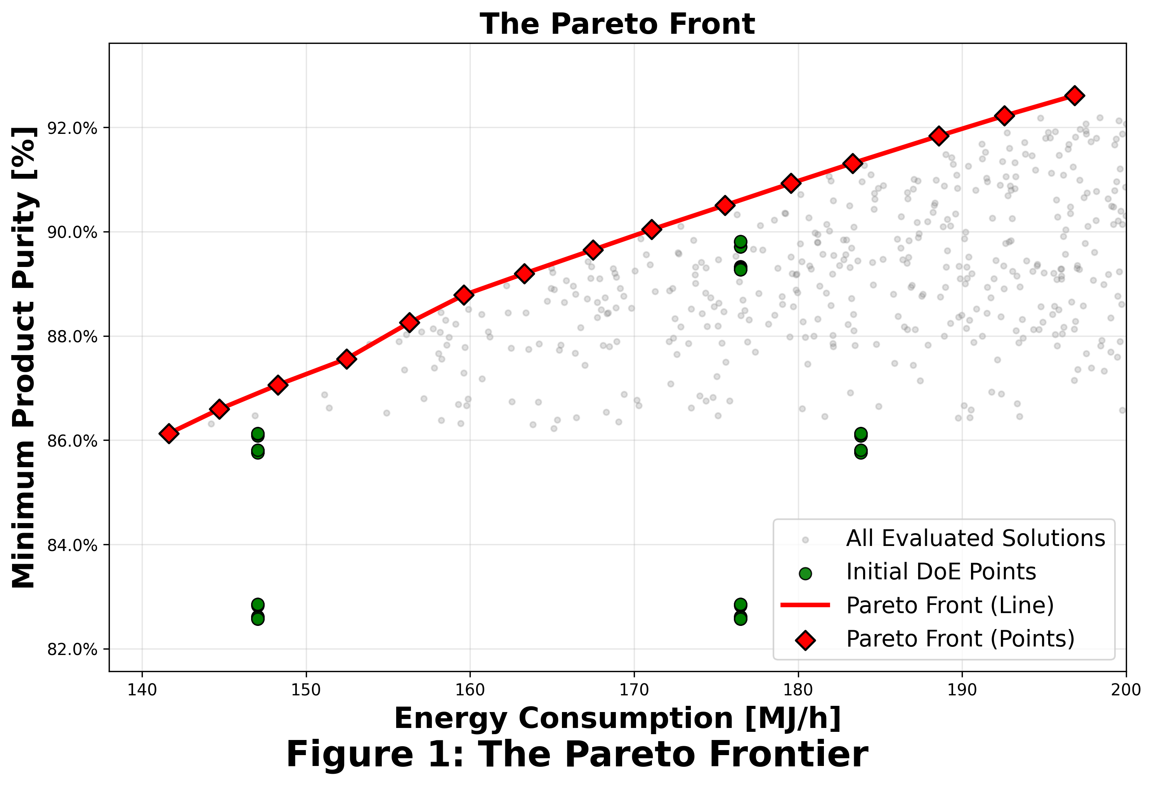
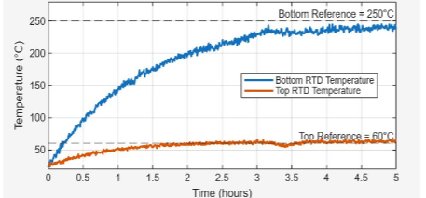
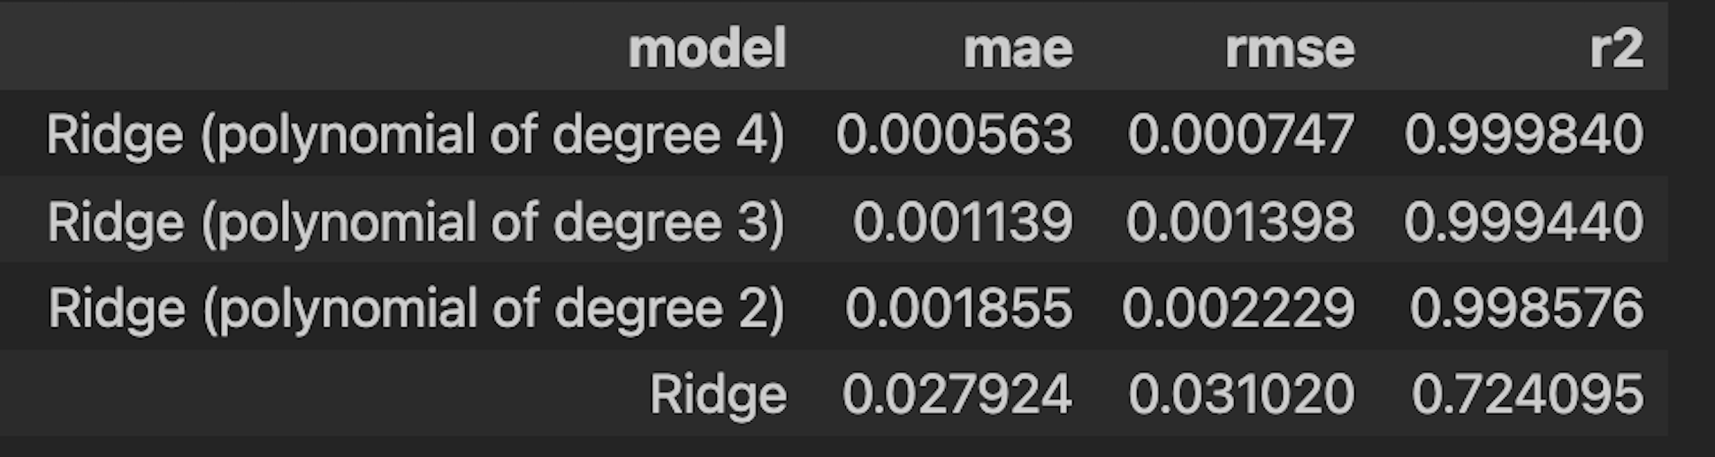
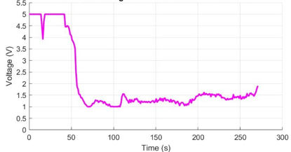
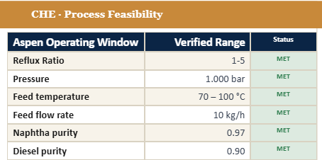
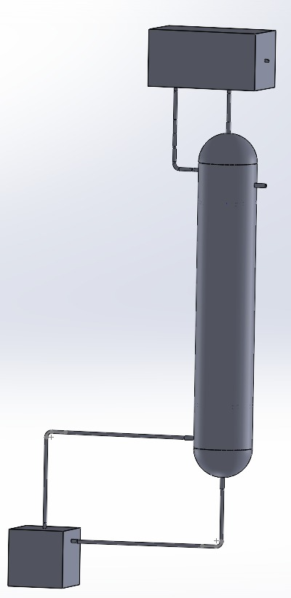
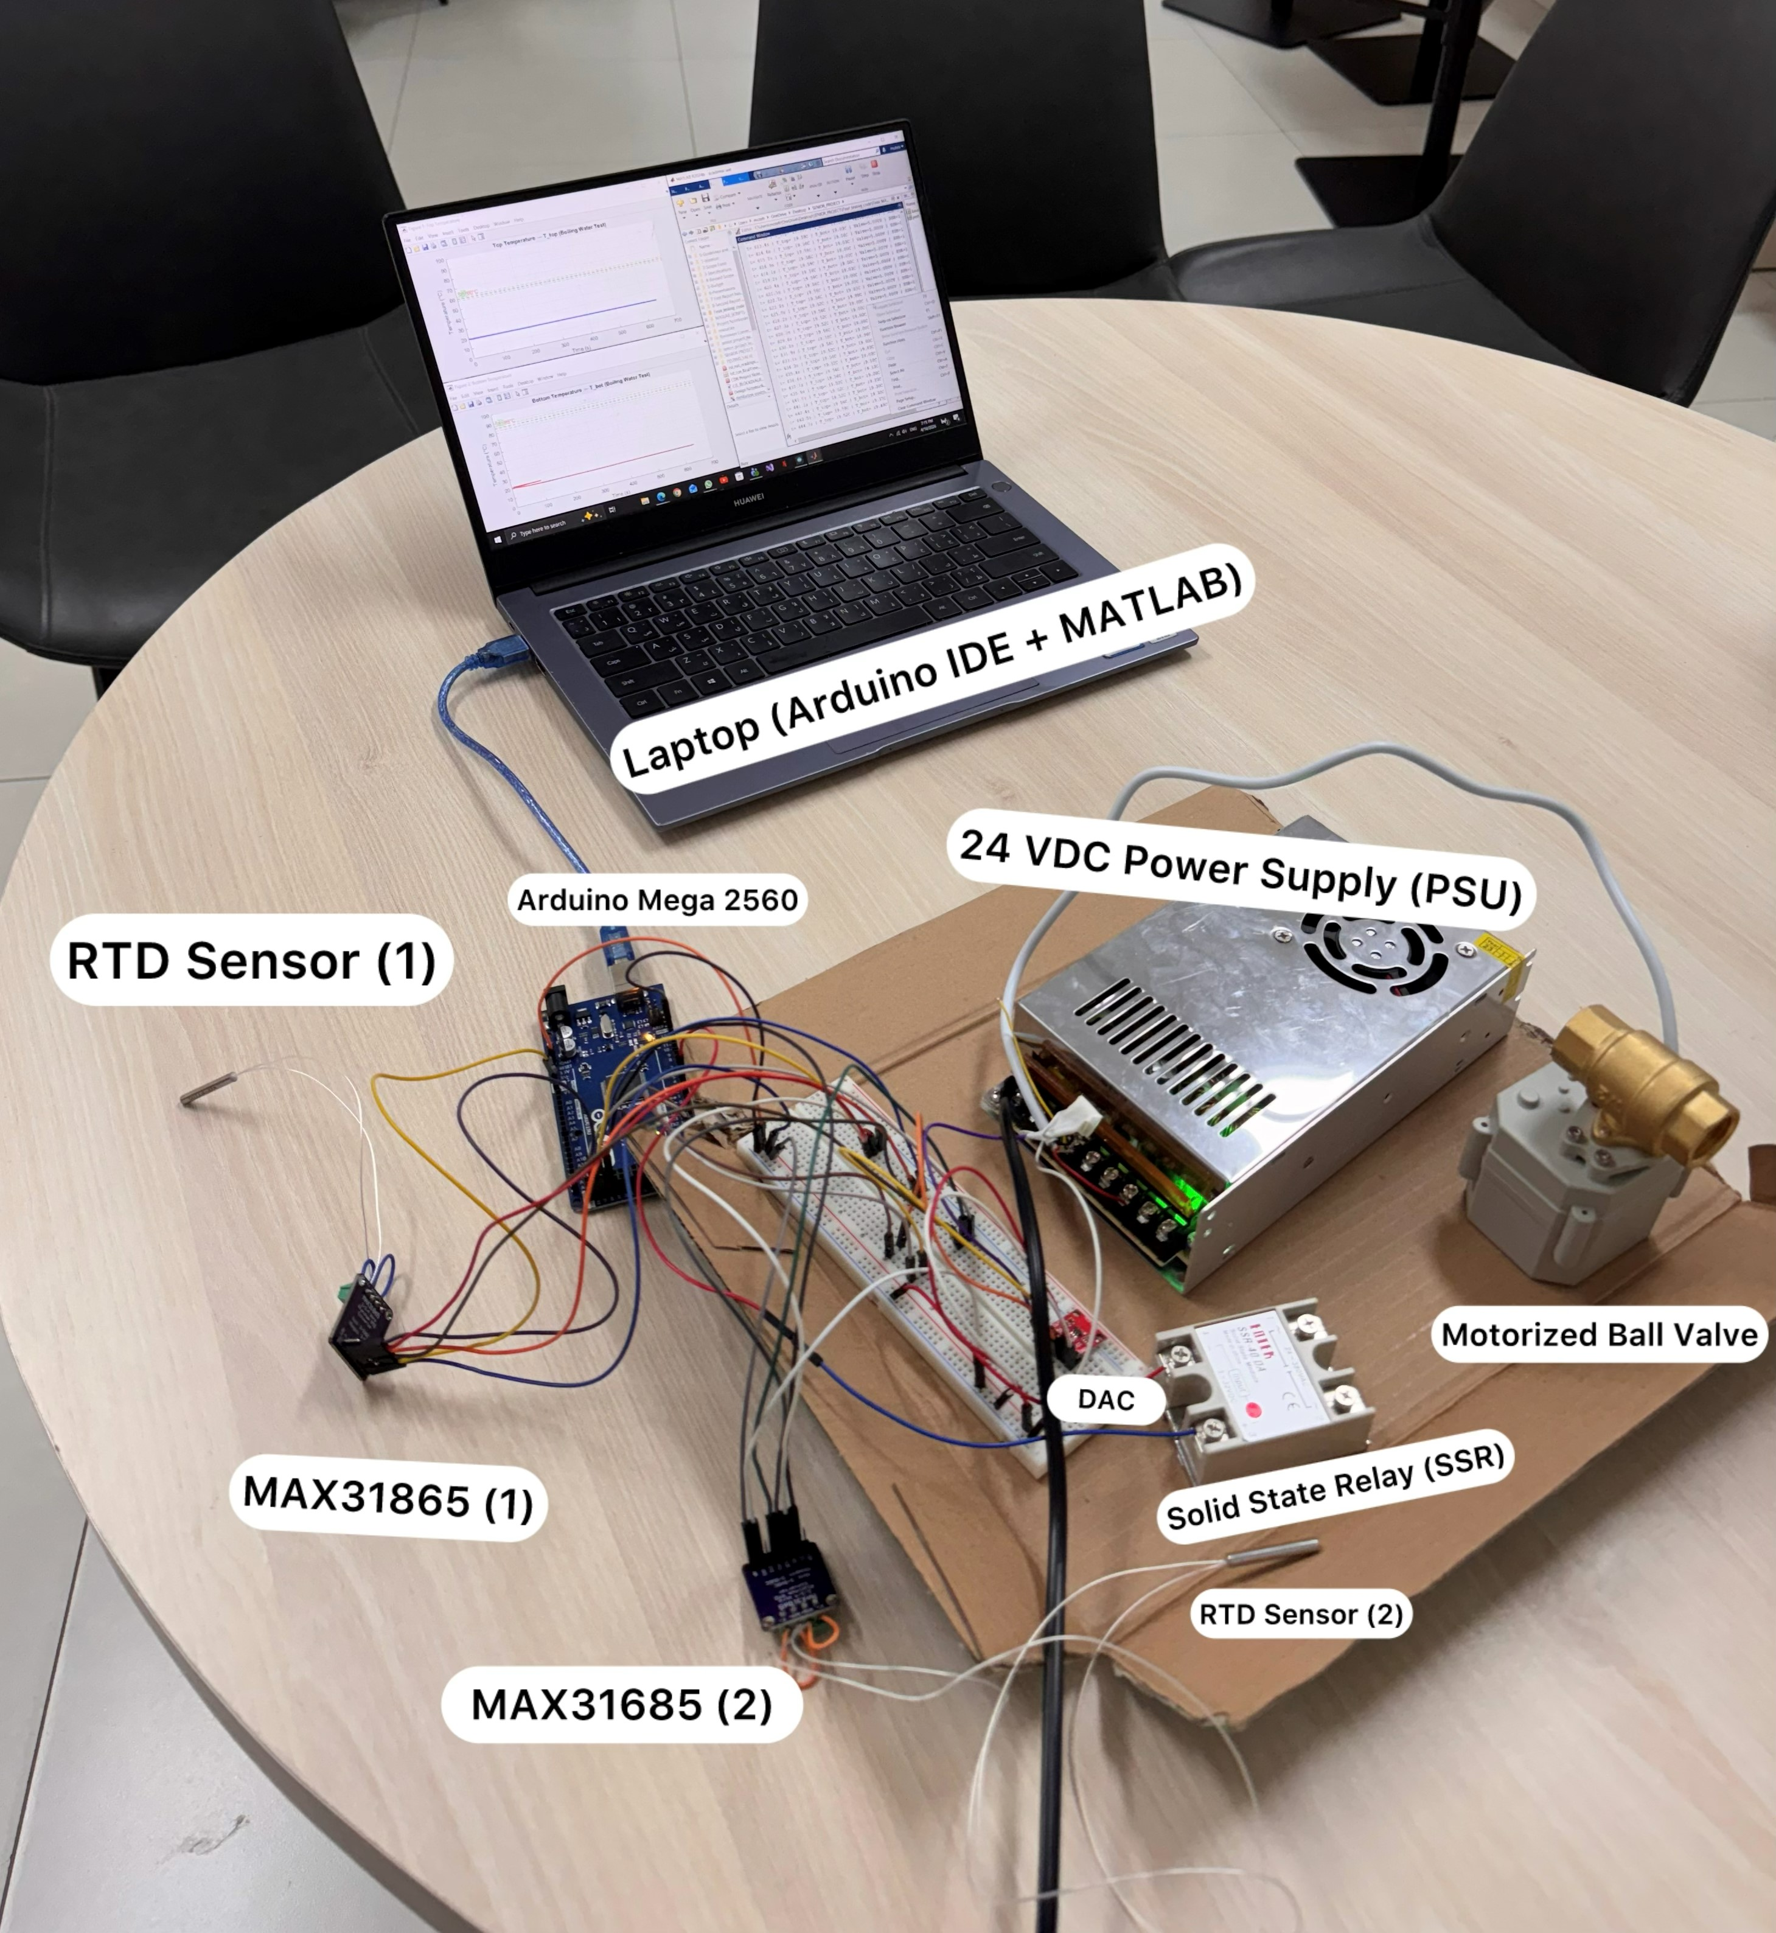
Sustainable Conversion of Date Pit Waste via Pyrolysis
and Distillation into Valuable Fuel Fractions
TEAM
M062
Abdulaziz Alahamri (CHE), Sami Alesaa (CHE), Ahmad Aldawood (ISE)
Rashed Jafry (SWE), Khalid Alghamdi (ME), Muteb Aljohani (CIE)
Coach: Dr. Muhammad Niazi, Chemical Engineering Department
Background
Constrains
Testing & Validation
Saudi Arabia generates ~1.6 M tonnes/yr of date palm waste.
Date pits contain high-value carbon-rich biomass suitable for pyrolysis.
The large volume of date pits creates a scalable opportunity for fuel recovery.
Feed: C6–C16 hydrocarbons
Reboiler Duty ≤ 1,000 MJ/h
Software/ML cannot override primary safety interlocks (operator approval required)
NSGA-2 search space:
Reflux Ratio ∈ [1.5, 5.0], Q ≤ 1,000 MJ/h
Stable closed-loop response under feed disturbances 80–120 t/day
Specifications
Figure 2: RTD Response for Top and Bottom Temperature
Feed flow 80–120 kg/hr
ΔT 60–250 °C (no cracking)
Problem Statement
≥ 70% purity in all fuel cuts
Shell rated ≤ 1 bar(g)
Table 1: AI accuracy Results
Date pits remain a wasted fuel opportunity.
No integrated system links conversion, separation, prediction, and monitoring.
≥ 15 Pareto-optimal operating points
(Diesel & Naphtha purities vs. energy)
Surrogate model
R² ≥ 0.85
ML purity MAE < 10%
Sensor → dashboard < 2 s latency
RR within ± 10% of setpoint
Table 2: Process feasibility (CHE)
Figure 3: Valve Control Signal – Closes When T Enters band
Prototype Design
Conclusion
T_top / T_bot recover to ± 3% of SS within 10 min after ± 20% feed disturbance
Condenser
Multidisciplinary prototype delivered: SS316 packed column (0.7 m × 0.2 m), Aspen-validated separation, dual-loop PID, NSGA-II OR layer, and AI dashboard
Aspen separation: naphtha & diesel cuts at ≥ 85% purity
CIE control: recovery times in less than 10 minutes for both loops top and bottom
SWE pipeline: > 99% classification accuracy, end-to-end latency < 2.5 s
Objective
Integrated Specifications
Design & validate an integrated waste-to-fuel system converting date pits into naphtha, diesel
Continuous fuel cuts at ≥ 75% avg purity under nominal conditions
Real-time fuel quality estimation MAE ≤ ± 10%
Industrial-scale deployable design
Reboiler

