Slide 1

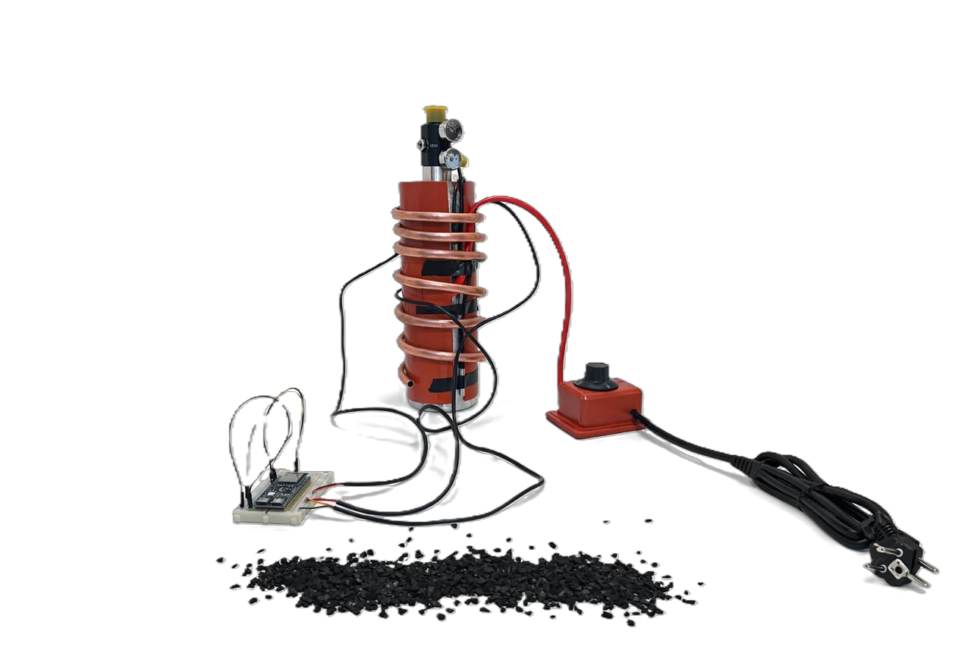
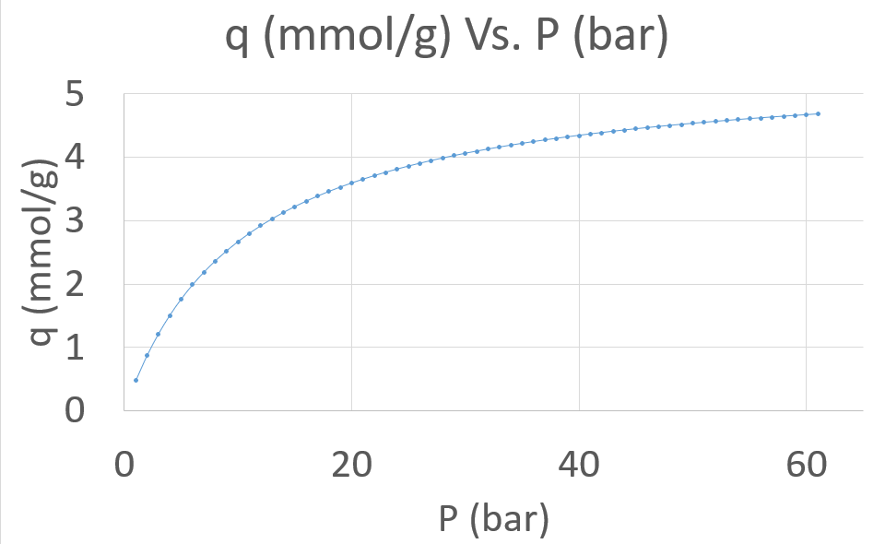
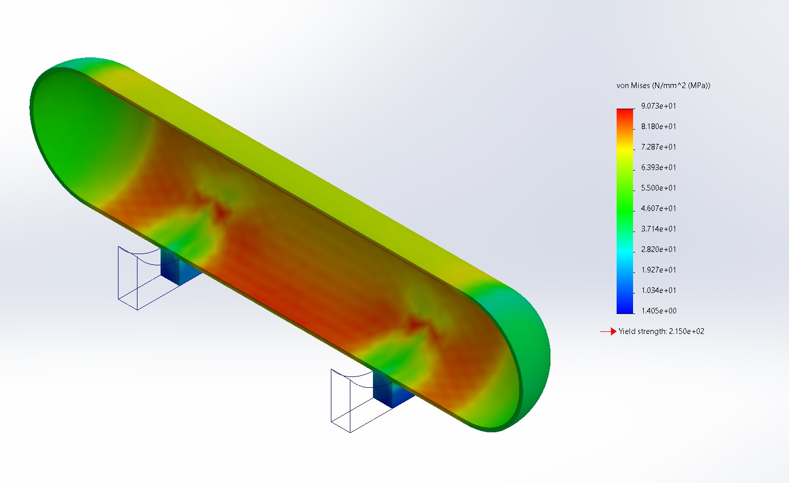
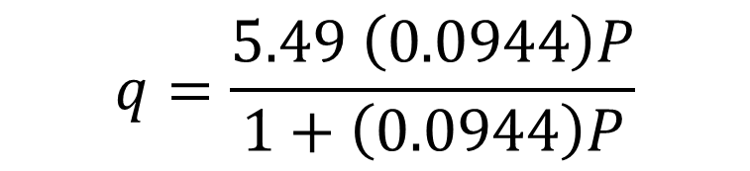

Seasonal Methane (CH₄) Storage and Release Using
(ANG) Technology
TEAM
M059
Ahmed Alibrahim, Sultan Alabdali, Hussain Al Salah, Ali Alahmad, Hassan Aqrish, Mohammd Al Saif
Coach: Dr. Md Abdullah Al Bari
Introduction/Background
  The vessel shall be designed with a safety factor ≥ 2.5 against yielding
  Working capacity ≥ 80% at 35 bar, 298 K
  Vessel leak rate ≤ 10⁻⁶ atm·cm³/s
  Energy consumption ≤ 10 % of stored methane energy
  Automated cycling reliability ≥ 99.5 % over 100 cycles
  System lifetime ≥ 50 adsorption/desorption cycles without adsorbent replacement
  Maintain adsorbent bed temperature at 10–40°C during operation
  Maintain temperature uniformity within ±5 °C across the adsorbent bed
Prototype:
Parameter | Value / Condition
Test Type | Laboratory-scale prototype under controlled conditions
Operating Pressure | ~27 bar (system designed up to 127 bar) (safety factor ≥ 3 against yielding)
Methane Purity | ≥ 99.99 mol% meeting system requirements
Adsorbent Type | 0.2 Kg of Activated carbon as the primary storage medium
Packing Density | > 550 kg/m³ satisfying specification target
Operating Temperature | 20–30 °C within controlled thermal limits. Maintaining temperature uniformity within ±4 °C across the adsorbent bed.
Thermal Behavior | Adsorption/desorption with managed heat effects.
Storage Density | 104.68 VSTP/kg AC as performance indicator.
Work Capacity | 82.6%, which meets the required specification of ≥ 80%.
Safety Measures | Pressure regulation and leak detection applied. System is ISO 11114-4 compliant.
Validation Method | Analytical and prototype-based (extrapolated to high pressure)
Key Limitation | Testing conducted at reduced pressure.
Problem statement: High-pressure gas storage is costly, energy-intensive, and poses safety risks for seasonal demand.
Objective: Design and test a lab-scale ANG system for safe, low-pressure methane storage.
Constrains:
  Use high-performance activated carbon with methane adsorption capacity ≥100 VSTP/kg at 35–60 bar
  Vessel must withstand up to 60 bar without deformation or failure
  Prototype total footprint shall not exceed 0.60 m × 0.60 m × 0.80 m, with a total mass ≤ 25 kg
  Methane purity ≥98 mol%, moisture ≤50 ppmv, sulfur ≤5 ppmv
Specifications:
  The adsorbent bed shall achieve a packing density of ≥ 450 kg/m³
  Adsorbent mass ≤ 0.5 kg
Testing / Validation
Prototype Design
$$q=\frac{5.49 \left(0.0944\right)P}{1+\left(0.0944\right)P}$$
Conclusions
Stress Analysis:
Prototype operated safely with effective methane adsorption.
Results show strong potential for higher-pressure performance and scale-up.
System demonstrated reliable adsorption–desorption cycling.

