Slide 1

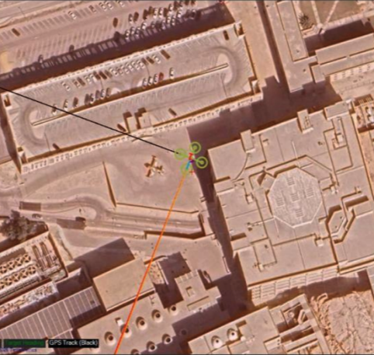
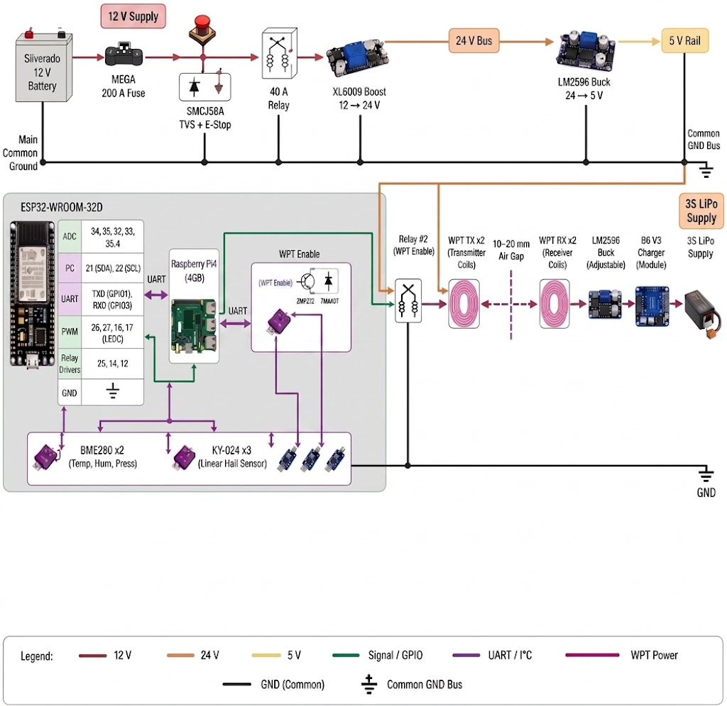


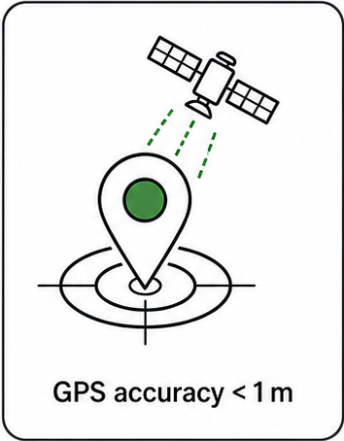
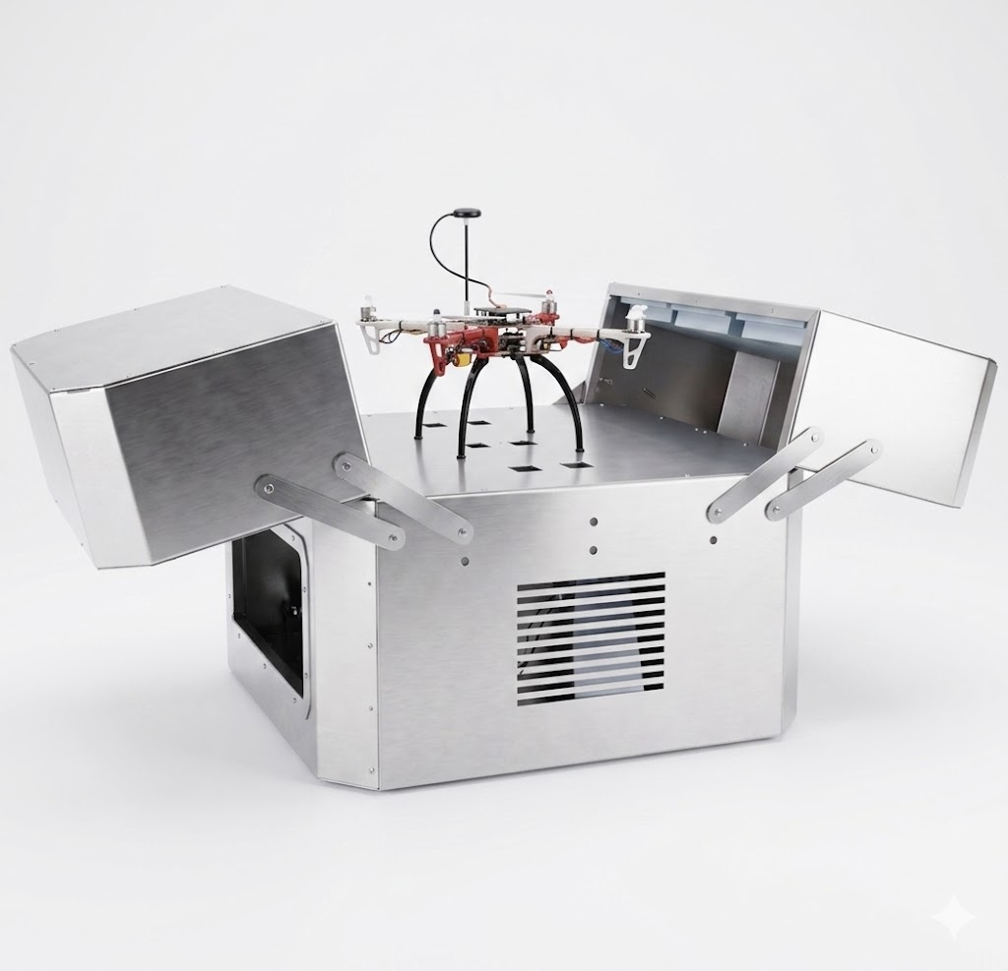
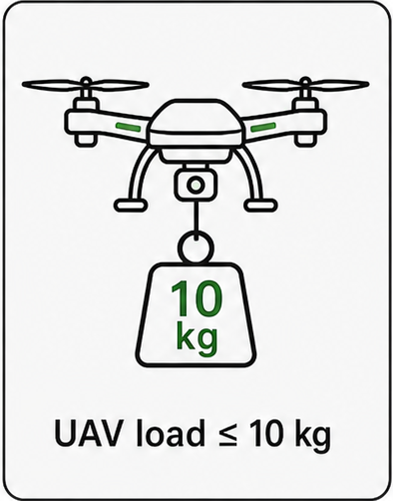
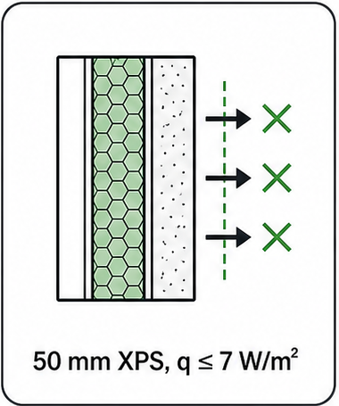
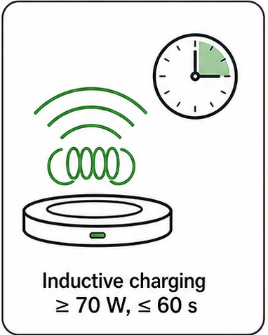
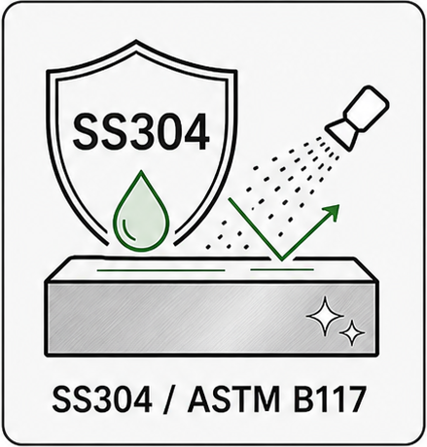
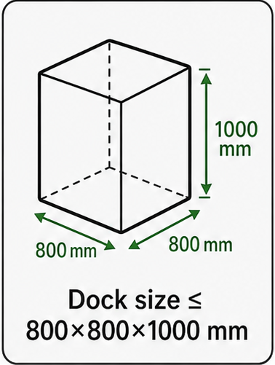
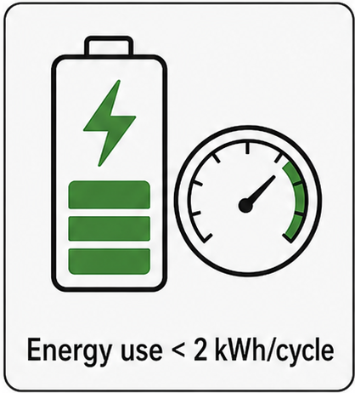
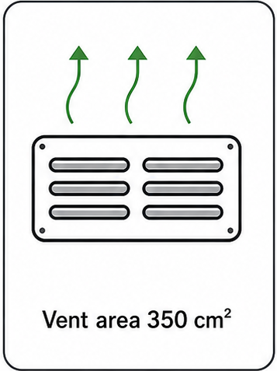
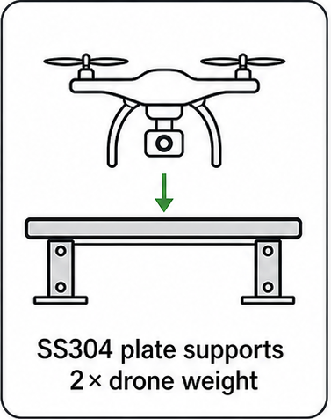
Design and Development of a Mobile Drone Docking Station Integrated into a Pickup Truck Bed for Field Operations
TEAM
M057
Alyazan Fatani (202159230) [AE] - Salman Sayedahmad (202181190) [MSE] - Laith Duhaithem (202178430) [ME]
Ahmed Almajed (202163850) [EE]- Ali Albinalshaikh (202036820) [AE] - Abdullah Alumran (202033280) [SWE]
Coach: Dr. Wail Mousa
Background
Problem Statement
Testing and Validation
A mobile drone docking station was designed to be integrated into a pickup truck bed for field operations. The system provides protected storage, battery charging, thermal management, and faster drone deployment in a single mobile platform.
Conventional drone docks are mainly fixed-site systems and do not meet the needs of mobile field missions. A compact vehicle-integrated solution is needed to support safe storage, charging, and quick redeployment of the drone.
Constraints
EPH ≈ 0.74 m
Specifications
Prototype
Conclusions
Reduced project costs by 15% using simplified material selection.
Improved deployment efficiency by 26% with 0.74m GPS accuracy.
Reduced docking preparation time by 28% with faster motors.
Reduced overall docking cost by 90%.

