Slide 1
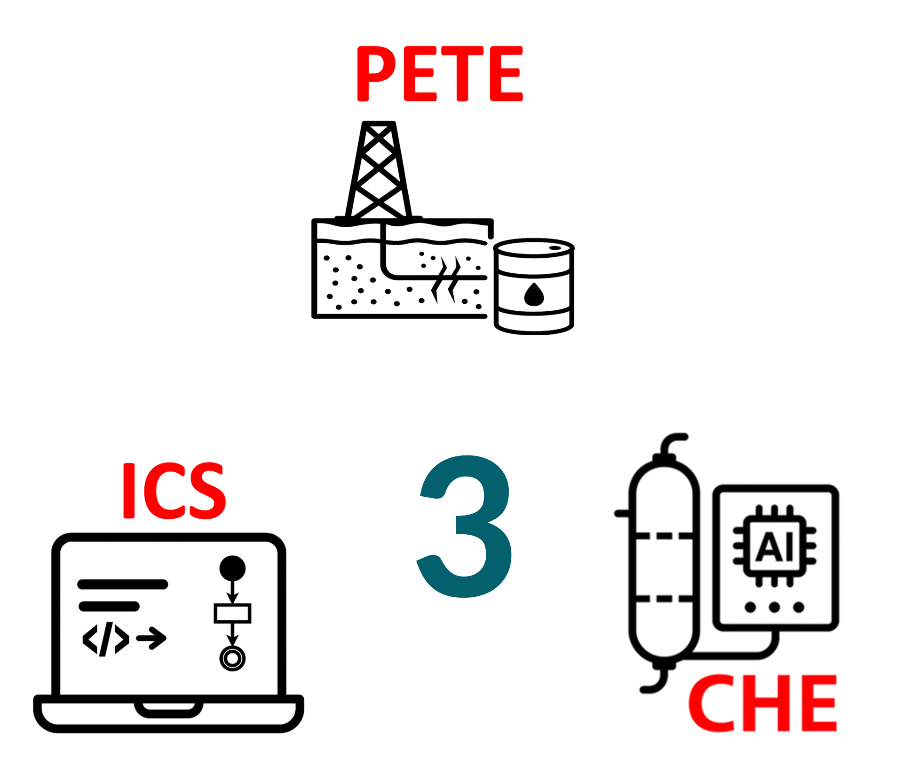
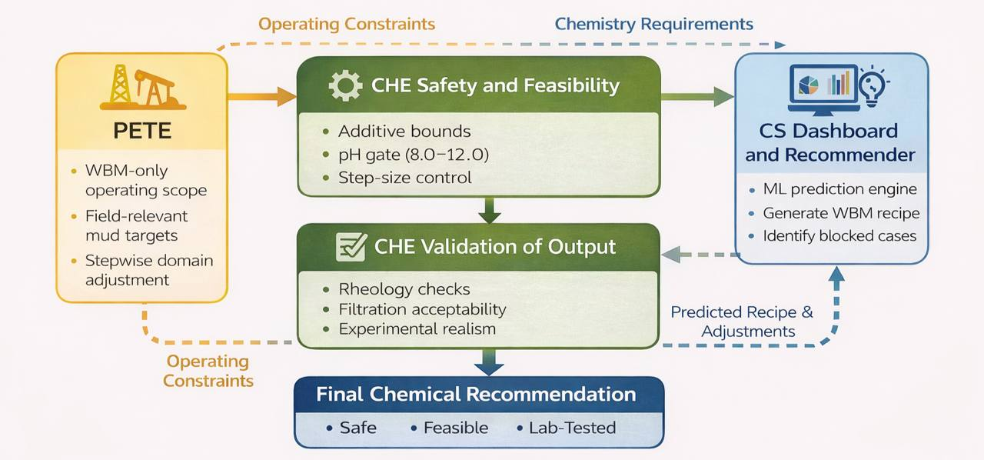
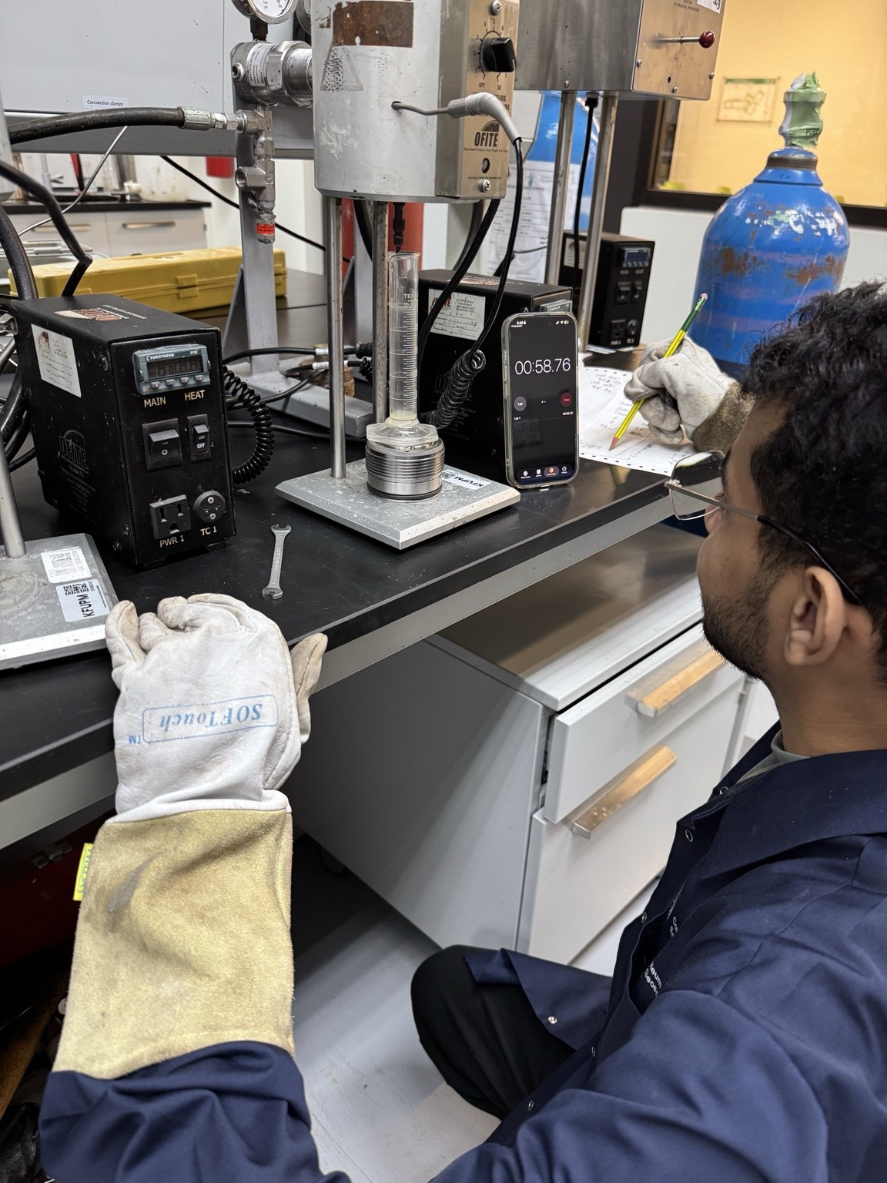
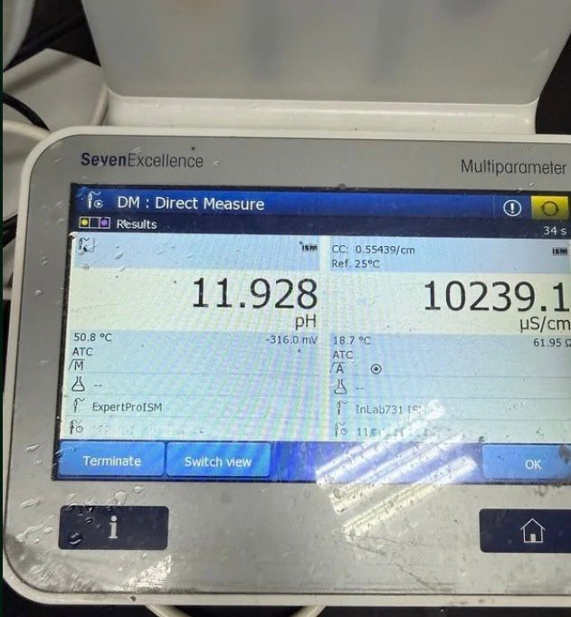
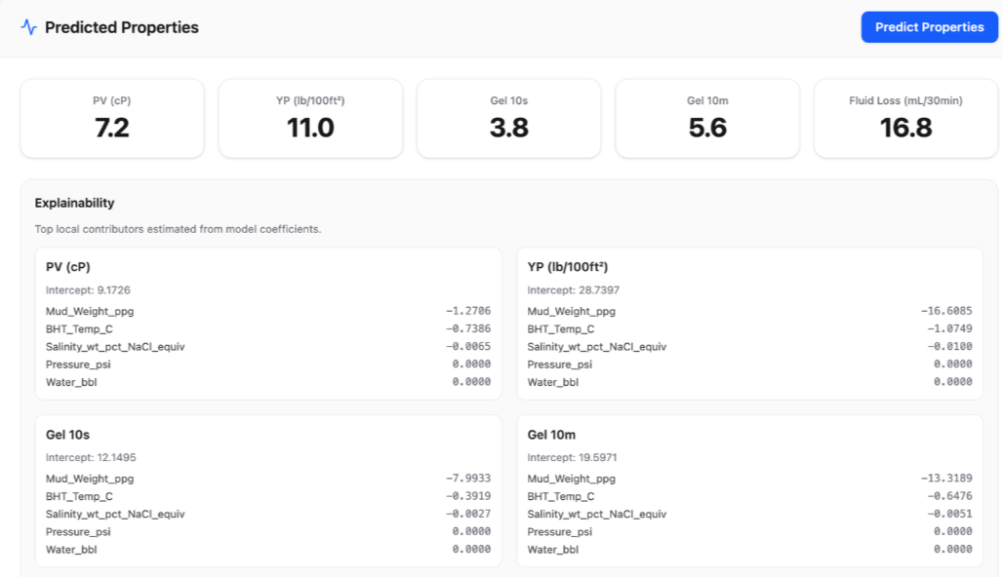
TEAM
M055
AI Mud Property Predictor & Dose Recommender
Ziyad Alrushud, Fahad Alathel, Abdullatif Alqahtani, Mohammed Alhudar, Mohammed Albugami, Ahmed Alzain
Coach: Omar Hammad
Project Overview
• Dose recommendation success rate: ≥ 80% of blind tests hit targets.
• Every recommended recipe must satisfy working pH 8.0–12.0.
• End-to-end workflow: full cycle from user input to recipe output.
• Safety guardrails: no suggestions outside trained bounds.
• Integrated input → predict → recommend → review → export.
• Designed for consumer-grade usage and lab-compatible validation.
Validation & Conclusions
Objective
• Predict PV, YP, gels, and API fluid loss for WBM.
• Recommend bounded recipe changes and reduce lab trial-and-error.
Validation & Verification
• Testing assessed predictor generalization.
• Blind-test cases assessed bounded recommender performance.
• Out-of-domain checks confirmed safe interactive use.
Multidisciplinary Design
Problem Statement
• Mud design is iterative, time-consuming, and lab-intensive.
• Property interactions are nonlinear and hard to tune manually.
System & Prototype
Metric | Verified Result
PV RMSE | 8.44%
YP RMSE | 9.60%
API fluid-loss MAE | 1.04 mL
Recommender hit rate | 87%
Latency | < 200 ms
Input
Predict
Rec
Review
Export
Constraints
• Consumer-grade hardware only: i5 CPU, 8 GB RAM.
• Model complexity ≤ 50 MB for quick application loading.
• Xanthan polymer type only.
• Mud type limited to Water-Based Mud (WBM).
System Overview
• React dashboard, FastAPI backend, and Python ML pipeline.
• Predictor estimates PV, YP, Gel 10s, Gel 10m, and API fluid loss.
• Recommender proposes bounded changes with warnings and explainability.
Computer Science (CS)
• Built the prediction/recommendation app and bounded logic.
• Added validation, explainability, and CPU-efficient deployment.
Lab validation using rheology / fluid-loss test setup
Requirements Attainment
• Accuracy and latency targets were met within the validated WBM domain.
• Recommendations stayed bounded; unsupported cases were blocked.
Specifications
• Prediction latency ≤ 200 ms per prediction on laptop CPU.
• PV/YP accuracy: RMSE ≤ 10%; API FL measurement range: 2–25 mL.
• Domains: density 8.5–12.5 ppg; temperature 25–120°C.
• Inputs must stay within defined density, salinity, and temperature ranges.
• UI must clearly show predictions, doses; explainability required.
Chemical Engineering (CHE)
• Enforced additive bounds, xanthan limits, pH gate.
• Blocked chemically unsafe recommendations and checked lab feasibility.
Conclusions
• The prototype improves decision speed without removing lab validation.
• AI + CHE + PETE guardrails make the system credible and usable.
• Results support safe, explainable, efficient deployment.
Petroleum Engineering (PETE)
• Defined PV/YP/gels/fluid-loss targets and the WBM operating domain.
• Aligned outputs with API RP 13B-1/13B-2 and required lab confirmation.
Prototype Development
• Built from a validated WBM dataset.

