Slide 1

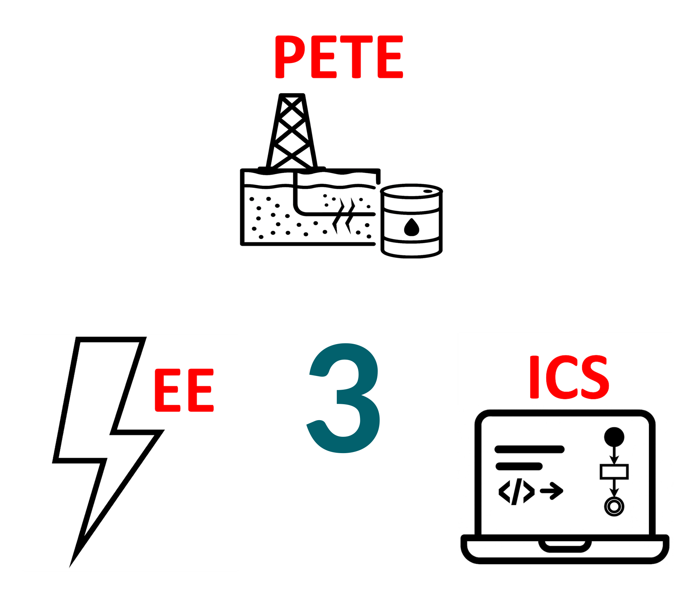
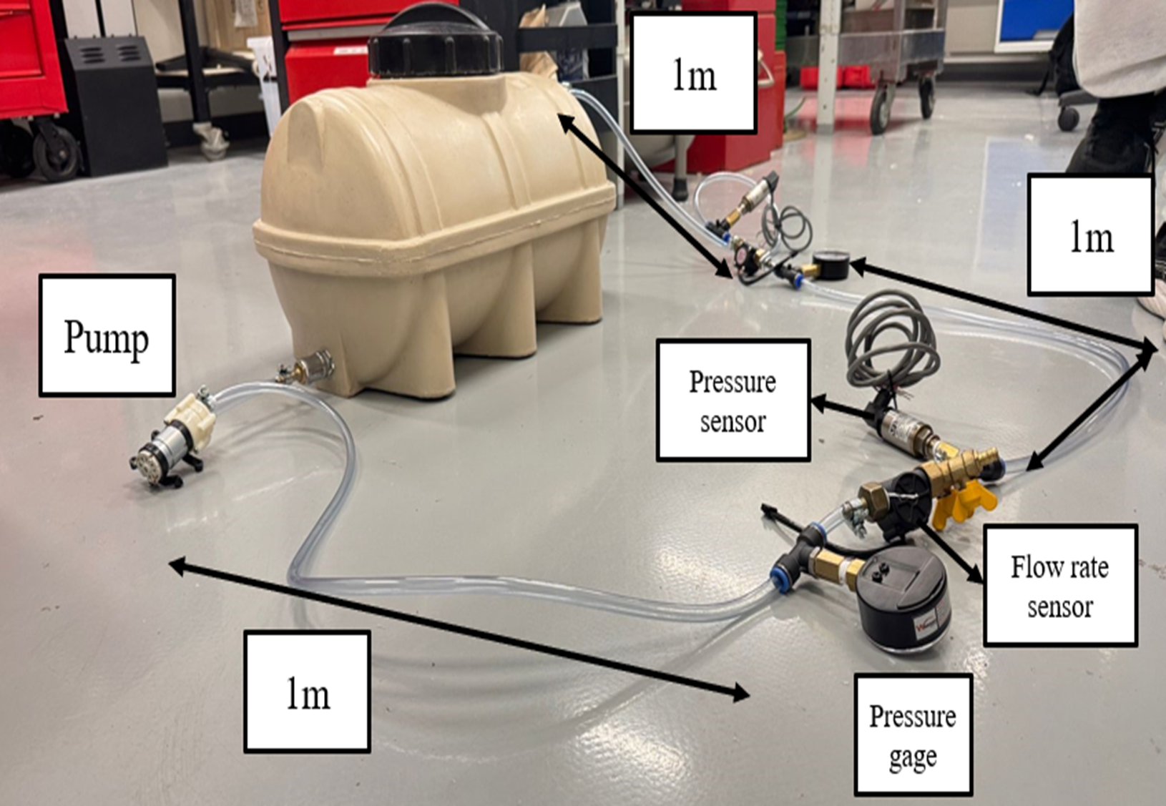
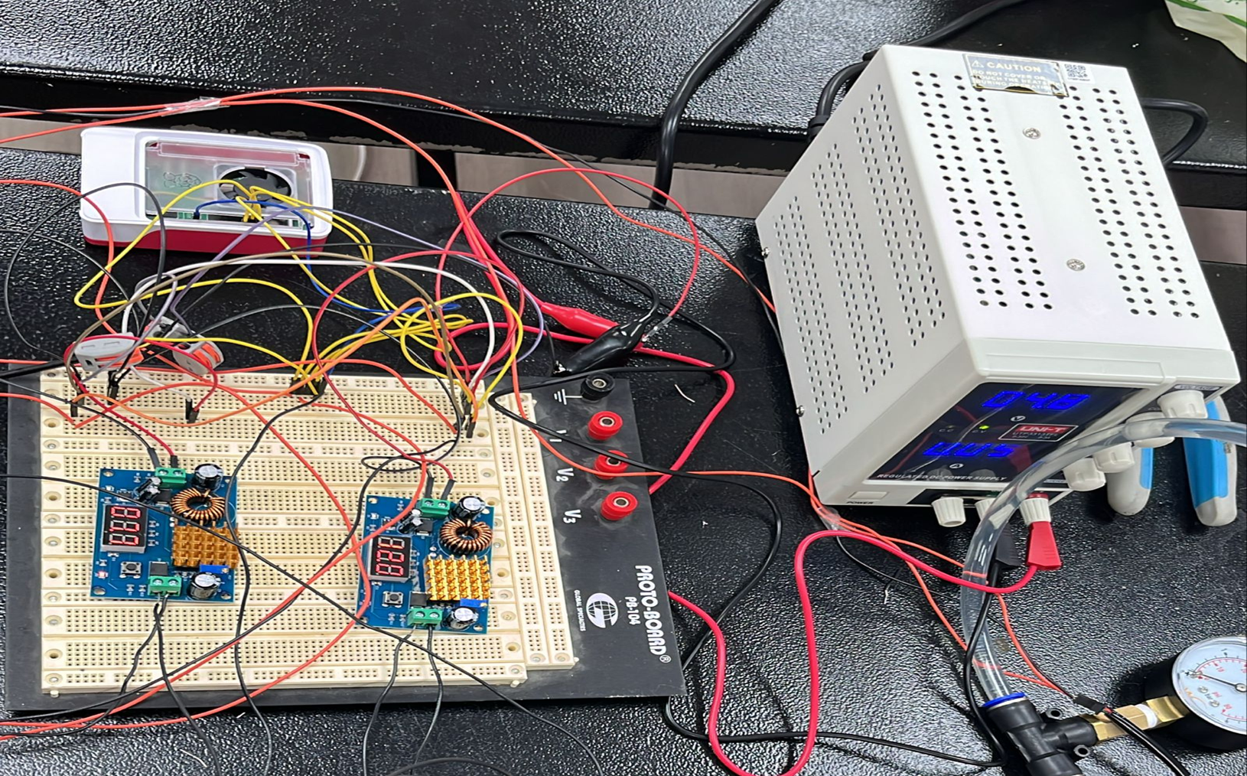
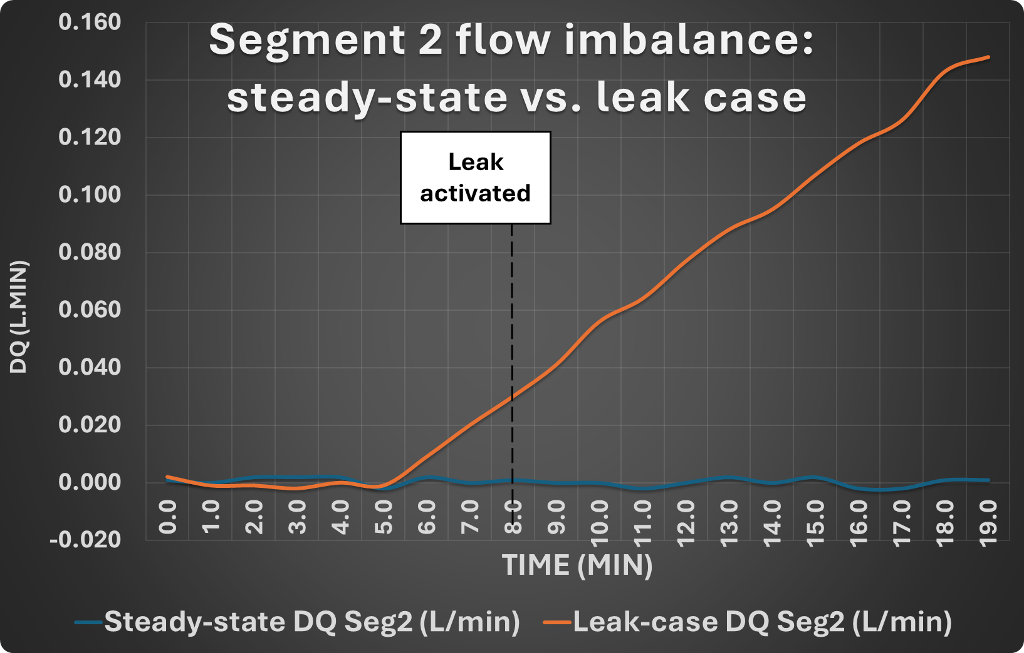
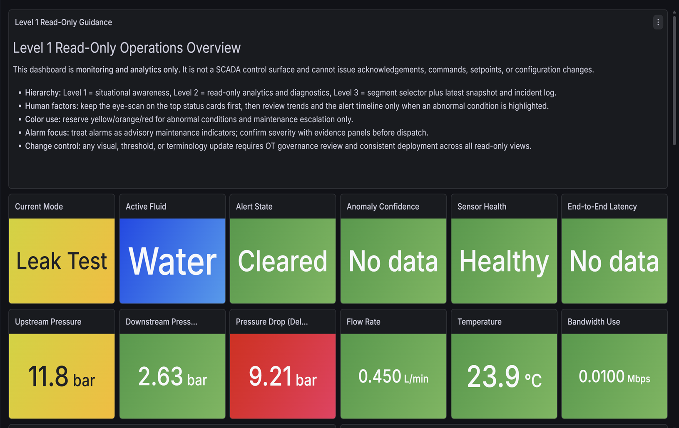
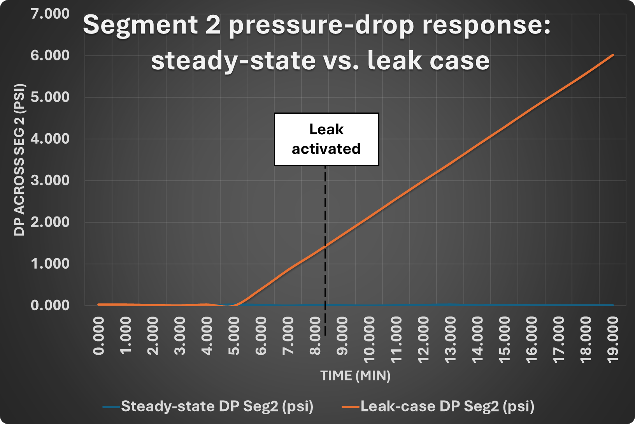
TEAM
54
Predictive Maintenance and Anomaly Detection for Fluid Pipeline Systems
Abdulaziz Alabdulqader, Ahmed Alessa, Murtadha Alramadhan, Mohammed Hamadah, Hussain Alabdulali, Reda Alali
Coach: Dr. Omar Hammad
Prototype Design
Background & Objective
Specifications & Constraints
Multidisciplinary Integration
The project develops a low-cost leak detection platform using pressure and flow sensors in a closed-loop system. When a leak is detected, it shows the abnormal condition clearly on a real-time dashboard and triggers a buzzer alarm for immediate warning.
Constraints
Cost: ≤ SR 5000
Bandwidth: ≤ 5 Mbps/site
Limits: 0–70°C, ≤ 1500 psi
Test scope: ~3 m pipeline section
Power: ≤ 3.5 kWh/day
Fluid: Water or oil
Specifications
Flow: 0.25–1 L/min
Testing: 1–2 virtual pipeline segments
Detection: TPR ≥ 85%, FPR/FNR ≤ 5%, with RUL
Reporting: Reports ≤ 1 hr; storage ≥ 180 days
Simulation: 2 realistic PIPESIM datasets
Sensors: 4–20 mA compatible
Integrated Specs
Alerting: End-to-end ≤ 5 s
Accuracy: F1 ≥ 80%
Reliability: Uptime ≥ 90%, data loss ≤ 10%
Dashboard: Flow, pressure, temperature visualization
PETE: Designed the closed-loop pipeline, 3-m test section, and leak scenario. Analyzed pressure and flow changes to identify abnormal behavior.
EE: Integrated pressure/flow sensors, ESP32, power supply, wiring, and buzzer alarm for data collection.
CS: Processed sensor readings, displayed pipeline status on the dashboard, and supported leak detection logic.
Integration: Combines hydraulics, electronics, and software into one low-cost leak detection prototype.
Testing & Validation
Conclusion
The project develops a low-cost leak detection platform using pressure and flow sensors in a closed-loop system. When detected, it shows abnormal conditions.

