Slide 1
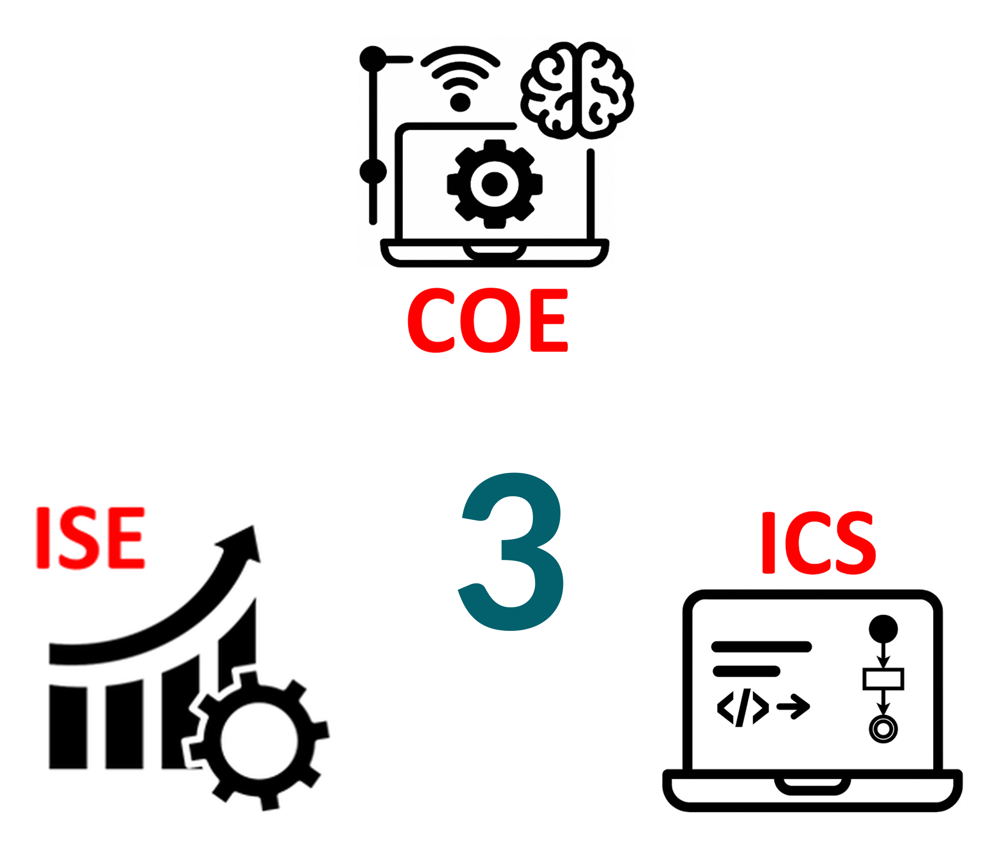
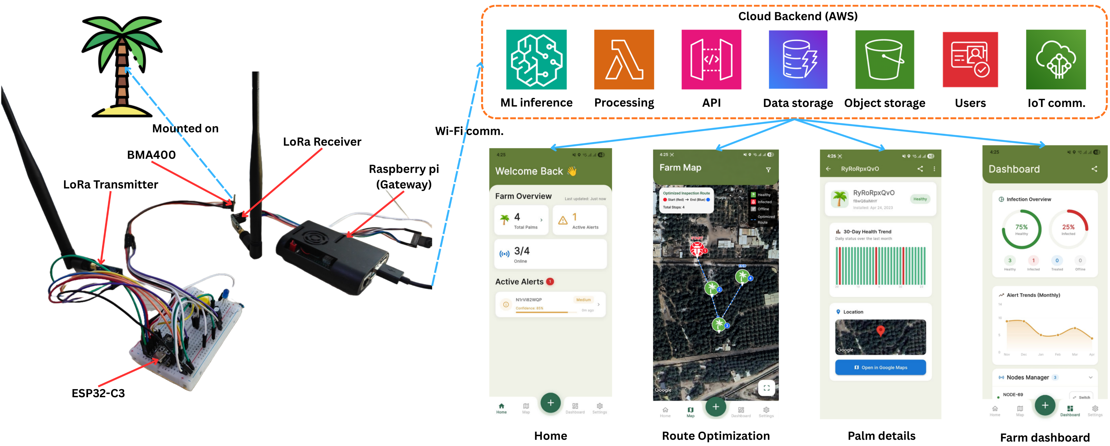
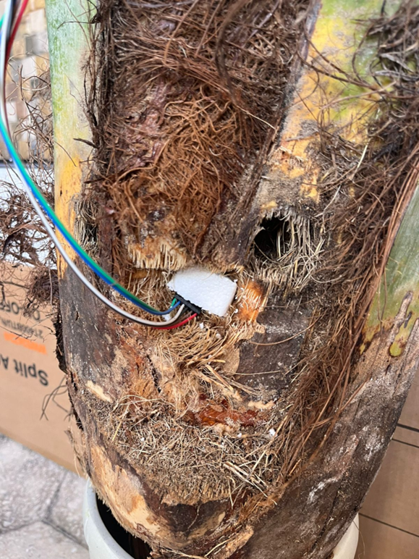
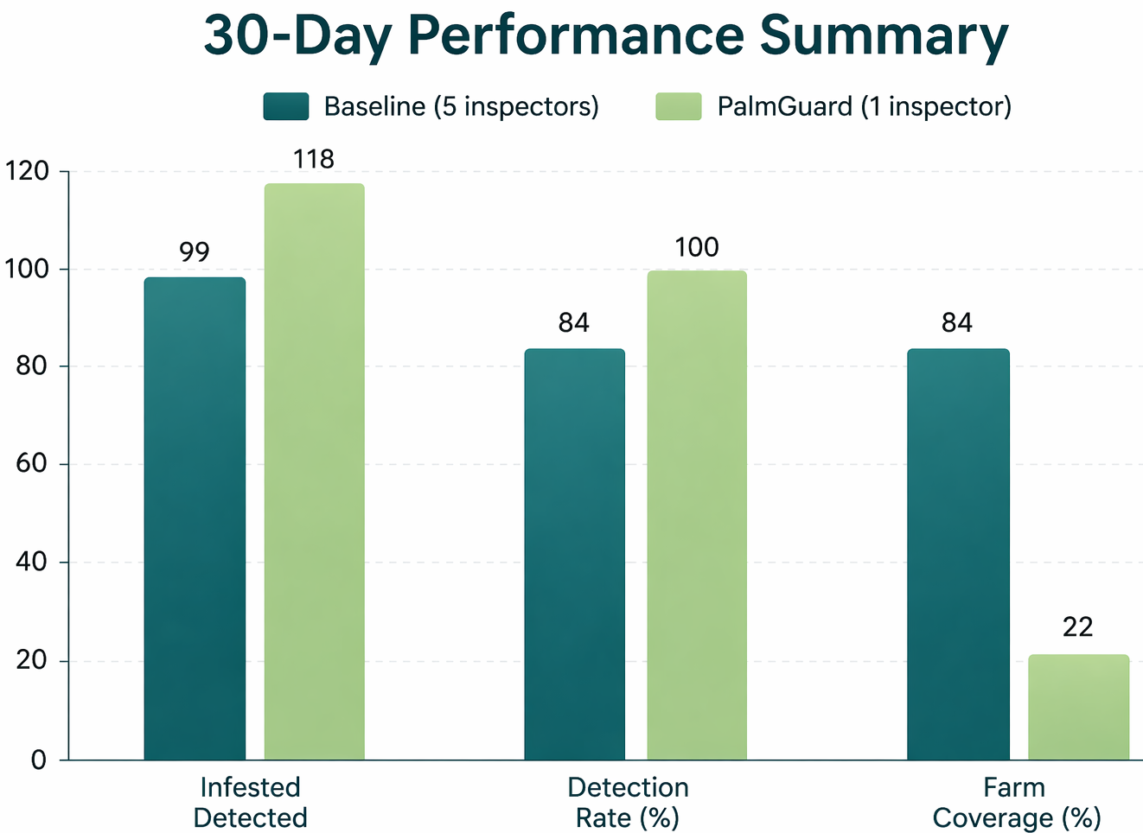
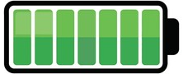



PalmGuard: Red Palm Weevil Detection System
TEAM
M052
INSERT HERE The Multi-Disciplinary Strength logo
Abdulaziz Alghadeer, Turki Alyamani, Najaf Bumijdad, Abubaker Tayeb, Abdullah Alhani, Abdulaziz Alhur
Coach: Firas Muin Al-Hindawi
Background
Specifications
Prototype Design
Palms are vital economic resource in KSA
RPW causing significant losses
Avg. power ≤ 5 W
Packet delivery ≥ 90% @ 60 m
Deep sleep current < 500 µA
ML latency ≤ 600 ms (p95)
API latency ≤ 500 ms (p95)
SUS score ≥ 75
≤ 4 taps to view palm info
≥ 20% increase in high-risk detection
≥ 60% risk coverage
Alert delay ≤ 15 sec
≥ 85% alert precision
System availability ≥ 99%
Problem Statement
RPW stays hidden for months inside the trunk
Manual inspection = Reactive + Slow
Current methods aren’t scalable
Objective
Detect RPW early using vibrations & AI
Real-time alerts
Optimize inspection route
Testing & Validation
Conclusion
Tested on a held-out 5-hour real RPW dataset collected using our system, achieving 93.45% precision
Stress testing showed API and inference ≤ 500 ms, alert delays ≤ 15 s
Packet delivery ≥ 90% at 60 m, with nodes remaining operational for up to 2 months
Integrated end-to-end RPW monitoring system
Enables early detection with real-time alerts
Improves efficiency via optimized inspection routes
Reduces reliance on manual inspection
Scalable for smart agriculture deployment
Constraints
+2 Months
AI in Cloud
IOS + Android
+15% vs Manual

