Slide 1




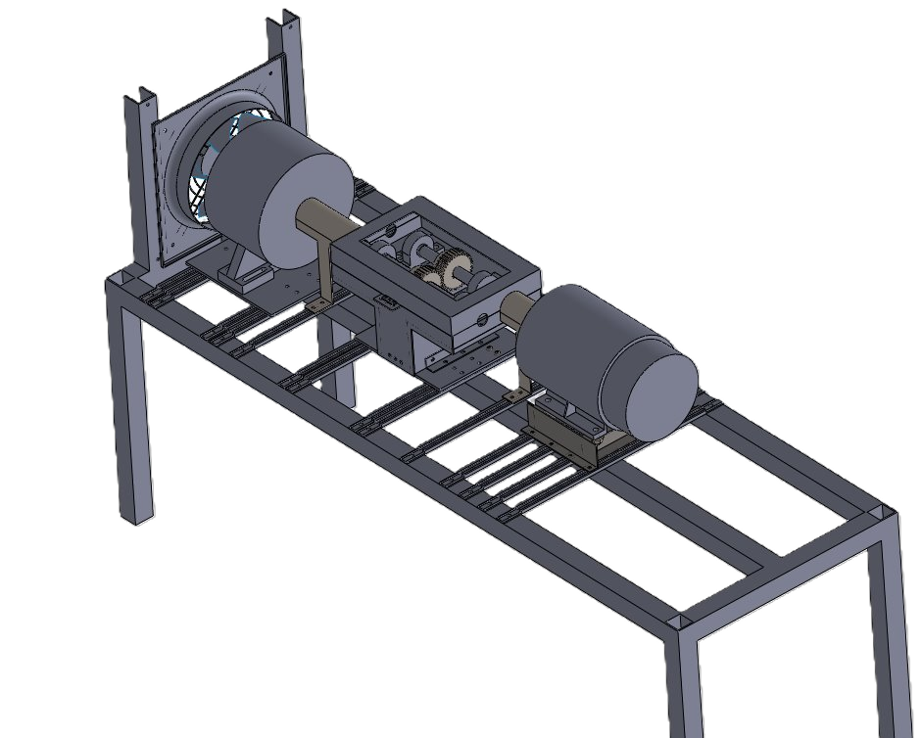
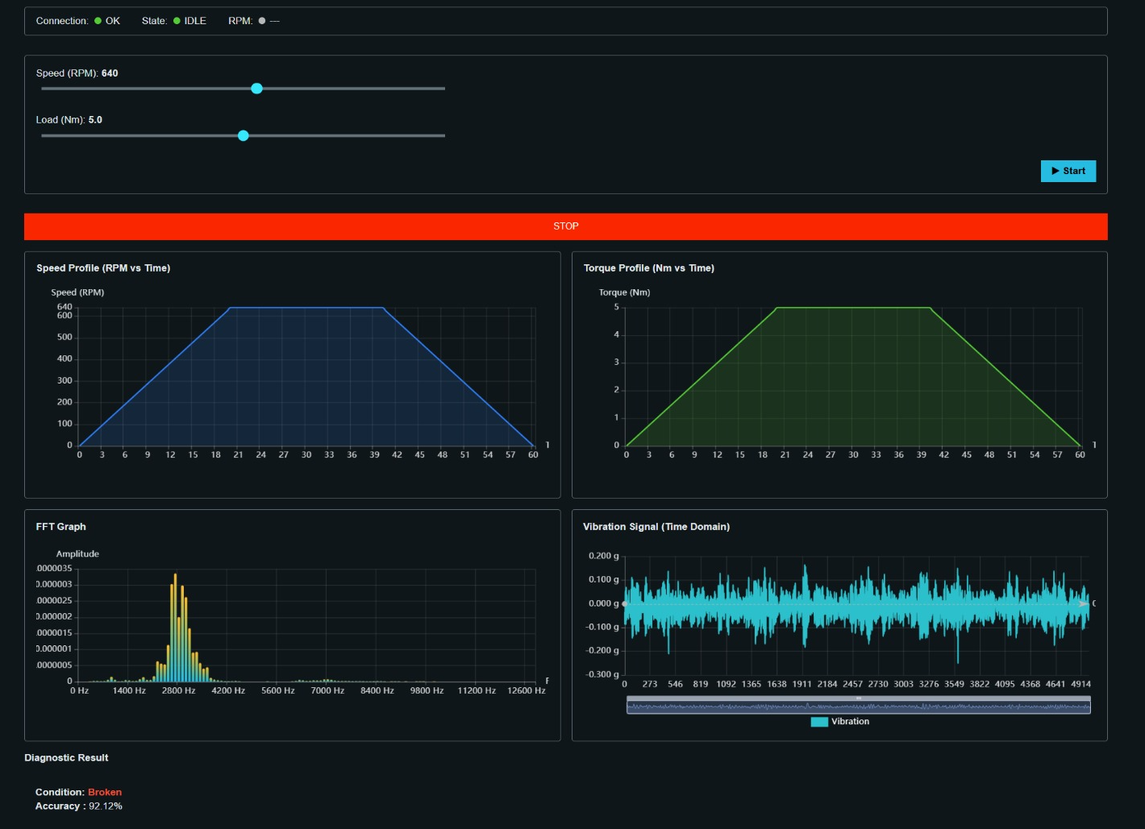
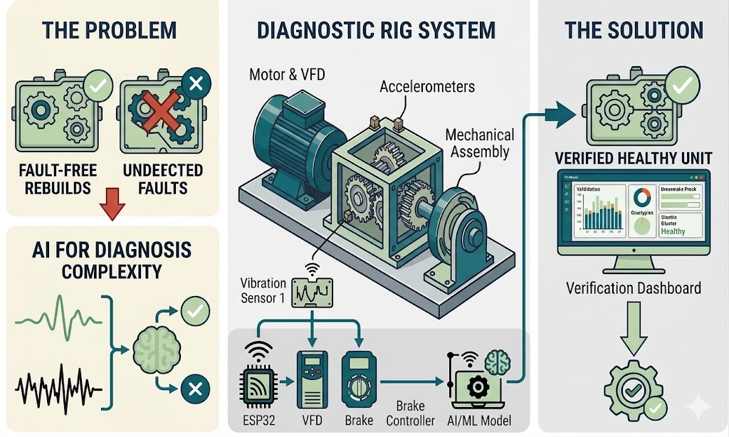
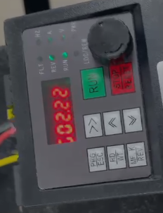
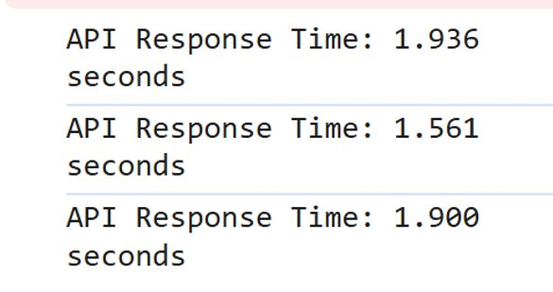
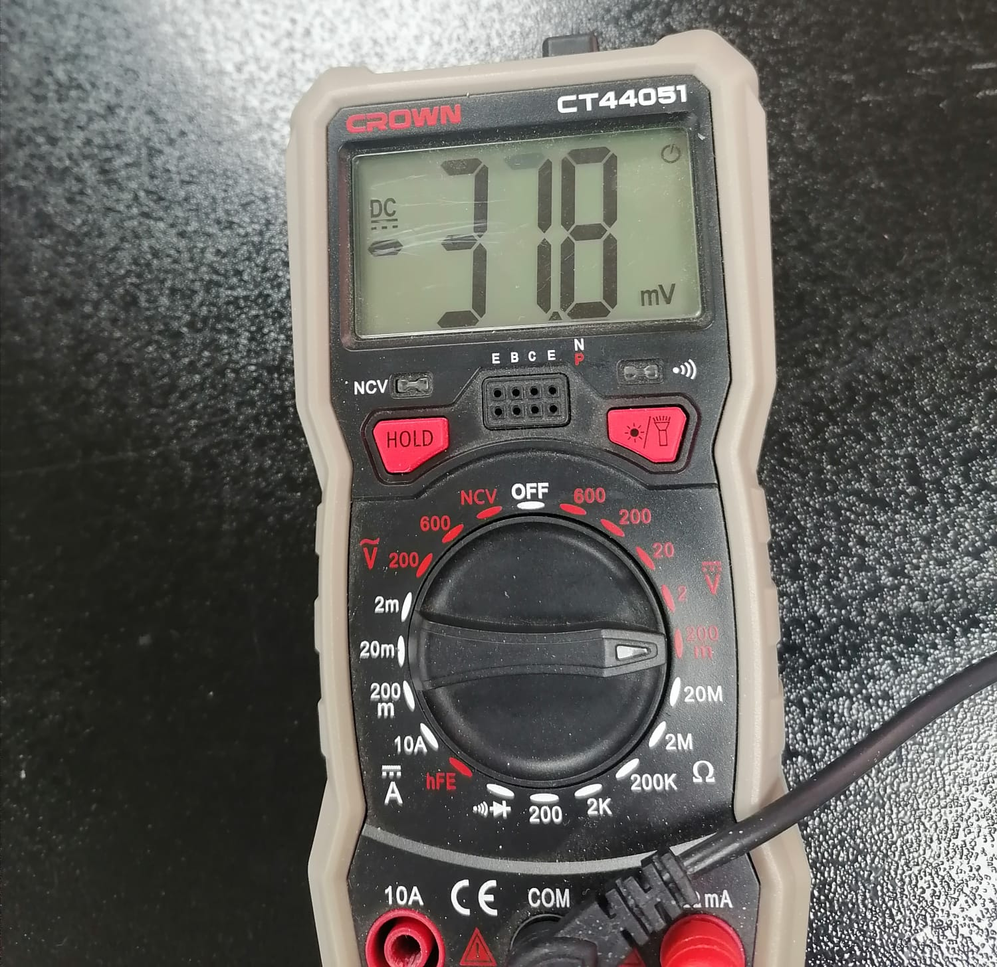
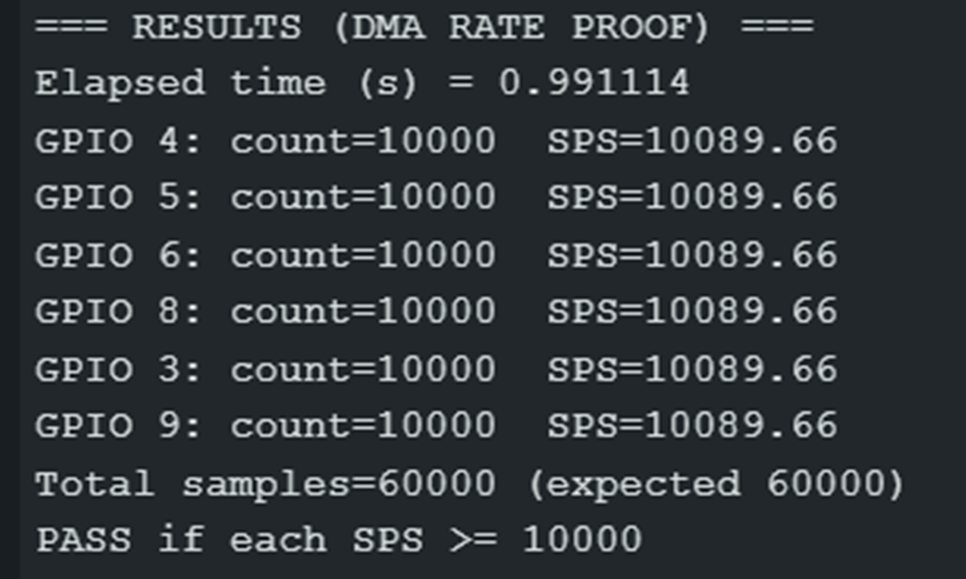
AI-Driven Automated Gearbox Failure
Diagnostic Rig
TEAM
M049
4
Abdullah Alotaibi (ME)​, Abdullah Alammari (ME)​, Fahad Almutairi​ (CS), Mana Al Abas (CS), Khalid Al Saif (COE), Mohammed Aman​ (EE)
Coach: Dr. Bilal Qureshi
Problem statement
Prototype Design
This project builds a vibration-based diagnostic rig with AI to detect existing faults and prevent repeat failures.
Mechanical Assembly
User Interface
UI (C3)
Block Diagram
Single stage spur gearbox (C1)
Vibration sensor 2
VFD
Vibration sensor 1
Brake controller
ESP 32
2.22 kW from VFD (C2, S1)
Response time (S5)
Constraints
Brake Controlled via KTC-812
C1: The rig should only be able to work on single stage spur gearboxes
C2: speed shall be controlled by a PID controller
C3: The UI allows to input test parameters and displays visualizations
2.2 kW rated Gearbox
Software & ML model
Motor & VFD
Accelerometer noise (S2)
sampling per second (S4)
Specifications
Testing & Validation
Conclusion
S1: Gearbox handle power of 2.2 kW
S2: Accelerometer noise level < 50 mV
S3: Classification accuracy ≥ 75%
S4: Sampling ≥10 kS/s per channel
S5: Response time should be ≤ 2s.
Healthy condition (S3)
Chipped condition (S3)
Missing condition (S3)
The project successfully managed to:
Provide diagnosis accuracy ≥ 75%
For future work, improving system to accommodate for diverse gear types.

