Slide 1
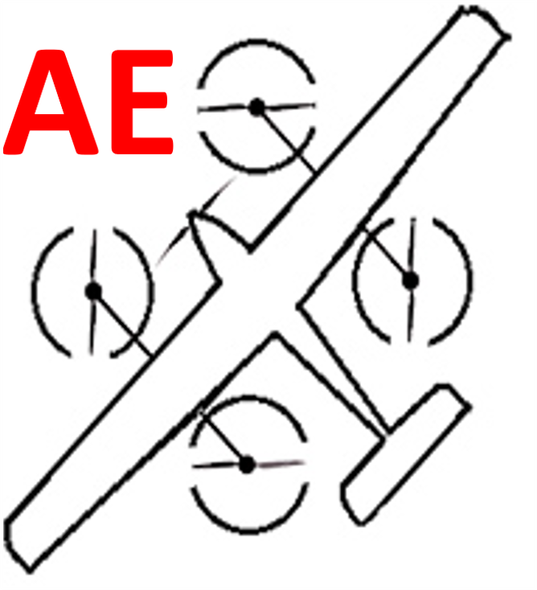



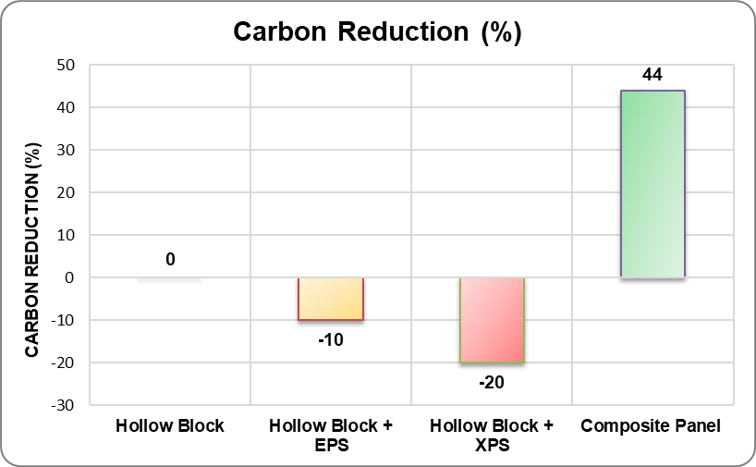
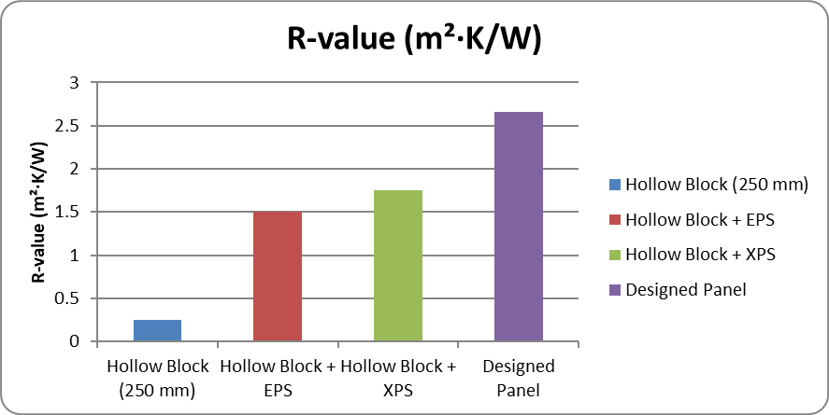
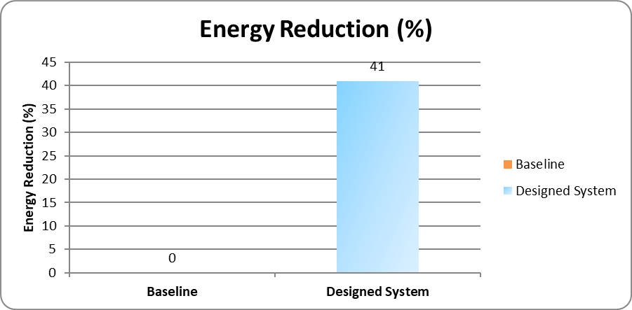
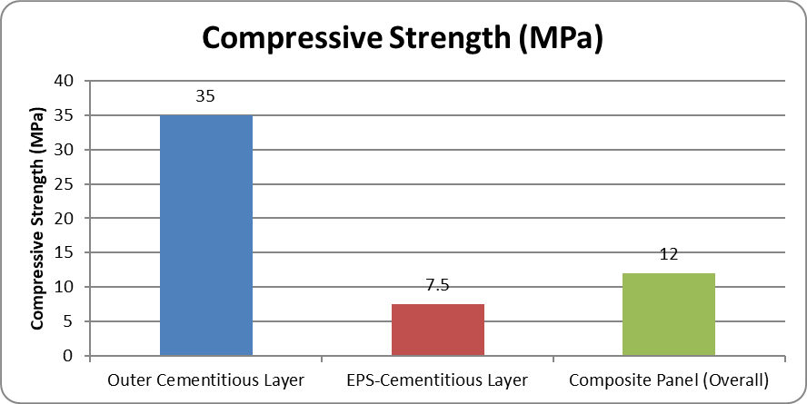
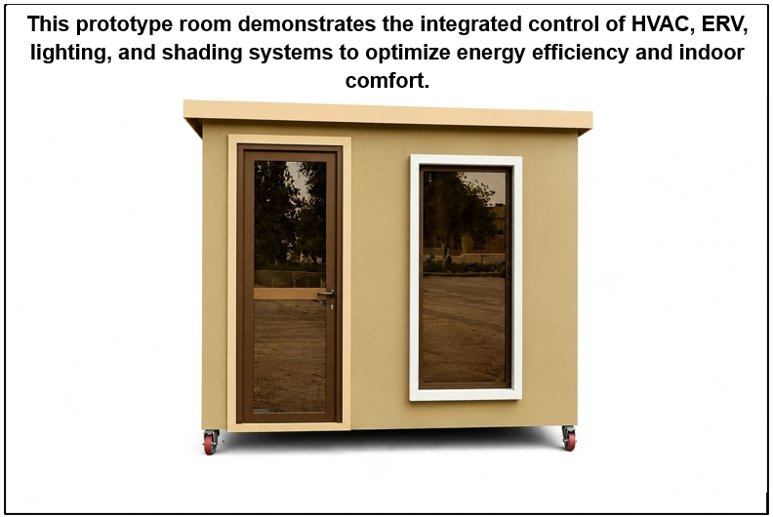
Design of an Integrated Smart Passive Modular House for Hot Climates
TEAM
M047
4
Majed Affan, Jamal Jaradat , Mazen Alanazi, Mohammed Alhammad, Ahmed Almulhim, Ahmed ALAKKAWI
Coach: Dr. Amin Al-Fakih, Dr. Mohamed Ahmed
Introduction
Constraints & Specifications
Performance Evaluation
Problem Statement:
Extreme heat drives AC to 60–70% of energy use in Saudi Arabia, while date palm waste remains underutilized. Current buildings rely on high-carbon materials and fail to provide efficient cooling, comfort, and ventilation due to poor control and inefficient systems.
Constraints | Specifications
Structural compliance: designed according to SBC 301 requirements | Thermal performance: R = 2.0–4.0 m²·K/W
Building representation: typical Saudi single-family house (200–300 m²) | Energy efficiency: ≥ 25% reduction in heat gain
Prototype scale: single-zone module ≤ 12 m² | Ventilation: 0.35–0.5 ACH
Constructability: simple, repeatable geometries for fabrication | Daylighting: DF = 2–4%
System practicality: applicable at building scale | HVAC–ERV integrated control: settling time ≤ 30 min
System feasibility: use off-the-shelf HVAC/ERV and control components | Cooling system sizing: ≤ 15% of peak load
Operational safety: system operates safely at standard residential power (230V ±10%) | Material sustainability: ≥ 30% reduction in embodied carbon
Integrated System Solution
This project introduces an integrated passive–smart system designed to reduce heat gain, improve indoor quality, and lower embodied carbon through optimized design, low-carbon materials, and intelligent control.
The system integrates:
Optimized building design (orientation + controlled daylighting)
Multi-layer modular panel (insulation + reflective air gap + lightweight composite)
Energy Recovery Ventilation (ERV) for improved IAQ
Smart control system for adaptive operation of cooling, lighting, and shading
Prototype Design
Conclusion
The project developed an integrated smart modular system combining passive design, advanced materials, and intelligent controls.
41% energy reduction achieved through integrated envelope, ERV, and smart controls.
44% lower embodied carbon using slag and date palm fiber.
High thermal performance (R = 2.66 m²·K/W) with adequate strength (~12 MPa).
Validated prototype demonstrates a practical, scalable solution for hot climates.
Overall, the system provides a practical, sustainable solution for hot climates, aligning with energy efficiency and environmental goals.

