Slide 1
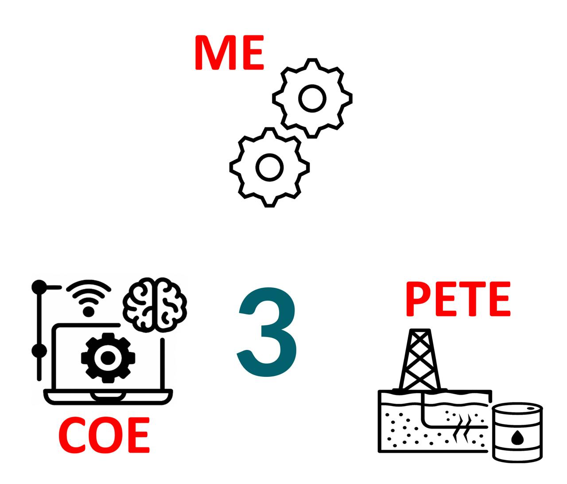
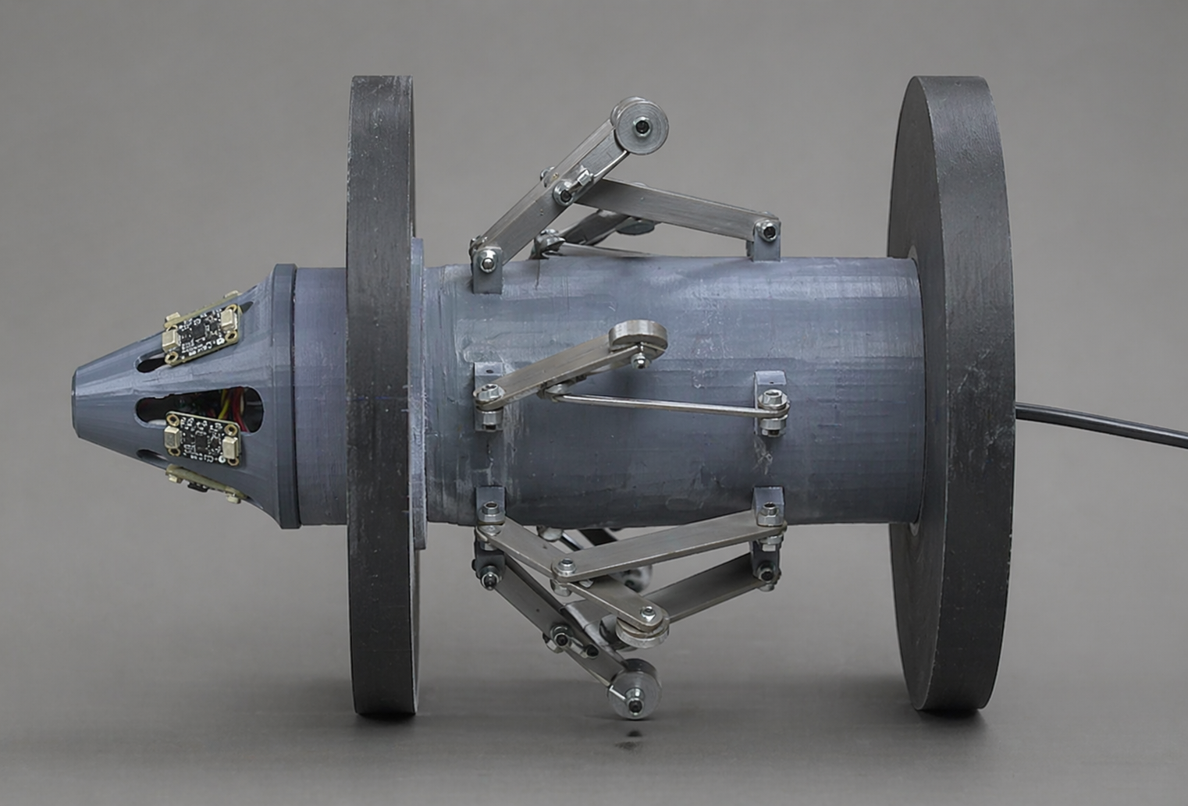
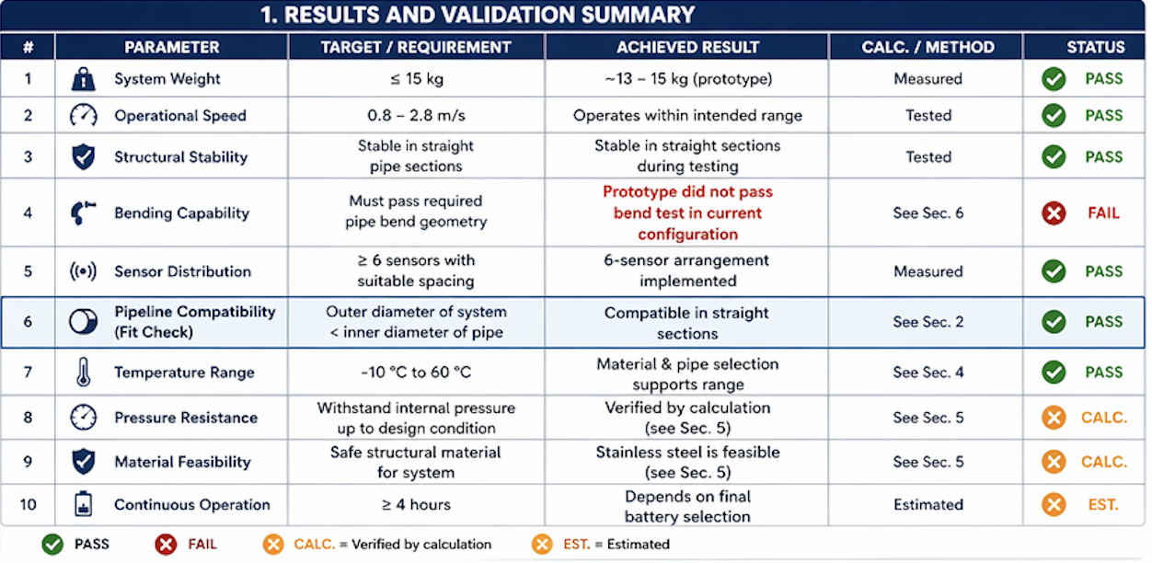
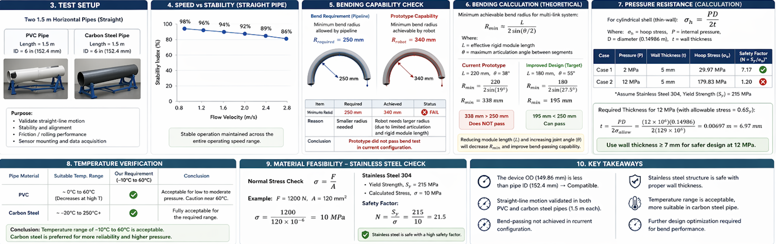
Robotic PIG for Pipeline Inspection with AI-Based Defect
TEAM
M043
Khalid Aljabir, Osama Alghamdi, Yousef Almutairi, Kamal Alkatheri, Fawaz Altheeb, Abdullateef Alwayel
Coach: Dr. Uthman Baroudi
Background & Problem
System Overview
Design Basis
Prototype Design
Pipeline operators need reliable internal inspection without shutting down the line, so we designed a compact robotic pig that moves with the flowing oil and maps internal defects.
Our system integrates a mechanical body for stable movement, a sensing and processing unit for data capture, and petroleum-based operating limits that ensure the tool runs safely in real pipeline conditions.
We based the design on downstream oil service with expected temperature and pressure ranges, and we assumed realistic flow-driven pigging speeds to protect sensors and maintain stable measurements.
Constraints & Specifications
Results and Validation
Conclusions​
The developed robotic pig successfully demonstrates a compact, stable, and scalable solution for internal pipeline inspection. By combining adaptive mechanical design with distributed sensing, the system achieves reliable navigation and full circumferential coverage within strict operational constraints.

