Slide 1

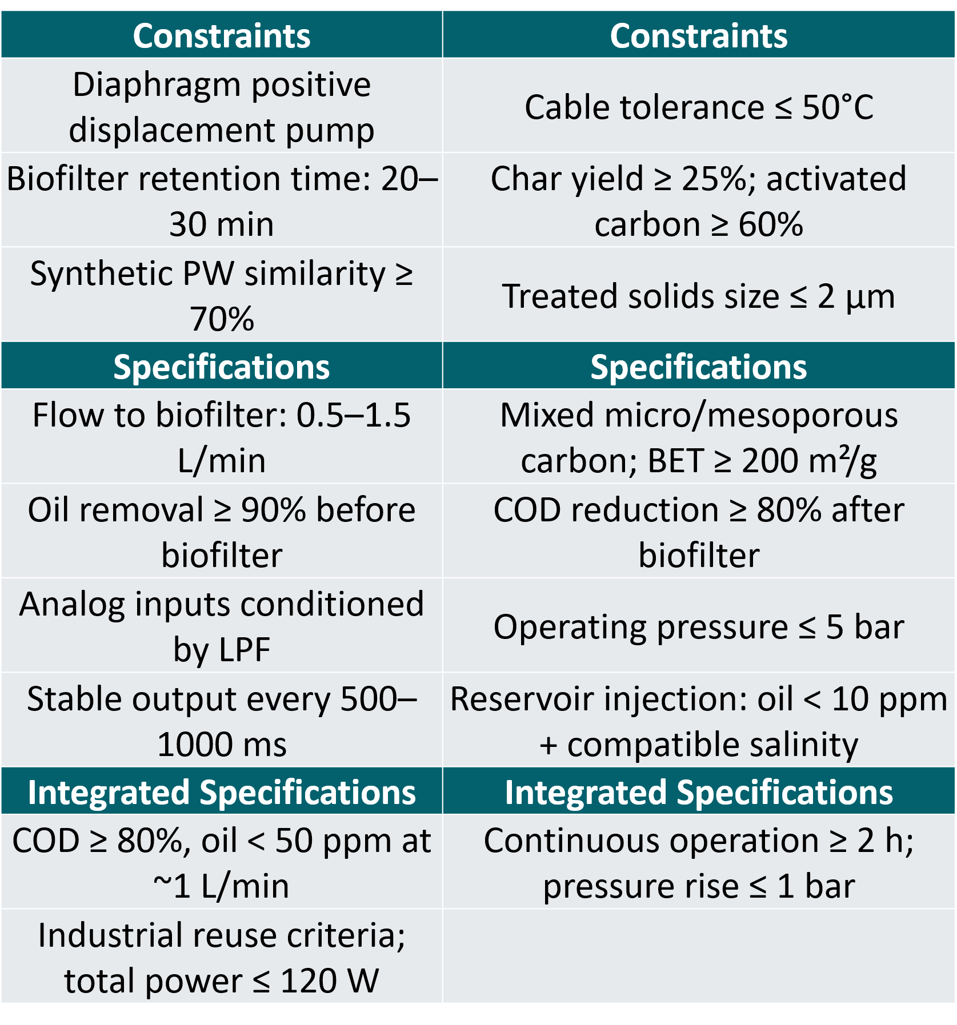
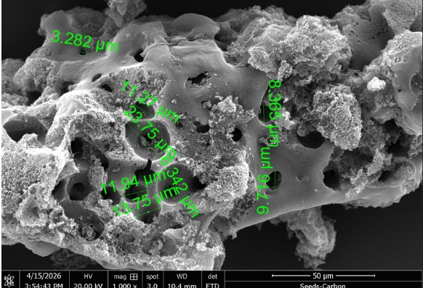
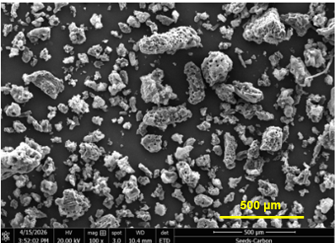
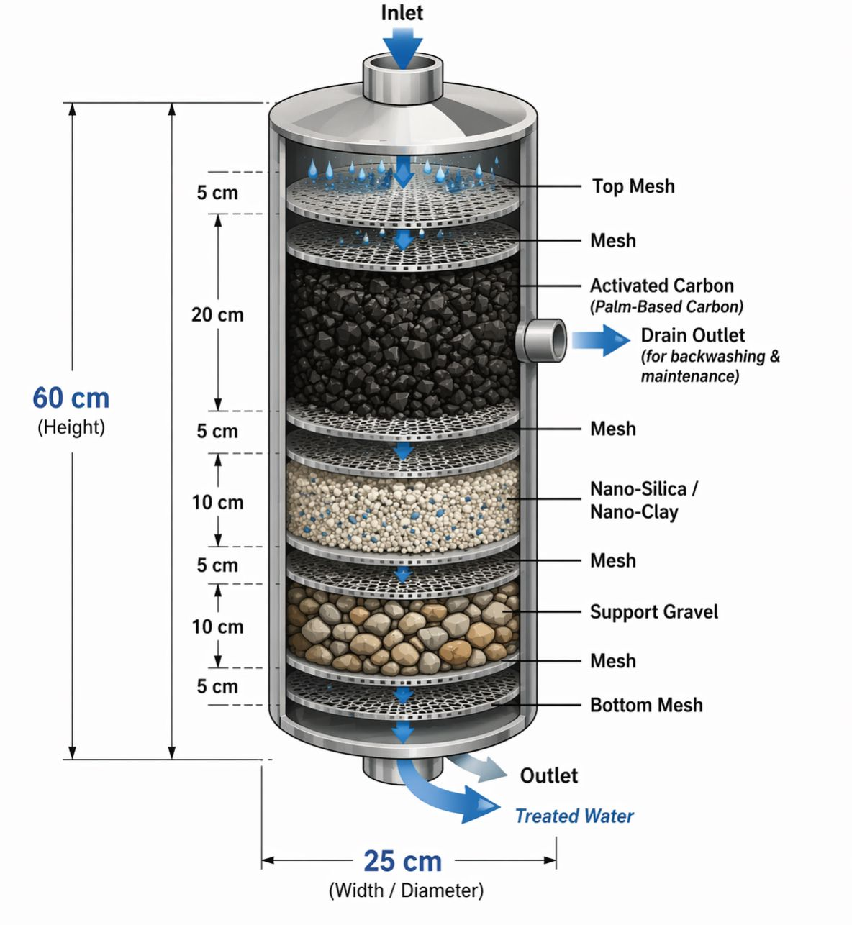
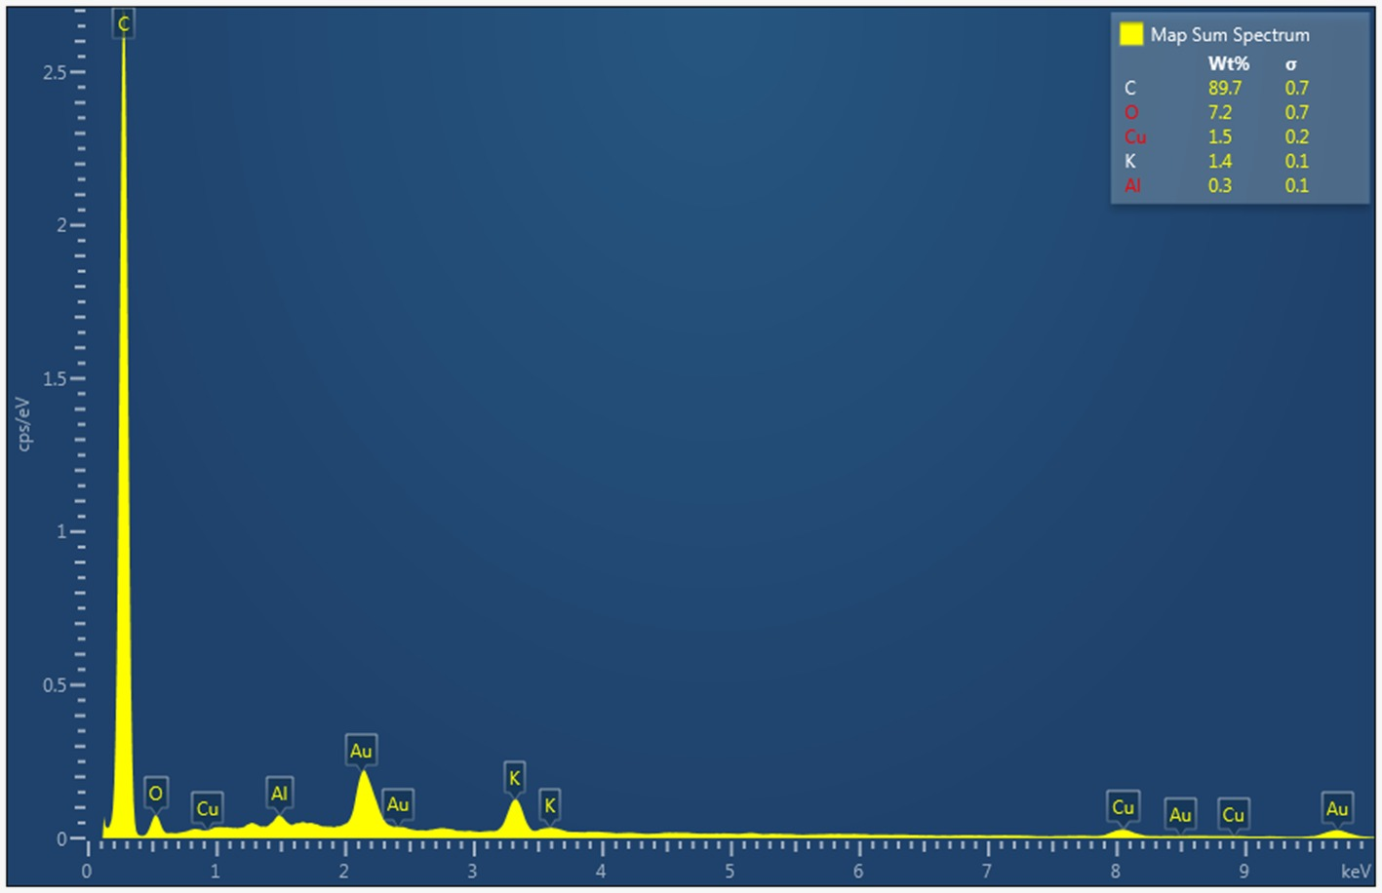
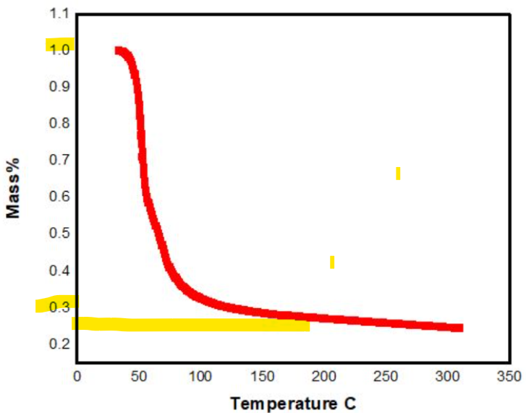
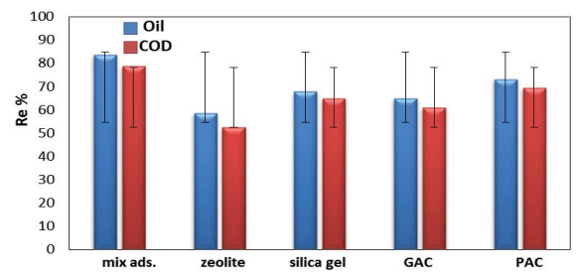
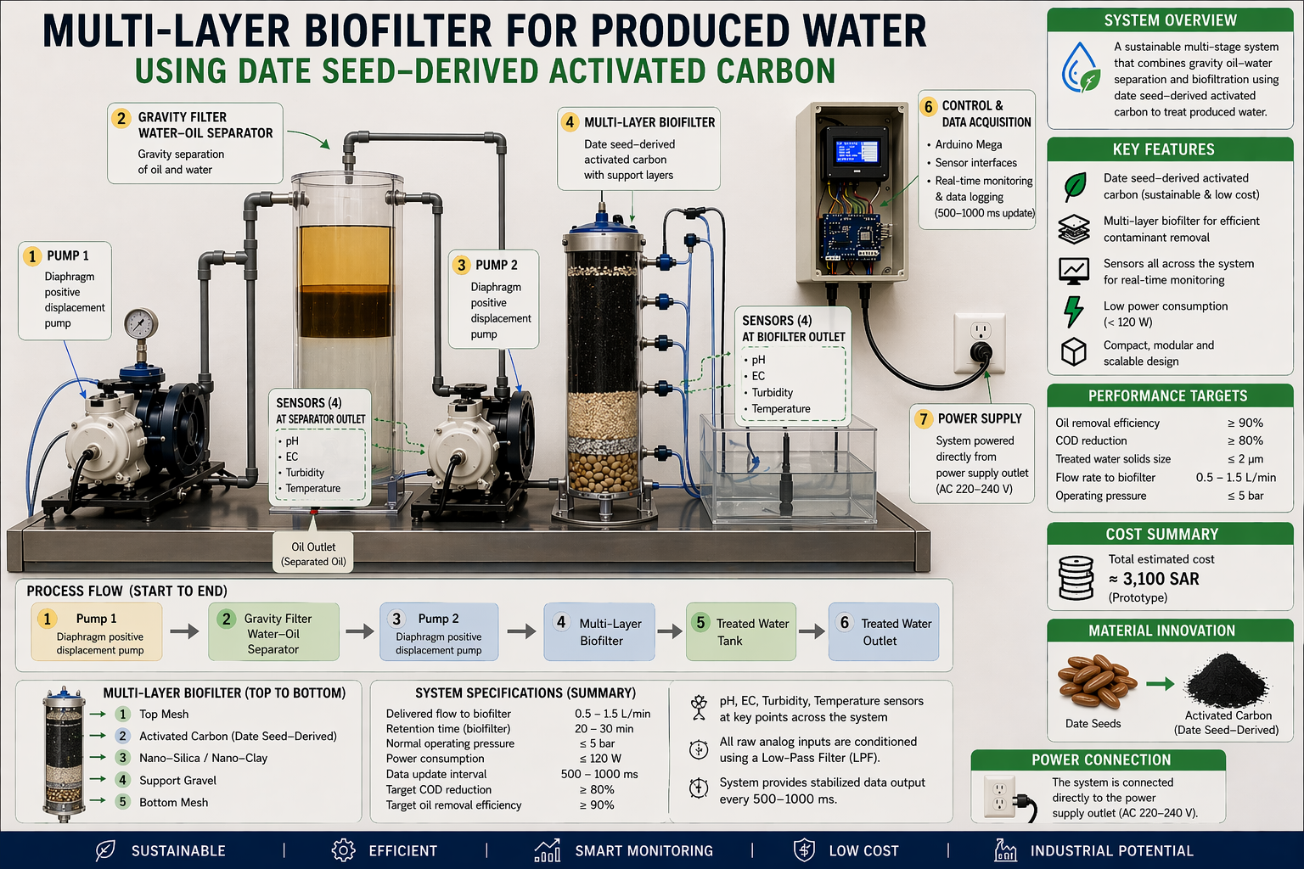
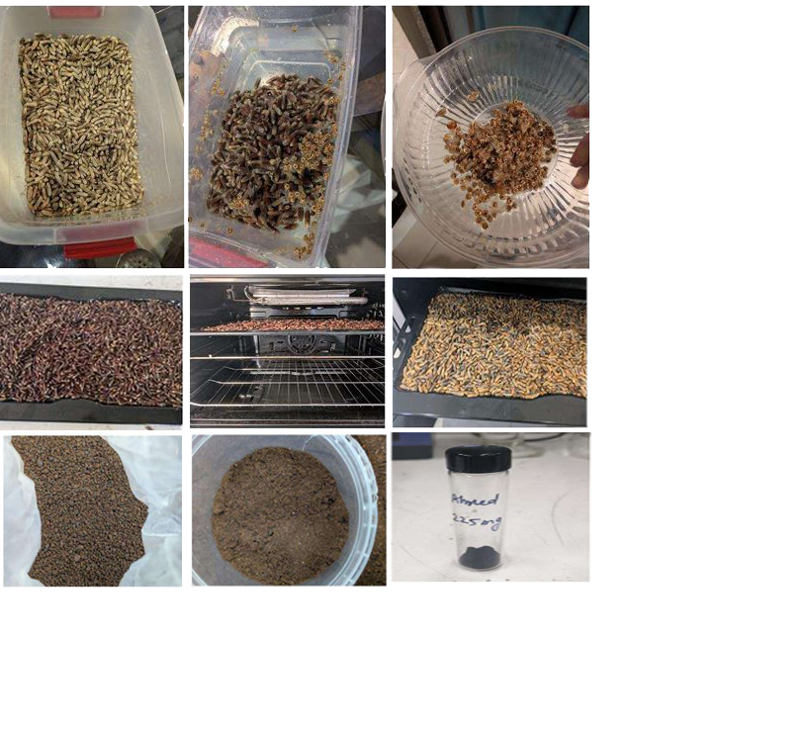

Sustainable Multi-Layer Produced Water Filter Using Date Seed Carbon
TEAM
M042
Hussein Aljaroudi, Reda Aldshaishi, Mohammed Alebarhim, Ahmed Al-Omran, Ahmed Alalwan, Ahmed Alqassab
Coach: Murtada Al-Jawad
Overview
Testing / Validation
Technical Requirement
Oil and gas companies spend heavily on produced water treatment to meet reuse, discharge, and reinjection requirements. Our project offers a sustainable solution through a compact multi-stage treatment system, with the main innovation being activated carbon derived from date seeds—turning local agricultural waste into an eco-friendly filtration medium for produced water treatment.
Activated Carbon Characterization
Bio-filter media / COD Reduction
Layer | Volume (L) | Function | Chemical Engineering Principle
Activated Carbon | 18–20 | Adsorption + biodegradation | Mass transfer
Nano-silica/clay | 4–6 | Filtration | Porous media
Gravel | 4–6 | Support | Hydrodynamics
Total | ~30 | Reactor volume | Residence time
Oil Reduction Indicator
Target Costumer
Parameter | Value
TOC (mg/L) | 3.30
TC (mg/L) | 14.79
Primary: Oil & gas companies.
Secondary:Industrial water-treatment operators, environmental regulators, and lab/testing teams.
Concept Design
Conclusion
The date seed-based multi-layer biofilter achieved over 90% oil removal at a low prototype cost of about 3,100 SAR, demonstrating strong potential as a sustainable produced water treatment solution with room for further scale-up and improvement.
Scan Me

