Slide 1
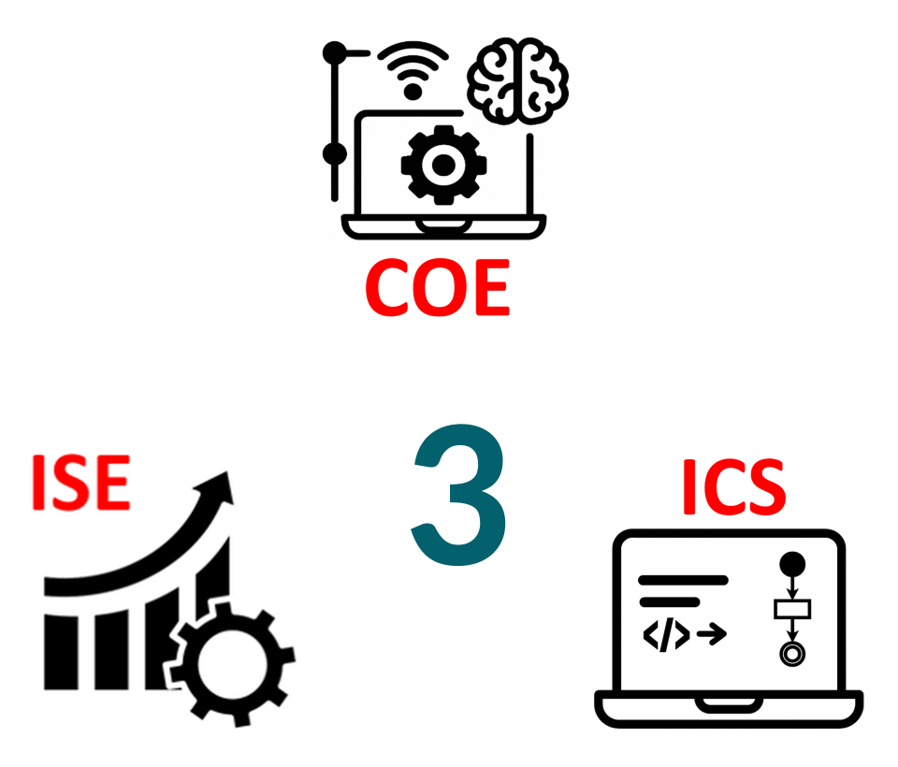
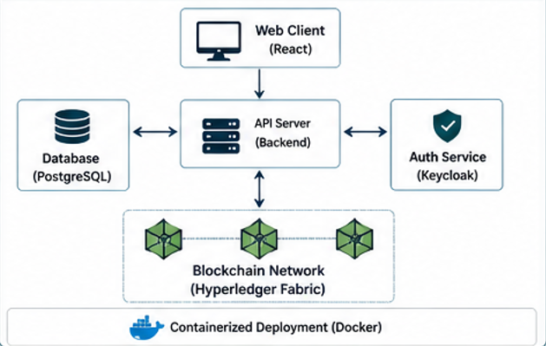
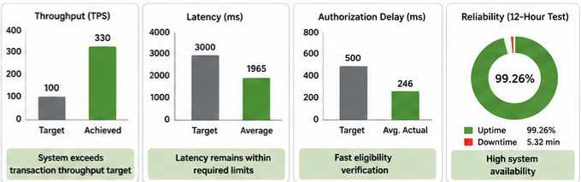





Secure Blockchain-Based Student Voting and Election Platform
(VeriVote)
TEAM
M041
Basim Alasmari (ICS) , Hawam Al Theeban(COE) , Turki Algethami(ICS) , Abdulrahman Alqhtani(ICS) , Omar Alswayel(ISE)
Faisal Alnughaymishi(ISE)
Coach: Dr. Firas Al Hindawi
  Traditional voting relies on manual or centralized systems
  Limited transparency and auditability
  Slow result processing and verification
  ≥100 transactions per second
  ≤3 seconds confirmation time
  AES-256 encryption (data at rest)
  TLS 1.3 secure communication
  Authorization <500 ms average, <1000 ms peak
  ≥10 API requests per second
  80% responses <5 seconds
  System reliability ≥95%
Prototype Design
Background
Specifications
  Lack of transparent and verifiable voting
  Voters cannot independently confirm results
  Manual processes increase delay and errors
Problem Statement
Testing & Validation
  Secure and verifiable voting achieved
  One-vote-per-user enforced successfully
  Immutable blockchain records
  High throughput and low latency confirmed
  Authorization operates within required limits
  All performance targets satisfied
  Build secure web-based voting platform
  Enforce voter eligibility and one-vote rule
  Provide fast and verifiable results
Conclusion
Objective
Constraints

