Slide 1
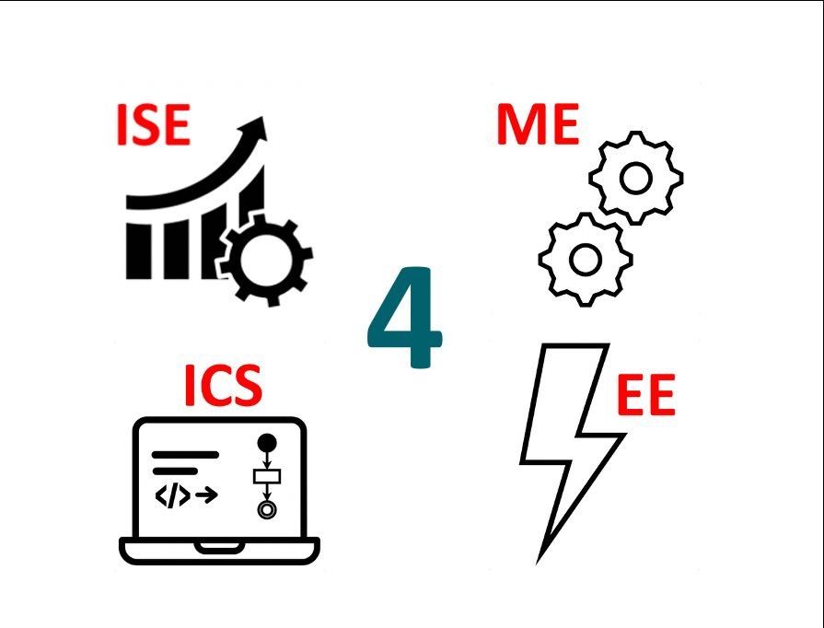
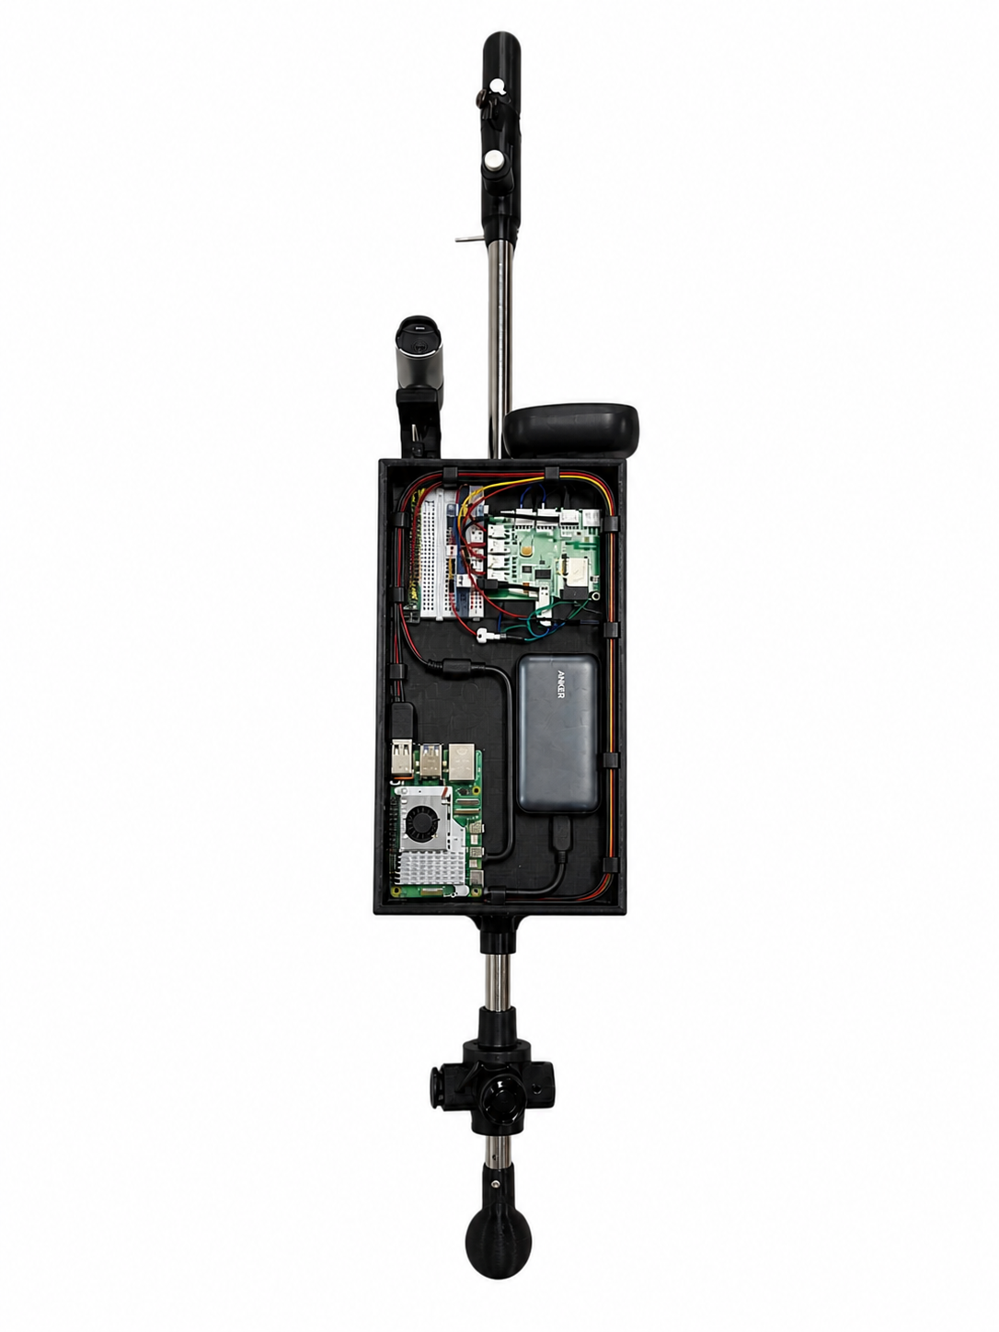
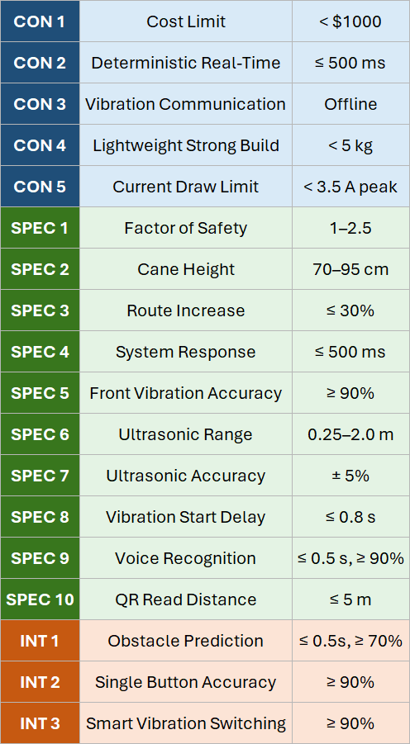
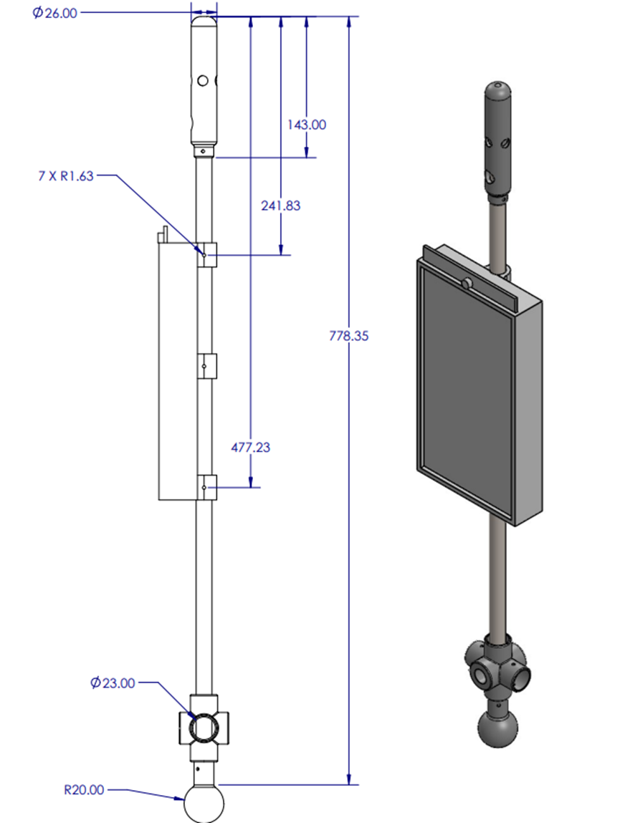
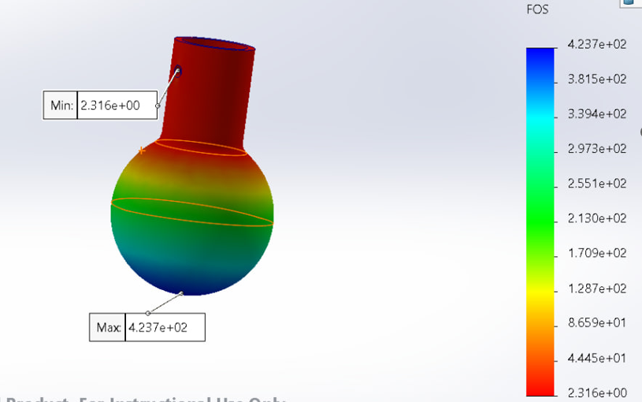

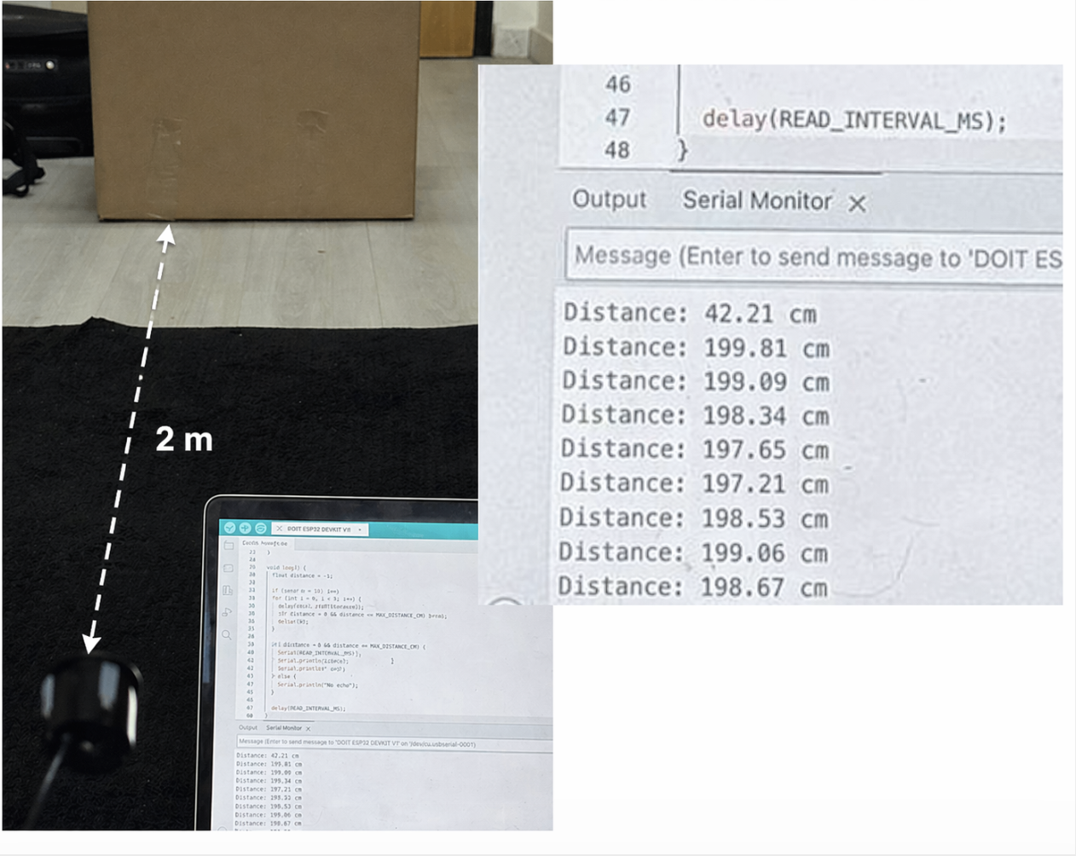
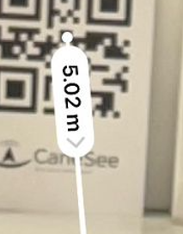
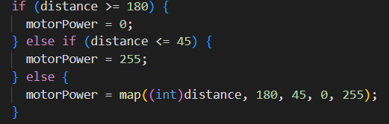
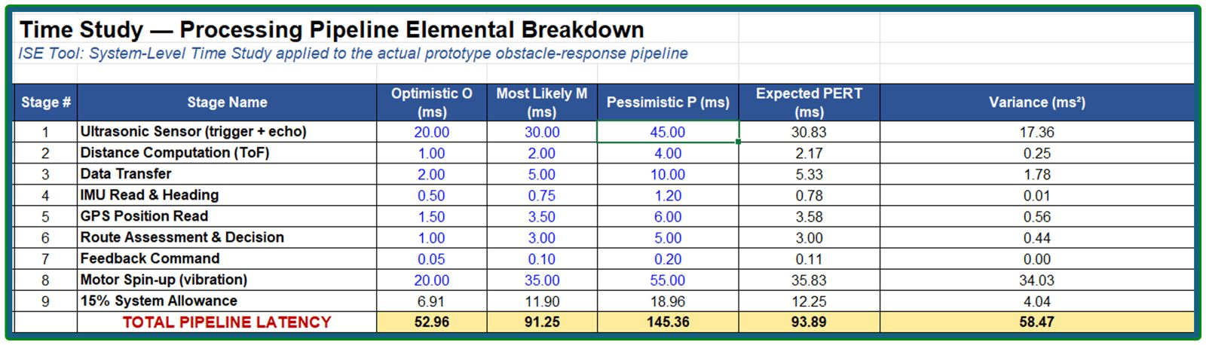
Smart Assistive Walking Cane for Visually Impaired
Users
TEAM
39
Saleh Alakkas (ME), Mohammed Alsunayyin (ME), Abdulmohsen Alshawarib (CS), Naif Alshalan
(SWE), Saleh Almutairi(EE), Nawaf Alharbi(ISE), Coach: Dr. Firas Al Hindawi
PROBLEM STATEMENT
Prototype
Constraints & Specifications
Testing & Validation
Visually impaired individuals need real-time obstacle detection beyond traditional canes to improve safety and independence.
Cane Dimension
4 Vibration motors (Directional feedback)
Button
Camera
& Mic
Critical Component No Failure
OBJECTIVES
Speaker
Detect nearby obstacles in real time.
Provide clear vibration feedback to the user.
Support basic navigation guidance.
Improve user safety and independence.
Maintain a lightweight and comfortable cane design.
ESP32 (Controller)
PCB
(interface board)
Power
bank
Raspberry Pi 5
(Processor)
4 Ultrasonic
Sensors
Cane
Ball tip

Slide 2
Smart Assistive Walking Cane for Visually Impaired
Users
TEAM
39
Saleh Alakkas (ME), Mohammed Alsunayyin (ME), Abdulmohsen Alshawarib (CS), Naif Alshalan
(SWE), Saleh Almutairi(EE), Nawaf Alharbi(ISE), Coach: Dr. Firas Al Hindawi
PROBLEM STATEMENT
Prototype
Constraints & Specifications
Testing & Validation
Visually impaired individuals need real-time obstacle detection beyond traditional canes to improve safety and independence.
Cane Dimension
Critical Component No Failure
OBJECTIVES
Detect nearby obstacles in real time.
Provide clear vibration feedback to the user.
Support basic navigation guidance.
Improve user safety and independence.
Maintain a lightweight and comfortable cane design.

Slide 3
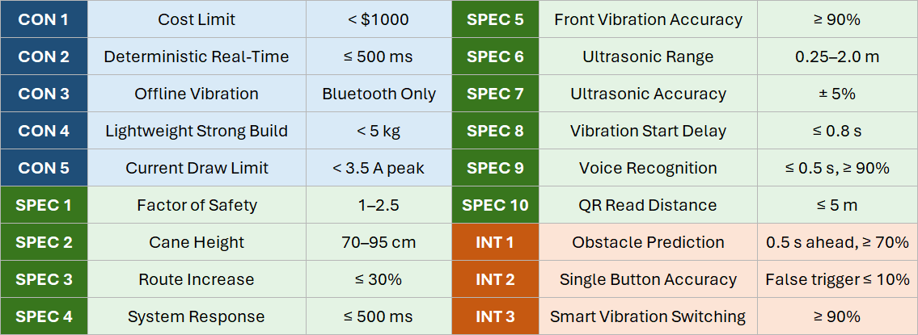
Smart Assistive Walking Cane for Visually Impaired
Users
TEAM
39
Saleh Alakkas (ME), Mohammed Alsunayyin (ME), Abdulmohsen Alshawarib (CS), Naif Alshalan
(SWE), Saleh Almutairi(EE), Nawaf Alharbi(ISE), Coach: Dr. Firas Al Hindawi
PROBLEM STATEMENT
Cane Prototype
Testing & Validation
Visually impaired individuals need real-time obstacle detection beyond traditional canes to improve safety and independence.
Constraint 1
Cane Dimension
Critical Component No Failure
OBJECTIVES
Detect nearby obstacles in real time.
Provide clear vibration feedback to the user.
Support basic navigation guidance.
Improve user safety and independence.
Maintain a lightweight and comfortable cane design.
Specification 6
Specification 5
CONSTRAINTS & SPECIFICATIONS

Slide 4
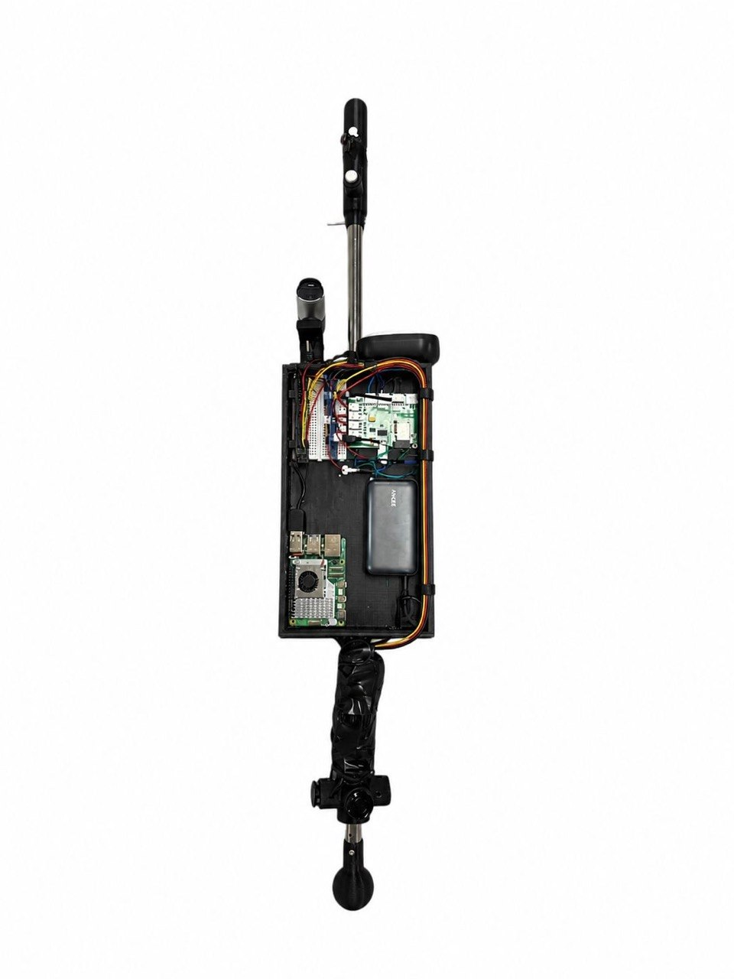
Smart Assistive Walking Cane for Visually Impaired
Users
TEAM
39
Saleh Alakkas (ME), Mohammed Alsunayyin (ME), Abdulmohsen Alshawarib (CS), Naif Alshalan
(SWE), Saleh Almutairi(EE), Nawaf Alharbi(ISE), Coach: Dr. Firas Al Hindawi
PROBLEM STATEMENT
Cane Prototype
Testing & Validation
Visually impaired individuals need real-time obstacle detection beyond traditional canes to improve safety and independence.
Mechanical Engineering Contributions:
  Structural Design
  FEA for All Components
  Sensors Mounting
  Prototype Assembly
Cane Dimension
Critical Component No Failure
OBJECTIVES
Detect nearby obstacles in real time.
Provide clear vibration feedback to the user.
Support basic navigation guidance.
Improve user safety and independence.
Maintain a lightweight and comfortable cane design.
CONSTRAINTS & SPECIFICATIONS
ultrasonic sensor shall detect obstacles within a range of 0.25 m to 2.0 m with an accuracy of ±5%.
All components of the cane should be have 1< FOS < 2.5
Voice commands are recognized within ≤ 0.5 s after the user finishes
speaking, with ≥ 90% intent accuracy in typical walking noise.
The system shall
respond to
detected obstacles
within 500 ms
When the front
distance is under
1.8 m, the handle
vibrates with at
least 90%
accuracy.

Slide 5
Smart Assistive Walking Cane for Visually Impaired
Users
TEAM
39
Saleh Alakkas (ME), Mohammed Alsunayyin (ME), Abdulmohsen Alshawarib (CS), Naif Alshalan
(SWE), Saleh Almutairi(EE), Nawaf Alharbi(ISE), Coach: Dr. Firas Al Hindawi
PROBLEM STATEMENT
Cane Prototype
Testing & Validation
Visually impaired individuals need real-time obstacle detection beyond traditional canes to improve safety and independence.
Constraint 1
Cane Dimension
Critical Component No Failure
OBJECTIVES
Detect nearby obstacles in real time.
Provide clear vibration feedback to the user.
Support basic navigation guidance.
Improve user safety and independence.
Maintain a lightweight and comfortable cane design.
Specification 6
Specification 5
CONSTRAINTS & SPECIFICATIONS
Constraints & Specification | Constraints and Specifications (Value/Metric)
Specification 1 | Response time: ≤500 ms
Specification 2 | Detection range: 0.25–2.0 m, ±5%
Specification 3 | Feedback accuracy: ≥90% under 1.8 m
Specification 4 | Vibration start: ≤0.8 s
Constraint 1 | Cane weight: <5 kg
Specification 5 | Factor of safety: 1–2.5
Specification 6 | Cane height: 70–95 cm
Specification 7 | Battery operation: ≥2.5 hours
Constraint 2 | Peak current: ≤3.5 A
Constraint 3 | Offline vibration + Bluetooth only

