Slide 1

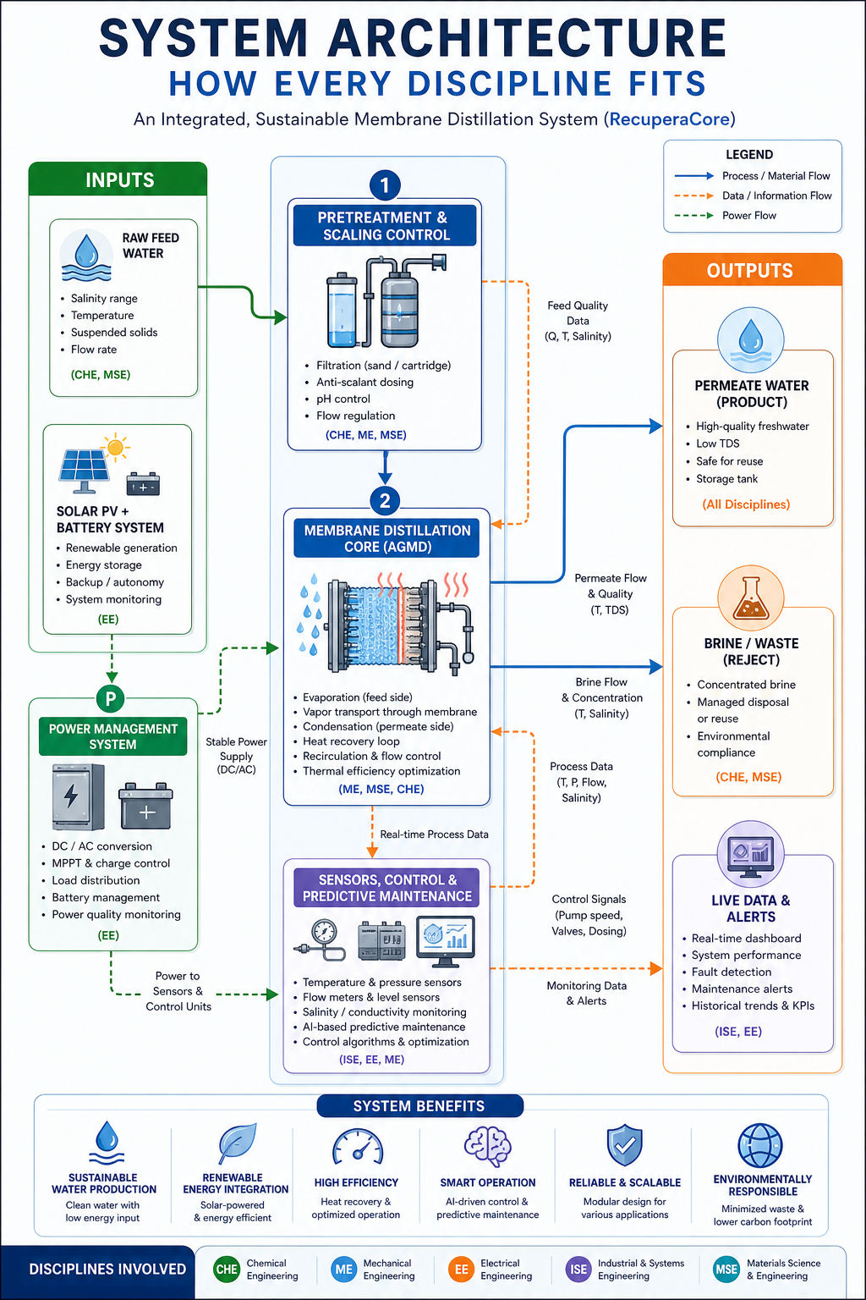
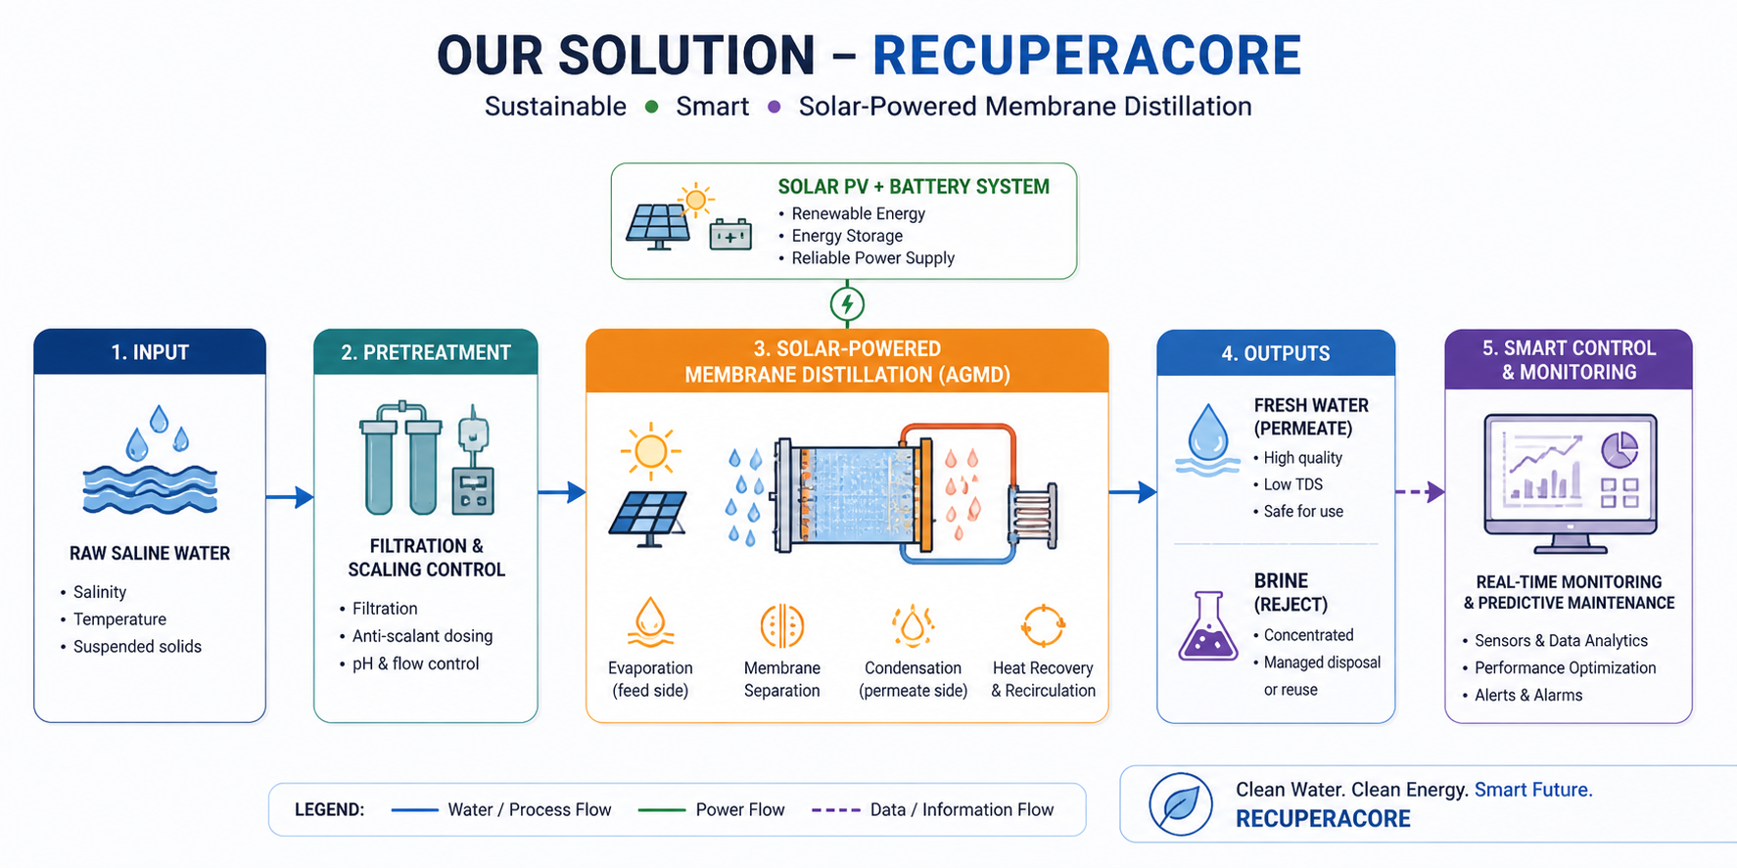
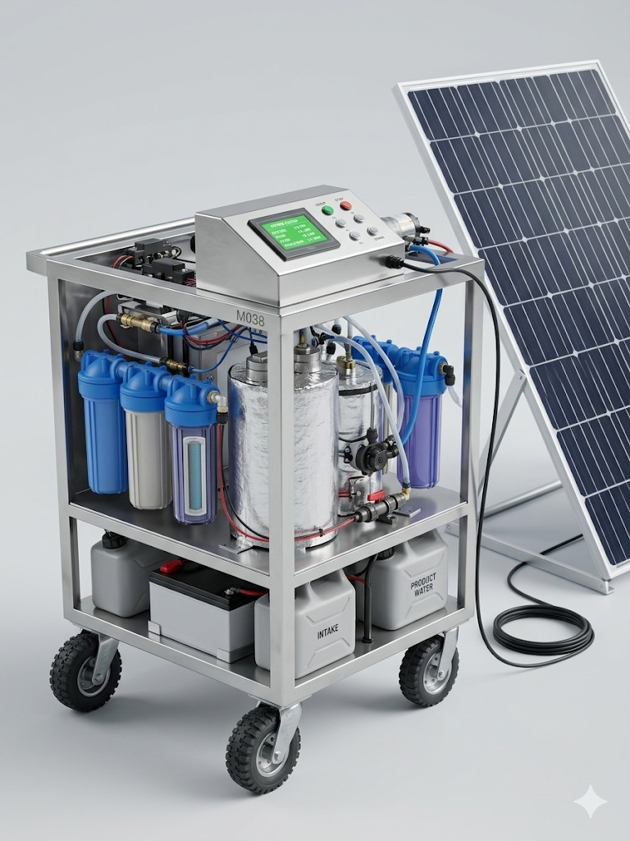
Solar-Powered Membrane Distillation Station for Remote Areas
TEAM
M038
Khalid Alkamah (MSE) · Tameem Almusharraf (ISE) · Mahdi Aleissi (EE) · Osama Aljohani (CHE) · Abdullah Alhafthi (ME) · Abdulrahman Alsendi (MSE)
Coach: Dr. Naveed Iqbal | Senior Design Project II (Term 252) | KFUPM
Objective & Problem
System Architecture
Constraints & Specifications
Validation and Verification
Design and prototype a portable, solar-powered AGMD system that produces potable water from seawater
Fully self-contained, grid-independent, operable by one person
2+ billion people lack safe drinking water
Conventional RO is energy-intensive and not portable
Existing MD systems require grid power or bulky infrastructure
C,# S#, IS# | CONSTRAINTS, Specifications and Integrated Specification
C1 | Operates fully on solar power — no external grid connection
C2 | Produces potable water meeting WHO/SASO standards
C3 | Total mass ≤ 40 kg; footprint ≤ 0.5 m²; wheels + handles
C4 | Feed water: brackish/seawater 4,000–40,000 ppm TDS
C5 | Site selection model: ≥10 locations, ≥2 regions, ≥5 criteria; integer programming; efficiency ≥ 90%
C6 | Membrane remains hydrophobic during operation (LEP > 3.7 bar)
C7 | Loop operating pressure ≤ 0.5 bar; ΔP across membrane ≤ 0.1 bar
C8 | All hot-loop components rated ≥ 75 °C
S1 | Rolling enclosure ≈ 0.85 × 0.55 × 0.40 m (± 0.15 m)
S2 | Membrane contact angle ≥ 90°; pore size 0.1–1 µm
S3 | Salt rejection ≥ 95%; permeate TDS ≤ 500 mg/L
S4 | LCD readout: TDS, temperature, flow rate — update ≤ 2 s
S5 | Average electrical power ≤ 75 W at 1.0 L/min loop flow
S6 | Pretreatment: 5 µm filter; pH 6.0–6.5; Fe ≤ 0.3 mg/L; Mn ≤ 0.4 mg/L; As ≤ 10 µg/L; F⁻ ≤ 1.5 mg/L
S7 | Heat recovery ≥ 30% via thermal-loop recuperation
S8 | Outlet pH 6.0–6.5 monitored at ≤ 2 s update rate
S9 | Pretreatment reduces feed water hardness by ≥ 40%
S10 | Leak integrity at 0.5 bar — zero visible leaks
S11 | LSTM fouling detection ≥ 80% accuracy; false alarm rate ≤ 20%
S12 | SPC alarm detects out-of-control TDS within ≤ 30 s; sampling interval ≤ 60 s
IS1 | PV 200W ± 10%; battery ≥ 12V, 50 Ah
IS2 | Water production rate ≥ 1 L/day
IS3 | Continuous operation 6–8 h/day under ≥ 6 kWh/m² solar irradiance
IS4 | Closed-loop MCU: temp, TDS, level, flow, pressure — ≤ 1 s update; PWM + safety shutdown
Test | Acceptance Criteria
C1 — Solar operation | Runs continuously off-grid
C2 — Water quality | TDS ≤ 500 mg/L
C3 — Portability | Mass ≤ 40 kg; footprint ≤ 0.5 m²
C4 — Feed range | 4,000–40,000 ppm TDS
C5 — Site model | ≥10 sites; efficiency ≥ 90%
C6 — Hydrophobicity | Contact angle ≥ 90°; LEP > 3.7 bar
C7 — Loop pressure | ≤ 0.5 bar; ΔP ≤ 0.1 bar
C8 — Thermal rating | Hot-loop survives ≥ 75 °C
S1 — Enclosure size | 0.85 × 0.55 × 0.40 m ± 0.15 m
S2 — Membrane props | Angle ≥ 90°; pore 0.1–1 µm
S3 — Salt rejection | Rejection ≥ 95%; permeate ≤ 500 mg/L
S4 — LCD update | All params refresh ≤ 2 s
S5 — Power consumption | Avg power ≤ 150 W at 1.0 L/min
S6 — Pretreatment | pH 6–6.5; Fe ≤ 0.3; Mn ≤ 0.4; As ≤ 10 µg/L
S7 — Heat recovery | Recovery ≥ 30%
S8 — pH monitoring | pH 6.0–6.5; update ≤ 2 s
S9 — Hardness reduction | Feed hardness reduced ≥ 40%
S10 — Leak integrity | Zero leaks at 0.5 bar
S11 — LSTM detection | Accuracy ≥ 80%; false alarms ≤ 20%
S12 — SPC alarm | Alert within ≤ 30 s; sample ≤ 60 s
IS1 — PV + battery | PV 200W; battery ≥ 12V, 50 Ah
IS2 — Production rate | ≥ 1 L/day
IS3 — Solar runtime | 6–8 h/day under ≥ 6 kWh/m²
IS4 — Closed-loop MCU | Refresh ≤ 1 s; PWM + shutdown OK
Solution
Prototype Design
Conclusion
01 | Prototype achieved stable closed-loop AGMD operation at 60–80 °C with no visible leaks confirmed at 0.5 bar.
02 | Permeate quality, live TFT monitoring, and closed-loop sensor feedback confirm viability of off-grid potable-water production.
03 | 200W PV + 100 Ah LiFePO₄ battery system exceeds the minimum power target, validating the portable solar-powered desalination concept.

